Slide 1
HIV TESTING
MICHAEL OKUMU
NURSING

Slide 2
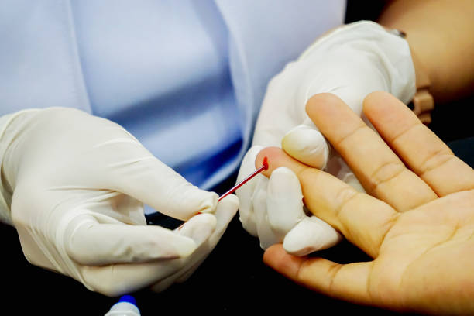

Slide 3
LEARNING OUTCOMES
By the end of the session, you will be able to
Describe the approaches used in HIV testing in Kenya
Outline the indications for HIV testing
Describe the benefits of HIV testing to the individual and community

Slide 4
DEFINITION OF TERMS
Emancipated minor
An individual who is not legally an adult but who because he or she is married, is the mother/father of a child is no longer dependent on the parents. S/he may not require permission for medical or surgical care.
HIV self testing
A process in which an individual collects his/her specimen, performs a test and interprets the test results in private. Reactive/positive test results must be followed by additional guidelines

Slide 5
DEFINITION OF TERMS
KEY POPULATIONS/MOST AT RISK POPULATIONS
Groups, who due to specific higher-risk behavior, are at an increased risk of contracting HIV, irrespective of their epidemic type or local context. Legal, cultural and social barriers related to their behavior increase their vulnerability to HIV. In Kenya these populations include men who sex with men(MSM), people who inject drugs(PWID) and sex workers(SW)

Slide 6
DEFINITION OF TERMS
PRIORITY POPULATIONS
Individuals who because of their circumstances are at an increased risk of HIV transmission. These include fisher folk, truckers, persons in confinement and adolescent and young women

Slide 7
HIV TESTING SERVICES
Used to indicate the full range of services that a client is offered together with HIV testing. This include counselling (pre and post testing), linkage to appropriate HIV prevention, care and treatment services and other clinical support services, and coordination with laboratory services to support quality assurance in delivery of correct results

Slide 8
PACKAGE FOR HIV TESTING SERVICES
Pre-test counselling
HIV testing
Post test counselling
Linkage to HIV prevention, care and treatment
Assessment for other health related needs

Slide 9
APPROACHES THAT IMPROVE LINKAGE TO CARE AND TREATMENT
Information
Disclosure
Addressing barriers to linkage
Establishing systems to facilitate linkage
Care coordination and integration

Slide 10
PRINCIPLES OF HTC
Consent-Individuals need to give informed consent before testing. They need to be aware of the process and the right to decline testing
Confidentiality-The discussions are not shared with anyone else unless with permission of the client
Shared confidentiality-with partner, family members and other healthcare providers may be beneficial
Counselling-The sessions must be accompanied by high quality counselling and testing

Slide 11
PRINCIPLES OF HTC
Correct test results-Quality assurance mechanisms to ensure accurate results
Connections-To preventive care and treatment. Must ensure that positive individuals are linked to care and the negative individuals offered prevention services

Slide 12
TYPES OF HIV TESTS
Antibody tests(widely used)
Long ELISA
Rapid assays
Molecular methods(Gold standard/definitive)
PCR-DNA
PCR-RNA

Slide 13

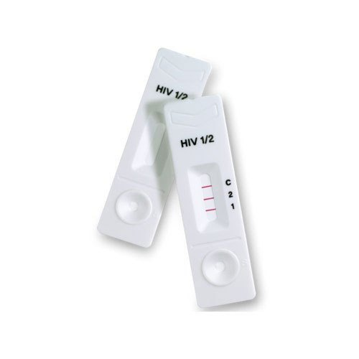
RAPID TEST KITS

Slide 14
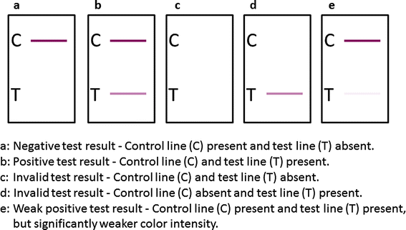
HIV TEST RESULT INTERPRETATION

Slide 15
SETTINGS FOR HIV TESTING
To optimize access to testing services, HIV testing can be conducted in the following settings
Facility/hospital based
Community based
Self testing

Slide 16
FACILITY BASED TESTING
Routine opt-out provider initiated HIV testing and counselling(PITC) should be offered to all clients regardless of the reason for visit.
PITC should be integrated into all service delivery points at the health facility-adult and pediatric units, maternal and child health services, specialty clinics, GBV care units and SRH/FP clinics

Slide 17
FACILITY BASED TESTING SETTING
Birth testing to infants born to HIV-Positive mothers
All infants born to HIV positive mothers must be offered HIV DNA PCR testing at birth, first contact not later than 2 weeks after birth.
HTS of infants and children below 18 months
Antibody testing for all mothers with unknown HIV status or those who tested negative previously is done.
Those who test positive will have their infants tested using the DNA PCR method

Slide 18
HTS IN DIFFERENT SETTINGS
HTS in children 18 months-2 years
HIV antibody testing is done to all children with unknown HIV status with parental consent irrespective of reason for hospital visit
Testing to children of newly infected adults is done as soon as possible and linkage done if need be

Slide 19
HIV TESTING FOR ADOLESCENTS 10-19 YEARS
All adolescents visiting the health facility should be offered the service
Those aged 15 and above and emancipated minors can provide self consent. The younger ones would need parental consent
Those that test negative should be tested annually if no new risk is identified.
Testing should be extended to the partners of those who are sexually active and to the children of those who are parents

Slide 20
HIV TESTING FOR PREGNANT AND BREASTFEEDING CLIENTS
Counselling an testing should be offered to all women in their first visit unless those with known positive status.
Subsequent tests are done in every trimester of the pregnancy.
All breastfeeding women should be counseled and tested at 6 weeks and subsequently every 6 months as per the guidelines of the general population.
Spouses of the pregnant and breastfeeding women should also be offered testing services.

Slide 21
TESTING OF SEXUAL PARTNERS AND CHILDREN OF HIV POSITIVE CLIENTS
Previously referred to as partner notification service (PNS) before being expanded to include children
All PLHIV should receive disclosure counselling and be supported to disclose their HIV status.
Counselling and testing should be encouraged for all partners and children younger than 14 years.
Linkage to prevention, care and treatment should be offered as needed

Slide 22
TESTING FOR KEY POPULATIONS
Tested irrespective of the reason for visits through drop in centers.
Retesting is done every 3 months for those who test negative
For sexually active adults with partners, counselling and testing should be offered to the partners
Adults accessing HTS should be counseled and linked to VMMC

Slide 23
HTS IN DIFFERENT SETTINGS
Community based settings
HIV self testing discussed earlier

Slide 24
COMMUNITY BASED HIV TESTING
Targeted testing in the community offers opportunities to identify and link to care people living with HIV of unknown HIV status
The setting is appropriate for testing children and partners of index clients through family based testing, outreach to key populations, orphans and vulnerable children(OVC) and adolescents

Slide 25
HIV SELF TESTING
Allows individuals to test themselves and later followed up incase of a positive result
Uptake has increased due to availability of easy to use and easily accessible testing methods.
Important for reaching special populations such as key populations, stigmatized individuals

Slide 26
INDICATIONS/RATIONAL FOR HIV TESTING
Every individual at risk
Clinical conditions
Persistent diarrhea
Severe respiratory infections-TB
Oral thrush/candidiasis
Herpes zoster
STIS
Loss of more than 10% of body weight(unexplained)

Slide 27
BENEFITS OF HIV TESTING
Early access to treatment
Ability to make family planning choices
Possibility to make lifestyle changes
Ability to change behavior to avoid transmission to others
Prevention of mother to child transmission
Planning for possible health problems

Slide 28
MOST AT RISK POPULATION/KEY POPULATION

Slide 29
MARPS
Most-at-risk-populations (MARPs) are defined as those populations at highest risk for sexual acquisition/transmission of HIV due to either the number of partners that they have, or the higher risk sex that they engage in.

Slide 30
MARPS
1. Female Sex workers
Female sex workers are women who exchange anal, vaginal and/or oral sex for money or other items of value, primarily with men
Sex workers have the highest reported HIV prevalence of any group in Kenya.
FSW engage in sex with multiple partners, alcohol and drug mis-use or abuse, and relatively low condom use with regular and non-regular partners.
In recent Kenyan studies female sex workers are reportedly better at protecting themselves from HIV transmission compared to other groups who are vulnerable to HIV such as men who have sex with men.

Slide 31
MARPS
2. Men who have sex with men (MSM)
HIV prevalence among men who have sex with men (sometimes referred to as MSM) in Kenya is almost three times that among the general population.
The high prevalence is due to the risk of ulceration/ injury due to lack of lubrication in the anus.
Homosexuality is illegal in Kenya and can carry a prison sentence of up to 14 years.
This, coupled with entrenched social attitudes, leads to high levels of stigma and discrimination towards men who have sex with men as well as people who are lesbian, gay, bisexual and transgender (LGBT), deterring many people from seeking the HIV services they need.
However, Condom use among men who have sex with men has been rising. In 2016, 80% of men who have sex with men reported using a condom the last time they had anal sex, up from 55% in 2011.

Slide 32
MARPS
3. People who inject drugs (PWID)
In 2011, an estimated 18.3% of people who inject drugs (sometimes referred to as PWID) in Kenya were living with HIV.
The majority of people who inject drugs are concentrated in specific geographical areas such as Nairobi and Mombasa.
People who inject drugs (PWID) are at increased risk of HIV infection. In Kenya, the HIV prevalence among PWID is up to 4 times that of the general population.
The high risk is due to sharing of needles.
PWID also suffer a higher burden of viral hepatitis (HBV and HCV), TB and sexually transmitted infections irrespective of HIV status. Despite this, PWID have limited access to HIV treatment and prevention services.

Slide 33
OTHER AT RISK POPULATIONS
4. Young people
More than half (51%) of all new HIV infections in Kenya in 2015 occurred among adolescents and young people (aged 15-24 years), a rapid rise from 29% in 2013.
Young women are almost twice as likely to acquire HIV as their male counterparts, and accounted for 33% of the total number of new infections in 2015.
A number of factors contribute to the increasing rate of HIV infection among young people including;
incorrect perception of HIV risk
having unprotected sexual intercourse under influence of alcohol or drugs.
Forced sex and sexual violence also increase young people’s vulnerability to HIV.

Slide 34
OTHER AT RISK POPULATIONS
YOUG PEOPLE CONT
Young Kenyan women who are three times more likely to be exposed to sexual violence than young Kenyan men.
It is estimated that 33% of girls in Kenya have been raped by the time they reach the age of 18, with 22% of girls aged 15-19 describing their first experience of sexual intercourse as forced.

Slide 35
OTHER AT RISK POPULATIONS
Women
In 2016, women accounted for 910,000 of the 1.6 million people living with HIV in Kenya.
women in Kenya face discrimination in terms of access to education, employment and healthcare.
As a result, men often dominate sexual relationships, with women not always able to practice safer sex even when they know the risks. For example, in 2014, 35% of adult women (aged 15-49) who were or had been married had experienced spousal violence and 14% had experienced sexual violence.

Slide 36
OTHER AT RISK POPULATIONS
Bridging populations
Defined as members of the general population that interact sexually with key population members.
They may further facilitate the spread of HIV infection.
In particular, receptive anal intercourse has been cited as an important risk factor for HIV infection and described primarily in the context of MSM behavior in Kenya.
Others include heterosexual anal intercourse among women

Slide 37
NOTE
Many of the behaviors that place key populations at increased risk of acquiring and transmitting HIV are illegal in Kenya.
The prevailing stigma and criminalization make these groups hidden and difficult to reach in routine HIV surveillance, impeding their access to HIV prevention, care, and treatment services.
READ ON INTERVENTIONS IN PLACE TO REDUCE THE RISK OF HIV IN EACH OF THE MARPS

Slide 38
