Slide 1


Slide 2
US YouTubers Project (Team 6)
Emmanuel, Polina, Michelle, Katie
As a team we communicated, collaborated, wrote hundreds lines of code, and worked on individual parts to do our data investigation and analysis...
Notes:
Emmanuel-

Slide 3
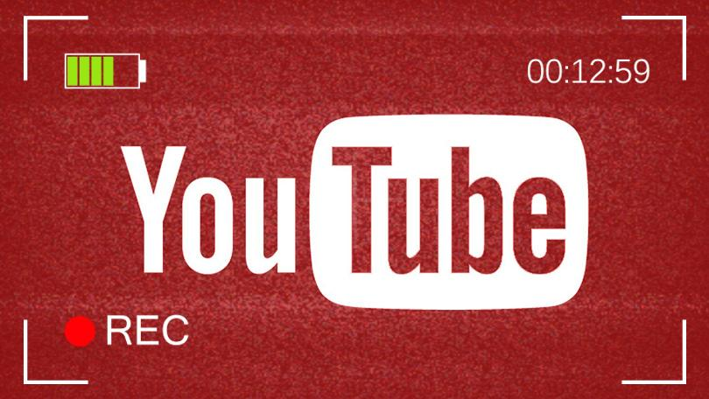

So...You want to make an awesome video for all of your adoring fans on YouTube that will become a trending video...
What things matter when trying to get the most out of your video?
Notes:
Emmanuel-

Slide 4

There were several questions we looked at:
Does the category ID correlate to the number of likes/dislikes, the comments or the total number of views it gets?
Does the channel make a difference?
How about how many likes or dislikes a video has?
Do the number of days a video trends relate to the total number of views?
What about the month, day, or time a video is published?
And finally...what about video tags? Do they relate to anything?
Notes:
Emmanuel- (Just read slide)

Slide 5
What was the Category ID?
Column in our Data set that classified YouTube videos numerically.
Each video had a Category ID classification.
Though consistent, it was not clear what this classification represented.
The Category ID had to be decoded through a query process of the Youtube Data API v3.

Slide 6

YouTube Data API v3
YouTube Data API v3 provides access to YouTube Data such as video statistics and channel Data
An API call was made to establish the Category ID column of our data set
A total of 32 video categories were derived.
The top 5 Category IDs were:
10. Music 24. Entertainment 1. Film & Animation 34. Comedy 22. People & Blogs

Slide 7
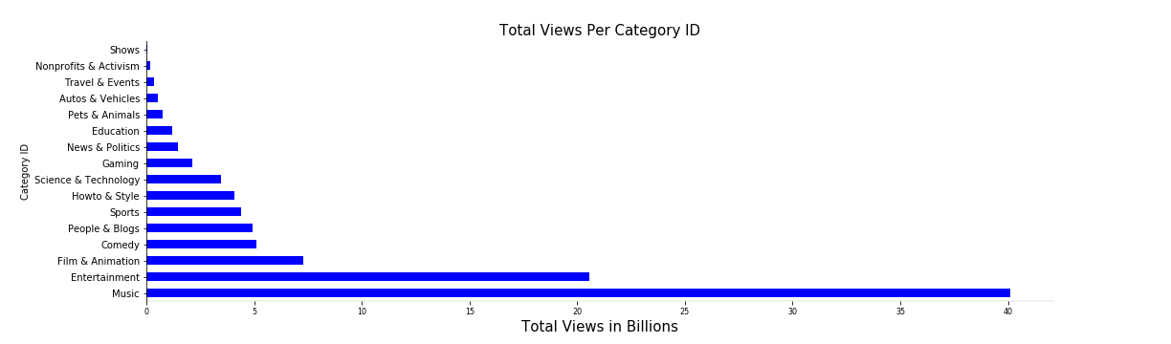
Views Per Category

Slide 8
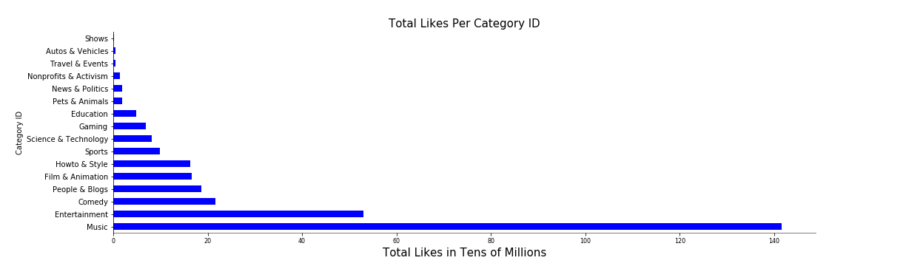
Likes Per Category

Slide 9
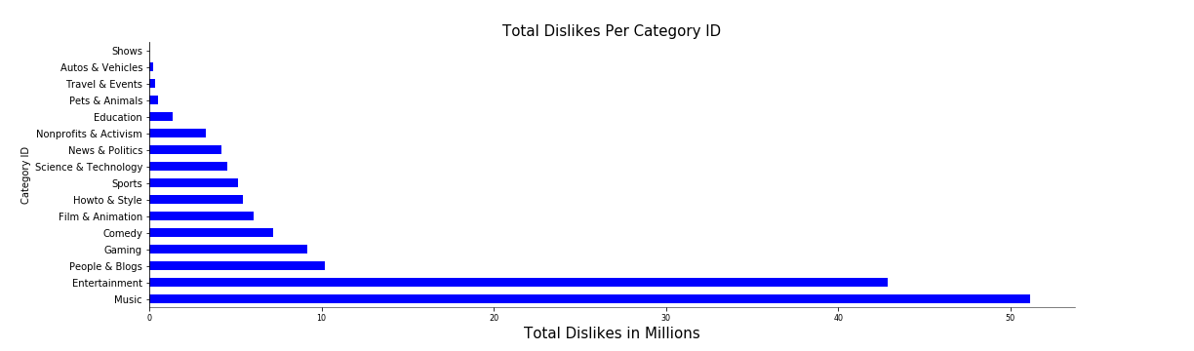
Dislikes Per Category

Slide 10
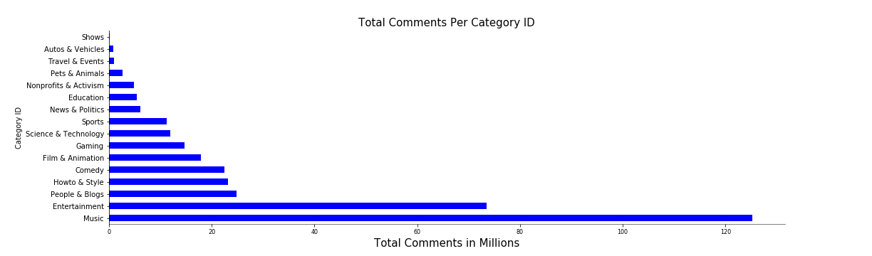
Comments Per Category

Slide 11
Conclusion
Videos within Music and Entertainment/Pop Culture Categories have an extraordinarily strong probability of being the most trending and generate strong channel traffic.

Slide 12
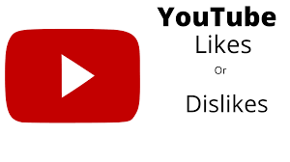


Channels, Likes, Views...
Notes:
Like everyone else, I started with getting to know my data by using a number of ways to explore our US YouTube dataset immediately followed by cleaning my data segment.
My individual part was to look closely into popular channels, likes, and views. Is there any relationship between them? How strong are they? What will the charts I created using my coding skills reveal?
My hypothesis was that the most popular channels get more views. If there is also a correlation between views and likes variables then we possibly know the right path for vloggers to make their videos to get more likes. Could I find answers to that having a little over forty thousand row dataset and a few columns of my interest? 6351 rows/videos

Slide 13
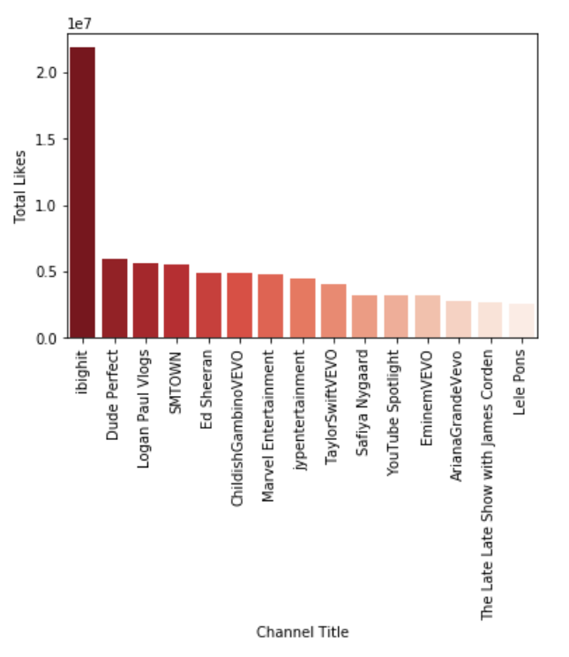
Channels, Likes, Views...
Notes:
After a lot of thinking, planning and data analysis, I am ready to share some of my results:
· To discover 15 the most popular channels, I grouped the data by channel and the sum of total likes. The same was performed on the number of total dislikes. The seaborn bar plots displayed the visuals with IBighit, Dude Perfect, Logan Paul Vlogs… TayllorSwiftVEVO… EminemVEVO and the rest of the top 15.

Slide 14
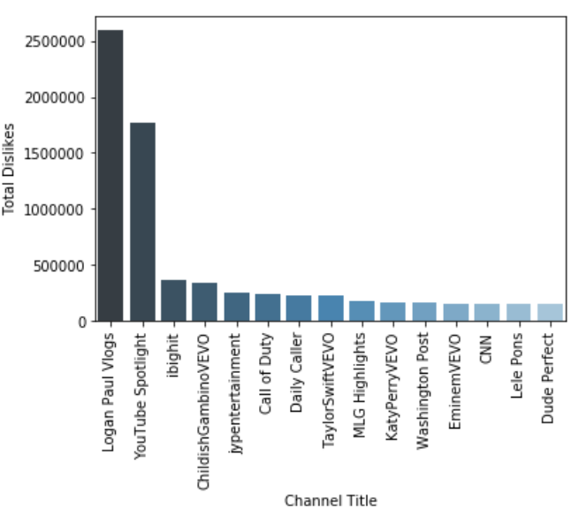
Channels, Likes, Views...
Notes:
The Logan Paul Vlogs channel also gets the highest number of dislikes out of the same top 15 channels.. hmm What kind of videos does that channel have??

Slide 15
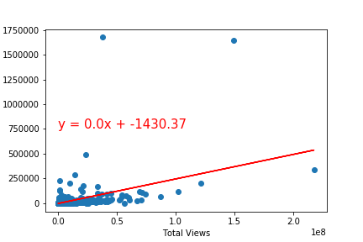
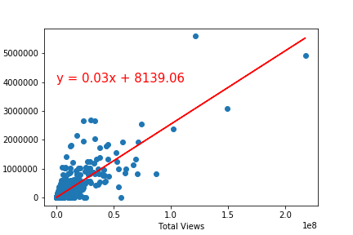
Channels, Likes, Views...
r - value is 0.47 r - value is 0.83
Total Likes vs. Total Views Total Likes vs. Total Views
Notes:
I created a function for linear regression plots. While the Total Views and Total Dislikes indicated by Pearson(r)is equal to a moderate positive relationship of 0.47, Total Views and Total Likes displayed on the plot has r value of 0.85 which is a strong correlation. This tells us about a linear relationship between those variables.

Slide 16
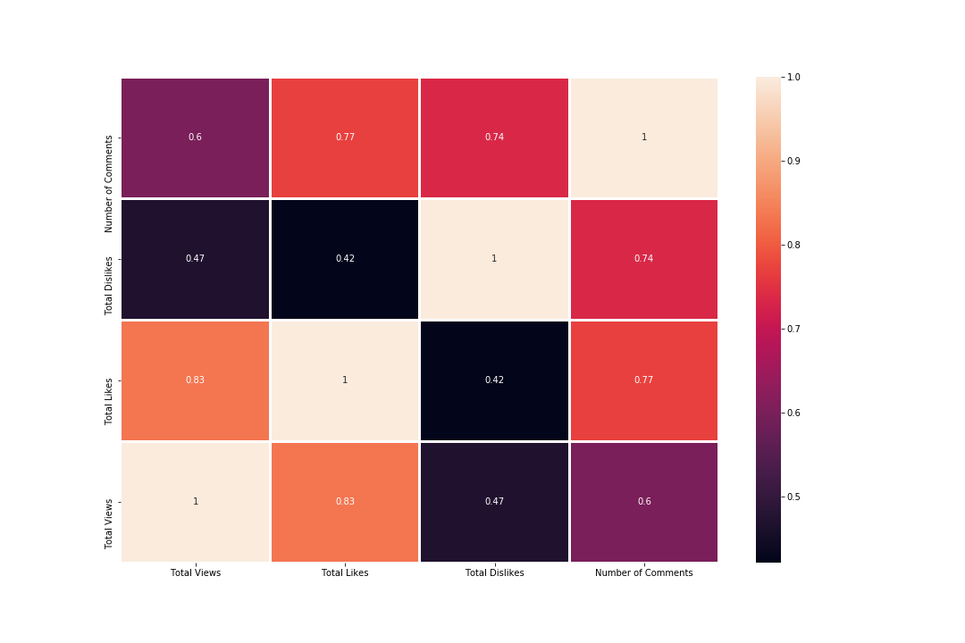
Channels, Likes, Views...
Notes:
Having a set with many columns, I utilized a visualization tool (visualized the correlation matrix as a heatmap using the seaborn and matplotlib packages) to quickly check the correlations coefficients among columns. In this heatmap the lighter the color, the larger correlation magnitude. What are variables most correlated with likes? Views = 0.83 c. coef.

Slide 17

Channels, Likes, Views...
Conclusions:
My conclusion is that my hypothesis was leading
me in the right direction.
The relationship between channels, views,
and likes indeed exist.
Notes:
I encountered a problem dealing with large numbers on my plots. I was thinking to simplify them for the visuals at first but decided to refresh my memory about reading scientific notations and be ready to clarify if questions arise. Here is a example: 1e8 in reference to the y-axis mean 1*(10^8). It is s standard scientific notation, indicating scale factor for the y axis (2 actually indicates 2*1e8 = 2e8 = 2 * 10^8 = 200,000,000). Another obstacle was to extract a truly unique number of views but with the help of great teammates it was done.
While I could share a lot more about my processes, analysis, outliers, limitations, more visuals and results, I have to stop right here and let Michelle talk about her US YouTube dataset adventure.

Slide 18

What did I look at? - I looked at time, time, and more time!
How many days trending vs. total views
Month posted vs. days trending and views
Day posted vs. days trending and views
Hour posted vs. days trending and views
Notes:
So when we were divvying up the topics, I thought it would be interesting to see if there was any connection between the time things were posted and how many days they trended and how many total views they got. It definitely stretched my abilities as I had to sort thru and break up information to get what I needed and I got a lot of practice trying different charts and graphs that are available in the libraries we have been working with!

Slide 19
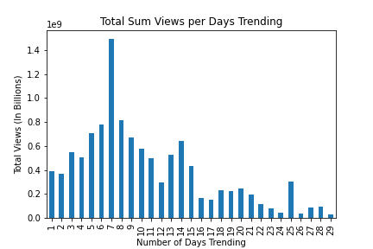
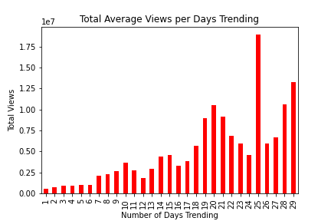
Does the Number of Days Trending REALLY affect the views?
Notes:
The first thing I looked at was if the number of days a video trended affected the number of views it got. When looking at the data set in a bar chart calculating the sum (the blue one on the left), it looks a little bit like 5-9 days trending might give you the most bang, but when looking at the average, it definitely looks like the more days it is trending, the higher your total views are going to be.

Slide 20
There are some other things to take into account when looking at these…..
Notes:
They seem to show opposite facts. But what we really need to understand is what is most applicable in our situation. While the total sum of views for the days trending on the left shows there were more views in days 5 through 9, we have to take into account that there are some outliers that will significantly affect these numbers. One video who had hundreds of millions of views could skew this. So I thought I’d look at a box plot from the data of all videos that were trending

Slide 21
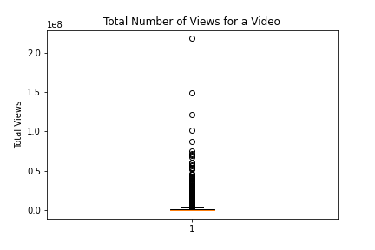
We have a LOT of outliers.
The max total number of views is: 217750076
The minimum total number of views is: 559
This is a huge range! So our sum may not be the best indicators….let’s keep the averages to make our assumptions.
In general, we can assume that the longer a video is trending, the more views it will receive.
Notes:
Looking at the box plot, we can see the whiskers for it waaaay down at the bottom. That gives us a LOT of outliers. So our data is not normally distributed, and cleaning the outliers would get rid of a lot of the data! Adding those outliers into the data, especially some of those way up at the top, will affect the total SUM more than the average. I’m not saying it won’t affect the average, but it would make the sum stand out more. For that reason, I decided to use the average to make the somewhat weak assumption that the longer a video is trending, the more views in general, it will receive.

Slide 22
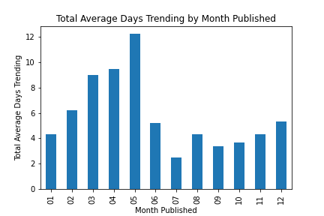
Does the Month make a difference in how many days your video might trend?
Notes:
The next thing I looked at was the month that videos were posted. (Read above) We can obviously see a trend here that spring time months tend to trend for more days than videos posted in months later in the year, and I wondered if these months also had more views in general.

Slide 23

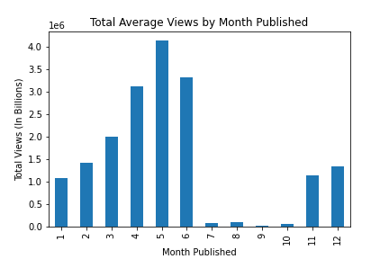
It sure looks like it!
Notes:
By looking at a bar chart of average total views by month published, it definitely shows the same relationship that publishing in the spring would be a good decision!

Slide 24
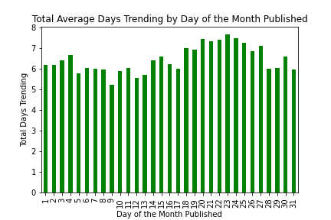
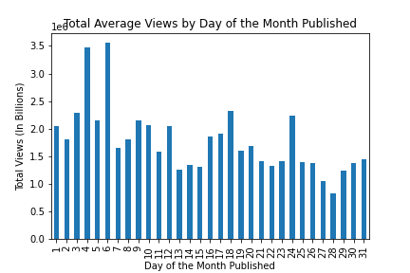
Does the day within each month matter?
Not Really.
Notes:
Since it seemed like months made a difference, I wondered if the day within each month would matter. As we can see here, the average number of days trending AND the average total views are not really that much affected by the day within the month. There is some variation, but not enough to make a strong argument one way or the other. By doing the same thing with the HOUR of the day it was published we can see that...

Slide 25
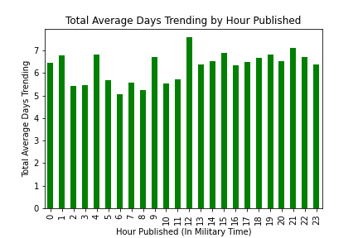
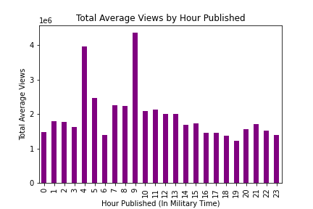
Hour of the day...
Notes:
Again, with a few outliers, there didn’t seem to be much of difference what hour during the day a video was published. Another Strikeout.

Slide 26
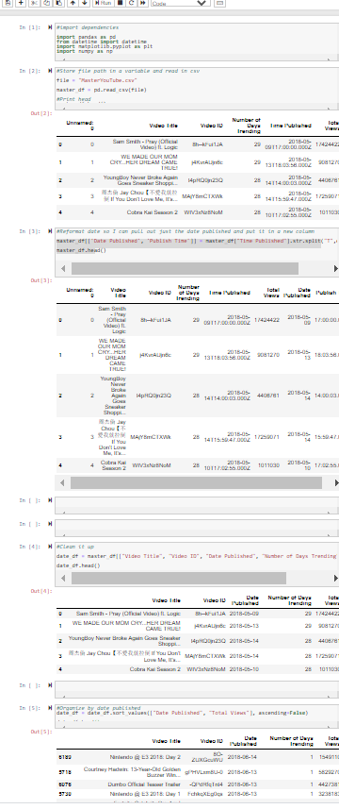
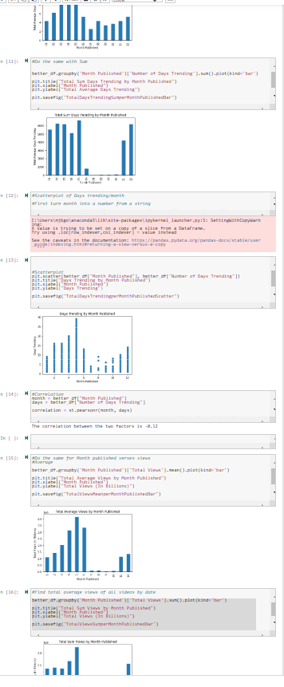
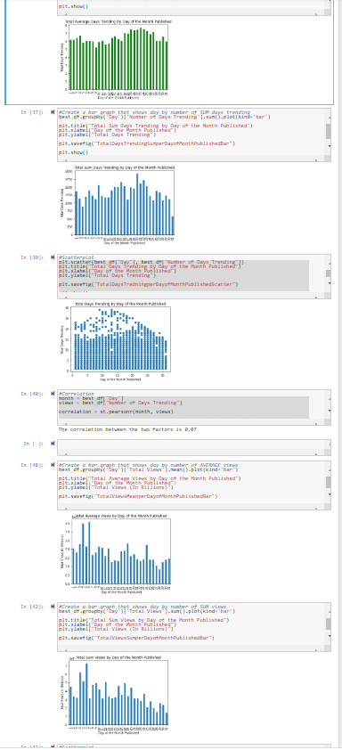
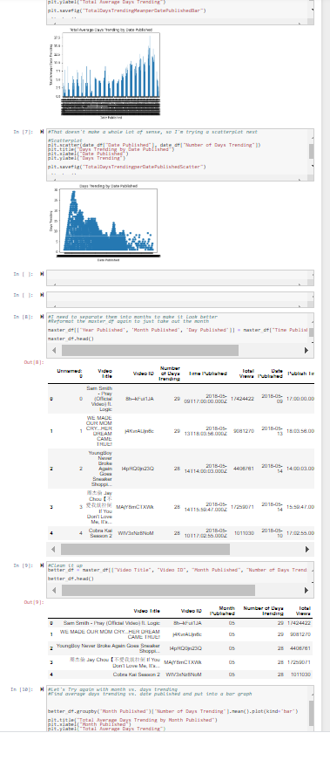
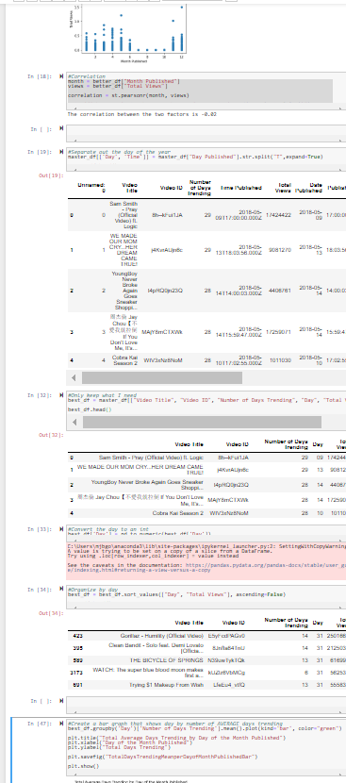
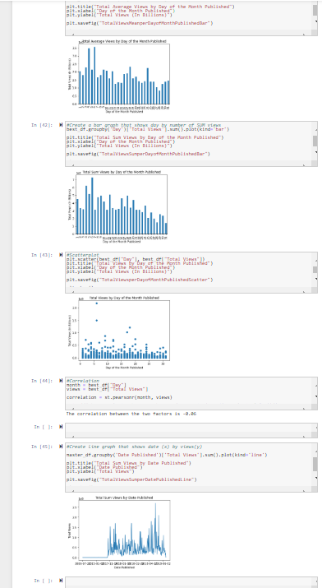
So….after a LOT of testing, and trying, and trying and testing…..
Notes:
(Read above) And this is only a small fraction of it!

Slide 27

So What Did I Learn?
Notes:
I decided some of the other things I looked into were not worth pursuing or reporting on. I was a little disappointed that I didn’t find more connections between the topics I was researching. But I did find a few, and I gained a lot more confidence in my ability to work on a project like this and with data like this, and now feel much more prepared to tackle something like this again! And from here I pass it on to my teammate, Katie.

Slide 28
Tags
What can the tags of YouTube videos tell us about going viral?
Do Tags make a difference in views?
What are some of the most popular tags?

Slide 29
Data Cleanup for Tags Analysis
Created DataFrame from CSV file and dropped duplicates
Created new column and stored a boolean variable in column to show whether a video had tags or not
Since number of videos with tags was so much larger than videos without tags, took sample of videos with tags and placed into new dataframe and merged with a dataframe containing all videos without tags

Slide 30
Do Tags Matter?
Wanted to see if having Tags on a video increased:
Video Views
Video Likes
Video Comment Counts

Slide 31
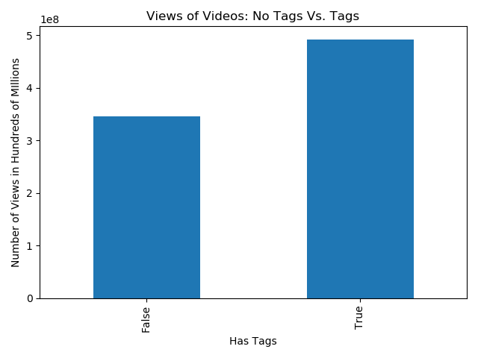
No Tags vs Tags: Video Views
Views of videos with tags: 492,421,145
Views of videos without tags: 346,174,150

Slide 32

No Tags vs Tags: Video Likes
Likes of videos with tags: 15,831,116
Likes of videos without tags: 6,356,362

Slide 33

No Tags vs Tags Comment Count
Comments of Videos with Tags: 2,297,523
Comments of Videos without Tags: 685,975

Slide 34
What did I learn?
Those videos with tags have more views, likes, comments
We learned previously that likes and comments are positively correlated with more views, if we are trying to get more likes and comments tags may help us drive that

Slide 35
Limitations
Our data set only explored videos that were trending on YouTube, having a larger universe of videos may have allowed more identification of popular tags
In this data set, the top individual tag was “NBA” but that tag had 200 fewer records than [none], because of this it may be hard to find tags that drive videos

Slide 36
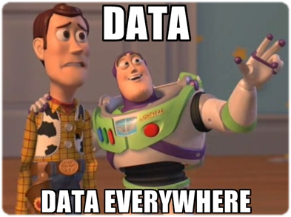
So….what? There were a few things that we found would point to publishing a video that would trend and get the most views….
Publishing in the Music category is definitely your best choice!
Post in a well-visited channel if you can!
For the most bang, publish your video in the late spring...April, May, or June
Use tags! Any tags!
Notes:
Katie-

Slide 37
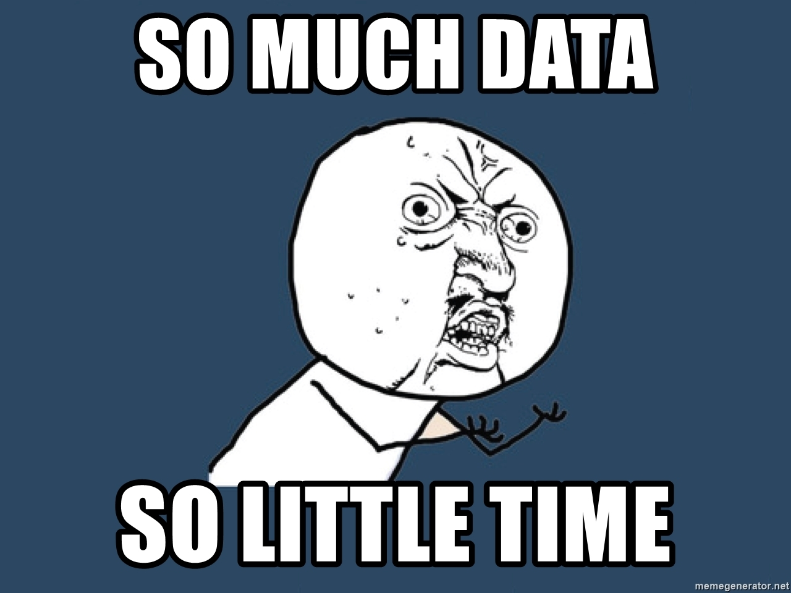
Ultimately, there was just SOOO much data. Someone could spend a month looking at everything available, and still have more to do!
But that will have to wait for another day and another project!
Notes:
Katie-

