Slide 1
Triangle Mesh Renormalization Using Physical Principles
Presenters: Emmanuel Arturo Hernandez and Colin Minhquan Pham
Mentor: Lan Pham
Department of Mathematics
Irvine Valley College

Slide 2
Acknowledgement
ROCCT program 2018 (grant info)
UCI
Irvine Valley College

Slide 3
Abstract
This project explores a physics-based approach to triangle mesh renormalization, a critical process in computer graphics and engineering simulations. While creating a triangulation of a region is relatively straightforward, producing an optimal triangulation, especially through remeshing. This is significantly more complex due to the interdependency between mesh points. Traditional remeshing techniques rely on geometric algorithms, which often struggle with dynamic adjustments across the mesh. This research introduces a novel methodology that applies physical principles such as electrostatic, spring, and resistance forces to reposition interior points while preserving boundary constraints. By modeling interior and boundary points as charged particles, a repulsive electrostatic force helps maintain mesh integrity. The remeshing process is simulated by numerically solving a second-order differential equation using Euler’s method, implemented in VB.NET with visualization in MATLAB. Initial results across various shapes including rectangles, triangles, and L-shaped regions demonstrate the effectiveness of the approach, particularly in tracking time-evolving changes. Future developments will aim to localize refinements in complex subregions, enabling greater detail and accuracy in mesh-based modeling.

Slide 4
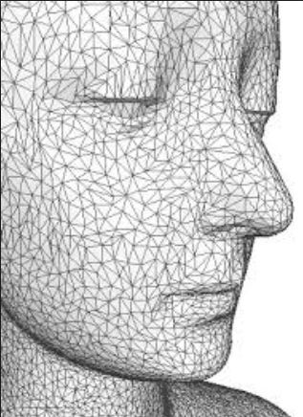
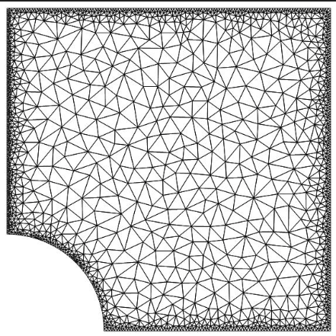
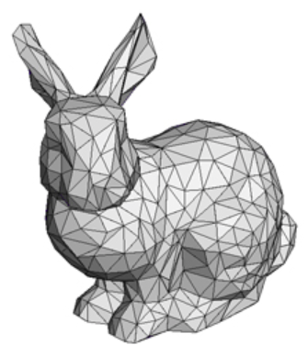
Triangle mesh is used in many Applications Computer graphics & Engineering

Slide 5
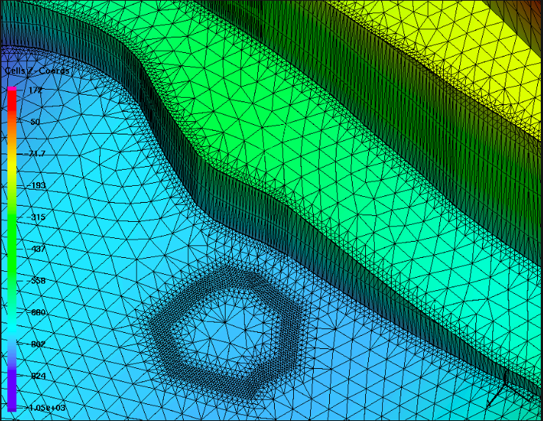
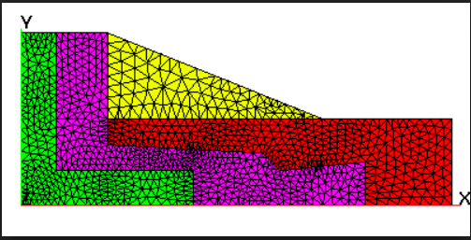
Finite Element Meshes In Engineering Illinois Basin https://meshing.lanl.gov/proj/screenshots/GRID_GALLERY.html
https://meshing.lanl.gov/proj/screenshots/GRID_GALLERY.html

Slide 6
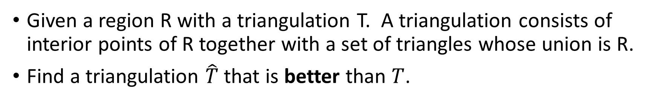
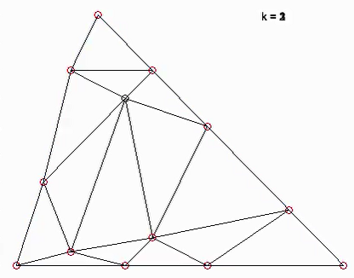
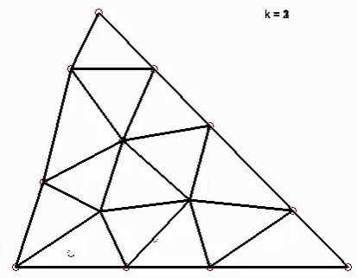
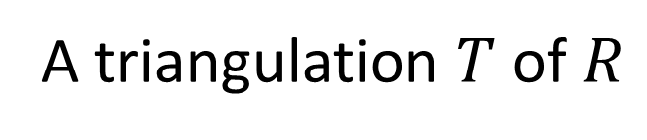
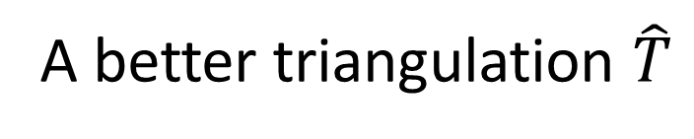
The Basic Problem

Slide 7
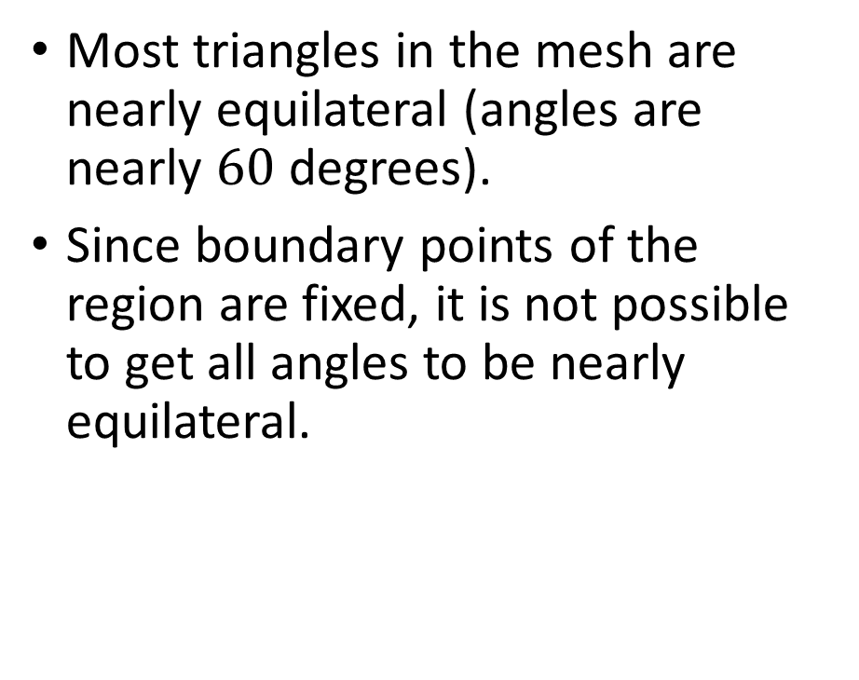
What makes a good triangulation T?

Slide 8
Triangulation is easy! Remeshing is hard.
Given a region, a triangulation of the region is easy.
A good triangulation is difficult. Current algorithms are geometric based.
Remeshing algorithm is difficult. Moving one point to make a triangle nice affects other triangles in the mesh.

Slide 9
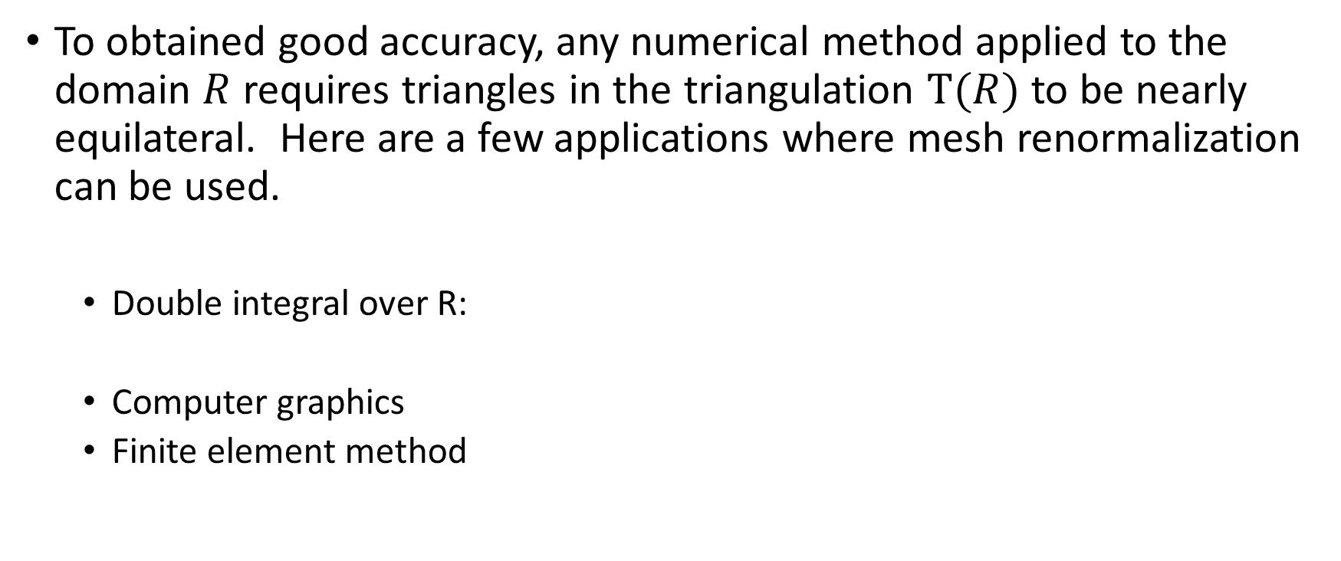
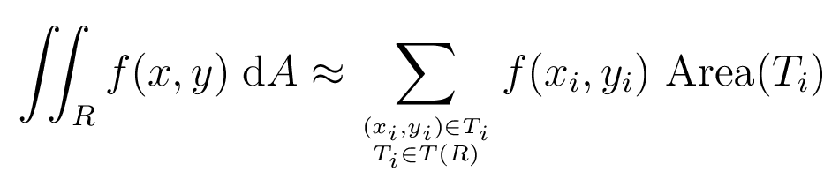
Why?

Slide 10
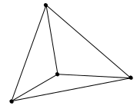









Methodology – Physics based approach
Given the region R with a triangulation T.
Region R is a triangle modeled by the set of points
T is a triangulation of R given by

Slide 11
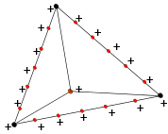
Repulsive Electrostatic Force
GOAL: to keep interior points inside R
Add virtual points (in red) along the boundary and model these points as point charges.
Interior points are modeled also as point charges.
Electrostatic charges will repel to keep interior points inside R

Slide 12


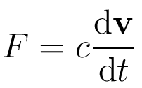
Physics-based Modeling
Electrostatic force is modeled by
Spring force is modeled by
Resistance force is modeled by

Slide 13
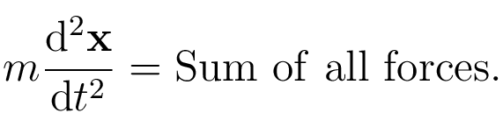
Remeshing
Remeshing is done by numerically solving a second order differential equation to compute the position of interior points. Boundary points cannot be moved.
Zero initial-velocity condition.
Euler’s first-order method.
Numerical code is written in VB.NET
Post-processing and visualization is done on Matlab.

Slide 14
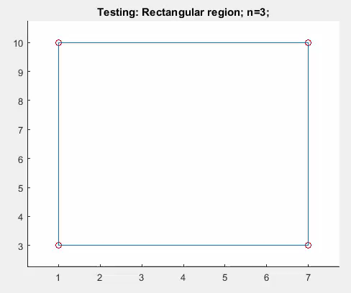
Results 01 Rectangular region with 2 interior points.

Slide 15
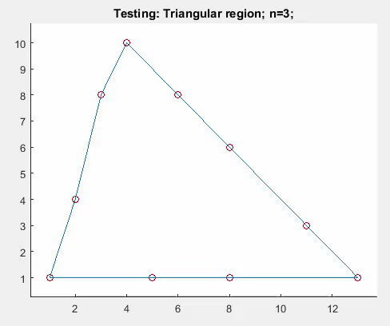
Results 02 Triangular region with 3 interior points

Slide 16
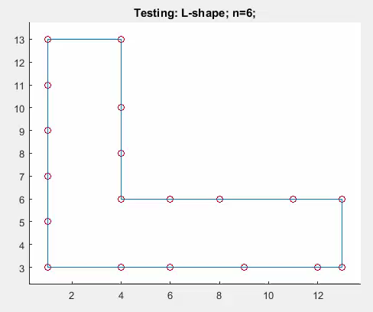
Results 03 L-shape with 6 interior points

Slide 17

Time-evolution problem Shape changes with time. Remeshing is done as shape changes.

Slide 18
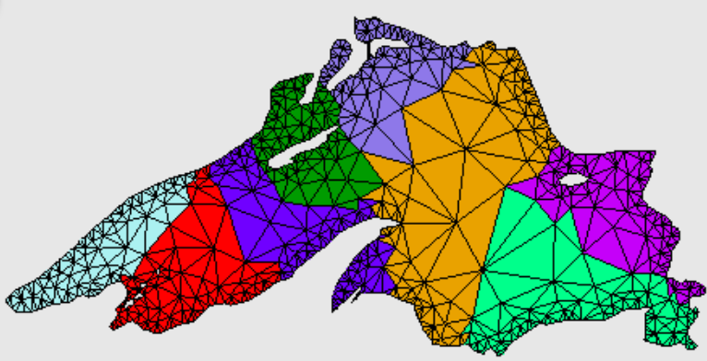
Future work
Implement localization to resolve details, small subregions that need to be modeled by more rectangles.
From https://www.cs.cmu.edu/~quake/triangle.html (Jonathan Shewchuk)

