Slide 1
Retail Business Company
Descriptive Analytics Report · 2015–2018
A structured F.I.R.E. analysis — Facts, Insights, Recommendations & Expected Outcomes
Prepared for management to guide strategic decision-making and support sustained revenue growth.
Prepared by Emmanuel Israel – Data Analyst

Slide 2
FACTS
Business at a Glance
$2.26M
4,922
Total Sales
Unique Orders
Revenue generated across all categories, regions, and segments over the full reporting period
Individual transactions processed between 2015 and 2018
$459
4
Average Order Value
Years Analyzed
Mean sales per order across the entire reporting period
Full-year data from 2015 through 2018

Slide 3
FACTS
Sales by Category
Technology Leads Revenue
Technology generated the highest share of total revenue at $827,456, closely followed by Furniture ($728,377) and Office Supplies ($705,399).
Revenue is well-distributed across all three categories, with no single category dominating disproportionately — a sign of a balanced product portfolio.

Slide 4
FACTS
Sales by Region
West Region Dominates
The West Region generated the highest revenue at $710,220, followed closely by the East ($669,237). The Central and South regions contributed $492,647 and $389,128 respectively.
West and East together account for over 60% of total sales, highlighting a strong coastal market presence and a clear opportunity to grow in the South.

Slide 5
FACTS
Sales by Customer Segment
Consumer Segment Drives Demand
The Consumer segment generated the highest sales at $1,148,061 — nearly 51% of total revenue. Corporate contributed $688,471 and Home Office $424,701.
Consumer dominance underscores strong individual buyer demand, while Corporate and Home Office segments present meaningful untapped growth potential.

Slide 6
FACTS
Sales by Ship Mode
Standard Class is Overwhelmingly Preferred
Standard Class shipping accounts for $1,340,550 — nearly 59% of all sales by ship mode. Second Class and First Class follow at $449,891 and $345,572 respectively.
Same Day delivery represents the smallest share at $125,219, suggesting limited customer demand for premium-speed fulfillment or limited service availability.

Slide 7
FACTS
Sales Trend: 2015–2018
Sales grew steadily from $466,738 in 2015 to a peak of $719,726 in 2018 — a 54% increase over four years. The strongest acceleration occurred between 2016 and 2018, signaling growing market traction and effective business momentum.

Slide 8
INSIGHTS
Key Findings
Technology Leads Categories
Technology generated the highest revenue at $827,456, with Furniture and Office Supplies close behind — a well-balanced product mix.
West & East Drive Regional Revenue
The West Region led at $710,220, with East close behind. Together they represent over 60% of total sales, highlighting a strong coastal market presence.
Consumer Segment Dominates
Consumer generated $1,148,061 — nearly 51% of total revenue — confirming strong individual buyer demand across all regions.
Consistent Year-on-Year Growth
Sales rose 54% from 2015 to 2018, with the sharpest acceleration between 2016 and 2018, signaling growing market traction.

Slide 9
RECOMMENDATIONS
Strategic Priorities
Strengthen Regional Performance
Invest in the Consumer Segment
Maintain West Region leadership while developing targeted initiatives to close the performance gap in the South Region.
Deepen engagement with the highest-value segment while developing tailored strategies to grow Corporate and Home Office revenue.
Sustain Sales Momentum
Address Underperforming Areas
Build on the 2015–2018 growth trajectory through targeted marketing, customer retention programs, and market expansion strategies.
Analyze root causes limiting South Region and Home Office performance, then implement focused initiatives to increase their contribution.

Slide 10
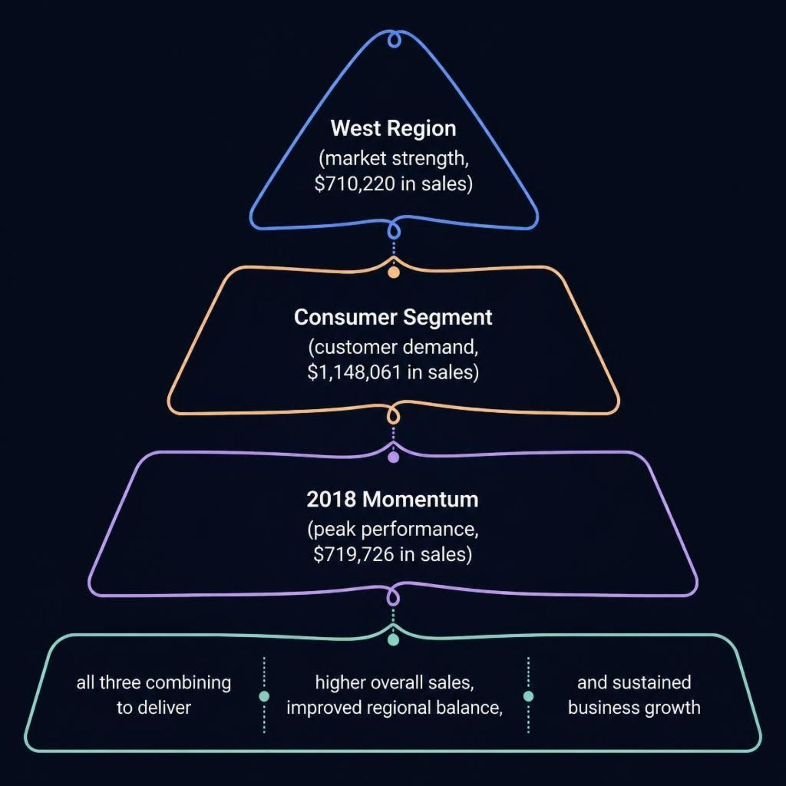
EXPECTED OUTCOMES
The Path Forward
Three Key Revenue Drivers
The strongest revenue strategy centers on three proven pillars:
West Region — market strength and established customer base
Consumer Segment — highest demand and largest revenue share
2018 Growth Momentum — peak performance to build upon
Leveraging these areas will drive higher overall sales,
improved regional balance and sustained year-on-year
growth.

