Slide 1

Changes in temperature, precipitation, specific humidity, and extreme precipitation events.
A 2006 to 2080 weather data exploration to determine trends, relationships and implications.
EART60702 Earth and Environmental Data Science
Group 2 Presentation
24 February 2026
Xinqi Xie Qianhao Li Xinhao Zhou Emmanuel Julius.

Slide 2
Introduction
Parameters of choice;
Temperature (TREFMXAV), precipitation rate (PSRN), and specific humidity (TREFHT)
Analyses conducted;
Trend analysis, Correlation,
Specific objectives;
To investigate long term-trends in temperature, precipitation and humidity.
To identify the correlation between parameters.
To quantify the changes in the frequency and intensity of extreme precipitation events and their implications.

Slide 3
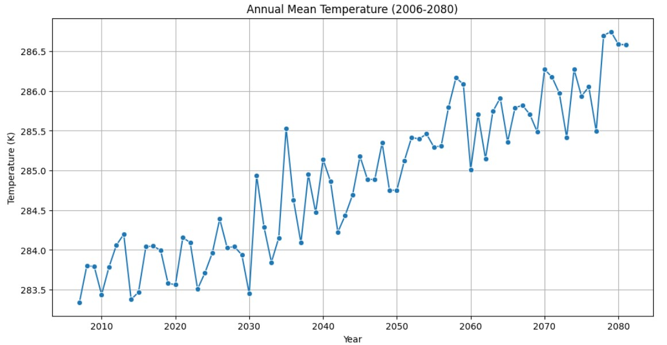
Trend in temperature

Slide 4
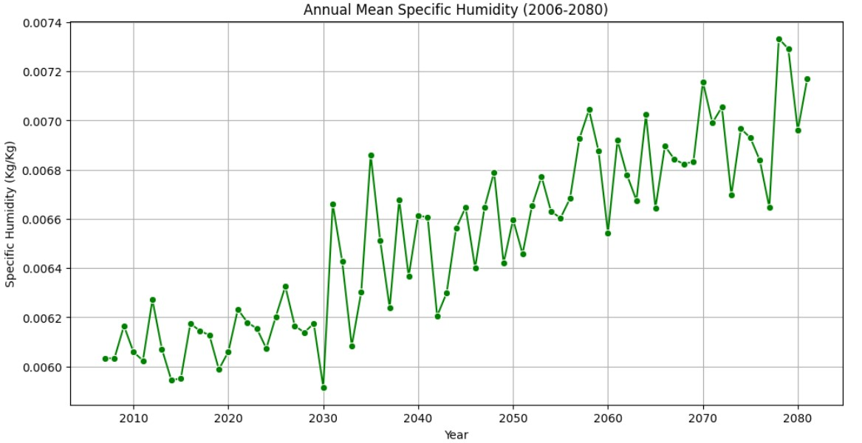
Trend in humidity

Slide 5
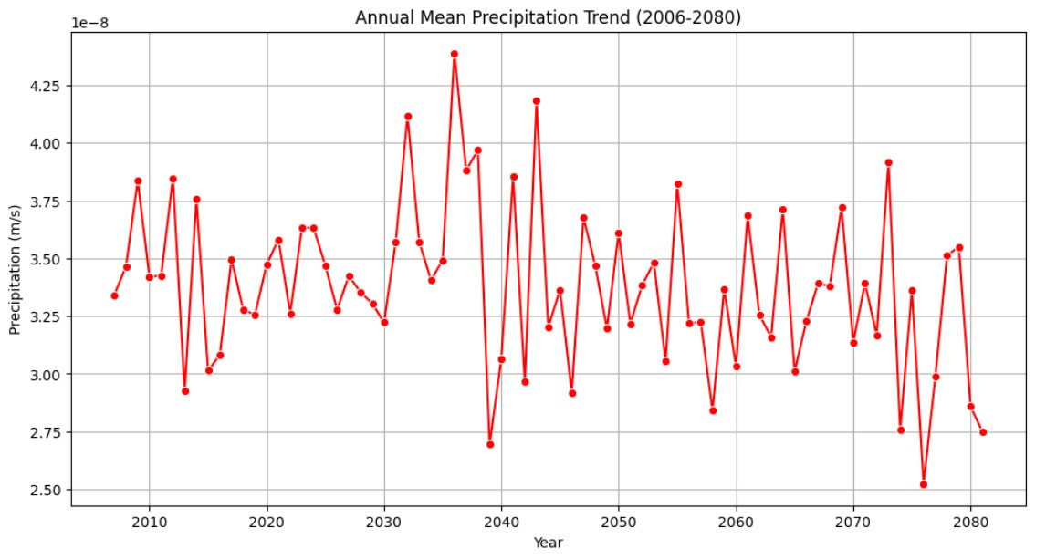
Trend in precipitation

Slide 6
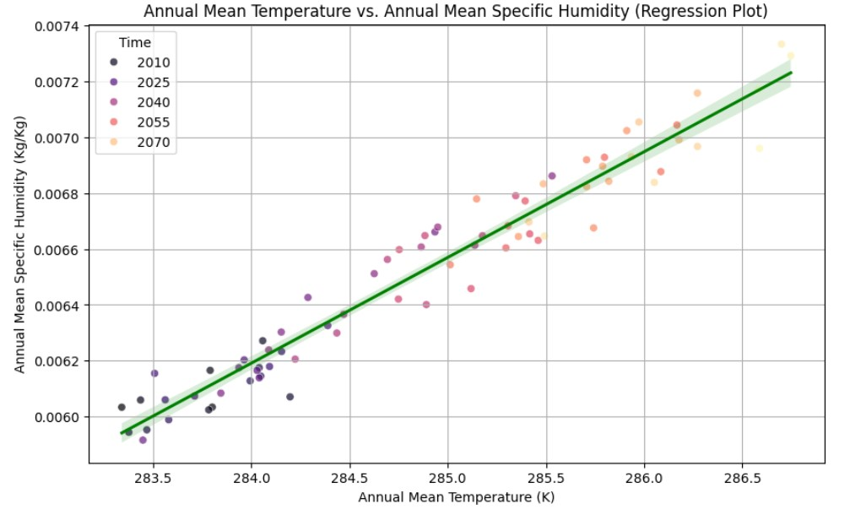
Temp-humidity correlation

Slide 7
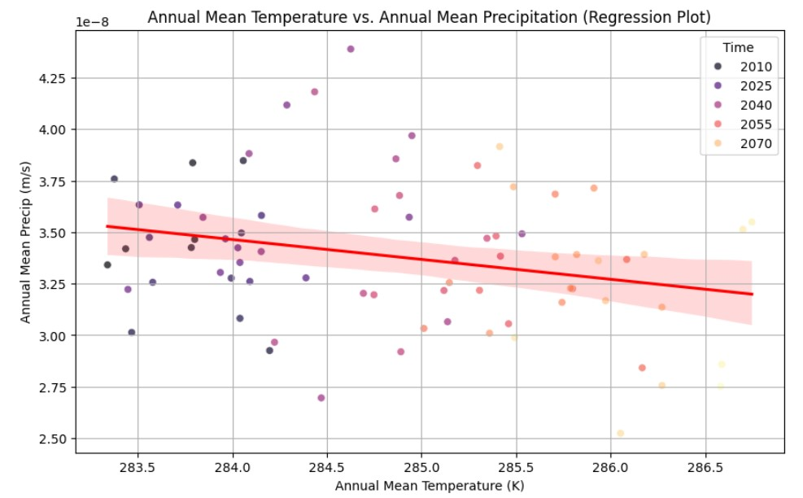
Temp-precipitation correlation

Slide 8
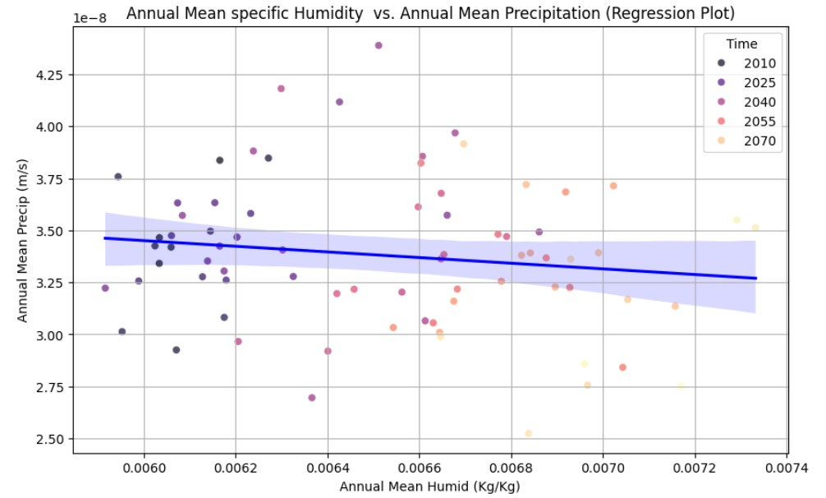
Humidity-precipitation correlation

Slide 9
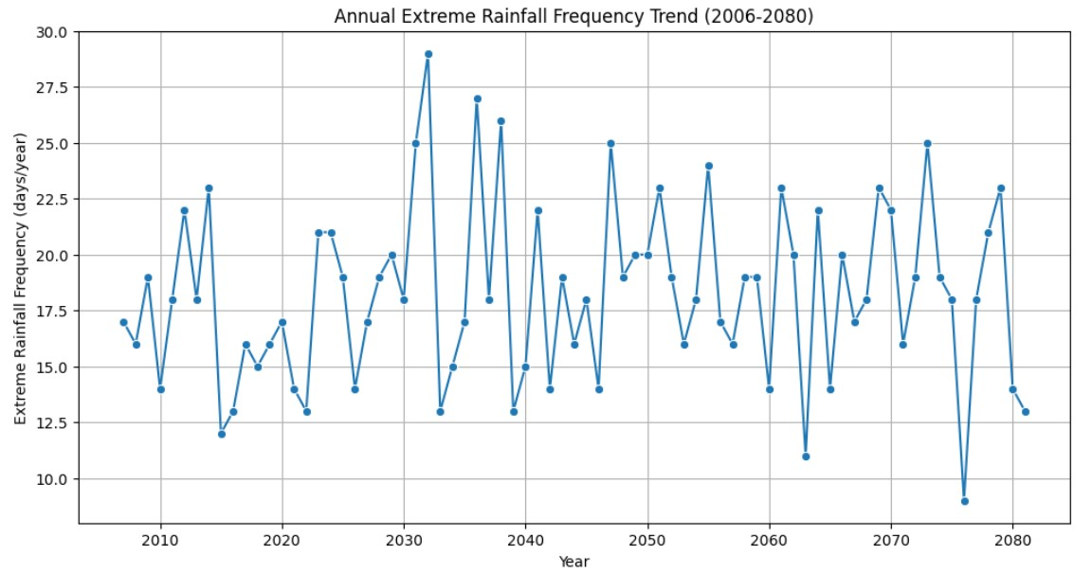
Frequency of extreme precipitation events

Slide 10
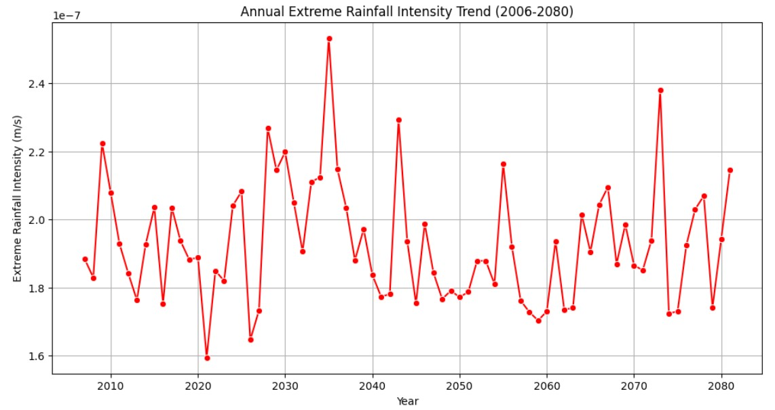
Intensity of extreme precipitation events

Slide 11



Implications of the projected changes
Be uniform in size
Compliment the content
Not impact on the copy area

Slide 12
Conclusion
Conclusion remarks of the findings
Lesson learnt and possible limitations
Recommendations

