Slide 1


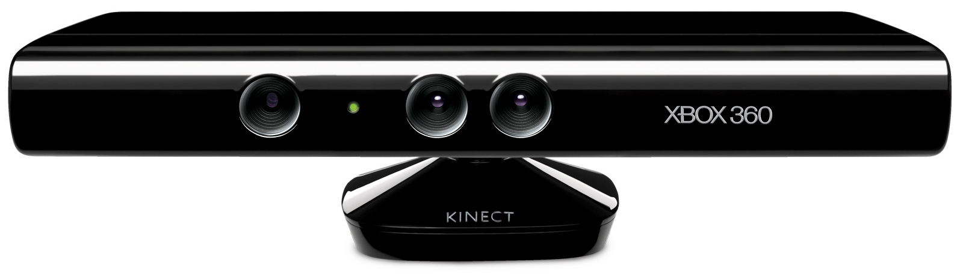
Bouissière Mathieu
Gonzalez-Conde Damien
Projet Long
Enhancing Sportsman Performance Using Motion Sensing Device
Supervised by Euriell Le Corronc and Elodie Chanthery from DISCO team
February 1st – March 11th 2016
Manjarres Bustos Juan David
Miquet Emmanuel

Slide 2
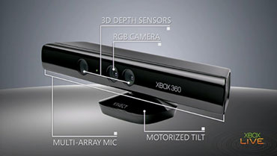
Presentation Organization
Enhancing Sportsman Performance Using Motion Sensing Device
Project Management
Hardware Presentation
Data Acquisition
Data Classification

Slide 3
Project Workflow
Development Environment
Task | Allocated Time | Contributors
Learning how to use GitHub and setting up our repository | 15/02 – 16/02 | 1/2
Data Acquisition
Task | Allocated Time | Contributors
Discovering Kinect device and Software Development Kit | 01/02 – 08/02 | 4
C# language learning | 01/02 – 14/02 | 1/2
Matlab data acquisition and graphical interface | 01/02 – 09/02 | 1
C# data retrieving, first versions Graphical User Interface | 01/02 – 14/02 | 3
C# interface upgrade, adding features, and saving data to files | 15/02 – 22/02 | 1/2
Positions and Movements Classification
Task | Allocated Time | Contributors
Exploring available solutions for data classification | 09/02 – 14/02 | 2
Comparing classification algorithms [Matlab] | 15/02 – 19/02 | 1
Classifying simple movement (first algorithm) [Matlab] | 20/02 – 25/02 | 1
Work on decision trees algorithms | 26/02 – 01/03 | 1
Classifying simple movement (first algorithm) [Matlab] | 20/02 – 01/03 | 1/2
Exploring other software solutions [Orange] | 26/02 – 01/03 | 1
Reporting
Task | Allocated Time | Contributors
Preparing report, abstracts and presentation | 01/03 – 06/03 | 4

Slide 4
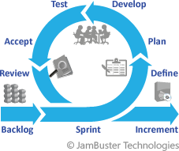


Software Development
Agile Software Development Scrum

Slide 5
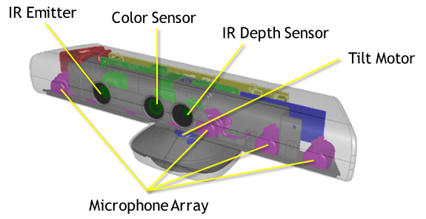
Kinect General Presentation
Development & Commercialization
Development: “Natal Project”, 2009
Commercialization: 5 January 2011
Number of products sold: 8 millions
Two types of Kinect
Kinect for Xbox 360 (games & development)
Kinect for Windows (only development)
Kinect: technical representation

Slide 6
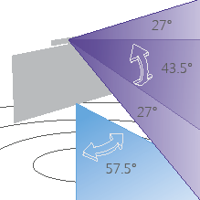
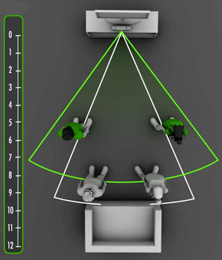
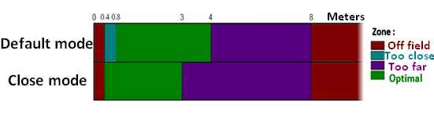
Kinect: Characteristics and Functions
Fields of view
57° horizontal
43° vertical
+/- 27° vertical thanks to the tilt motor
Data stream
RGB: 320*240, 16 bits, 30 fps
640*380, 32 bits, 30 fps
Depth: 640*380, 30 fps
Two sensor ranges
Close Mode
Default Mode

Slide 7
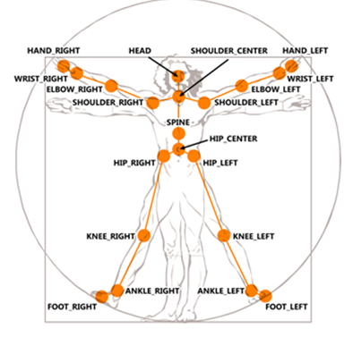
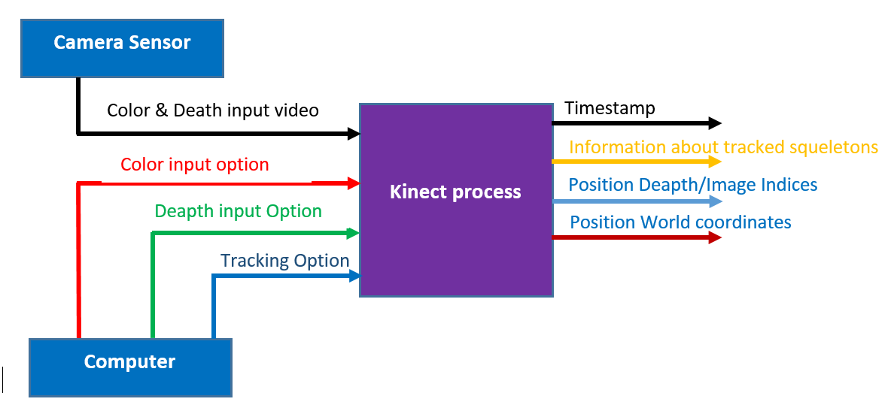
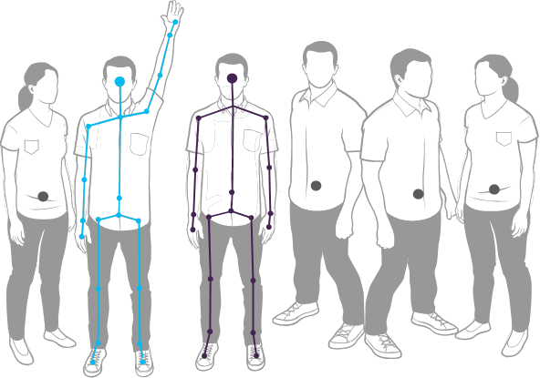
Kinect: Movements recognition
Joints recognition
Tracking system
Skeleton feature

Slide 8
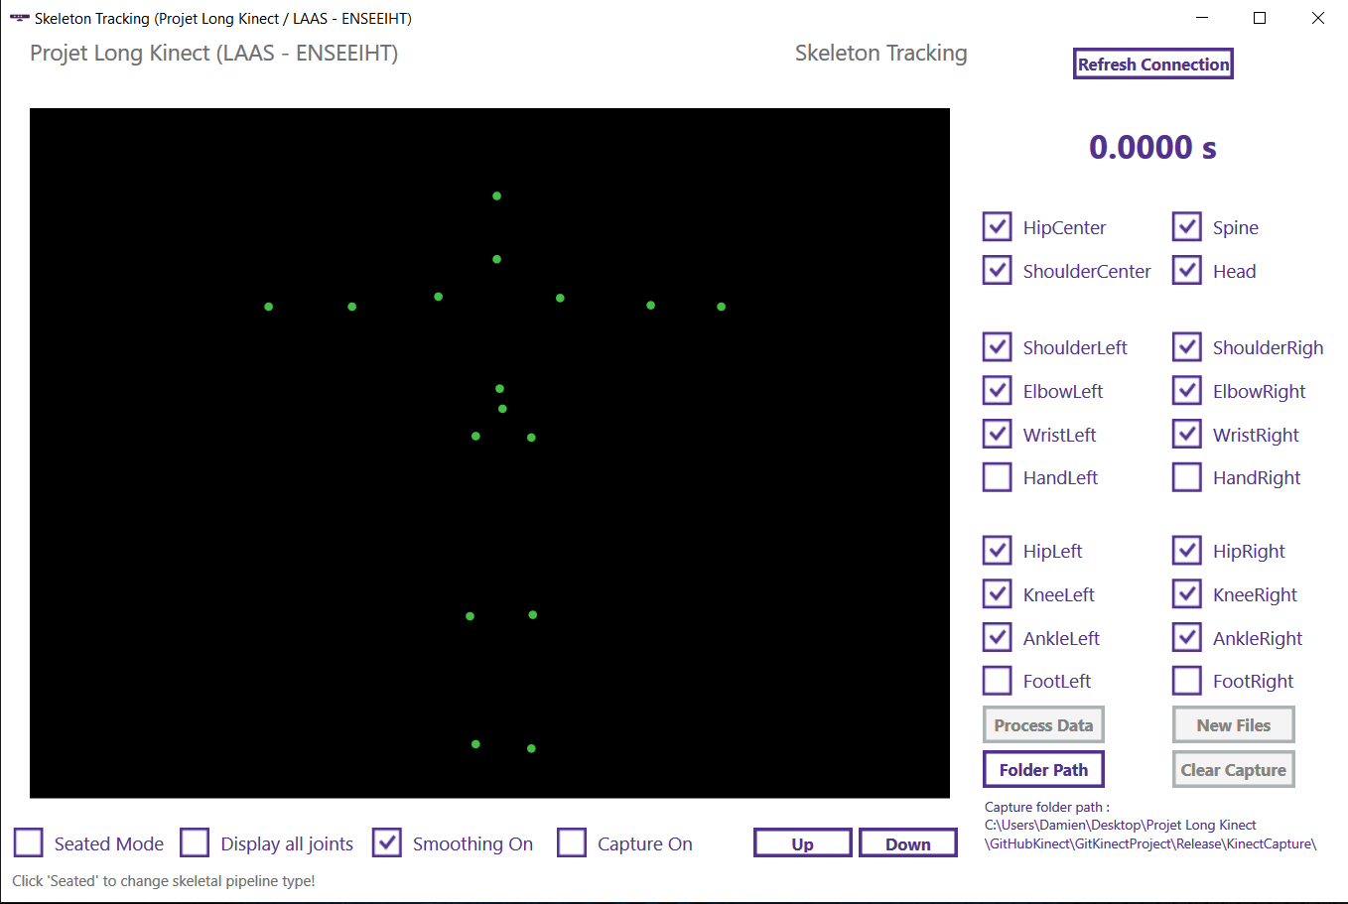
Graphical User Interface: Retrieving Data
Retrieving spatial points :
Matlab, comparing RGB and Infrared
  Infrared, better tracking
Windows C# application
  Joints selection
  Smoothing
  Capture points
  Files creation
  Moving Kinect
  …
Live demonstration

Slide 9
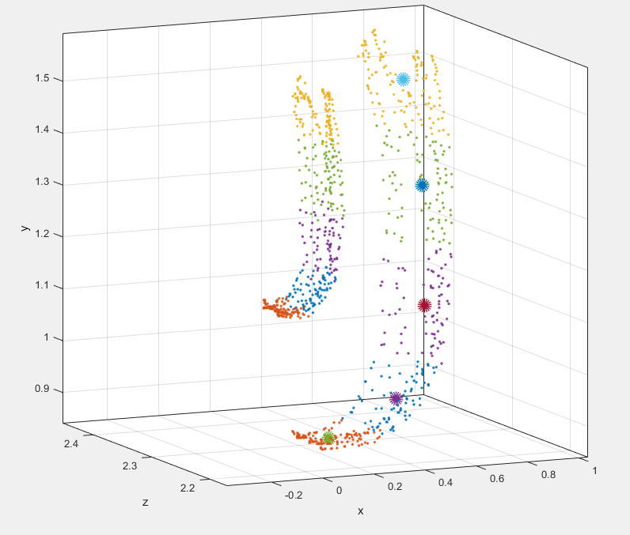
Classification: Machine Learning and Prediction
Big Data : need to regroup similar data to find common configurations
Learning : supervised and unsupervised
Prediction : finding known, previously learned patterns in new data sets

Slide 10
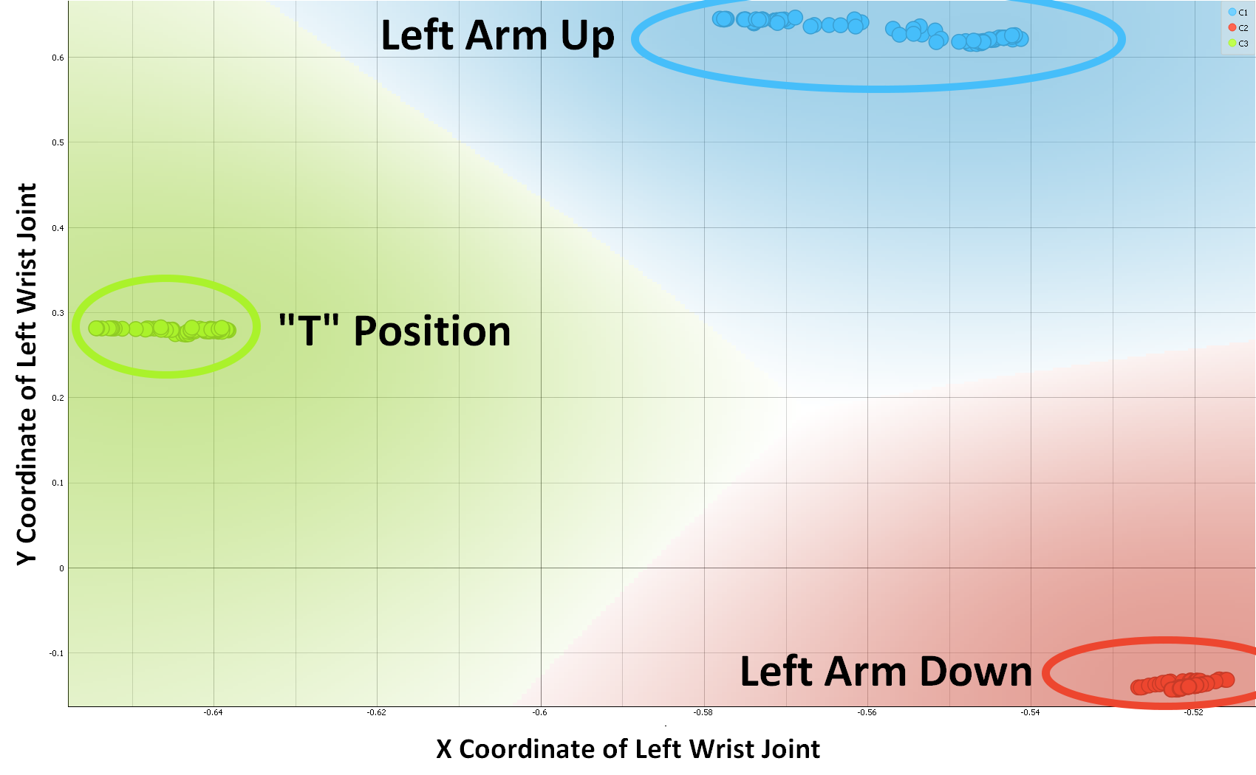
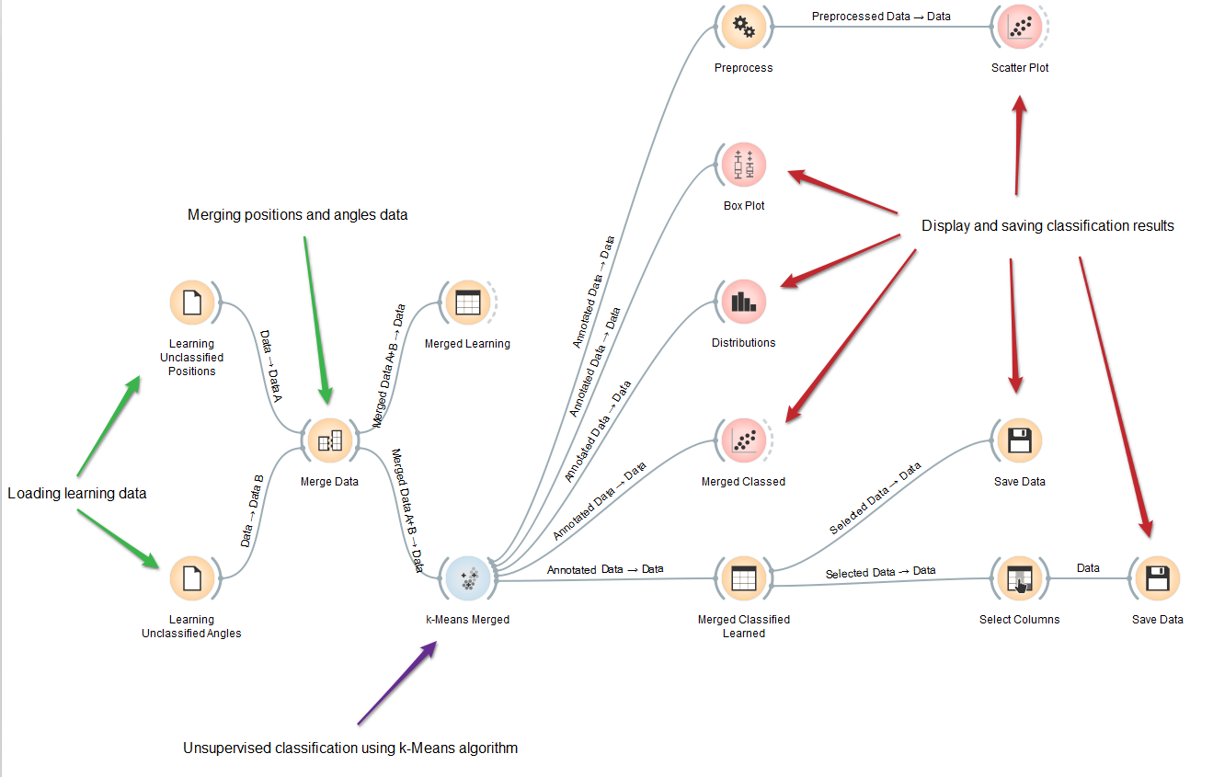
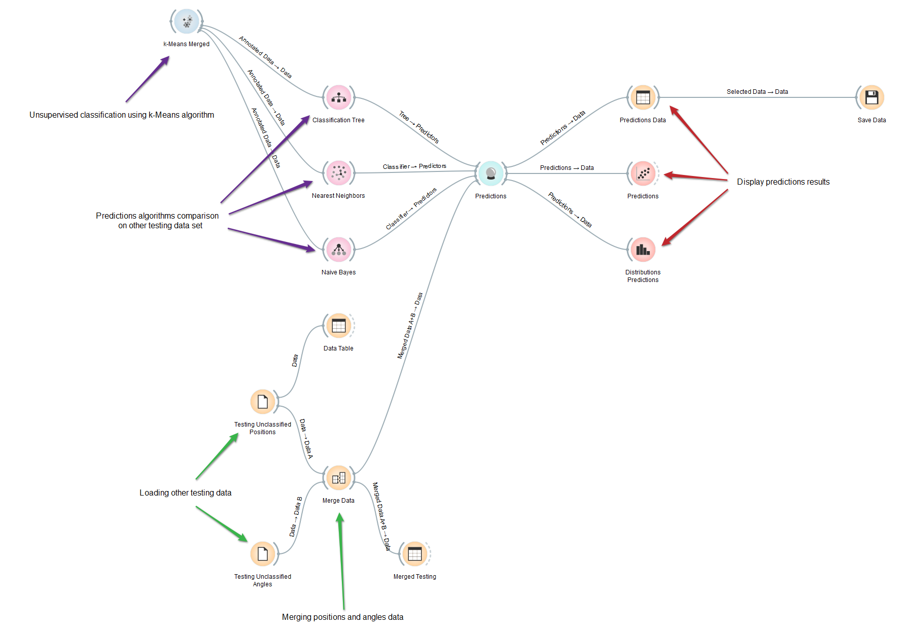
Classification: First Approach With Orange
Widely Used Software Solution: Orange (v3.2), last release in 2013
Based on Python language, uses graphical interface

Slide 11
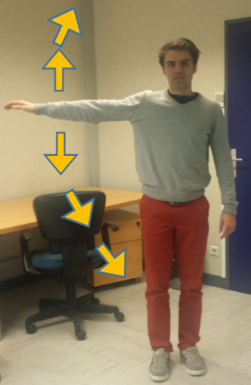
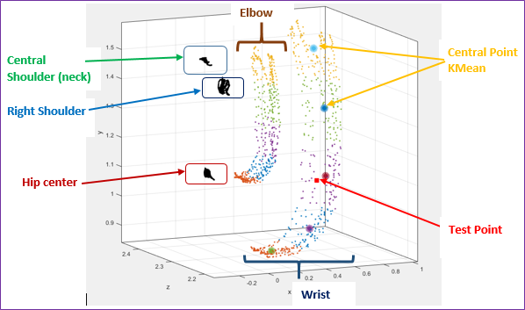
Classification: Unsupervised Learning
Movement
3D Position tracking

Slide 12
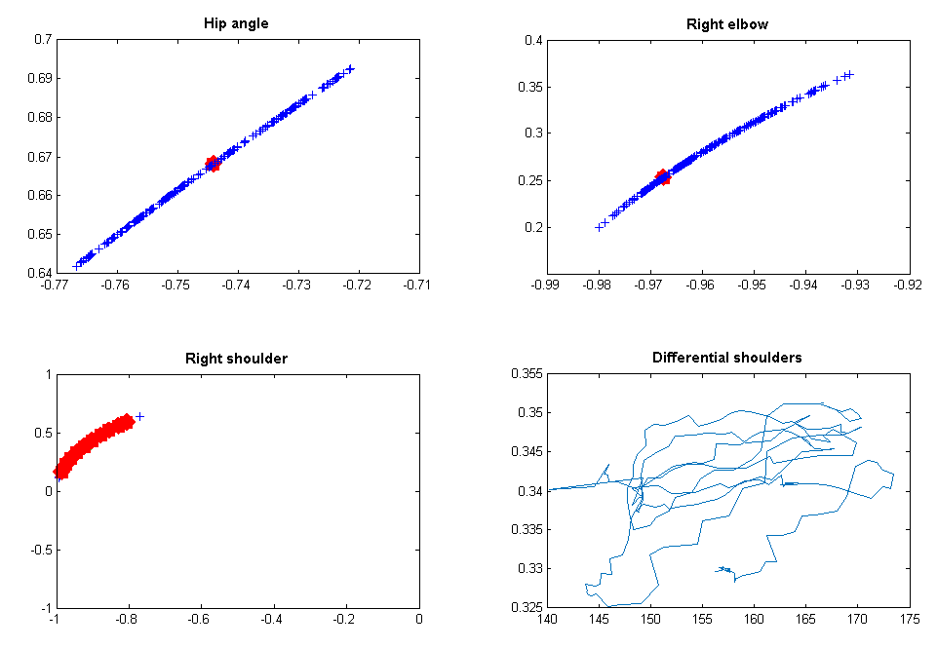
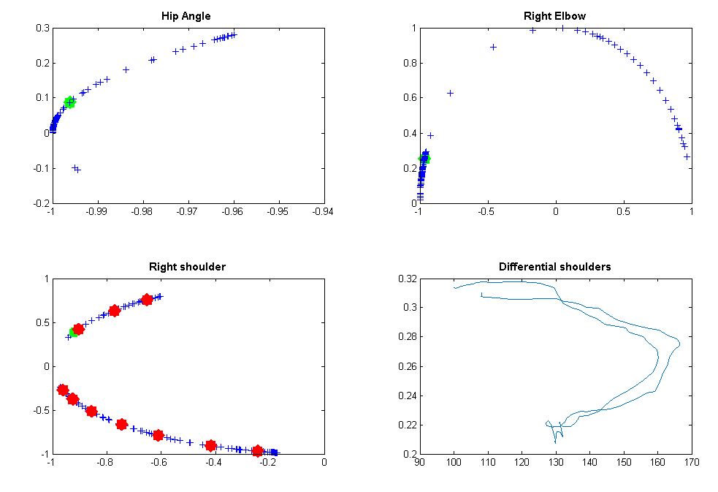
Classification: Using Joints Angles
Angle tracking
Transformed angle tracking

Slide 13
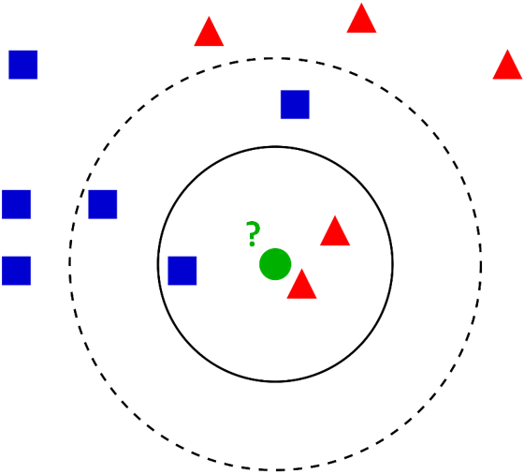
Classification: Nearest Neighbors Algorithm
Principle: Evaluate from a sample point, the distance to a referenced points database and find the nearest point(s). Once the nearest neighbor in the database is established, the sample point gets the same class label as the referenced point.
Matlab K-Nearest Neighbors (KNN) Function
Build a KNN model from a training test with the corresponding label class
Predicts the class from a test group using the model stablished
All samples in the test group are classified

Slide 14
Classification: Nearest Neighbors Algorithm
To do a better classification of good and bad body positions we need to reject the samples points which are too far away from their nearest neighbor.
Custom KNN Function
Uses the Matlab KNN search to establish the distance between the sample point and its nearest neighbors in referenced points database
Evaluate if the found distance is too far away using a threshold
Only classifies the sample points with nearest neighbors distances lower than the threshold
Unclassified samples test goes in a rejected class

Slide 15
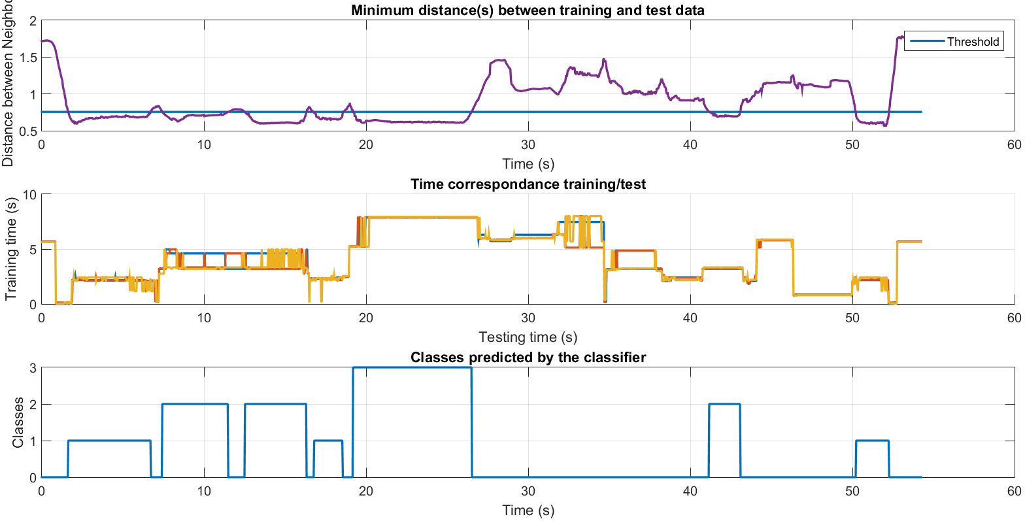
Classification: Nearest Neighbors Algorithm
Results of implemented algorithm

Slide 16
Limitations and Improvements
Working data acquisition application
Reusable data classification algorithms
Learning Algorithm (supervised or not)
Learning Data Sets
Graphical User Interface
Diagnostic
Human Expertise
New Data Sets (unknown classes)
Prediction Algorithm
Kinect hardware limitations
Going further: classifying movements, other data sets…

Slide 17
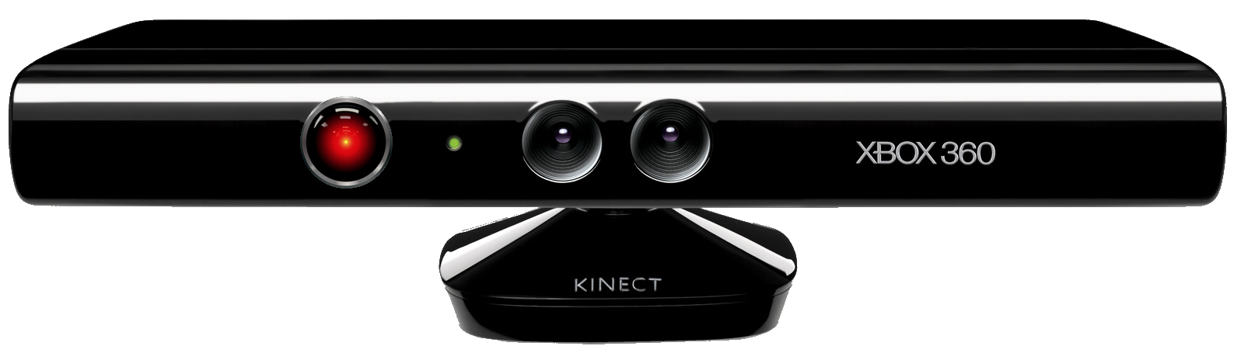
Thanks and Questions
Special thanks to our supervisors Euriell Le Corronc and Elodie Chanthery
All images rights belong to the original owner

