Slide 1

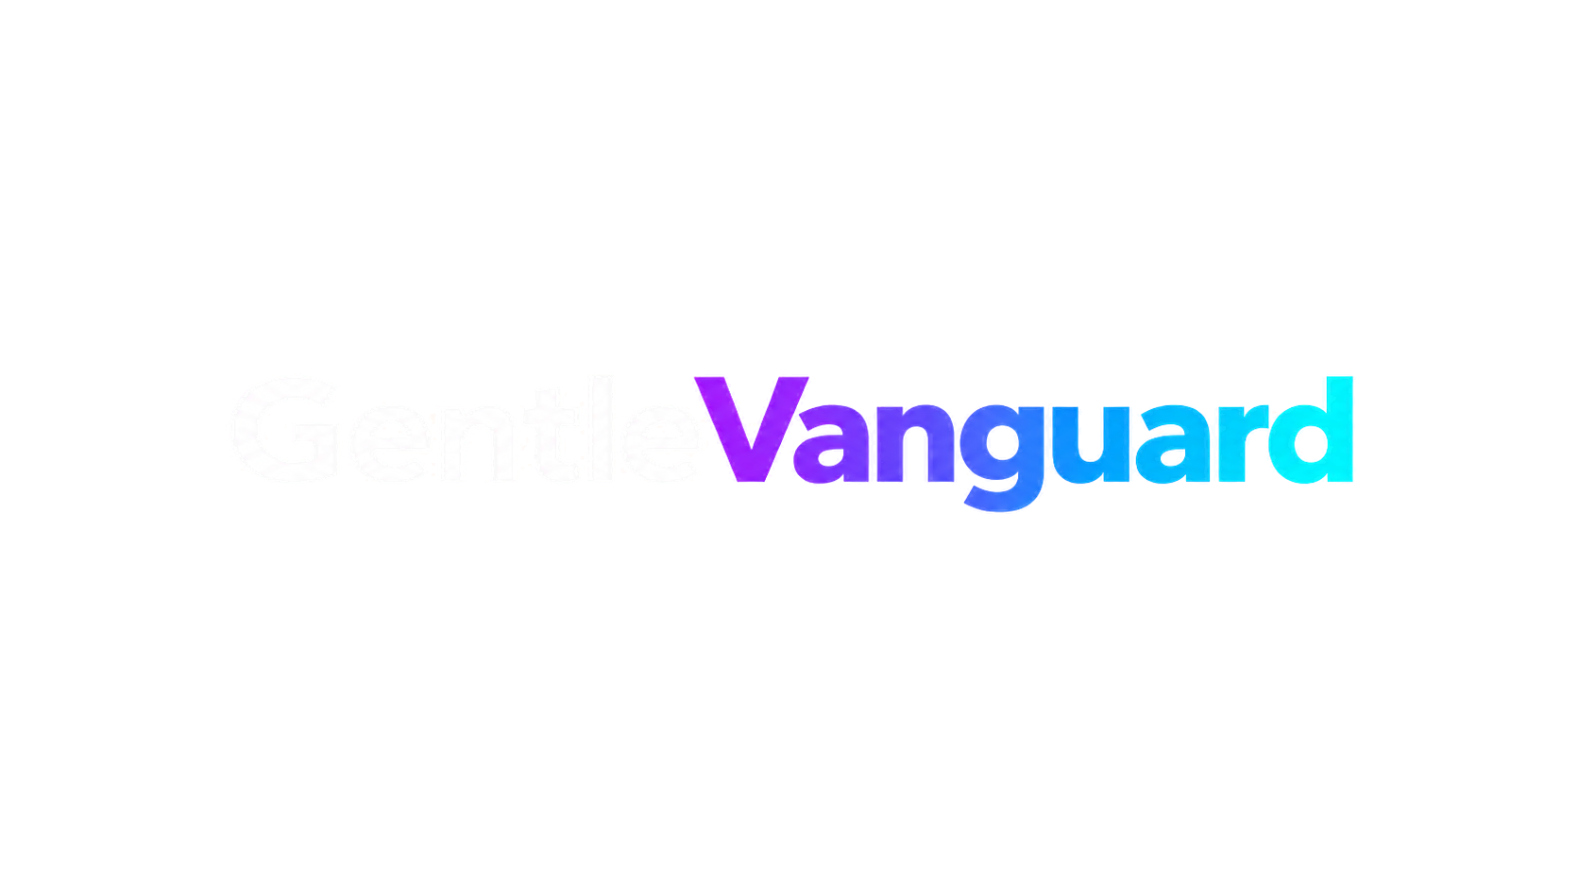

INTERNAL AI ADOPTION - A GOVERNED STACK
An orchestration layer
for your company AI
A local-first stack that turns AI assistants into governed capability: defined roles, token budgets, traceability and audit.
Local first
Traceable
Portable
Stack v4.3.0 - November 2026

Slide 2

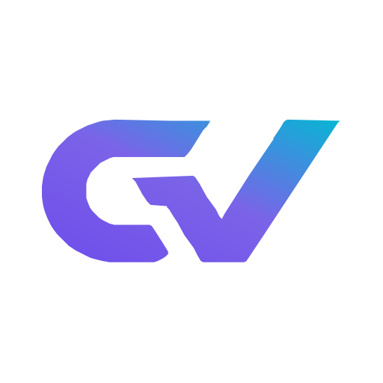
WHO BUILDS IT
The person who knows applied AI in large companies has done it before
Emmanuel Ortiz Gutierrez: software architect, AI integration engineer and founder of GentleVanguard. More than 15 years building and analysing systems for companies: software architecture and AI integration at DIRECTV Latin America, technical consulting at GlobalLogic and Oracle, plus analysis, QA and development team coordination.
DIRECTV
GlobalLogic
UNSJ
Latin America
Oracle
Information Systems
Software architecture and AI integration
Technical consulting for enterprise clients
BSc in Information Systems
GentleVanguard
1
GentleVanguard - Stack v4.3.0

Slide 3




WHAT IT IS
The stack is not a chatbot: it is the layer that governs it
Each layer solves one class of problems and keeps a record of what it did.
A roster of agents
Tools
CLI, IDEs and product surfaces
21 agents with model, permissions, step limits and budget assigned.
Agents
Specialized profiles per runtime
Capabilities
256 reusable skills invoked by context, not by code.
Orchestration
Context, routing and steps
Evidence
Knowledge
Engram, CodeGraph and Graphify
Sessions, traces, events and hash-chained audit.
Operational data
Nexus / SQLite, kept separate
Controls
Fail-closed policies, secret scanning and permission traceability.
Quality & delivery
Gates, review and evidence
GentleVanguard
2
GentleVanguard - Stack v4.3.0

Slide 4
ANATOMY
Nine layers, each with an explicit boundary
The structure is what makes it possible to audit, replace or extend one piece without breaking the rest.
Surfaces
Ten audited tool profiles (OpenCode, Codex, ZCode, MiniMax Code, Claude Code, Antigravity, Cursor, Cline, Windsurf and VS Code) over one workspace.
Orchestration
Model and agent routing, step escalation by complexity, and a learnable routing table with 17 domains and overrides.
Agents
21 definitions with permissions and step limits; 29 mapped roles and 30 model bindings by domain and criticality.
Capabilities
256 indexed skills, with 28 critical ones under a contract verified in real execution.
Knowledge
Engram (memory), CodeGraph (incremental index), graphify (deterministic AST graph) and Nexus (44 tables, 22 migrations, WAL).
Tools
Ten MCP servers with uniform access, including two external ones behind a circuit breaker.
Infrastructure
Watchtower watching 35 components, six operating modes and auto-heal.
Observability
Dashboard with real traces, a 7-component health API, OTLP export and configurable alerts.
Applications
28 of our own apps running on the stack, validating the architecture in production.
GentleVanguard
3
GentleVanguard - Stack v4.3.0

Slide 5
SCALE
Not a prototype: a system under sustained use
Figures verified against the repository at version 4.3.0.
800+
552+
611+
35
TypeScript files in src/
Test files
npm scripts
Components watched
Own stack code, organised by area
Unit, e2e, integration, security and skills
Every stack operation is an auditable command
Health checks per component, with auto-heal
GentleVanguard
4
GentleVanguard - Stack v4.3.0

Slide 6

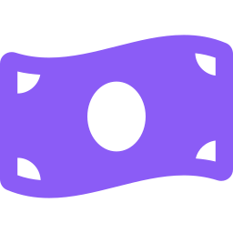

CAPABILITIES
What the company gets when it installs the stack
Roles, not people
Cost under control
Explicit permissions
29 mapped roles with primary and fallback subagents, triggers and skills. AI stops being one person tool and becomes a role with a standard.
A daily budget of 10 million tokens, 3 million per session and 100 thousand per agent, with routing by cost, latency and load.
Per-agent permissions, fail-closed policies, an MCP security gateway, secret scanning and a separation between reconstructable and non-reconstructable data.
GentleVanguard
5
GentleVanguard - Stack v4.3.0

Slide 7




OPERATION
How a task actually runs, end to end
The loop does not change between a one-week project and a six-month one.
Pre-process
Routing
Execution
Verification
Every turn injects context, skills and rules before the model sees the message.
The router picks model and agent by domain, complexity and cost.
The agent works with real tools and leaves a trace of every step.
Gates and the reviewer close the loop before work is declared done.
>
>
>
GentleVanguard
6
GentleVanguard - Stack v4.3.0

Slide 8



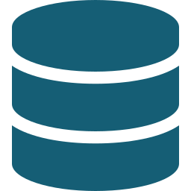
GOVERNANCE
What keeps this from being an uncontrolled experiment
36 quality gates
Supply traceability
19 on pre-commit, 2 on commit-msg, 2 on post-commit, 3 on pre-push, 8 in CI, 1 governance and 1 deploy. 33 of 36 enforced strictly.
Generated and validated SBOM, artifact provenance and a documented mapping against the OWASP Top 10 for agents.
Secret scanning
Real observability
80 patterns with optional entropy filtering and redaction by default, wired into the hook and the watchtower. Three independent scanners coexist.
A dashboard with no mock data: metrics, traces, alerts and feedback come from the operation, not from a mockup.
Chained audit
Backup and recovery
Event sourcing with prevHash and a SHA-256 hash per event. It detects accidental mutation or inconsistent log editing.
Scheduled daily database backup keeping 14 copies, plus recovery drills with measured RTO and RPO.
GentleVanguard
7
GentleVanguard - Stack v4.3.0

Slide 9





THE DECISION
Adopting AI tool by tool, or with an orchestration layer
This is the difference between a software contract and an organisational capability.
Governed stack
Tool by tool
The capability stays inside the company
Each team improvises its own path
One standard for every team, defined in the repository.
Every tool carries its own rules, with no shared standard.
Budget, permissions and limits per role, not per tool vendor.
Cost stays invisible until the invoice arrives.
Evidence for every task: traces, events and chained audit.
No record of what the model did or which data it used.
Process knowledge in the company database, not in a chat memory.
Process knowledge is lost with every conversation.
Continuity: the stack is upgraded and migrated with versioning.
Vendor lock-in: changing tools means starting over.
Works with whichever model provider the company picks, or with local models.
No upgrade path: every new version becomes a project.
GentleVanguard
8
GentleVanguard - Stack v4.3.0

Slide 10
TOPOLOGY
Where each part lives, and why it matters
Operation is local; exposure is optional and reversible.
Layer
Residence
Design reason
Orchestration and agents
Local, on the team machine
Process control does not depend on an external service
Operational database (Nexus)
Local SQLite in WAL
Queries without network latency, with programmable backup
Memory and knowledge
Local, with optional sync
Organisational context does not leave the machine by default
Models
Provider or local
Failover chain: provider, then Ollama, then LM Studio
Applications
Local or cloud depending on the case
Exposed by URL when needed, without changing the logic
Audit and traces
Versioned local files
Can be archived, shipped to a SIEM or retained by policy
GentleVanguard
9
GentleVanguard - Stack v4.3.0

Slide 11
ECONOMICS
The cost of AI, measured and bounded
The router picks the model by cost, latency and load. Budgets cut before spend becomes a surprise.
10M
3M
100k
3
Tokens per day
Tokens per session
Tokens per agent
Routing profiles
Global budget with a soft cut at 70 percent
Ceiling per working session
Each role carries its own limit
cheap, balanced and premium, with chained failover
GentleVanguard
10
GentleVanguard - Stack v4.3.0

Slide 12
ADOPTION
How to get in without breaking anything
Four steps, each reversible and each with its own success criterion.
01
02
03
04
Audit
Pilot
Extend
Govern
Review the tools, skills and permissions already installed. The audit does not guarantee execution, but it does reveal the real surface.
One area, one process, one agent. With a token budget and tracing live from day one.
Promote what worked into formal roles, with permissions and limits per role.
Gates, backups, audit and stack upgrades become part of the operating routine.
GentleVanguard
11
GentleVanguard - Stack v4.3.0

Slide 13
The next step is a diagnostic, not a contract
We propose a working session to audit how AI sits in your organisation today and which part of this platform can be adopted without friction. No cost and no implementation commitment.
Request the stack diagnostic
See the full architecture
WhatsApp: +54 9 264 545-2221
The stack is open source. Internal adoption happens on top of the repository and your own company policies.
Email: gentlevanguard@gmail.com
Emmanuel Ortiz Gutierrez - Software Architect, AI Integration Engineer

