Slide 1



CUSTOM SOFTWARE - AUTOMATION - APPLIED AI
Your business grows.
Your systems should too.
We design apps, business systems and automations around how your team actually works. Free diagnostic, staged proposal and fixed prices by milestone.
Free diagnostic
Fixed price per milestone
San Juan, Argentina
Stack v4.3.0 - November 2026

Slide 2


WHO WE ARE
A software studio that listens before it builds
GentleVanguard designs and builds custom apps and business systems for small and mid-sized companies that need to order their processes, automate operations and grow on dependable software. We work project by project, as an independent contractor, from San Juan, Argentina.
15+
3
1
Years of practice
Service lines
Accountable owner
Software architecture and applied AI inside companies
Custom software, automation and applied AI
The same person designs, builds and delivers
GentleVanguard
1
GentleVanguard - San Juan, Argentina

Slide 3



WHAT WE DO
Three ways to bring an operation back in order
Every project starts from the real process, not from a tool.
Custom software
Automation
Applied AI
Apps and portals built around your processes, not the other way around. Customer management, operations and tracking. Evolution of systems that no longer scale.
Integrations across systems, CRM and payments. Conversational service flows. Dashboards and reports so tracking stops depending on spreadsheets.
We assess where artificial intelligence actually pays off: assistants connected to your own information, with clear limits and human review.
GentleVanguard
2
GentleVanguard - San Juan, Argentina

Slide 4
HOW WE WORK
A short method, with the criteria agreed before we start
We understand first
Then we build
We stay with it
We talk about the problem, the people involved and the tools you already use. Nothing is designed on assumptions.
We agree on priorities, stages, deliverables and acceptance criteria. The first version is tested and reviewed with evidence.
Go-live, documentation, training and an agreed path for evolution. Delivery is the start of the operation, not its end.
A project does not start with a proposal. It starts with a diagnostic that ends in a process map, the main pain points, automation opportunities and a staged roadmap.
GentleVanguard
3
GentleVanguard - San Juan, Argentina

Slide 5
THE DIFFERENCE
We do not sell hours: we operate on a platform we already built
GentleVanguard is a studio with its own stack. That platform is what holds up delivery times, quality and traceability on every project.
28
21
256
35
Own apps
AI agents
Skills
Components watched
Systems we developed and that run today
Roles with model, permissions and budget assigned
Reusable capabilities that are not rewritten per project
Health checks per component, with auto-heal
GentleVanguard
4
GentleVanguard - San Juan, Argentina

Slide 6




THE PLATFORM
A layered stack, not a one-off project
Each layer solves one class of problems and keeps a record of what it did.
Layers
Tools
CLI, IDEs and product surfaces
Surfaces, orchestration, agents, skills, knowledge, tools and infrastructure.
Agents
Specialized profiles per runtime
Traceability
Sessions, traces, events and hash-chained audit in the local database.
Orchestration
Context, routing and steps
Governance
Knowledge
Engram, CodeGraph and Graphify
36 quality gates, secret scanning and fail-closed policies.
Operational data
Nexus / SQLite, kept separate
Local first
Runs on your team machine and is exposed to the cloud when needed.
Quality & delivery
Gates, review and evidence
GentleVanguard
5
GentleVanguard - San Juan, Argentina

Slide 7
THE PATH
From the first conversation to a running operation
Stages with verifiable deliverables, not open-ended phases.
01
02
03
04
Understand
Define
Build
Operate
We map the process, the roles and the tools in use today.
Scope, stages, deliverables and acceptance criteria are agreed.
A first useful version, tested and reviewed with its real users.
Go-live, documentation, training and evolution.
GentleVanguard
6
GentleVanguard - San Juan, Argentina

Slide 8
SCOPE
What can be contracted, and in which order
Reference price list in US dollars, net of taxes. Refreshed before every quote.
Service
Reference range (USD)
When it makes sense
Analysis and proposal
200 - 400
You are not sure what to build. Deducted in full when you sign.
Landing page / Corporate site
350 - 700 / 900 - 1,800
You need your own presence and a simple way to receive enquiries.
Web app with integrations
3,500 - 8,000
The process already lives across several tools that need connecting.
Mobile app MVP
3,000 - 6,000
The team needs to operate away from a desk.
WhatsApp bot simple / hybrid with AI
1,500 - 2,500 / 3,500 - 5,000
There is repetitive service work that can be automated.
AI agent with RAG
4,000 - 8,000
Queries need to answer from your own documentation.
Custom CRM
5,000 - 15,000
Commercial tracking is scattered.
Maintenance and support
90 - 250 per month
A system already exists and needs sustaining and evolving.
GentleVanguard
7
GentleVanguard - San Juan, Argentina

Slide 9





WHY US
A studio with its own stack, versus an isolated build
Two paths that often look equivalent and are not.
GentleVanguard
Isolated build
A studio that operates on its own platform
The project starts and ends with the project
Fixed prices per milestone and bounded scope before we start.
Vague scope adjusted on the fly, with cost as the variable.
Documented diagnostic: process map, risks and staged roadmap.
Software handed over with no documented process and no transferred operation.
Code, documentation and delivery criteria under one quality bar.
Every project re-solves the same base problems.
Capabilities reused across projects: what was solved is not paid for twice.
No knowledge transfer: the system depends on a single person.
Continuity after delivery: support, improvements and new integrations.
No agreed continuity: the system ages with no path forward.
Own training: GV Academy so your team adopts the system.
No training: adoption stays in the provider hands.
GentleVanguard
8
GentleVanguard - San Juan, Argentina

Slide 10
BEYOND THE PROJECT
GV Academy: the knowledge stays with your team
A live, open catalogue: 89 products across applied AI, software and business practice.
30
33
26
89
Courses
Ebooks
Toolkits
Products
With 429 hours of video content
2,634 pages, 18 of them in the premium edition
Prompts and flows ready to apply
Published and sold individually
GentleVanguard
9
GentleVanguard - San Juan, Argentina

Slide 11

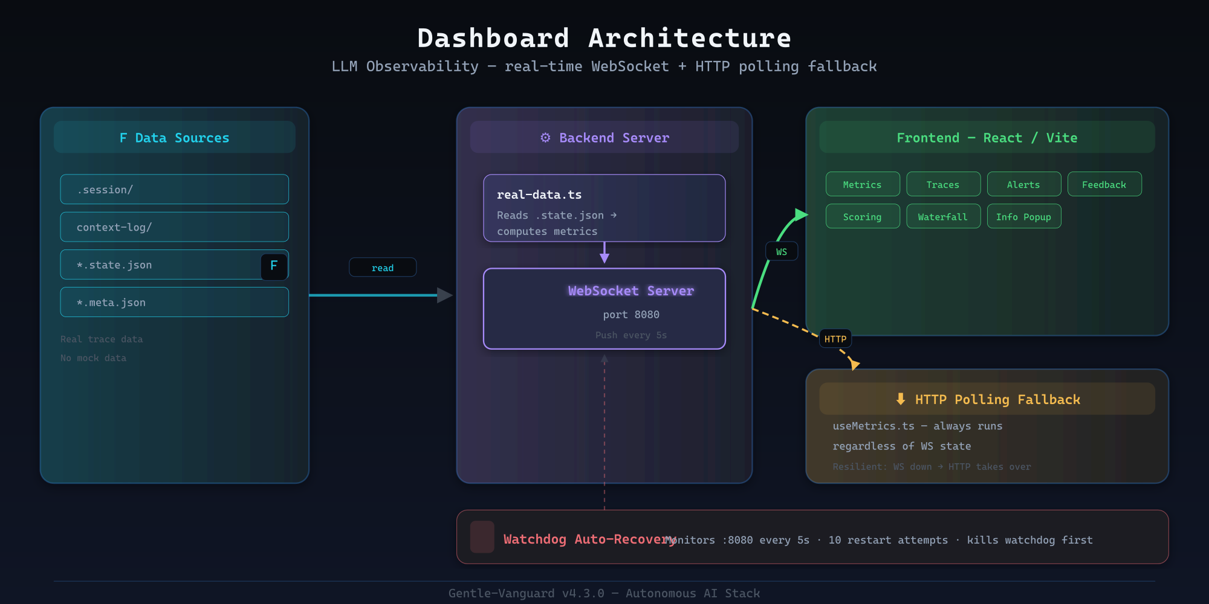



PROOF OF WORK
This is already running: 28 of our own developments
These are not catalogue products or client case studies. They are systems we built and that run today.
GV Academy
Learning platform, portal, CRM and a catalogue of 89 products.
WhatsApp bot
Deterministic conversational service, running in production.
Observability
Dashboard with live metrics, traces, alerts and feedback.
Command center
App lifecycle: start, status and logs.
Stack observability dashboard, fed by real traces
GentleVanguard
10
GentleVanguard - San Juan, Argentina

Slide 12
THE FIRST STEP
The first consultation is free of charge
We meet, we understand your operation, and you walk away with a clear analysis plus a staged proposal with fixed milestone pricing. Then you decide whether we move forward. If we do not, the diagnostic is still yours.
Free
50/40/10
30 days
Initial diagnostic
Payment milestones
Warranty
Includes process map and staged roadmap
Fixed price per milestone, paid in advance
Product warranty at delivery sign-off
GentleVanguard
11
GentleVanguard - San Juan, Argentina

Slide 13
Let us start by understanding your operation
One diagnostic conversation is enough to know whether there is a project here and what it is worth. No commitment.
I want my free diagnostic
See the catalogue
WhatsApp: +54 9 264 545-2221
The institutional presentation and the Academy catalogue are published at gentlevanguard.github.io
Email: gentlevanguard@gmail.com
San Juan, Argentina - Project basis, independent contracting

