Slide 1

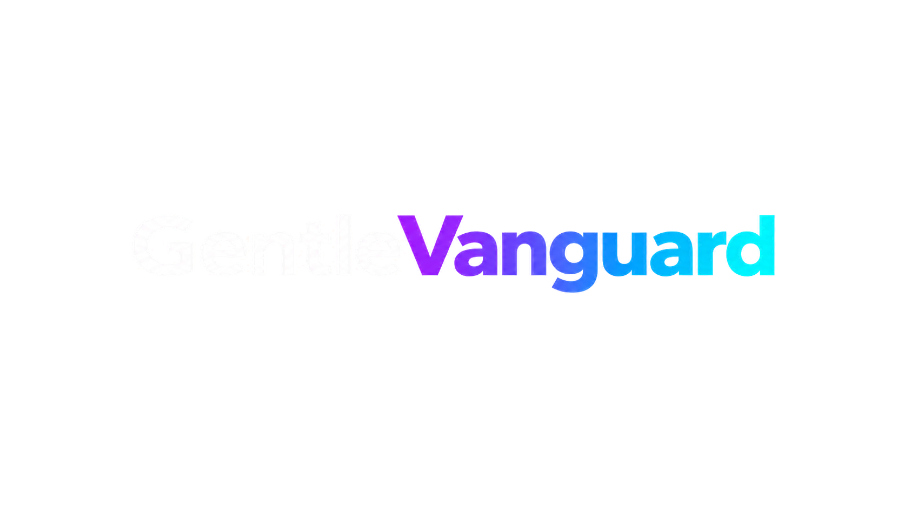

TECHNICAL ONBOARDING
How work happens
inside the stack
Repository map, anatomy of a session, agents, skills, commands, operational database and the rules that hold the rest together.
Stack v4.3.0
Node 24
pnpm 11
Onboarding guide - November 2026

Slide 2

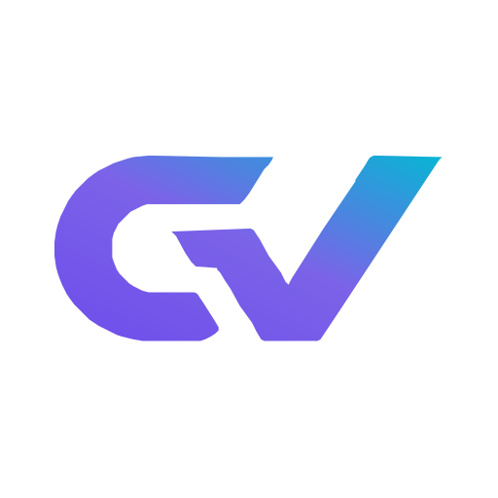
ROUTE
What you will walk through
The recommended order for a first week.
01
Repository map
05
Nexus
What lives in each folder and why it is separated.
The operational database: 44 tables, migrations and backup.
02
Anatomy of a session
06
Development flow
What happens between your prompt and the agent reply.
From request to commit: ODD, slices, gates and the reviewed boundary.
03
Agents and skills
07
Repo rules
The 21 roles in the roster and how capabilities get invoked.
What is not negotiable and why it exists.
04
Commands
08
Where to look
The commands used daily and what each one verifies.
The shortest path to each kind of answer.
GentleVanguard
1
GentleVanguard - Stack v4.3.0

Slide 3
MAP
Eight folders, one responsibility each
The separation is not cosmetic: it is what makes the validations automatic.
src/
more than 800 TypeScript files. Stack code by area: orchestration, security, retrieval, data, tools, quality and ops.
apps/
28 of our own applications running on the stack, validating the architecture in production.
skills/
256 capabilities with contract and frontmatter. Invoked by task description.
docs/
Stack manual by module, full manual, 38 ADRs and the design decision log.
config/
Single source of configuration: model router, role mapping, quality gates, budgets and MCP registry.
packages/
Workspace holding the official design system and the shared packages the code imports.
tests/
more than 550 test files: unit, e2e, integration, security, skills, workflows, eval and performance.
assets/
Official brand, self-hosted fonts and the canonical shell diagram.
GentleVanguard
2
GentleVanguard - Stack v4.3.0

Slide 4





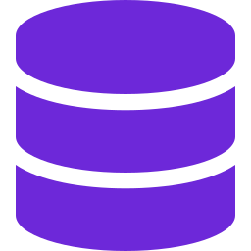
SESSION
What happens when you write a request
Six stages, all instrumented. None of them is magic: each one leaves a record.
Autostart
Pre-processing
Router
Agent
Skills
Nexus
Prepares session, engram, security orchestrator, codegraph, budgets, watchtower and Nexus.
Injects skills, context and rules before the model sees the message.
Picks the model by cost, latency, domain and task criticality.
Executes with real tools. Every step lands in the trace.
Invoked by context. Each skill declares its contract and its outcome.
Sessions, traces, tokens, events and skill outcomes are persisted.
>
>
>
>
>
GentleVanguard
3
GentleVanguard - Stack v4.3.0

Slide 5

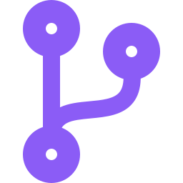


ROSTER
21 agents, each with its own perimeter
An agent has a model, permissions, a step limit, a budget and a declared fallback.
Orchestration
SDD cycle
Operations
Business areas
orchestrator, session-agent, knowledge-agent and self-diag-agent: the loop and its own diagnostics.
sdd-explore, sdd-design, sdd-apply and sdd-verify: the opt-in path for multi-session specs.
ops-agent, maintenance-agent, gitflow-agent, premortem-agent and doc-agent: daily operation.
mkt, sales, finance, hr, legal, bus-tele and sia: business roles with their own permissions.
GentleVanguard
4
GentleVanguard - Stack v4.3.0

Slide 6






CAPABILITIES
Skills: the library that stops us rewriting things
What they are
What is not copied
A SKILL.md with frontmatter, description and contract. They are indexed and routed by task similarity, not by remembering the name.
Only 28 critical skills propagate to the five external surfaces. The rest are not copied so host metadata does not degrade.
How they are invoked
What was adopted
The skill router scores the task against every capability description and proposes the closest one.
Including frontend-design, canvas-design, doc-coauthoring, theme-factory and the marketing family, with attribution in the frontmatter.
How they are validated
Hygiene
24 critical contracts are exercised in real execution. Nexus separates production, evaluation and maintenance outcomes.
Every skill passes structure and accent lint plus the secret scanner before it enters the index.
GentleVanguard
5
GentleVanguard - Stack v4.3.0

Slide 7
COMMANDS
The ones used every day
Every stack operation is an auditable command. There are no hidden actions.
Command
What it does
npm run session:autostart:detached
Session startup in the background. Idempotent. About 1.3 seconds.
npm run watchtower:health
35 components watched; the report lists the detail of every check. PASS expected.
npm run db:health
Nexus verification: integrity, WAL, tables and rows.
npm run token:status
Real budget: used, ceiling and percentage.
npm run stack:facts
Regenerates the stack fact inventory and its documentation.
npm run stack:facts:check
Fails if there is structural drift against the inventory.
npm run quality:universal
Universal quality gate: intake, plan, build, verify, release, operate, learn.
npm run guard:snapshot
Backs up untracked files and uncommitted patches before a risky operation.
npm run scan:secrets -- --scan
80 detection patterns, with optional entropy and redaction.
npm run graphify -- query "..."
Query the deterministic AST graph of the repository.
npx tsx src/orchestration/recommend-agent.ts --task "..." --topn 3
Agent recommendation for a task.
npm run upgrade
Syncs the workspace with what is published on origin, with a prior snapshot.
GentleVanguard
6
GentleVanguard - Stack v4.3.0

Slide 8
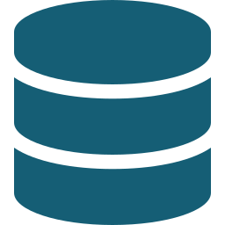


DATA
Nexus: the operational memory of the stack
44 tables and 22 migrations in SQLite with WAL. Everything the stack learns ends up here.
What it holds
Engram
Persistent memory across sessions
Metrics, sessions, traces, events, alerts, feedback, cache, skill usage, tokens and routing.
Retention
Events at 30 days, cache at 7 and token usage at 90. Daily backups keeping 14 copies.
CodeGraph
Symbols and relations in the repository
Queries
Direct SQL over the database, with no reporting layer that could drift from the truth.
Nexus
Metrics, events and traces (SQLite)
Integrity
The watchtower checks file size, WAL, integrity and row counts on every health cycle.
GentleVanguard
7
GentleVanguard - Stack v4.3.0

Slide 9
QUALITY
Quality is not requested: it is executed
The stack runs its own controls on every commit, every push and every health cycle.
36
552+
21
80
Quality gates
Test files
CI workflows
Secret patterns
33 of 36 enforced strictly
Unit, e2e, integration, security and skills
CI, security, release, public sync and automated labelling
With optional entropy and redaction by default
GentleVanguard
8
GentleVanguard - Stack v4.3.0

Slide 10
INSTALL
From clone to first session
Idempotent steps: if it breaks, you re-run it and nothing duplicates.
01
02
03
04
Prerequisites
Dependencies
Nexus
Hooks
Node 22.18 or later, pnpm 11 and Git. Strict verification with install:doctor.
pnpm install with a frozen lockfile. The workspace tree resolves once.
The SQLite database is created under .runtime and pending migrations are applied.
lefthook is installed with the commit and push hooks.
GentleVanguard
9
GentleVanguard - Stack v4.3.0

Slide 11
ROUTER
The router decides, and the code decides it
Temperature and the default model are locked by policy: they do not change on the fly.
Criterion
Current rule
Profiles
cheap, balanced and premium. The active one is balanced.
By domain
premium for finance, legal and governance; balanced for marketing, sales, HR and telecoms; fastCheap for gitflow, ops and session.
Escalation
Steps up by input length, item count, or architectural design and security review questions.
Failover
opencode, then ollama, then lm-studio2, with a 5 minute cache and a fallback model.
Circuit
Five failures open the circuit, two successes move it to half-open.
Temperature
Locked by default. Command override is not permitted.
Audit
Every routing decision is written to a log with 90 days of retention.
GentleVanguard
10
GentleVanguard - Stack v4.3.0

Slide 12




RULES
What is not negotiable in this repository
Invisible processes
Documentation with order
Every spawn goes through runNpxTsx with windowsHide. Zero console windows. A regression test verifies it.
Summary, context, scope, out of scope, assumptions, solution, operation, data, security, plan and annexes. Never "TBD".
Destruction guardrail
Commits per slice
No bulk deletion or overwrite without explicit confirmation. The untracked snapshot runs before any risky operation.
Large work: feature doc before the first write, slices of roughly 400 lines and one conventional commit per slice.
TypeScript and bash only
Reviewed boundary
Stack logic goes in TS. PS1 and CMD only in sanctioned exceptions. No new PowerShell scripts.
After an accepted review, the next one starts from the delta rather than the full range.
GentleVanguard
11
GentleVanguard - Stack v4.3.0

Slide 13
REFERENCE
Where to find each kind of answer
The knowledge is versioned. You do not need to ask.
I need
Go to
The rule currently in force
AGENTS.md at the repository root
The detail of one module
docs/stack-manual-modules.md
The complete architecture
docs/stack-manual-full.md
Generated stack figures
docs/generated/STACK-FACTS.md
Task examples with agents and skills
docs/use-cases/EXAMPLES.md
Project, proposal and contract templates
docs/templates/gv/
How the design system stands
packages/gv-design-system and docs/brand/
The interactive presentation book
docs/presentations/
GentleVanguard
12
GentleVanguard - Stack v4.3.0

Slide 14
Your first day
Install, start a session and ask for the stack health status. Then pick a small issue and let the inline flow do the rest: explore, implement and verify in proportion to the risk.
Start with setup
See the command map
Documentation: AGENTS.md and docs/stack-manual-modules.md
Setup command: npm run setup
If you have any doubt about a repository rule, the answer is in AGENTS.md or in the stack manual.
Health status: npm run watchtower:health

