Slide 1


Assessment 3 - Advanced Machine Learning Analysis
ITEC613: Classifying Fashion-MNIST & Predicting California Housing Prices
Emmanuel Orunta

Slide 2
Part 1: Fashion-MNIST Classification
Objective: To build and compare advanced classifiers to accurately identify 10 classes of fashion items.

Slide 3






Methodology: Data Preparation
Split & Stratify
Standard Scaling
PCA Reduction
Data split into `emmanuel_train` (80%) and `orunta_test` (20%) using `random_state=57` to ensure reproducible results.
Normalized all 784 pixel features (Z-score) to ensure models like KNN and SVM were not biased by pixel intensity.
Applied Principal Component Analysis (PCA), reducing 784 features down to 256 components while retaining 95% of the data's variance.

Slide 4
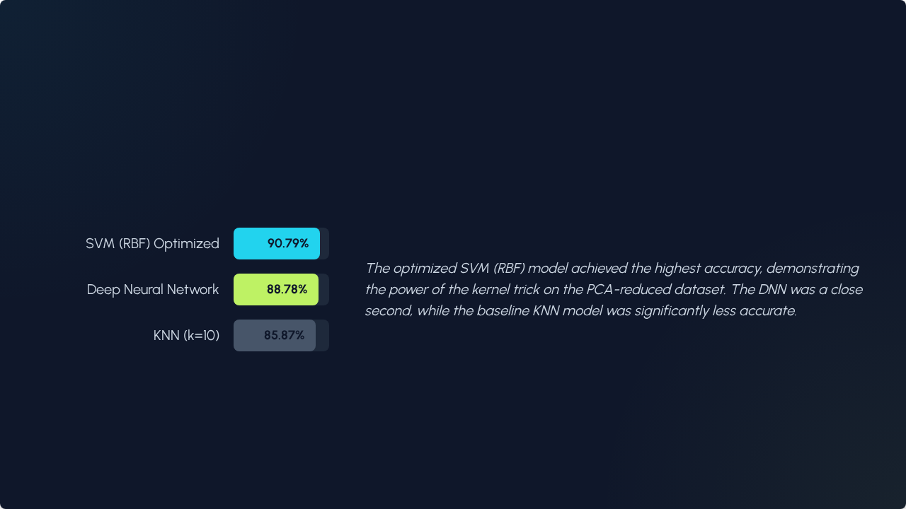
Finding: SVM Outperforms DNN & KNN

Slide 5
Performance Deep Dive: Accuracy vs. Cost
Model | Accuracy | F1_Macro | Time_Train_Sec
SVM (RBF) Optimized | 0.9079 | 0.9073 | 414.4s
DNN | 0.8878 | 0.8859 | 114.2s
KNN (k=10) | 0.8587 | 0.8584 | 110.2s

Slide 6



Ethical & Strategic Implications
Fairness & Bias
Accountability
Transparency
Models trained on biased data (e.g., only Western attire) will fail on underrepresented groups. This impacts fairness and alienates customer segments.
The 'black-box' nature of SVMs and DNNs makes errors hard to trace. We must implement model governance and human-in-the-loop (HITL) review.
To trust the model, we must use techniques like SHAP or LIME to explain *why* a prediction was made, moving beyond just the accuracy score.

Slide 7
Part 2: California Housing Regression
Objective: To predict housing prices and analyze model complexity, regularization, and overfitting.

Slide 8
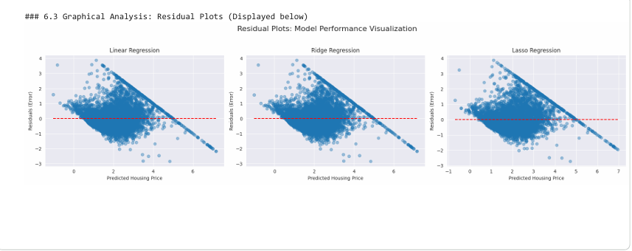
Finding: All Linear Models are Flawed
Model Comparison
We applied three linear models. Regularization (Ridge/Lasso) provided a minor performance boost over standard Linear Regression.
Key Finding: Residual Analysis
The residual plot (right) shows a clear funnel shape (heteroscedasticity). This means our models are systematically flawed: they are confident on cheap homes but have high error on expensive ones.
This violates a core assumption of linear regression and indicates a non-linear problem.

Slide 9
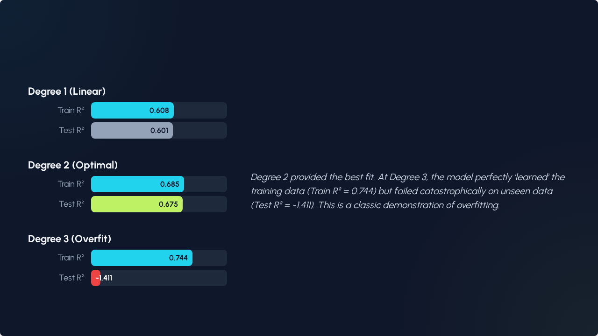
Key Insight: The Overfitting "Cliff"

Slide 10
Strategic Insights & Recommendations
Highest Accuracy Isn't Always Best: The SVM model was the most accurate but took 4x longer to train. For applications needing frequent re-training, the DNN offers a better balance of speed and performance.
Always Validate Model Assumptions: The Regression R-squared scores looked acceptable (0.67), but the residual plots showed the models are unreliable. Analysis must go deeper than just the metrics.
Complexity Must Be Justified: Our polynomial regression analysis proved that a more complex model (Degree 3) can be significantly *worse* than a simpler one (Degree 2) if it leads to overfitting.
Use the Right Tool for the Job: For the image task, a Convolutional Neural Network (CNN) would be the correct state-of-the-art approach, likely surpassing all models.

Slide 11
A comprehensive, multi-model analysis is essential. The 'best' model is not just the one with the highest accuracy, but the one that balances performance, cost, and real-world reliability.
— Emmanuel Orunta

Slide 12
Thank You
Questions?

