Slide 1


ResearchLens AI
SPRINT 2 OF 5
Sprint 2 Progress Update
Academic paper discovery, project management, and a full platform redesign
Multi-Source Search
Project CRUD
Account Settings
Visual Redesign
Team ResearchLens · Capstone Project · Aug 2026
Notes:
Sprint 2 update deck. Formatted to match the Sprint 1 deck. Covers multi-source search, project CRUD, settings, and the full visual redesign.

Slide 2




Sprint 2 Core Objectives
Four workstreams the team focused on this sprint, building directly on the Sprint 1 prototype.
Multi-Source Paper Search
Full Project Management
Combined OpenAlex + Semantic Scholar results in one query, with year filters, sorting, and pagination.
Complete CRUD for research projects — create, edit, and delete from a new My Projects hub.
Account & Settings
Full Visual Redesign
A dedicated Settings page for name and password changes, plus self-service account deletion.
A cohesive new design system across every page — typography, color, spacing, and layout.
ResearchLens AI · Sprint 2 Update
2 / 6
Notes:
Four core objectives for Sprint 2: multi-source search, project CRUD, account settings (including self-service account deletion), and the visual redesign.

Slide 3
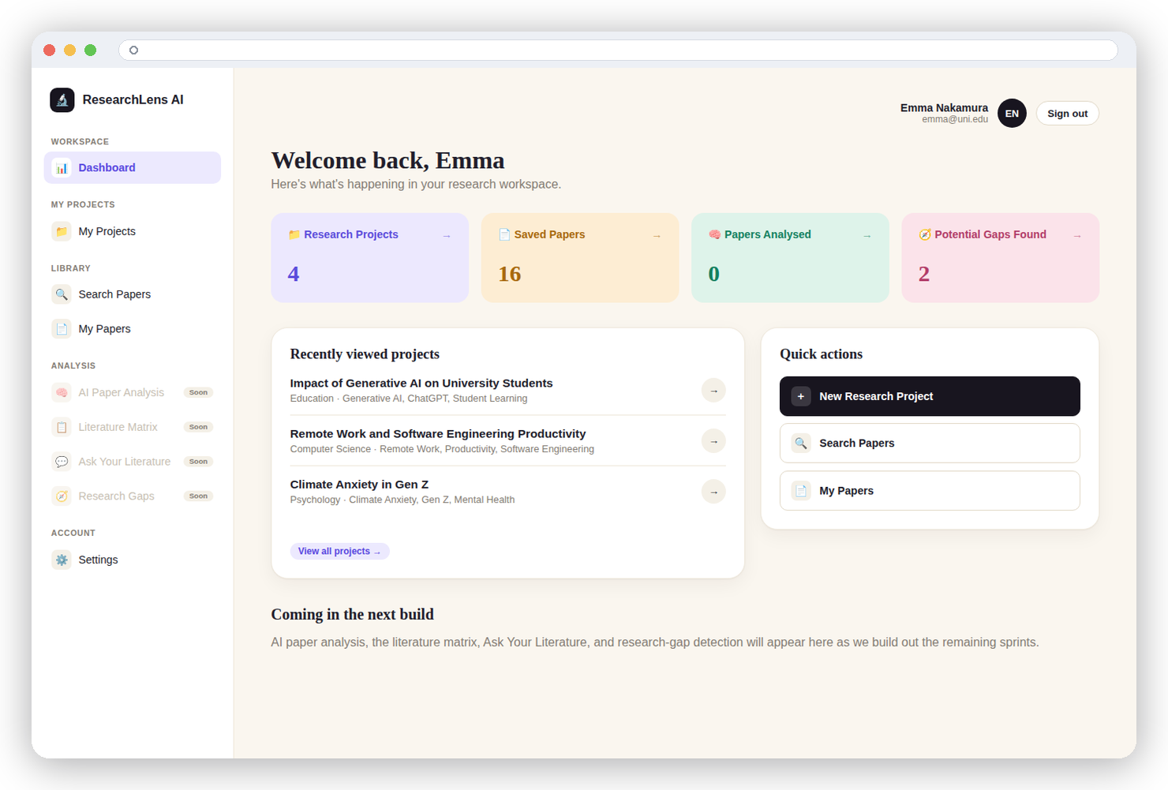

Implemented Features
Working prototype — redesigned dashboard, live in the app.
Redesigned dashboard with recently viewed projects
My Projects hub with full create / edit / delete
Combined OpenAlex + Semantic Scholar search
Year-range filters and newest / oldest sorting
Paginated results, 10 papers per page
New Settings page for name & password changes
Self-service account deletion, with full data cleanup
Fixed a critical session bug affecting every project view
Live screenshot — redesigned dashboard
ResearchLens AI · Sprint 2 Update
3 / 6
Notes:
Feature checklist alongside a real screenshot of the redesigned dashboard, not a mockup.

Slide 4






How Multi-Source Search Works
One query now fans out to two academic APIs and returns a single merged, de-duplicated, paginated list.
1
2
3
4
5
User Query
Semantic Scholar
+ OpenAlex
Merge &
De-dupe
Filter &
Sort
Paginated
Results
keywords
parallel fetch
by DOI / title
year, relevance
10 per page
Architecture Note
The Project Plan originally scoped ResearchLens AI as a Streamlit application. The team pivoted to a Flask + Jinja2 + SQLAlchemy architecture this sprint for finer control over multi-page navigation, custom UI, and session-based auth — enabling the redesign and CRUD features shown in this deck.
ResearchLens AI · Sprint 2 Update
4 / 6
Notes:
Search flow: query fans out to both APIs in parallel, results are merged and de-duplicated by DOI/title, then filtered, sorted, and paginated. Also notes the Streamlit-to-Flask architecture pivot.

Slide 5
Sprint 2 Key Achievements
Measurable progress since the Sprint 1 prototype review.
2
100%
1
Paper sources merged
into one search
CRUD coverage for
research projects
Critical session bug
fixed app-wide
What shipped
Fixed the DetachedInstanceError crash that hit every “view project” click
Shipped a full design system (Fraunces + Inter, warm palette) across 10+ templates
Built a My Projects hub with create, edit, and delete flows
Added year-range filters, newest/oldest sorting, and pagination to search
Built Settings with password changes and secure account deletion
Moved account info and sign-out into a persistent top bar
ResearchLens AI · Sprint 2 Update
5 / 6
Notes:
Key achievements: two sources merged, full CRUD, the DetachedInstanceError fix, the redesign, settings with password changes and account deletion, and search filters/pagination.

Slide 6
Sprint 2 Completed vs. Sprint 3 Focus
Next up: AI-powered paper analysis, per the original project roadmap.
Sprint 2 — Completed
Sprint 3 — AI Paper Analysis
Multi-source search (OpenAlex + Semantic Scholar)
OpenAI integration for paper summarisation
Year filters, sorting, and pagination
Automatic key-point / finding extraction
My Projects — full CRUD
Literature matrix — cross-paper synthesis view
Settings — profile, password & account deletion
Refined PDF upload & text extraction
Complete visual redesign
Research gap detection improvements
Session bug (DetachedInstanceError) resolved
User testing on the redesigned UI
ResearchLens AI · Sprint 2 Update
6 / 6
Notes:
Sprint 2 completed items on the left; Sprint 3 focus on AI paper analysis (OpenAI summarisation, extraction, literature matrix) on the right, per the original project plan roadmap.

