Slide 1

ResearchLens AI
SPRINT 3 OF 5
Sprint 3 Progress Update
OpenAI-powered paper summaries, relevance analysis, and a multi-note system for saved papers
OpenAI Integration
AI Summaries
Relevance Analysis
Multi-Note System
Team ResearchLens · Capstone Project · Sep 2026
Notes:
Sprint 3 update deck (condensed 4-slide version), formatted to match the Sprint 1 and Sprint 2 decks. Covers the four Sprint 3 roadmap items: OpenAI integration, AI-generated paper summaries, relevance analysis, and the new multi-note system - scoped strictly to Sprint 3 of the 5-sprint roadmap.

Slide 2




Sprint 3 Core Objectives
Per the project roadmap's Sprint 3 scope: OpenAI integration, paper summarisation, relevance analysis, and user notes.
OpenAI API Integration
AI-Powered Summaries
OpenAI wired in through a dedicated service layer (openai_service.py), following the same pattern already used for search and authentication.
A structured, 300-500 word OpenAI-generated summary for any saved paper, drawn from its abstract, extracted PDF text, or open-access full text.
Relevance Analysis
Multi-Note System
An AI assessment of how well a saved paper answers the project's own research question - not a generic summary, but a project-specific judgement.
Saved papers now hold any number of titled notes instead of one free-text field, each addable, editable, and deletable on its own.
ResearchLens AI · Sprint 3 Update
2 / 4
Notes:
Four core objectives for Sprint 3, each mapped 1:1 to a roadmap line item: OpenAI API integration, AI-generated paper summarisation, relevance analysis, and the new multi-note system (user notes). PDF upload, the fifth Sprint 3 roadmap item, is omitted here since it actually shipped early in Sprint 2.

Slide 3

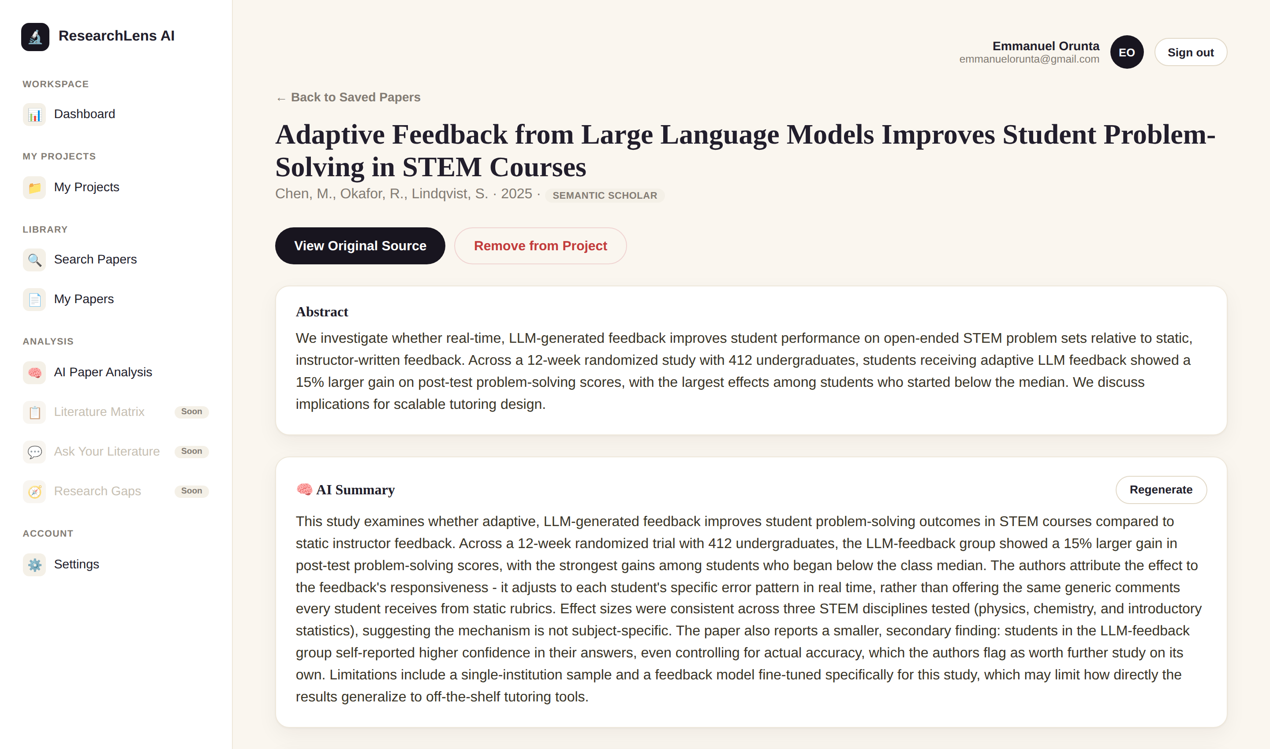
Implemented Features
Working prototype - screenshot taken directly from the running app.
OpenAI integration via a dedicated service layer (openai_service.py)
AI Summary: a structured, 300-500 word summary for any saved paper
Relevance Analysis scoped to each project's own research question
New per-paper detail page: abstract, AI Summary, relevance, notes
"AI Paper Analysis" hub page across every saved paper
Multi-note system replacing the old single free-text notes field
Legacy single-note data automatically migrated, once, with no loss
Real screenshot - AI Summary on a saved paper
ResearchLens AI · Sprint 3 Update
3 / 4
Notes:
Feature checklist alongside a real screenshot of the per-paper detail page, not a mockup - shows the AI Summary card as rendered by the actual template and stylesheet. Scoped to the four Sprint 3 roadmap items: OpenAI integration, summarisation, relevance analysis, and notes.

Slide 4
Sprint 3 Key Achievements
Measurable progress since the Sprint 2 prototype review - Sprint 3 scope, complete.
300-500
2
100%
Words per structured AI-generated summary
Independent AI analyses per saved paper
Of existing note data auto-migrated, zero loss
What shipped
Structured, longer AI Summary format (up from a one-line blurb)
Relevance Analysis grounded in each project's own research question
New "AI Paper Analysis" hub page across every saved paper
Multi-note system: unlimited titled notes, add / edit / delete
Legacy single-note field migrated to the new system automatically
All four Sprint 3 roadmap items delivered end-to-end
ResearchLens AI · Sprint 3 Update
4 / 4
Notes:
Key achievements: the structured 300-500 word summary format, two independent AI analyses per paper, the new AI Paper Analysis hub, the multi-note system, and the automatic legacy-notes migration. This closes out all four Sprint 3 roadmap items; Sprint 4 (agentic RAG) is out of scope for this deck.

