Slide 1
RESEARCHLENS AI
Sprint 5
Integration, Testing & Final Prototype
Demo Mode · Automated Testing · Human Testing
Emmanuel Orunta
Capstone Project — Flask / SQLAlchemy / OpenAI
Notes:
Title slide. Sprint 5 doesn't add new features - it makes everything already built (Sprints 1-4) demo-ready, verified, and honest about its own limits: a prepared demo account, automated checks, and real human testing.

Slide 2
WHERE SPRINT 5 PICKS UP
From a built app to a demo-ready, tested prototype
Sprints 1–4 built the whole app — accounts, search, and four AI features. Sprint 5 adds no new features; it makes sure everything already built actually works, is easy to show live, and is honest about its own limits.
Make the live demo bulletproof
A ready-to-present account with everything pre-filled, so the demo never depends on WiFi or a live AI call succeeding at the wrong moment.
1
Demo Mode
Catch problems automatically, every time
Dozens of checks that run in seconds and verify login, search, and every AI feature's safety behavior.
2
Automated Testing
Catch what only a person can catch
Real people clicking through the app, and real AI answers checked against the real papers they're about.
3
Human Testing
2
Notes:
Recap + objectives combined: names what Sprint 5 is actually for (readiness, not new features), then previews the three pillars that deliver it.

Slide 3
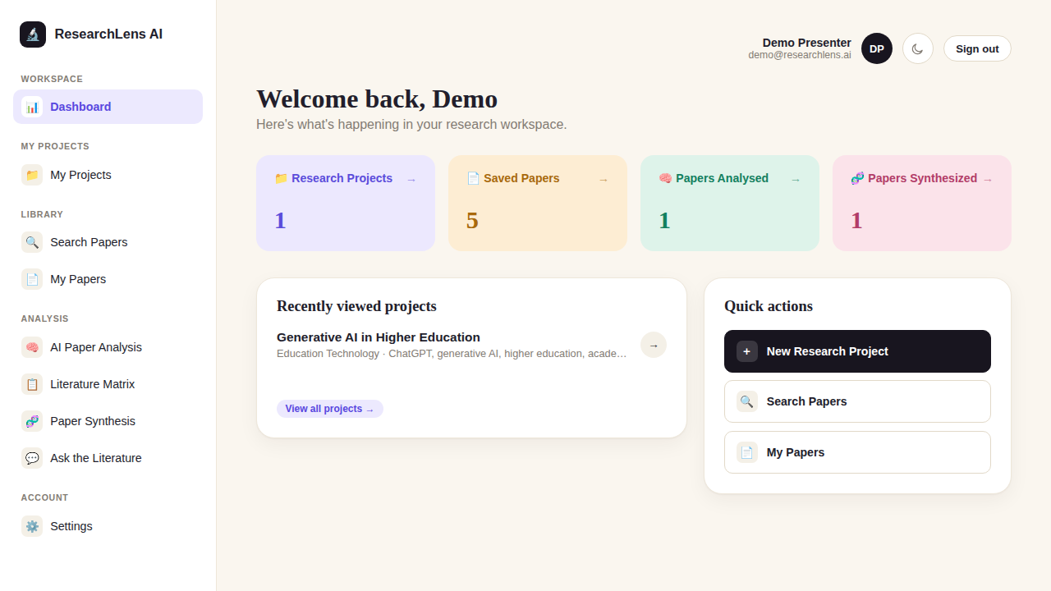
READINESS 1 OF 3
Demo Mode
A ready-to-present account, so the live demo never depends on luck
Before Sprint 5, a live demo meant hoping the room's WiFi held up and a real OpenAI call succeeded at exactly the right moment. Now, one command fills a real account with a real project, five papers, and every AI feature's result already generated — the actual screen a judge would see, shown here.
How it works
1
One command sets the whole stage
Running a single script creates a login, a project, and realistic results for every feature — instantly.
2
Nothing on the core path needs the internet
Every AI Summary, comparison, and chat answer shown is already saved — no live call happens during the walkthrough.
3
Reset it any time, right before presenting
Run the same command again the morning of the demo and it's back to this exact, known-good state.
3
Notes:
This is a real screenshot of the actual seeded demo account - Demo Presenter, 1 project, 5 saved papers, 1 analysed, 1 synthesized.

Slide 4
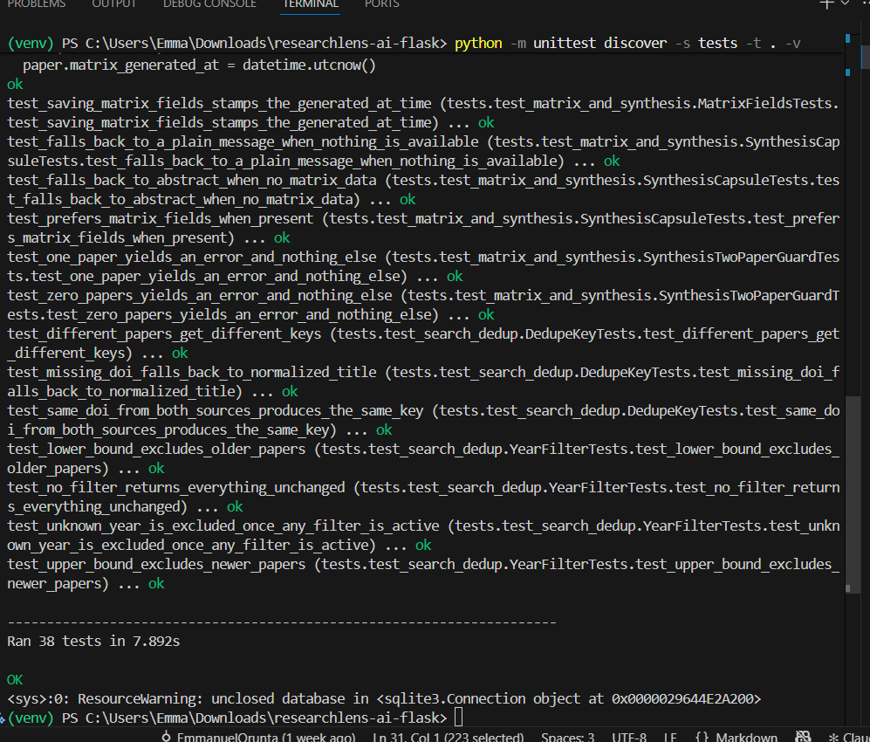
READINESS 2 OF 3
Automated Testing
Dozens of checks that run themselves, in seconds, every time
Instead of manually re-clicking through the app after every change, one command runs a whole battery of checks and reports back in under ten seconds. This is a real screenshot of this project's own test run — every line is a real, automatically-verified check.
How it works
1
Checks the things that must never break
Registration, login, logout, and making sure every private page is actually protected from a signed-out visitor.
2
Checks the AI features play it safe
Every AI feature is tested to fail with one clear message — never a crash — on bad input or a missing setup.
3
Re-runs after every change, for free
Any time the code changes, the whole suite runs again in seconds, catching a mistake before it ever reaches a real demo.
4
Notes:
Point out this is a real screenshot from the terminal, not a mockup - 38 tests, all passing, at the time this was captured.

Slide 5
READINESS 3 OF 3
Human Testing
Some things only a person can judge — so people did the judging
✓
Usability Testing
…
AI Accuracy Testing
DONE
IN PROGRESS
The team used the app hands-on throughout development — creating accounts, saving papers, and running every feature for real, across multiple real users.
The team is now checking real AI summaries, relevance ratings, and chat answers against the real papers they're about, using a structured checklist.
Why this step can't be automated away: a computer can confirm the app didn't crash, but only a person who's read the actual paper can say whether an AI summary is actually right.
5
Notes:
Usability: the team's own organic testing throughout the build counts as a real pass. AI Accuracy: the one genuinely open item - needs a person checking real AI answers against real papers.

Slide 6
CURRENT STATUS
Sprint 5 — where things stand
Every item from the project's own roadmap, tracked honestly — not everything is finished, and that's shown here too.
✓
Ready to present
✓
Verified automatically
…
Still in motion
Demo Mode — built, and tested against a WiFi-off walkthrough
Authentication — tested, passing
Academic search — tested, passing
Every AI feature's safety behavior — tested, passing
Usability testing — done, by the team itself
AI accuracy spot-check — underway now
Bug fixing — ongoing, as issues turn up
Thank you — questions welcome.
6
Notes:
Closing slide: an honest status report, not a polished 'everything's done' claim - the middle column (automated) and the left column (demo mode) are fully verified; the right column is real, ongoing work.

