Slide 1
RESEARCHLENS AI
Sprint 4
Research Intelligence
Literature Matrix · Paper Synthesis · Ask the Literature
Emmanuel Orunta
Capstone Project — Flask / SQLAlchemy / OpenAI
Notes:
Title slide. Sprint 4 is where the app moved from analysing one paper at a time (Sprint 3) to reasoning across a whole saved library at once: a structured comparison matrix, a multi-paper synthesis, and a grounded Q&A chat.

Slide 2
WHERE SPRINT 4 PICKS UP
From single-paper tools to a research workspace
1
2
3
Sprint 1 — Foundation
Sprint 2 — Discovery
Sprint 3 — AI Analysis
Accounts, sessions, and research projects: the container everything else saved into.
Search Semantic Scholar + OpenAlex, save papers or upload PDFs, into a project's library.
AI Summary and Relevance Analysis — but strictly ONE paper at a time, streamed live.
The gap Sprint 4 closes:
Every AI feature so far looked at exactly one paper in isolation. A real literature review needs to compare papers against each other, synthesize them into one narrative, and answer questions that may span the whole saved library — none of which a single-paper tool can do.
2
Notes:
Quick recap so the grader has context, then names the specific gap (single-paper only) that Sprint 4 exists to close.

Slide 3
SPRINT 4 OBJECTIVES
Three ways to reason across a whole library
1
Compare papers side by side
A structured, exportable table — Methodology / Sample / Findings / Limitations — across every paper saved to a project.
Literature Matrix
2
Synthesize them into one narrative
Pick any set of saved papers and get one flowing, citation-ready synthesis across them, not one summary per paper.
Paper Synthesis
3
Ask open-ended questions of the library
A persistent, ChatGPT-style conversation grounded in every paper saved to the project, with edit-and-resend.
Ask the Literature
3
Notes:
The three objectives map 1:1 onto the three shipped features, previewed here before the deep-dive slides.

Slide 4
FEATURE 1 OF 3
Literature Matrix
A structured, side-by-side comparison table
What it does
Why this shape
One row per saved paper, four fixed columns: Methodology, Sample, Findings, Limitations.
A literature review always needs this exact comparison — methodology, sample, findings, limitations, side by side. Fixing the four columns (instead of free-form AI output) makes every row directly comparable, and keeps AI extraction and manual correction interchangeable.
Each row can be filled in with one click (“Extract with AI”) — or typed by hand at any time, since the two aren't mutually exclusive.
Exportable as a formatted Excel workbook, PDF, or Word document — all three built from the exact same data.
The four fields live on the Paper record itself, so they're shared the moment the same paper appears in a second project.
4
Notes:
Sets up the matrix conceptually before the next slide shows the real screenshot and the extraction mechanics.

Slide 5
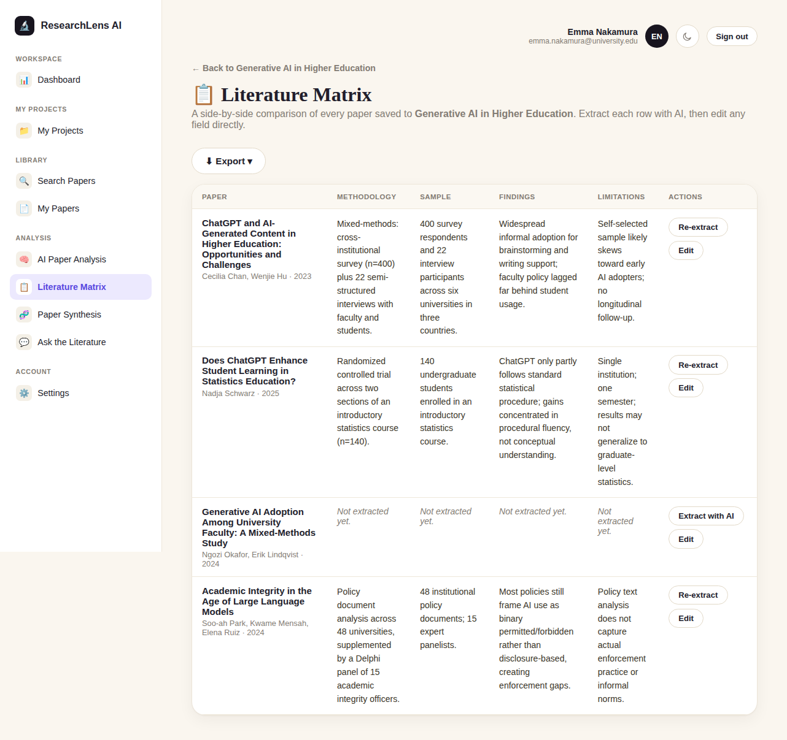
FEATURE 1 OF 3
How the matrix is built
1
AI extraction
stream_extract_matrix_fields() asks OpenAI for exactly four plain-prose paragraphs, in a fixed order, separated by blank lines — split client-side into the table's four cells.
2
Manual edit, always available
edit_matrix_fields() writes the same four columns directly. Extraction and hand-editing use the same save path, so neither is treated as more authoritative.
3
One export pipeline, three formats
export_service.py's _row_for_paper() is the single source of truth every Excel (openpyxl), PDF (reportlab) and Word (python-docx) export reads from.
Rows left un-extracted (e.g. the bottom two in this screenshot) show “Not extracted yet” rather than blank cells.
5
Notes:
Walk through the screenshot: point out the populated rows vs. the two 'Not extracted yet' rows, then the Export dropdown.

Slide 6
FEATURE 2 OF 3
Paper Synthesis
One flowing AI narrative across several papers at once
What it does
Why a 2-paper minimum
Select any two or more papers saved to a project; the AI writes 5–8 paragraphs of connected academic prose across them — not a row per paper, a single “Synthesis Review” section, the way a literature review's own synthesis chapter reads.
stream_synthesize_papers() refuses outright below two papers: “a synthesis of one paper isn't meaningful.” Rather than silently degrading into something that just reads like a single-paper summary, the feature is explicit about the one precondition that actually defines it.
Opens on the shared theme or gap connecting the selected papers.
Compares specific papers by name — where they agree, where their methods or findings diverge.
Names what the papers collectively rely on, and what limitations recur across more than one.
Critiques the body of work as a whole, then closes on its collective contribution.
6
Notes:
Emphasize the explicit guard against 1-paper 'synthesis' — a deliberate design choice, good talking point if asked about edge cases.

Slide 7
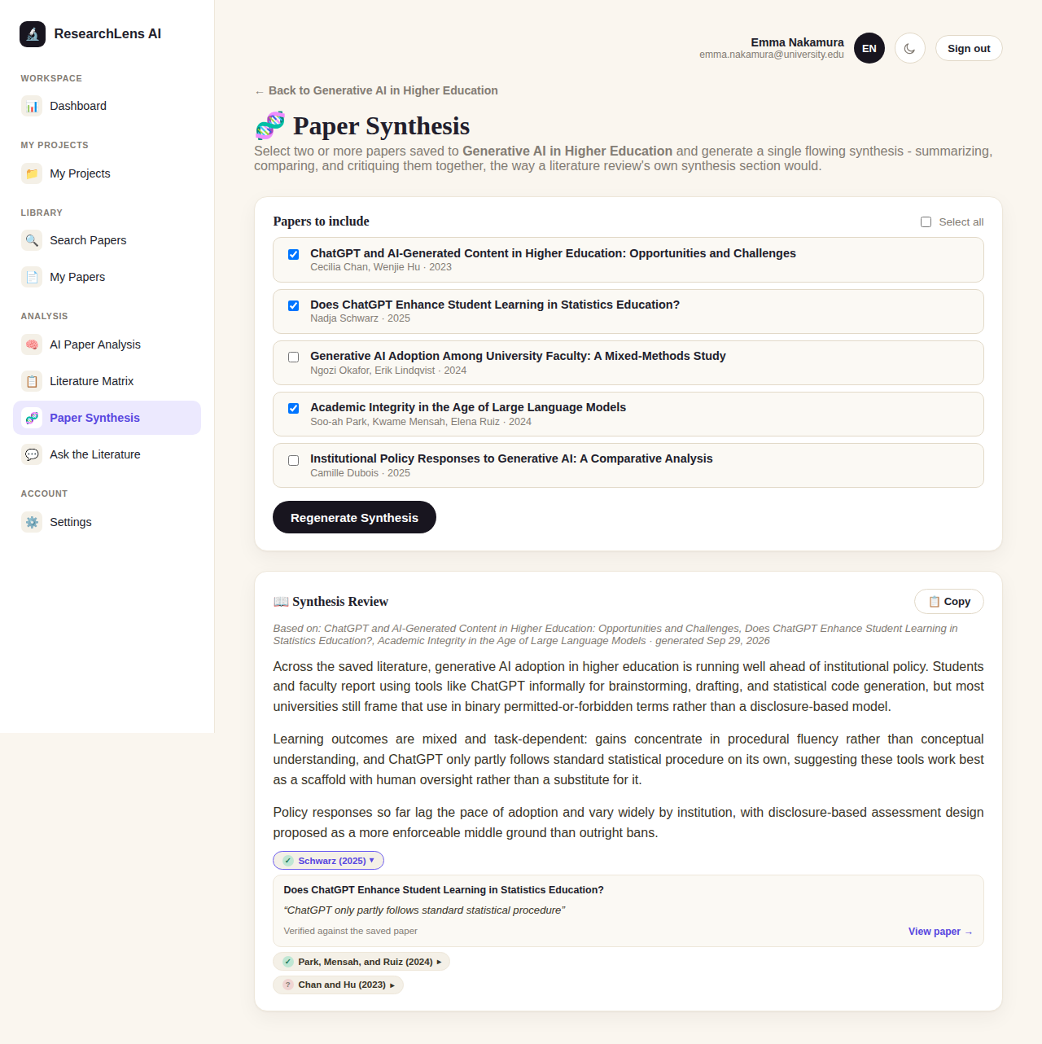
FEATURE 2 OF 3
How a synthesis gets generated
1
Capsule per paper
build_synthesis_capsule() prefers the Matrix's four distilled fields; falls back to the abstract, then a slice of extracted PDF text — whatever's richest for that paper.
2
Streamed like a chat reply
synthesis_stream() sends the checked paper_ids as form data, re-validates them server-side, then streams NDJSON events the page renders live, token by token.
3
Saved with its own sources
set_project_synthesis() stores the text plus the exact paper_ids it was generated from, so “Based on: …” stays accurate after a reload.
Server-side re-validation means a tampered form (an id from another project) can't smuggle someone else's paper into the prompt.
7
Notes:
The checkbox selection, the capsule-building fallback chain, and the re-validation step are the three things worth narrating here.

Slide 8
FEATURE 3 OF 3
Ask the Literature
A running, ChatGPT-style conversation grounded in a project's saved papers
What it does
Why whole-library, not hand-picked
Answers are grounded in EVERY paper currently saved to the project — the whole library, not a hand-picked subset like Synthesis.
Each question and answer is stored as its own row, building a real, persisting conversation history.
A question can be edited after the fact — “Edit + Resend” — which discards its old answer and everything asked afterwards.
“Clear conversation” starts a fresh thread without deleting the project itself.
A question can be about anything in the project — forcing a paper selection first would mean re-selecting before every follow-up. Synthesis is deliberate and curated; this is meant to feel like asking a colleague who has read everything in the room.
8
Notes:
Contrast with Synthesis explicitly: curated subset vs. whole library — that's the design distinction most likely to come up in questions.

Slide 9
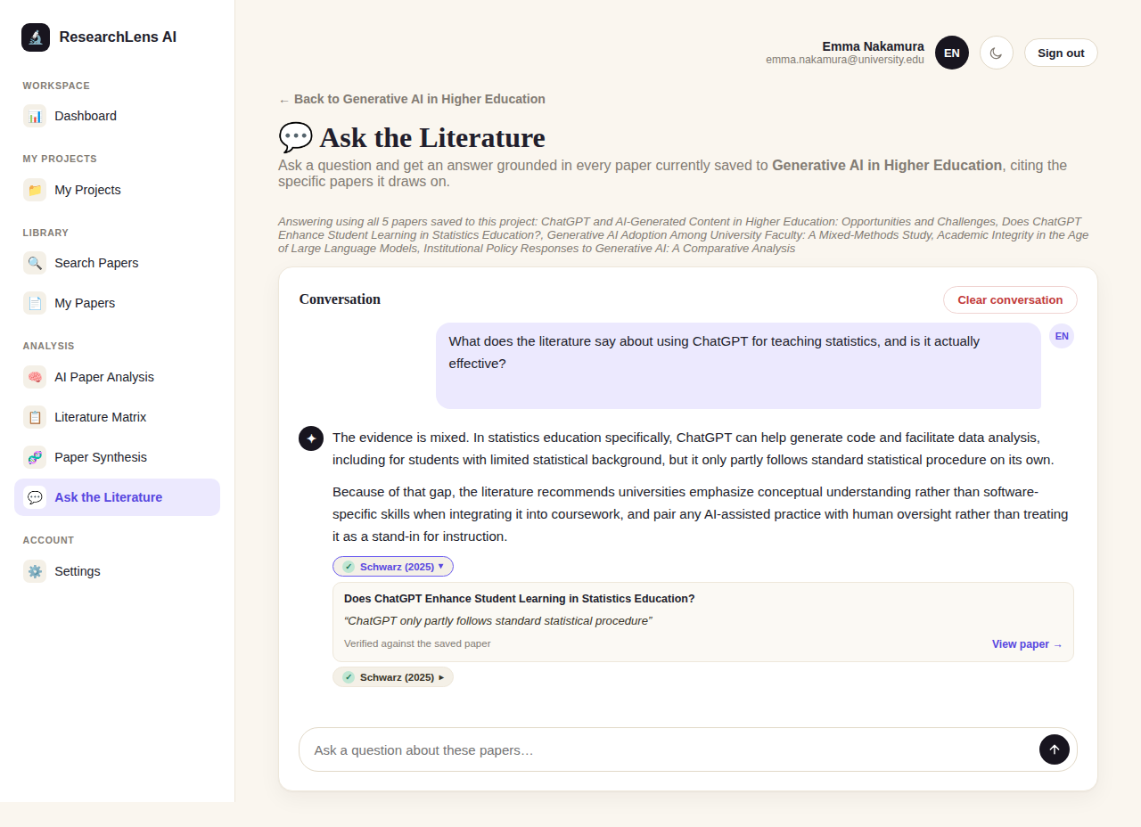
FEATURE 3 OF 3
How one turn of the conversation works
1
History is capped, not unbounded
get_recent_history_for_prompt() resends only the last 8 turns to the model — full history still lives in the database and on the page.
2
Each prompt piece gets its own budget
Papers block / history / question are each capped in characters BEFORE assembly, so the question — placed last — can never be sliced off by truncation.
3
Edit + Resend truncates the thread
edit_and_truncate_message() deletes everything after the edited question; a single linear thread, never a branching one.
9
Notes:
The truncation-order detail (question survives at the end) is a good 'why' answer if asked how prompt construction was engineered.

Slide 10
UNDER THE HOOD
Tech stack & architecture
AI
Browser (fetch, streaming UI)
OpenAI Responses API, streamed token-by-token (client.responses.stream)
Database
routes/papers_routes.py (controllers)
New SQLAlchemy columns/table added via the existing lightweight _ADDED_COLUMNS migration helper — no new framework introduced
Export
openpyxl (Excel) · reportlab (PDF) · python-docx (Word), all three from one shared row-builder
services/ (paper_service, project_service, literature_chat_service, openai_service, export_service)
Frontend
Server-sent NDJSON consumed by one generic fetch()-based JS handler, reused by all three features
models/ (Paper.matrix_*, ResearchProject.synthesis_*, LiteratureChatMessage) → SQLite
10
Notes:
Same layered architecture as every earlier sprint — Sprint 4 adds new columns/tables and services, not a new architectural pattern.

Slide 11
THOUGHT PROCESS
Design decisions worth explaining
Matrix fields live on Paper, not per-project
Synthesis hard-requires 2+ papers
A paper's methodology doesn't change depending on which project it's saved to — only which papers appear in the table is project-scoped.
A “synthesis” of one paper is just a summary with a different name. An explicit guard beats a result that quietly reads wrong.
One linear chat thread, not branching
Per-piece prompt budgets, capped before assembly
An edited question's old answer is now stale, and anything asked after it may depend on that answer — so the only consistent option is to truncate forward.
The shared truncation helper cuts from the end — exactly backwards when the newest question must survive intact at the very end of the prompt.
11
Notes:
These four are the 'why', not the 'what' — the slide most likely to be probed in a defense/Q&A setting.

Slide 12
CHALLENGES & SOLUTIONS
What was actually hard about this sprint
1
Getting AI output I could reliably parse
Tightly specified system prompts (“exactly N paragraphs, blank-line separated, no markdown”) instead of hoping the model's prose happened to split cleanly.
2
Three export formats that must never drift apart
One _row_for_paper() helper feeds the Excel, PDF, and Word builders — a single source of truth instead of three independent column lists.
3
Conversation cost/latency growing unbounded
get_recent_history_for_prompt() resends only the last 8 turns to the model, while the full thread still lives in the database and the page.
12
Notes:
Each challenge maps directly to a design decision from the previous slide — use them together if time is short.

Slide 13
WHAT'S NEXT
Sprint 4 recap
Literature Matrix, Paper Synthesis, and Ask the Literature turn a saved library of papers into something that can be compared, synthesized, and questioned — not just read one paper at a time.
Sprint 5 (already underway): evidence tracking — citing the exact sentence every AI claim came from.
A minimal tool-using OpenAI Agent, beyond today's prompt-and-stream pattern.
A broader usability and AI-accuracy testing pass.
Thank you — questions welcome.
Notes:
Close by naming Sprint 5 explicitly so the grader sees this was part of a continuing plan, not a one-off.

