Slide 1
RESEARCHLENS AI
Final Project Presentation
Prototype Demonstration & Critical Reflection
Requirements · Prototype · Testing · Reflection
ITEC631: Information Technology Masters Project, Part B
Assessment 2 — Final Project Presentation and Prototype Demonstration · Semester 2, 2026
[ Team name / member names — replace before presenting ]
Notes:
Title slide. State the team name and every presenting member's name out loud here. Keep this slide on screen only a few seconds - the talking starts with the next slide.

Slide 2
WHERE THIS PROJECT STARTED
A literature review tool that shows its work
Most AI research tools ask you to simply trust a generated summary. ResearchLens AI doesn't - every AI claim is checked against the real paper before it's shown, turning “trust the AI” into “check the AI.”
The problem
AI research tools can sound confident while being wrong - a real risk when the output is meant to support serious academic work.
1
Untraceable AI summaries
Who it's for
Anyone working through a stack of academic papers who needs to search, compare, and synthesize them quickly, without losing rigor.
2
Students & researchers doing a literature review
Why it matters
Every AI-made claim is checked against the paper's own saved text before it's shown - a genuine, working contribution to responsible AI use in research.
3
Trustworthy AI, not just fast AI
2
Notes:
Final approved scope, say out loud: full account system; dual-source academic search with direct PDF upload; AI Summary; Literature Matrix; Paper Synthesis; and Ask the Literature chat - every one of the last four built on the same Evidence Tracking mechanism. Keep this to under a minute; the detail comes on the next slide.

Slide 3
FROM APPROVED PLAN TO DELIVERED SYSTEM
What we committed to, and what changed
Requirements coverage
System architecture
✓
Accounts, login & session security
Browser
✓
Dual-source search (Semantic Scholar + OpenAlex) & PDF upload
The pages a user actually sees and clicks
↓
✓
AI Summary, with evidence-checked citations
Routes
Literature Matrix (AI-extracted or manual, exportable)
Flask blueprints: auth / main / papers / settings
✓
↓
✓
Paper Synthesis across multiple papers
Services
Business logic — the only layer that touches the database
✓
Ask the Literature — grounded Q&A chat
↓
Models + SQLite
!
One documented scope change: the roadmap's exploratory, tool-using OpenAI Agent was dropped - a deliberate trade-off to fully finish and test the six items above, not an oversight.
One table per thing: users, projects, papers, chat
AI features stream token-by-token from OpenAI straight to the page; evidence_service.py checks every citation against the real paper text before it's shown.
3
Notes:
Every query is also filtered by the requesting user's own id, not just the record's id - that's what stops one account from viewing or guessing into another account's data. Mention this if asked about security.

Slide 4
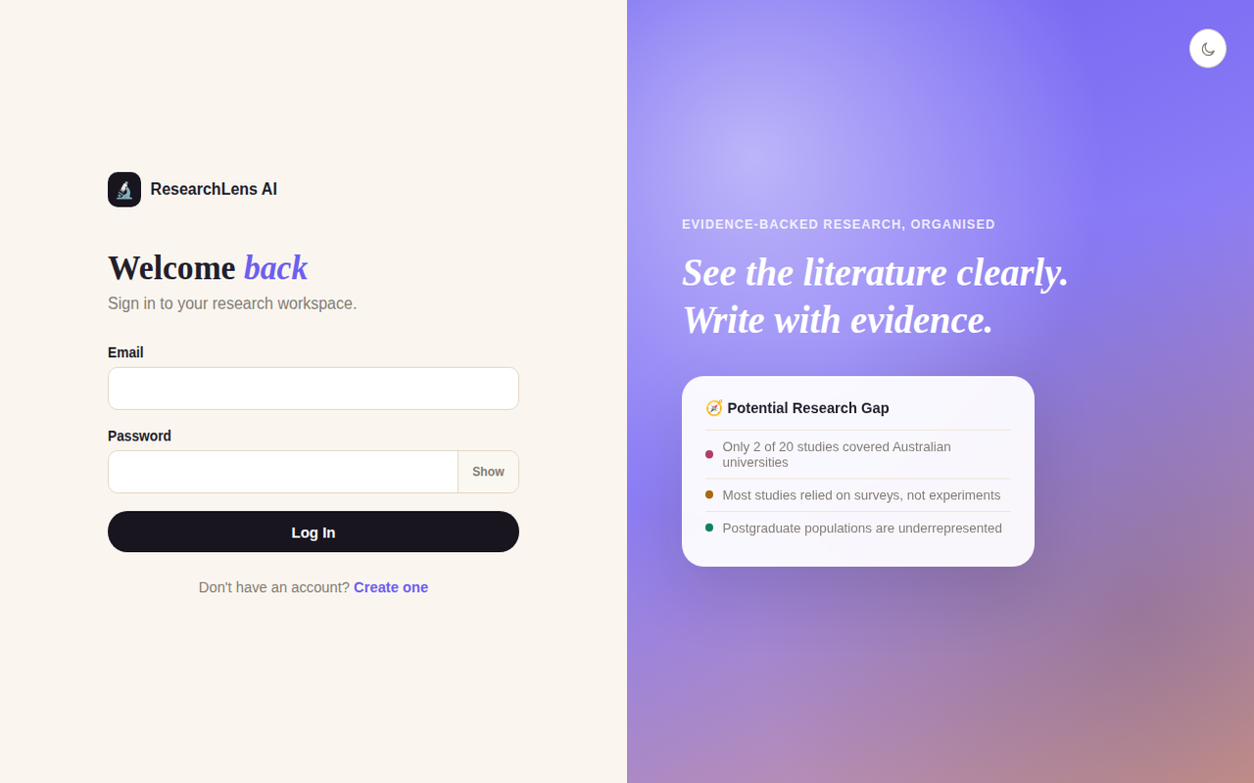
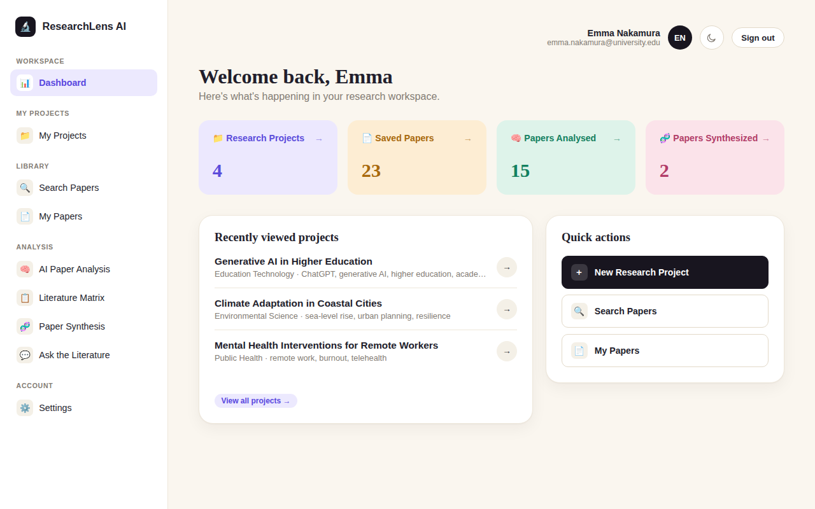
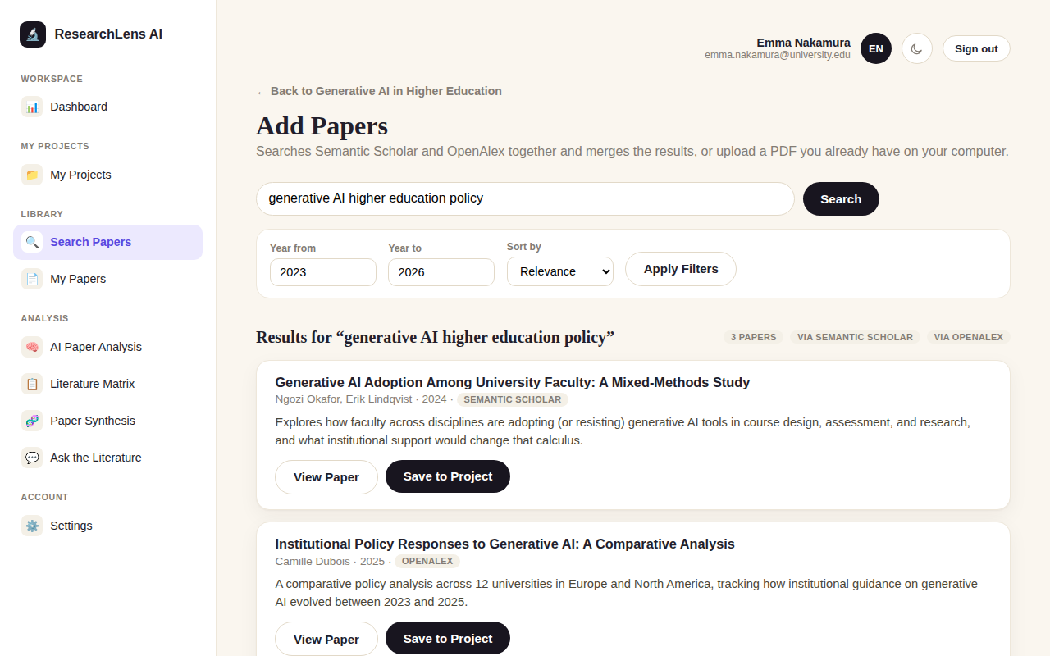
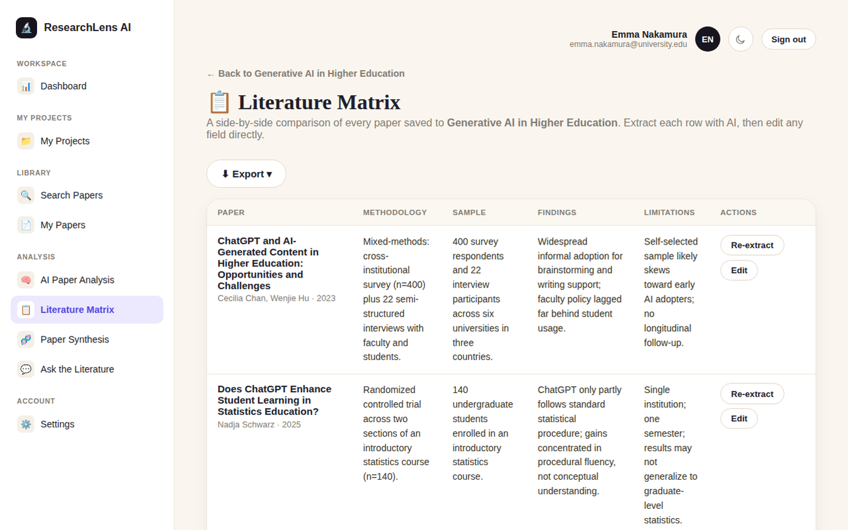
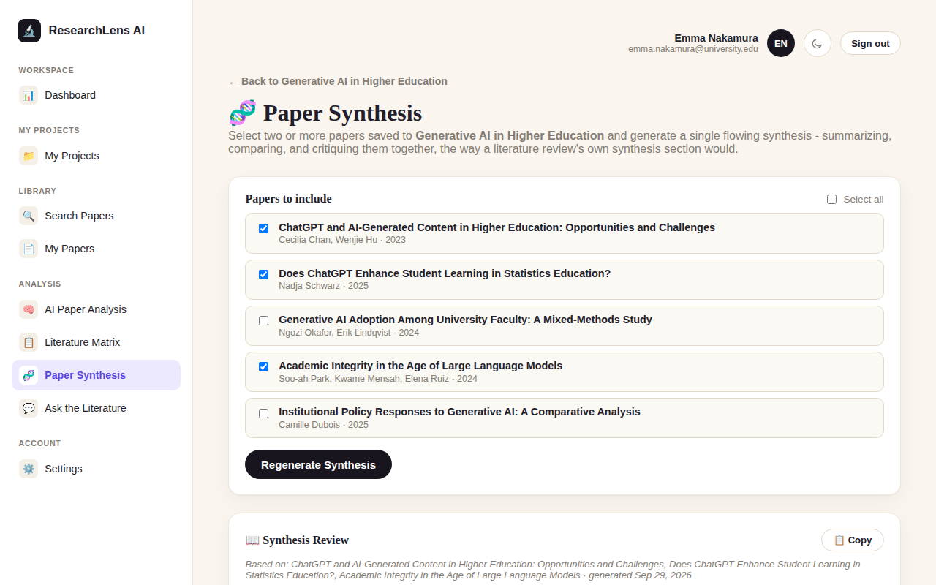
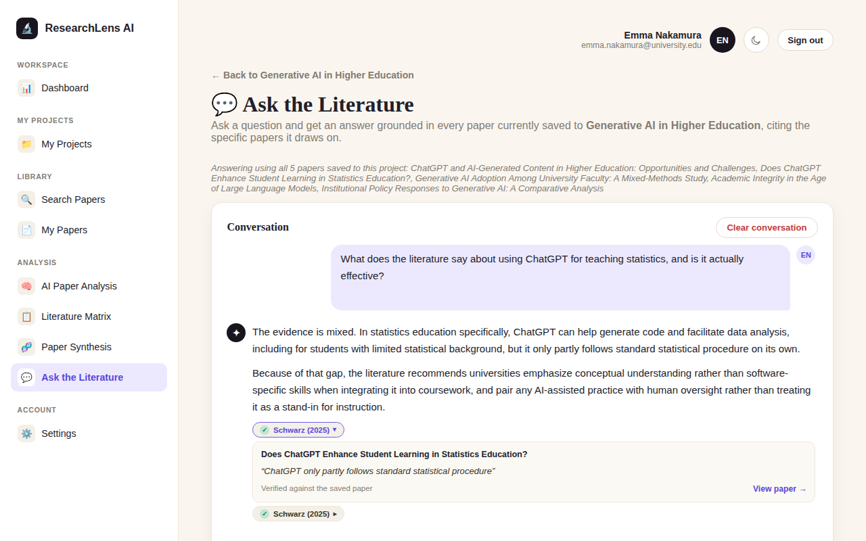
LIVE DEMONSTRATION — PART 1 OF 2
We'll now show this running, end to end
Six real screens from the working app — login through to a cited AI answer
1. Login & accounts
2. Dashboard
3. Search two sources at once
4. Literature Matrix
5. Paper Synthesis
6. Ask the Literature
4
Notes:
Cue slide only - switch to the live app here and walk the real path: login, dashboard, search & save a paper, open the matrix, run a synthesis, ask a question in the chat. These six images are real screens from the working app, not mockups - they're the backup if live demo isn't possible for any reason.

Slide 5
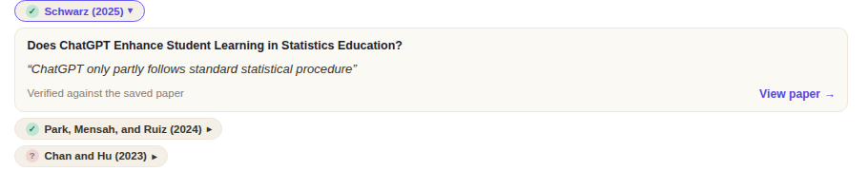
LIVE DEMONSTRATION — PART 2 OF 2
Built to succeed — and to fail safely
The rubric asks for a successful case AND a boundary case. Here's both, from the real system.
✓
Honest evidence, both ways
!
A graceful failure, not a crash
⚠ AI Summary unavailable
“Add a free OPENAI_API_KEY in .env to use AI analysis - see .env.example.”
A real Paper Synthesis answer. One citation is verified against the saved paper (green) and one isn't (amber) — both are shown, never hidden, so the reader always knows what to double-check.
This is the app's real, exact error message when AI isn't configured — tested automatically for every one of the five AI features, so the worst-case failure in front of an audience is a plain sentence, not a stack trace or a frozen page.
TESTED ACROSS ALL FIVE AI FEATURES
Summary
Relevance
Matrix
Synthesis
Chat
5
Notes:
Both of these are automatically tested, not just manually checked once - see the Testing & Quality slide next. If time allows, trigger the real missing-key message live by temporarily renaming OPENAI_API_KEY in .env.

Slide 6
HOW IT'S ACTUALLY BUILT
Technical implementation
BACKEND
DATABASE
AI
LITERATURE SEARCH
Python, Flask (4 blueprints)
SQLite via SQLAlchemy ORM
OpenAI Responses API, streamed
Semantic Scholar + OpenAlex APIs
AUTH
DOCUMENT EXPORT
PDF HANDLING
FRONTEND
bcrypt hashing + signed sessions
openpyxl, reportlab, python-docx
PyMuPDF text extraction
Jinja2 + vanilla JS + hand-written CSS
Three decisions we're proud of
1
One shared Evidence Tracking service
Built once in evidence_service.py and reused by all three AI-answering features, instead of three separate, harder-to-trust copies of the same logic.
2
Token-by-token streaming
AI answers appear live, the same way ChatGPT's own answers do, instead of a long silent wait before anything shows.
3
Per-user filtering on every query
Every project/paper lookup filters by the requesting user's own id, not just the record's id — closing a common access-control gap.
6
Notes:
If asked a technical question: the streaming client is shared JS code in static/js/app.js, reused by AI Summary, Relevance Analysis, Matrix extraction, and Paper Synthesis.

Slide 7
PROVING IT ACTUALLY WORKS
Testing & quality assurance
38+
What's automatically covered
✓
Registration, login, logout & session protection
automated tests, passing — in under 10 seconds, re-run after every code change, for free.
✓
Search de-duplication across two sources & year filtering
✓
Evidence Tracking — is a cited quote actually real?
✓
Literature Matrix saving & Paper Synthesis fallback logic
✓
Every AI feature's behavior on bad input
Security, privacy & reliability evidence
• Passwords hashed with bcrypt — never stored in plain text
✓
Every AI feature's behavior with no API key configured
• One generic login error — can't be used to find out which emails have accounts
Still needs a human: whether a live search is relevant, and whether a live AI answer is factually correct. Covered by a structured manual checklist, in progress — not something a computer can judge alone.
…
• Every query filtered by the signed-in user's own id
• No API keys, secrets, or personal data committed to the repository
7
Notes:
Mature-judgement framing for Q&A: we didn't claim to test everything - we automated everything that's provable without a live network call, and named the rest honestly as a manual, human-judgement pass.

Slide 8
DOES IT ACTUALLY WORK FOR A PERSON?
User interface evaluation
✓
Usability Testing
…
AI Accuracy Spot-Check
DONE
IN PROGRESS
The team used the app hands-on throughout development — creating accounts, saving papers, and running every feature for real, across multiple real users.
The team is checking real AI summaries, relevance ratings, and chat answers against the real papers they're about, using a structured checklist.
i
Accessibility review: not yet formally completed.
We're naming this honestly rather than glossing over it — a structured accessibility pass (keyboard navigation, screen-reader labels, color contrast) is listed as a concrete next step, see Limitations & Next Steps.
8
Notes:
This slide is deliberately honest about a gap - naming a real limitation clearly is stronger for the HD band than claiming full coverage we don't actually have evidence for.

Slide 9
WHAT WE LEARNED GETTING HERE
Project journey & key decisions
Not just one AI demo bolted on — Summary, Matrix extraction, Synthesis, and Ask the Literature all share one evidence-checking mechanism.
1
ACHIEVEMENT
Four working AI features, each with verifiable citations
Rather than rush an under-tested feature into the final week, the team chose to fully finish and test what was already built — a documented, deliberate trade-off.
2
CHALLENGE
Deciding to drop the planned OpenAI Agent from scope
A free, ten-second automated suite caught regressions a manual click-through would likely have missed, and gave the team confidence to keep changing code quickly.
3
LESSON LEARNED
Testing pays for itself
9
Notes:
Be ready for a follow-up question on the Agent decision: the honest answer is the team prioritized shipping evidence tracking, synthesis, and chat solidly rather than bolting on an under-tested feature to tick a roadmap box.

Slide 10
MAPPING THE WORK TO PROFESSIONAL SKILL STANDARDS
SFIA skills developed
Skill area
Evidence from this project
Programming / software development
Built the Flask backend, service layer, and streaming AI integration end to end.
Systems design
Designed the routes → services → models architecture and the reusable Evidence Tracking service.
Requirements definition & management
Tracked the approved scope against delivery, including one documented, justified scope change.
Testing
Wrote and ran an automated suite covering authentication, search logic, and every AI feature's safety behavior.
Quality assurance / user evaluation
Ran usability testing and a structured AI-accuracy checklist, feeding findings back into the system.
Mapped to SFIA v8 skill areas — exact skill codes and individual evidence are detailed in the project thesis.
10
Notes:
Each team member should be ready to say, in their own words, which of these rows they personally contributed most to.

Slide 11
INDIVIDUAL CONTRIBUTION, SUBMITTED AS A GROUP
Who did what
A
B
C
[Team member name]
[Team member name]
[Team member name]
CONTRIBUTION
CONTRIBUTION
CONTRIBUTION
[Primary contribution — e.g. backend & AI integration]
[Primary contribution — e.g. testing & quality]
[Primary contribution — e.g. UI & usability testing]
EVIDENCE
EVIDENCE
EVIDENCE
[Evidence — e.g. commit history, sprint notes]
[Evidence — e.g. test files, bug log]
[Evidence — e.g. design notes, feedback]
Replace each card with a real team member's name and contribution before presenting — every member should be ready to explain their own part and the overall system.
11
Notes:
EDIT BEFORE PRESENTING: fill in real names, contributions, and evidence (commit history, sprint board, peer feedback) for every team member.

Slide 12
CURRENT STATUS
Limitations & what's next
Named honestly, not glossed over — a realistic picture of where the project stands.
…
Known limitations
→
Planned next steps
✓
Ready for the thesis
The exploratory OpenAI Agent is out of scope
AI-accuracy human spot-check still underway
No formal accessibility audit completed yet
Finish the AI-accuracy checklist across real papers
Run a structured accessibility pass
Revisit the Agent as a post-capstone extension
Architecture and design decisions documented
38+ test automated suite in place and passing
Defense notes written for every major feature
Thank you — questions welcome.
12
Notes:
Closing slide. Every member should be ready to field a question directed at them individually, per the assessment guide.

Slide 13
EXTERNAL SOURCES USED IN THIS PROJECT
References
[1] Pallets Projects, “Flask,” [Online]. Available: https://flask.palletsprojects.com/
[2] SQLAlchemy, “SQLAlchemy — The Python SQL Toolkit and ORM,” [Online]. Available: https://www.sqlalchemy.org/
[3] OpenAI, “OpenAI API Documentation — Responses API,” [Online]. Available: https://platform.openai.com/docs/
[4] Semantic Scholar, “Semantic Scholar Academic Graph API,” [Online]. Available: https://api.semanticscholar.org/
[5] OpenAlex, “OpenAlex API,” [Online]. Available: https://openalex.org/
[6] PyMuPDF, “PyMuPDF Documentation,” [Online]. Available: https://pymupdf.readthedocs.io/
[7] pyca, “bcrypt — Python bcrypt password hashing,” [Online]. Available: https://pypi.org/project/bcrypt/
IEEE referencing used throughout, per the ITEC631 assessment guide. Confirm access dates and formatting against the unit's citation guide before final submission.
13
Notes:
Add any further borrowed diagrams, images, or datasets here if used elsewhere in the deck, with an in-slide citation on the relevant slide too.

