Slide 1

ResearchLens AI
SPRINT 3 OF 5
Sprint 3 Progress Update
OpenAI-powered paper summaries, relevance analysis, and a multi-note system for saved papers
OpenAI Integration
AI Summaries
Relevance Analysis
Multi-Note System
Team ResearchLens · Capstone Project · Sep 2026
Notes:
Sprint 3 update deck (condensed 4-slide version), formatted to match the Sprint 1 and Sprint 2 decks. Covers the four Sprint 3 roadmap items: OpenAI integration, AI-generated paper summaries, relevance analysis, and the new multi-note system - scoped strictly to Sprint 3 of the 5-sprint roadmap.

Slide 2




Sprint 3 Core Objectives
Per the project roadmap's Sprint 3 scope: OpenAI integration, paper summarisation, relevance analysis, and user notes.
OpenAI API Integration
AI-Powered Summaries
OpenAI wired in through a dedicated service layer (openai_service.py), following the same pattern already used for search and authentication.
A structured, 300-500 word OpenAI-generated summary for any saved paper, drawn from its abstract, extracted PDF text, or open-access full text.
Relevance Analysis
Multi-Note System
An AI assessment of how well a saved paper answers the project's own research question - not a generic summary, but a project-specific judgement.
Saved papers now hold any number of titled notes instead of one free-text field, each addable, editable, and deletable on its own.
ResearchLens AI · Sprint 3 Update
2 / 4
Notes:
Four core objectives for Sprint 3, each mapped 1:1 to a roadmap line item: OpenAI API integration, AI-generated paper summarisation, relevance analysis, and the new multi-note system (user notes). PDF upload, the fifth Sprint 3 roadmap item, is omitted here since it actually shipped early in Sprint 2.

Slide 3

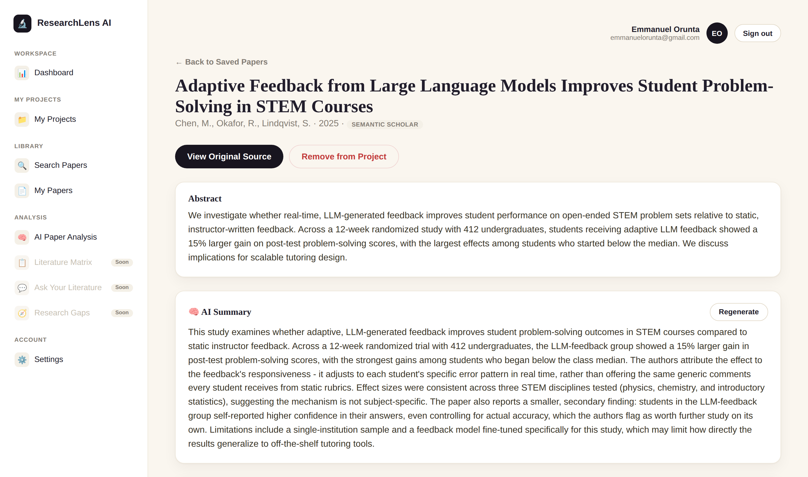
Implemented Features
Working prototype - screenshot taken directly from the running app.
OpenAI integration via a dedicated service layer (openai_service.py)
AI Summary: a structured, 300-500 word summary for any saved paper
Relevance Analysis scoped to each project's own research question
New per-paper detail page: abstract, AI Summary, relevance, notes
"AI Paper Analysis" hub page across every saved paper
Multi-note system replacing the old single free-text notes field
Legacy single-note data automatically migrated, once, with no loss
Real screenshot - AI Summary on a saved paper
ResearchLens AI · Sprint 3 Update
3 / 4
Notes:
Feature checklist alongside a real screenshot of the per-paper detail page, not a mockup - shows the AI Summary card as rendered by the actual template and stylesheet. Scoped to the four Sprint 3 roadmap items: OpenAI integration, summarisation, relevance analysis, and notes.

Slide 4



Coming in Sprint 4
Per the project roadmap's Sprint 4 scope - Research Intelligence: Agentic RAG, scoped only to the literature you've chosen to save, never the open web.
Evidence Tracking
Ask Your Literature
Every AI-generated insight will link back to the specific saved paper(s) it drew from, so output stays grounded in citable sources rather than a bare claim.
A question-answering feature grounded in, and cited to, the papers you've saved - retrieval scoped only to your own library, never the open web.
Paper Comparison
Started Early
A Minimal OpenAI Agent
Structured, side-by-side comparison across multiple saved papers.
The project's core agentic AI deliverable: a small, tool-using agent that plans and carries out a short multi-step task over your saved literature.
ResearchLens AI · Sprint 3 Update
4 / 4
Notes:
A forward look at Sprint 4 (Research Intelligence - Agentic RAG), mapped 1:1 to its four roadmap line items: evidence tracking, Ask Your Literature, structured paper comparison, and a minimal tool-using OpenAI Agent - the project's core agentic AI deliverable. Paper comparison is flagged 'Started Early' since the Literature Matrix (AI-extracted Methodology/Sample/Findings/Limitations across a project's saved papers, directly editable) is already built ahead of its Sprint 4 slot, the same way PDF upload shipped early in Sprint 2.

