Slide 1
Data Science UW
Methods for Data Analysis
Regression Part 2 – Uncertainty and Feature Selection
Lecture 6
Steve Elston

Slide 2
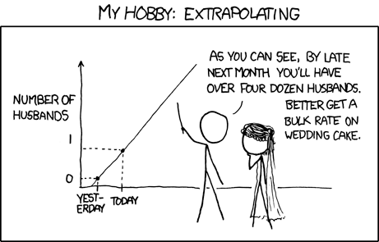

Slide 3
Topics
Review
Bootstrapping regression models
Linear Algebra overview
Decomposition Methods
SVD regression
Feature selection, stepwise regression and ANOVA

Slide 4
Review
Central Limit Theorem
Linear Regression
Example of presenting data science results
Bootstrap hypothesis testing

Slide 5
How good is a regression model
Uncertainty can be significant
Important to understand how good your model is
The predictions are never exact

Slide 6
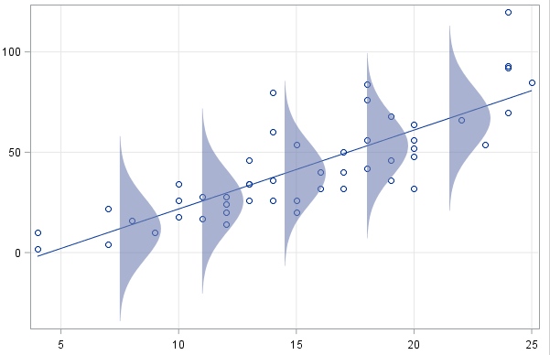

Uncertainty in Regression
Given a linear model with known constants:
Given a point that comes from that line, we can come up with a probability of observing that point.
$$y_{i}=mx_{i}+b+N(0,σ)$$

Slide 7
Regression Coefficients
Regression coefficients are not exact!
Uncertainty in regression coefficients leads to uncertainty in predictions
Coefficients may or may not be significant; e.g. may or may not be indistinguishable from zero
Examine model uncertainty with bootstrap resampling
Test Null Hypothesis that coefficient is zero with bootstrap resampling
R demo

Slide 8
Review of Linear Algebra
Linear Algebra is the Core of Linear Models
Understanding the linear algebra brings deeper understanding of how models work
Linear algebra illuminates the ways models can fail

Slide 9
Linear Algebra
Matrix: a rectangular array of values, with dimensions n by m (n rows, m columns).
Vector: a one dimensional array of values (n or m = 1).
Square matrix: a n x n matrix.
Identity matrix: a square matrix with 1’s on the diagonal and 0’s elsewhere.

Slide 10
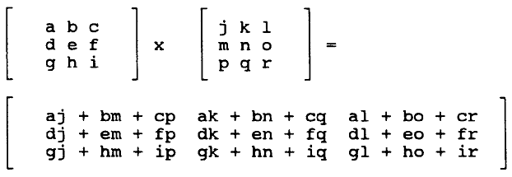

Linear Algebra
Algebraic Properties of Matrices:
Add/subtract matrices: Must be of the same dimensions
Multiplication of matrices:
Inner dimensions must match.
[n x m] * [m x p] = [n x p]
Note that matrix multiplication is not commutative
$$A×B≠B×A$$

Slide 11


Linear Algebra
Identity matrix: just like 1 is the multiplicative identity.
5*1=5
$$\left[\begin{matrix}1 & 3 \\ 2 & 4\end{matrix}\right]∙\left[\begin{matrix}1 & 0 \\ 0 & 1\end{matrix}\right]=\left[\begin{matrix}1 & 3 \\ 2 & 4\end{matrix}\right]$$
Identity matrix: a square matrix of zeros with 1’s on the diagonal. Also written as
$$I_{nxn}$$

Slide 12


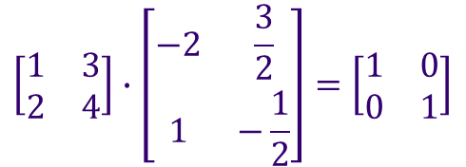
Linear Algebra
Transpose (given an element in position i,j, the transpose has the same element in position j,i.)
Inverse:
Just like the multiplicative inverse of n is 1/n, matrices also have multiplicative inverses:
$$A_{nxn}∙A_{nxn}^{−1}=I_{nxn}$$
$${A_{nxn}^{−1}∙A}_{nxn}=I_{nxn}$$
$$\left[\begin{matrix}1 & 3 \\ 2 & 4\end{matrix}\right]∙\left[\begin{matrix}−2 & \frac{3}{2} \\ 1 & −\frac{1}{2}\end{matrix}\right]=\left[\begin{matrix}1 & 0 \\ 0 & 1\end{matrix}\right]$$

Slide 13

Linear Algebra
For a 2x2 matrix:
What if (ad-bc) = 0? Then ad = bc or a/c = b/d.
If a/c = b/d, then one of the columns is a multiple of the other!
A is rank deficient
These columns are dependent on each other.
If these were columns in our numerical data frame, then one column would be a multiple of the other.
Example: Meters and Kilometers as separate predictors.
$$A=\left[\begin{matrix}a & b \\ c & d\end{matrix}\right]$$
$$=\frac{1}{ad−bc}\left[\begin{matrix}d & −b \\ c & d\end{matrix}\right]$$

Slide 14



Linear Algebra
$$A×X$$
Given a sequence of data points in a matrix, X, which has dimensions 2xn:
If we multiply by another matrix A (2x2):
Then we have a matrix A that transforms the points in X.
$$X=\left[\begin{matrix}1 & 2 & 0 \\ −2 & 3 & 1\end{matrix}\right]$$
$$A_{2x2}×\left[\begin{matrix}1 & 2 & 0 \\ −2 & 3 & 1\end{matrix}\right]$$

Slide 15
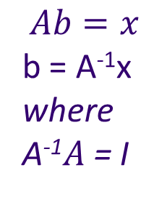
Linear Algebra and Multiple Linear Regression
Solve linear regression problem with normal equations
In typical case A is long and narrow
Solving for A⁻¹ is computationally difficult and inefficient
May not be unstable if A is rank deficient
Use an alternative formulation
A^{T}A is dimension m x m with A of dimension n x m, n >> m
A^{T}A can still be rank deficient!
$$Ab=x$$
b = A⁻¹x
where
A⁻¹$A$ = I
b = (A^{T} A)⁻¹ A^{T} x

Slide 16
Rank Deficient Problems
What can we do?
Find full rank approximation of the problem
Commonly shows up in data science
Models with many features
Especially, unstructured data

Slide 17


Matrix Decomposition
Eigenvalues: Given a nxn matrix, A, is an eigenvalue if there exists a vector X such that:
Finding the eigenvectors of A involves lots of computation.
If A rotates and shifts a vector X, then we can think of eigenvalues as a geometric hinge on which the ‘A’ operation acts.
Eigenvalues have corresponding eigenvectors.
Rank deficient matrix has eigenvalues that are zero or nearly so
This may seem insignificant at the moment, but eigenvalues and eigenvectors play an important role in manipulating our data.
$$λ$$
$$AX=λX$$

Slide 18

Matrix Decomposition
Matrix Decompositions allow us to write a matrix, A, in many different forms.
The one that is the most used, is Singular Value Decomposition (SVD).
U and V are comprised of orthogonal unit norm singular vectors
D is a diagonal matrix of singular values
A is comprised of the linear combination of singular vectors
The singular values define the weights for linear combination
Singular values define a spectrum of singular vectors
$$A=UDVT$$

Slide 19
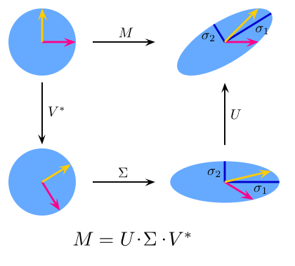



Linear Algebra
The SVD is a way to express a transformation from one n dimensional space (the space A lies in) to another n dimensional space by rotating and scaling A
$$A$$
$$D$$
$$A=UDVT$$

Slide 20
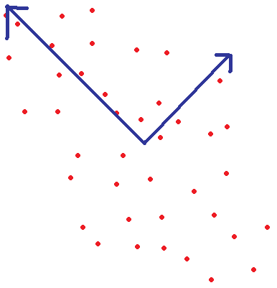
Principle Component Decomposition
PC decomposition same as SVD
If two variables are correlated, we can transform the data to directions in which they are not correlated.
These new axes are called the Principal Components.
x
x'
y'
y

Slide 21


PCA and SVD
Know that instead of our original system:
We now have the system:
The f functions are called our principle components.
Functions f are called the rotations
The f function outputs are guaranteed to be independent of each other.
We can no longer interpret our linear model coefficients!
$$y_{i}=β_{0}+β_{1}x_{1}+β_{2}x_{2}+…$$
$$y_{i}=β_{0}+β_{1}{f_{1}(x}_{1},x_{2}, …)+β_{2}{f_{2}(x}_{1},x_{2}, …)+…$$

Slide 22
Deriving Independent Features from Dependence
Noting that largest singular values are for directions with largest variance
With larger data sets, we’ve seen that no matter the quality, we can find a explanatory feature.
If we consider our data as a matrix, we know that having dependent columns is a problem.
Transform our data so the columns are the most important and independent:
Remove influence of columns that do not contain enough ‘information’.
Too much missing data.
Low Variance.
Remove influence of columns that are correlated

Slide 23
Feature Selection with SVD
Smallest singular values correspond to least important directions
SVD returns the same number of components as number of features.
Components are orthogonal: the first few components explain much more variance than the last few.
How do we decide how many to keep?
We look at the magnitude of the associated singular values for each principal component.
R-demo.

Slide 24
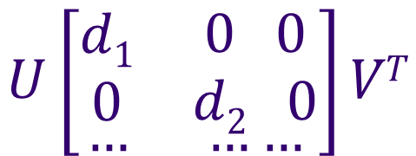

SVD Feature Selection
Select n orthogonal features with n nonzero singular values
Example: Select single most important feature
Example Select two most important features
$$U\left[\begin{matrix}\begin{aligned}d1 \\ 0\end{aligned} & \begin{aligned}0 0 \\ 0 0\end{aligned} \\ … & ……\end{matrix}\right]VT$$
$$U\left[\begin{matrix}\begin{aligned}d1 \\ 0\end{aligned} & \begin{aligned}0 0 \\ d2 0\end{aligned} \\ … & ……\end{matrix}\right]VT$$

Slide 25
SVD
This seems like an awful lot of work for little improvement and loss of interpretability.
But note that we lost the dependence in the data set!
There are other applications as well…

Slide 26
How Do We Find Full Rank Inverse
SVD is ideal for extracting full rank inverse
Full rank inverse is an approximation
For SVD we call this the pseudo inverse

Slide 27



SVD and the Pseudo Inverse
Since
The pseudo inverse of A is:
Where D⁺ is the transpose of:
Note that the smallest singular values have the largest weights in the pseudo inverse
$$A=UDVT$$
$$VD+UT$$
$$\left[\begin{matrix}\begin{aligned}1/d1 \\ 0\end{aligned} & \begin{aligned}0 0 \\ 1/d2 0\end{aligned} \\ … & … …\end{matrix}\right]$$

Slide 28
Pseudo Inverse and Regularization
Regularization is the process of transforming a rank deficient matrix into a full rank approximation
Regularize the pseudo inverse by selecting the n largest singular values
Regularization of pseudo inverse is the same as feature selection from the orthogonal projection

Slide 29
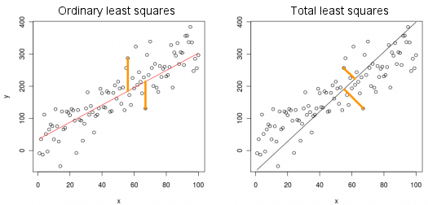
SVD, as a type of regression
Also, looking at the first principal component, we can consider SVD as a new type of regression, which is called total least squares. (Also called Deming regression or PCA Regression)
R demo
Regressing y on x
SVD Primary Principal Component

Slide 30
SVD, as a type of regression
When to use total least squares:
If we want to control for error in x as well as y.
We are minimizing the distance from the point to the line as opposed to the distance between the y-values.
R-squared doesn’t really apply here, at least in the way we have defined it
R Demo

Slide 31
SVD, as a way to compress information
We can group together similar points via SVD
Store only the first n principle components of the data.
Widely used for high-dimensional unstructured data
Text data
Image data

Slide 32
Another Approach to Feature Selection
SVD has some problems
Is approximation to a different problem
Loose interpretability
Computationally intensive, but can use projection methods
Are there other ways to measure feature importance?

Slide 33
Multiple Linear Regression
Throwing in all possible variables to help explain our response is sometimes not a good thing
Variables can be dependent on each other.
Variables might not be important to explain the response.
Note that the SSE is always larger for reduced models!

Slide 34
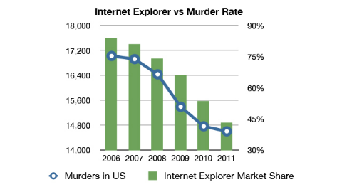
Multiple Linear Regression
How do we choose which combinations of independent variables to use?
We might consider looking at the difference in SSE between models and the number of explanatory variables.

Slide 35
Categorical Variables
Start with a first order model.
How do we deal with factor/categorical variables?
$$y=β_{0}+β_{1}x_{1}+β_{2}x_{2}+β_{3}x_{3}+ε$$
Gender
F
M
F
F
M
…
Gender
1
0
1
1
0
…
DayOfWeek
Monday
Tuesday
Wednesday
Thursday
Friday
Saturday
Sunday
…
DayOfWeek
1
2
3
4
5
6
7
…
Eye Color
Brown
Brown
Blue
Green
Green
Blue
Brown
…
Brown | Blue
1 | 0
1 | 0
0 | 1
0 | 0
0 | 0
0 | 1
1 | 0
… | …
“One hot encoding”
“Factor encoding”

Slide 36
Categorical Variables
Encoding increases the dimensionality of the model matrix
Encoding can lead to rank deficiency
Categorical variables with many levels
Many categorical variables
Categorical variables with infrequent cases have near zero variance

Slide 37
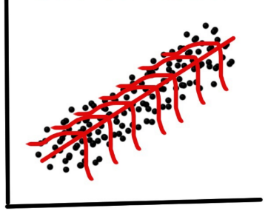
Multiple Linear Regression
Linear Model Likelihood
We assume errors are normally distributed. From the resulting set of errors, we can come up with a distribution. We then use each residual point and come up with a total error and calculate the probability of that model given our data. This is the likelihood.
To make the calculations easier, we usually take the logarithm of the model (remember we can do this because it is monotonic). This is called the ‘log-likelihood’. We will talk more about this when we get to Bayesian Statistics.

Slide 38

Multiple Linear Regression
Akaike Information Criterion (AIC)
Given a model with k-parameters, and a likelihood of L
Note that the more parameters, the higher the AIC.
The higher the likelihood, the lower the AIC.
Better models have lower AIC values.
$$AIC=2k−2ln⁡(L)$$

Slide 39
Multiple Linear Regression
How to select the variables in the model?
Stepwise regression.
Forward Selection:
Start with no independent variables and add the variables one by one, selecting the variable that improves your criterion the most.
Backward Selection
Start with all independent variables and remove on at a time. Remove the one that improves the chosen criterion.
R-demo

Slide 40
Assignment
Complete Homework 6:
Perform SVD regression on the auto price data
Use the following features for your initial model: make, fuel.type, aspiration, body.style, drive.wheels, length, curb.weight, engine.type, num.of.cylinders, engine.size, city.mpg
Apply SVD to a model matrix created with model.matrix(), and report the increase in dimensionality
Report how many orthogonal features you used for you model
Evaluate your model performance with plots and by computing RMS error. Hint see my demo code for plots.
Use stepwise regression to select features from the aforementioned set
Compare model performance with full model using summary statistics, plots and ANOVA

Slide 41
Assignment Continued
You should submit:
One R-script
Follow good coding practice; minimize cut and paste
Include comments
One document outlining and supporting your conclusions
See example I provided last week
Read Introduction to Data Science, Chapter 16.

