Slide 1
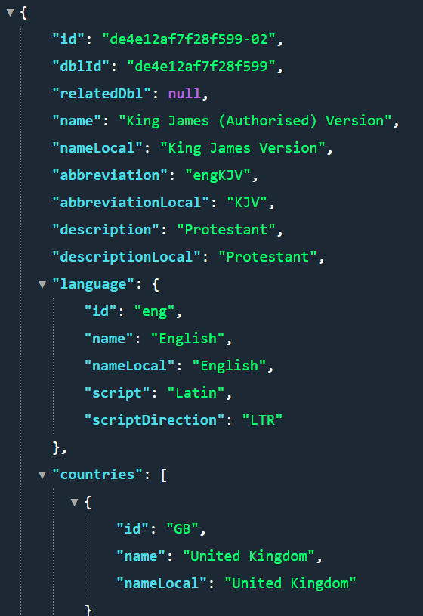
{"id": "de4e12af7f28f599-02",
"dblId": "de4e12af7f28f599",
"relatedDbl": null,
"name": "King James (Authorised) Version",
"nameLocal": "King James Version",
"abbreviation": "engKJV",
"abbreviationLocal": "KJV",
"description": "Protestant",
"descriptionLocal": "Protestant",
"language": {
"id": "eng",
"name": "English",
"nameLocal": "English",
"script": "Latin",
"scriptDirection": "LTR"
},
"countries": [
{
"id": "GB",
"name": "United Kingdom",
"nameLocal": "United Kingdom"
}
],
"type": "text",
"updatedAt": "2020-11-12T21:16:55.000Z",
"audioBibles": []
},

Slide 2
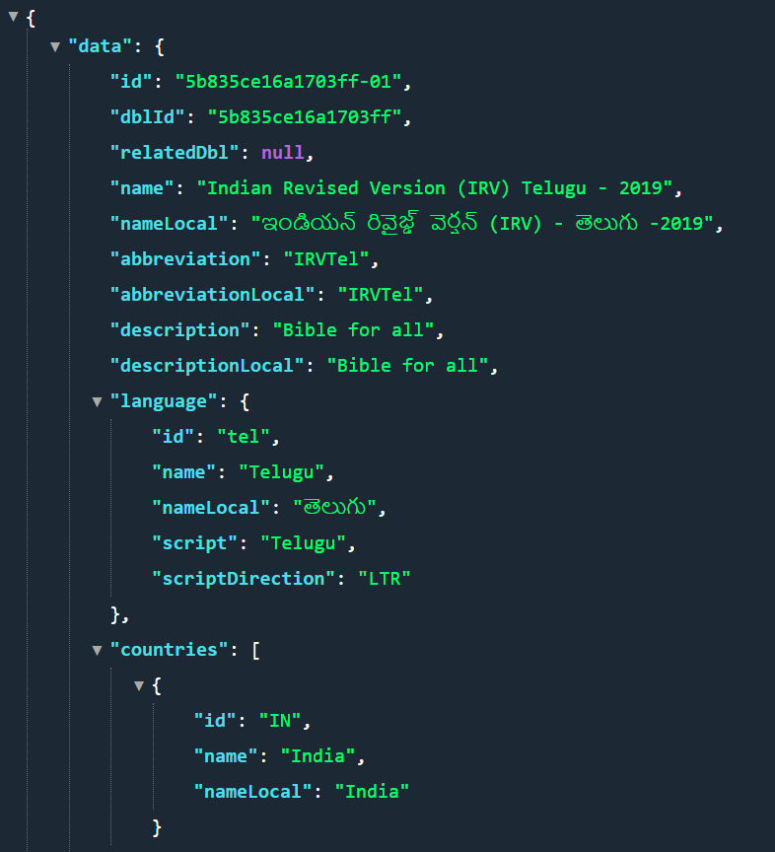
{"id": "5b835ce16a1703ff-01",
"dblId": "5b835ce16a1703ff",
"relatedDbl": null,
"name": "Indian Revised Version (IRV) Telugu - 2019",
"nameLocal": "ఇండియన్ రివైజ్డ్ వెర్షన్ (IRV) - తెలుగు -2019",
"abbreviation": "IRVTel",
"abbreviationLocal": "IRVTel",
"description": "Bible for all",
"descriptionLocal": "Bible for all",
"language": {
"id": "tel",
"name": "Telugu",
"nameLocal": "తెలుగు",
"script": "Telugu",
"scriptDirection": "LTR"
},
"countries": [
{
"id": "IN",
"name": "India",
"nameLocal": "India"
}
],
"type": "text",
"updatedAt": "2020-09-15T04:33:34.000Z",
"copyright": "CC BY SA",
"info": null,
"audioBibles": []
}

Slide 3
GEN: Genesis
EXO: Exodus
LEV: Leviticus
NUM: Numbers
DEU: Deuteronomy
JOS: Joshua
JDG: Judges
RUT: Ruth
1SA: 1 Samuel
2SA: 2 Samuel
1KI: 1 Kings
2KI: 2 Kings
1CH: 1 Chronicles
2CH: 2 Chronicles
EZR: Ezra
NEH: Nehemiah
EST: Esther
JOB: Job
PSA: Psalms
PRO: Proverbs
ECC: Ecclesiastes
SNG: Song of Solomon
ISA: Isaiah
JER: Jeremiah
LAM: Lamentations
EZK: Ezekiel
DAN: Daniel
HOS: Hosea
JOL: Joel
AMO: Amos
OBA: Obadiah
JON: Jonah
MIC: Micah
NAM: Nahum
HAB: Habakkuk
ZEP: Zephaniah
HAG: Haggai
ZEC: Zechariah
MAL: Malachi
MAT: Matthew
MRK: Mark
LUK: Luke
JHN: John
ACT: Acts
ROM: Romans
1CO: 1 Corinthians
2CO: 2 Corinthians
GAL: Galatians
EPH: Ephesians
PHP: Philippians
COL: Colossians
1TH: 1 Thessalonians
2TH: 2 Thessalonians
1TI: 1 Timothy
2TI: 2 Timothy
TIT: Titus
PHM: Philemon
HEB: Hebrews
JAS: James
1PE: 1 Peter
2PE: 2 Peter
1JN: 1 John
2JN: 2 John
3JN: 3 John
JUD: Jude
REV: Revelation

Slide 4

Verse Finder

