Slide 1
Multi Agent Hierarchical Expert Re-identification for Large-Scale Widlife Recognition
T.W. Manhema, J.S Phala, H.E Ashimwe, L. Phuma
MAHER

Slide 2
Overview
Problem: identifying wild animals without physical tags is hard because population are dynamic and new individuals keep popping up
Our approach
  Model A (general): predicts the species of an animal
  A routing table picks from a matching Model B of 4 animals that specialises on that species
  That specialist model looks for that specific individual, if it doesn't exist, flag it as new
Scope: 4 species (hyena, leopard, macaque, dog)
MAHER

Slide 3
Data & Key Decisions
Source: the wildlife-datasets package; SpottedHyenaID109, LeopardD102, MacaqueFaces, DogFaceNet.
12,308 labelled images across 4 species
Scoped down the wildlife-datasets to 4 species due to time and resource constraints
MAHER

Slide 4
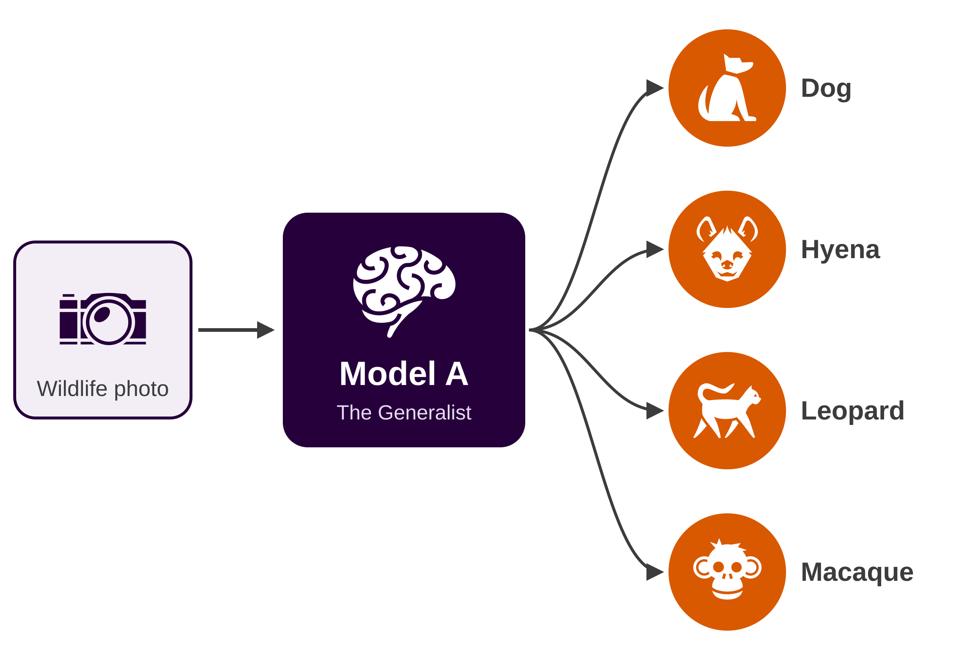
Model A
Testing
99.78%
0.997
accuracy · 455 / 456 correct
macro F1-score
Confusion matrix (rows = actual, columns = predicted)
 | Dog | Hyena | Leopard | Macaque
Dog | 155 | 0 | 0 | 0
Hyena | 0 | 71 | 1 | 0
Leopard | 0 | 0 | 90 | 0
Macaque | 0 | 0 | 0 | 139
MAHER

Slide 5
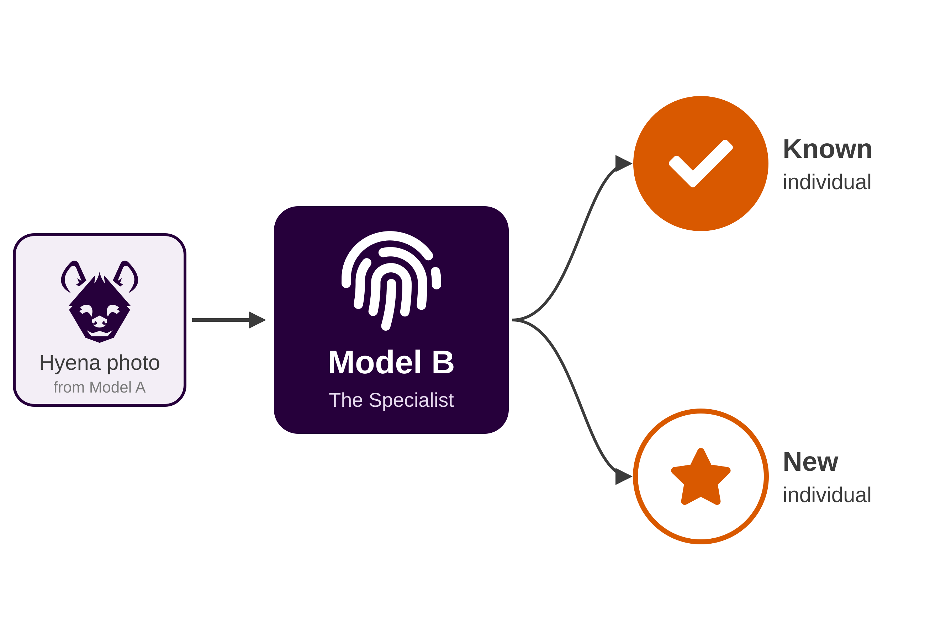
Model B
The specialist: one expert per species, trained to tell individual animals apart
A unique embedding: A Vision Transformer reads each animal's coat, face, and markings and compresses them into a compact signature. ArcFace loss pushes photos of the same animal together and different animals apart.
Known or new? Each signature is matched against the animals the specialist has already met. If nothing is close enough, the animal is flagged as a stranger.
Some species are much harder to tell apart.
Rank-1 accuracy
dog = 90.0% hyena = 80.0%
leopard = 89.0% macaque = 98.9%
Backbone | 192 for ViT-Tiny
Loss | ArcFace (angular margin)
Input size | 224 × 224
Training | 30 epochs per species, 4 specialists
Embedding size | 256
ArcFace Scale | 30.0
ArcFace Margin | 0.5 radian
Lr and weight Decay | 1e-4 and 1e-4
MAHER

Slide 6
UI, Integration & Deployment
Integration: photo in → Model A predicts species → routing table picks matching Model B → photo → known individual or new individual
Interface: a public web app built in Flask, returns the confidence of model A and the identification status of model B
Deployment:
  Containerised with Docker
  Served being a reverse proxy with automatic HTTPS
  Live, publicly accessable demo
Live Demo: https://maher.lwazi.gay

