Slide 1
Design of a web-based application to manage ‘njangi’ – Njangi-Hub

Slide 2
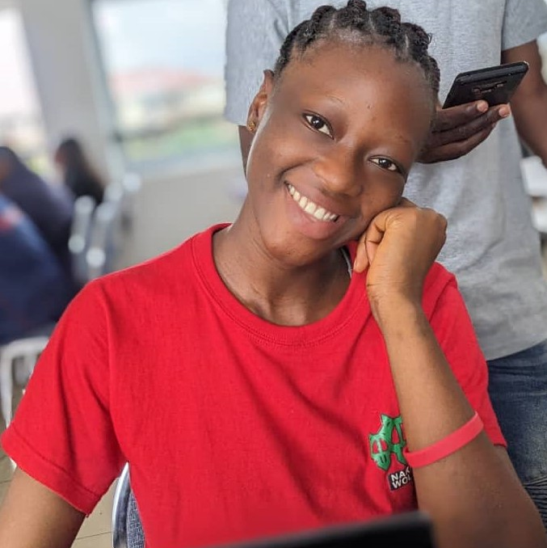
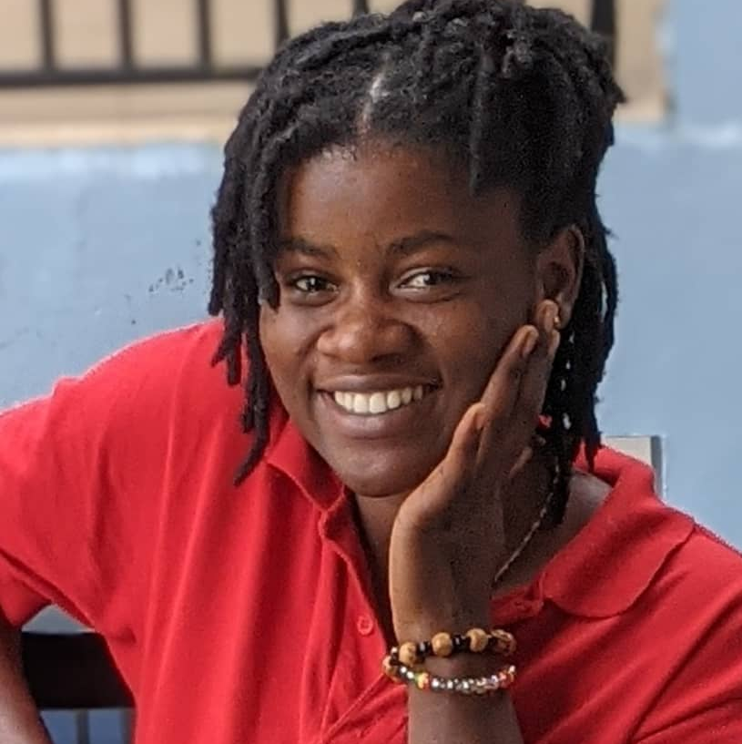
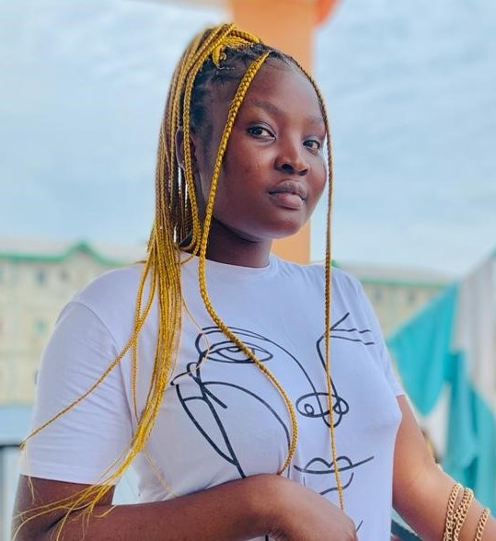
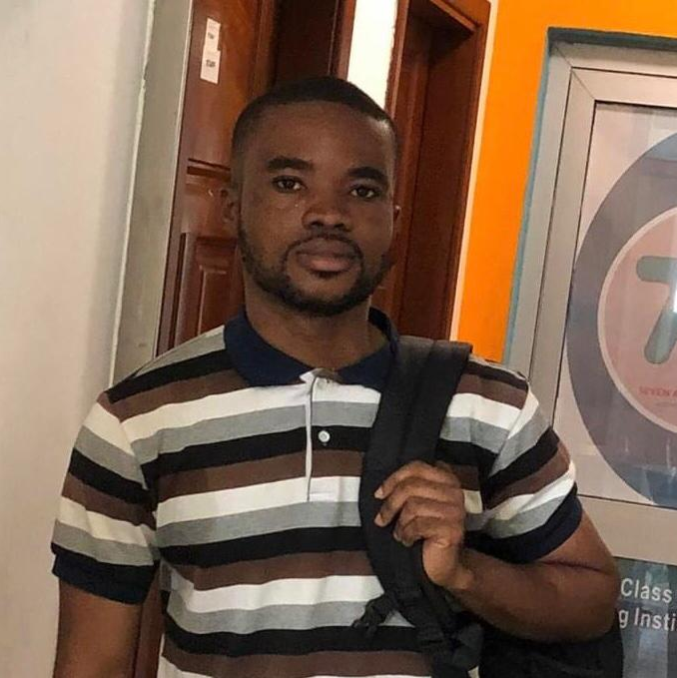
Meet our team
Kanyi Vanessa
Kwa Adella
Analyst
Designer and Analyst
Neba Nadine
Emmanuel Takor
Analyst
Analyst

Slide 3
Agenda
Problem statement
Objectives
Requirements
Project life cycle
Existing system(s)
Diagrams

Slide 4
Problem statement
Manual management of financial transactions in njangi houses
Lack of transparency in transactions
Lack of efficient payment and rotation schedules
Poor reporting and tracking systems

Slide 5
Objectives
The objectives for the design and implementation of a hybrid application to manage ‘njangi’ are defined as follows:

Slide 6
Objective 1
Develop a secure user management system, by implementing an efficient, effective and strict user verification process to be completed before a user can create, join or be added to any njangi, where they can view njangi rules and settings, including past announcements or create them

Slide 7
Objective 2
Implement a strict and effective contribution management system complete with reminders, which follows a contributions schedule and payment tracking for the management and implementing of fines based on the status of the payment

Slide 8
Objective 3
Enhance transparency and accountability in each njangi by incorporating a report generating system for every financial transaction (contributions, withdrawals), rotations and njangi rules

Slide 9
Objective 4
Implement a secure rotation management policy and system, by assigning unique codes to users both in automatic and manual rotations, and making the automatic rotation schedules private only for the njangi head and each member – their own schedule

Slide 10
Objective 5
Implement a secure user withdrawal system using third parties like MOMO and a policy that the system approves a user’s withdrawal request if and only if their secret code assigned during rotation is valid and correct, and the njangi head has approved

Slide 11
Functional Requirements
Users must be able to create, verify and manage accounts
System must be able to generate reports(financial and schedules)
System must be able to manage contributions, and payment tracking
Verified users must be able to create and manage njangi groups
Verified users must be able to join njangi groups
Users must be able to pay and withdraw contributions

Slide 12
Non-Functional Requirements
Security: The system, users and all transactions must be secured from unauthorized access
Compliance: The system must comply with all applicable laws and regulations
Reliability: must be trustworthy and reliable, and meet the user requirements

Slide 13
Continued…
Usability: must be easy for the user to use and understand, with optimal UX
Availability: must always be available at any time t when needed
Performance: System must be able to handle a required number of users without a degradation in the performance

Slide 14
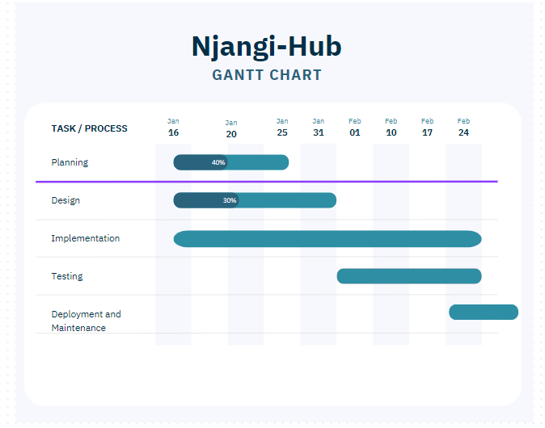
Project Life Cycle

Slide 15
Project Timeline
Deployment and Maintenance
Jan 16 -25 2024
Planning
16 Jan – 31 Jan 2024
Design
Feb 01 - 24
Implementation
Feb 01 –Feb 24
Testing
Feb 25 – Continuous

Slide 16
Existing System
Manual system
No existing system in Cameroon

Slide 17
Diagrams…

Slide 18
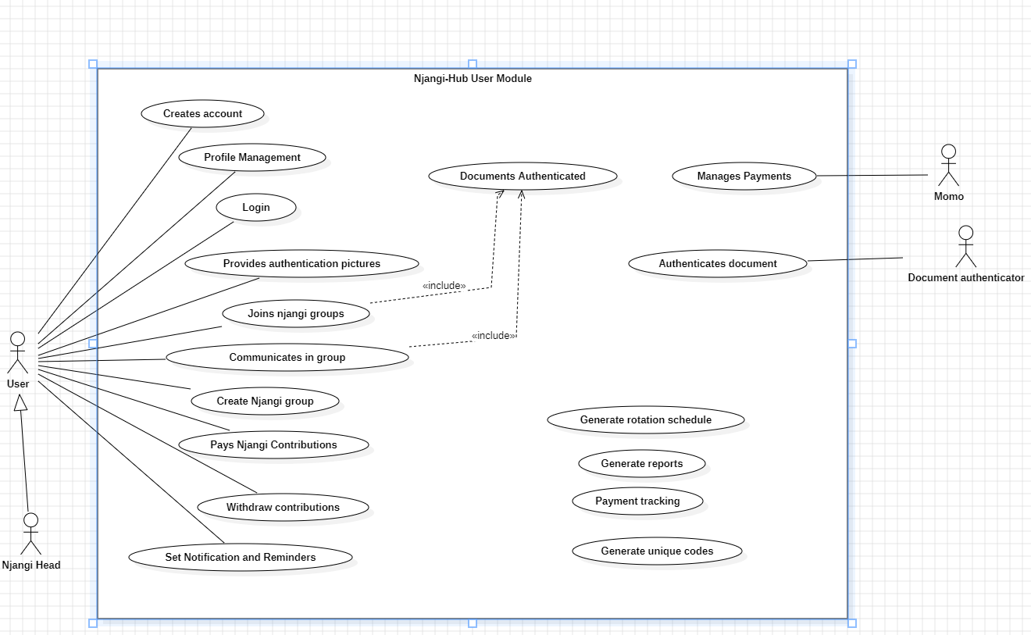
Use case: User’s Module

Slide 19
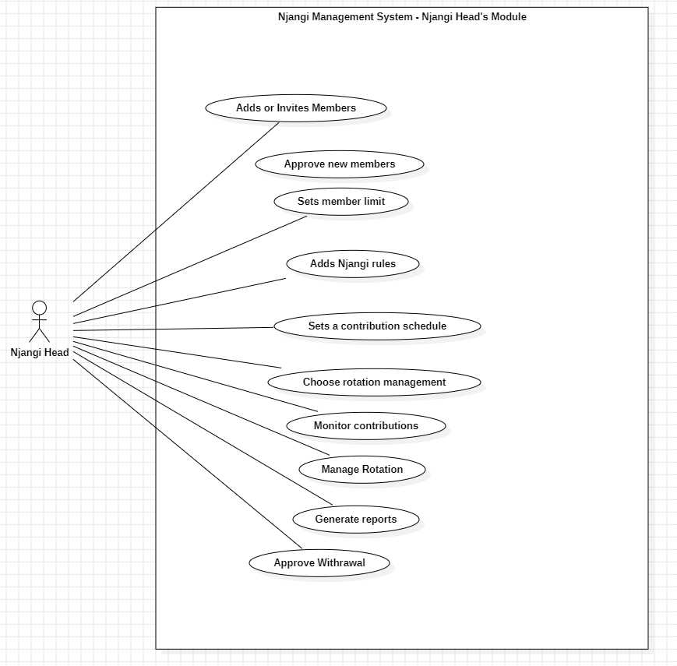
Use case: Njangi head’s Module

Slide 20
Thank you

