Slide 1
Design of a web-based application to manage ‘njangi’ – Njangi-Hub

Slide 2
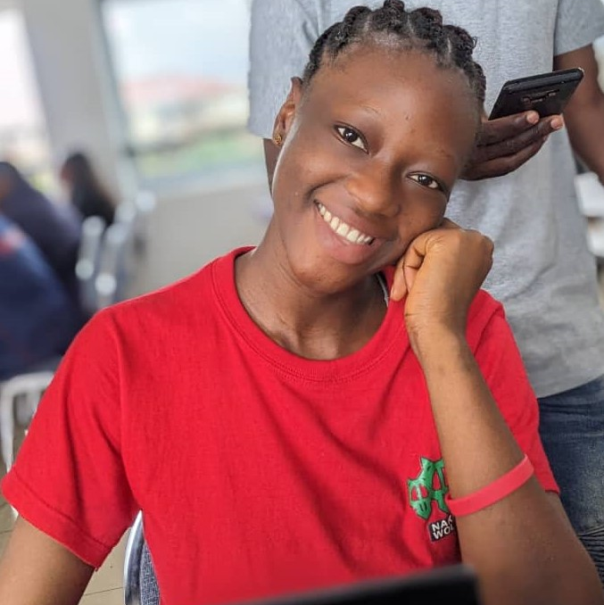
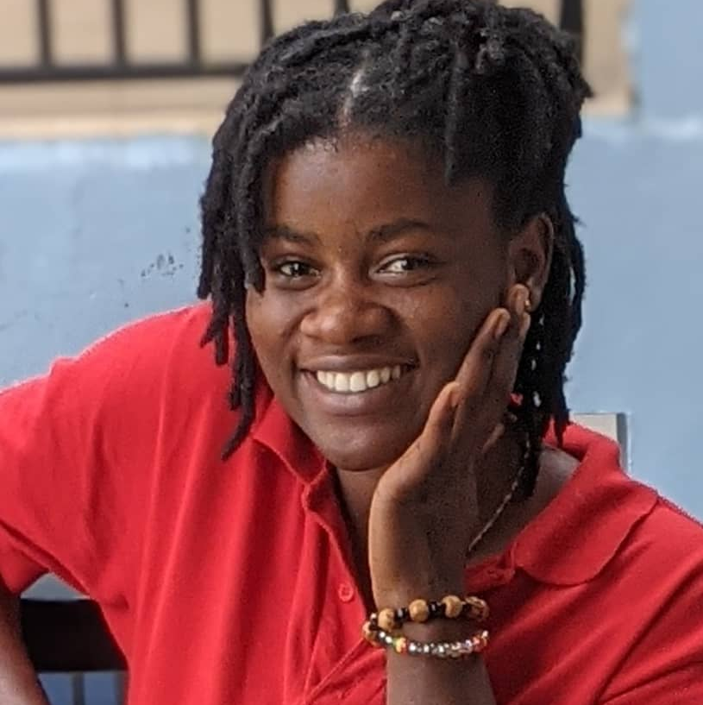
Meet our team
Kanyi Vanessa
Kwa Adella
Analyst
Designer and Analyst
Neba Nadine
Emmanuel Takor
Analyst
Analyst

Slide 3
Agenda
Problem statement
Objectives
Project life cycle
Use case diagram
Sequence diagrams
Class diagram

Slide 4
Problem statement
Manual management of financial transactions in njangi houses
Lack of transparency in transactions
Lack of efficient payment and rotation schedules
Poor reporting and tracking systems

Slide 5
Objectives
Implement and automate efficient contribution management
Automate njangi process and save time wasted in follow ups
Enhance transparency and accountability in njangi
Ensure security and data privacy for users and their transactions

Slide 6
Functional Requirements
Users must be able to create, verify and manage accounts
System must be able to generate and manage reports and tracking
Verified users must be able to create and manage njangi groups
Verified users must be able to join njangi groups
Users must be able to pay and withdraw contributions

Slide 7
Non-Functional Requirements
Security
Availability
Usability
Portability
Compliance

Slide 8
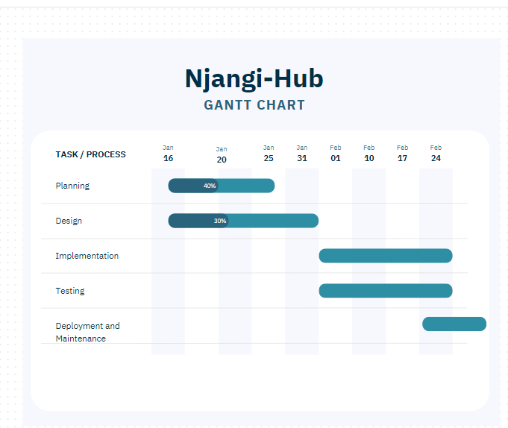
Project Life Cycle

Slide 9
Project Timeline
Deployment and Maintenance
Jan 16 -25 2024
Planning
16 Jan – 31 Jan 2024
Design
Feb 01 - 24
Implementation
Feb 01 –Feb 24
Testing
Feb 25 – Continuous

Slide 10
Existing System
Manual system
No existing system in Cameroon

Slide 11
Diagrams…

Slide 12
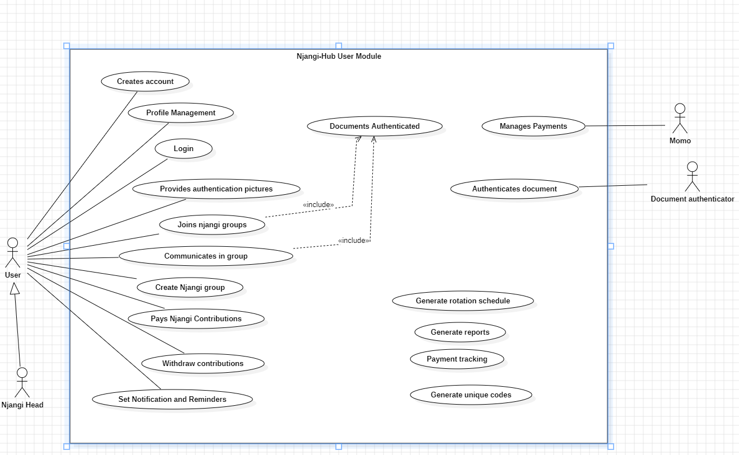
Use case: User’s Module

Slide 13
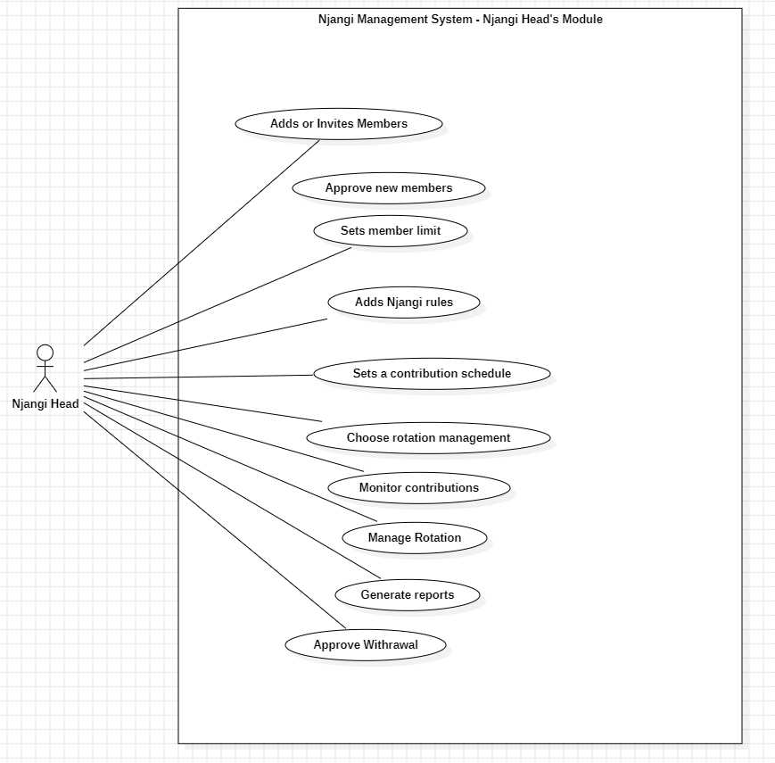
Use case: Njangi head’s Module

Slide 14
Thank you

