Slide 1
National Park Map ++
Presenters: Omar Salas, Brian Goldenberg, Harsh Gupta, Emmanuel Utomi

Slide 2


Application Overview
National Park exploration application
Obtain information about anything within the park with a single click
Path generator for tourists
Emergency Location finder
Park Data analysis

Slide 3




Exploration
Fun and interactive navigation
2D and 3D map for multiple options
2D and 3D map for multiple options
AR view for a more immersive experience
AR view for a more immersive experience
Location tracking for those who want a realtime moving map
Location tracking for those who want a real-time moving map

Slide 4


Data Collection
Initial data will be populated by the developers
Verification of data will be done by the users

Slide 5

Path Generator
Multiple paths are generated for each national park
Allow visitors to easily see entire park with an optimized trail
Paths that pass through specific areas
Avoid paths with dangerous animals/terrain

Slide 6
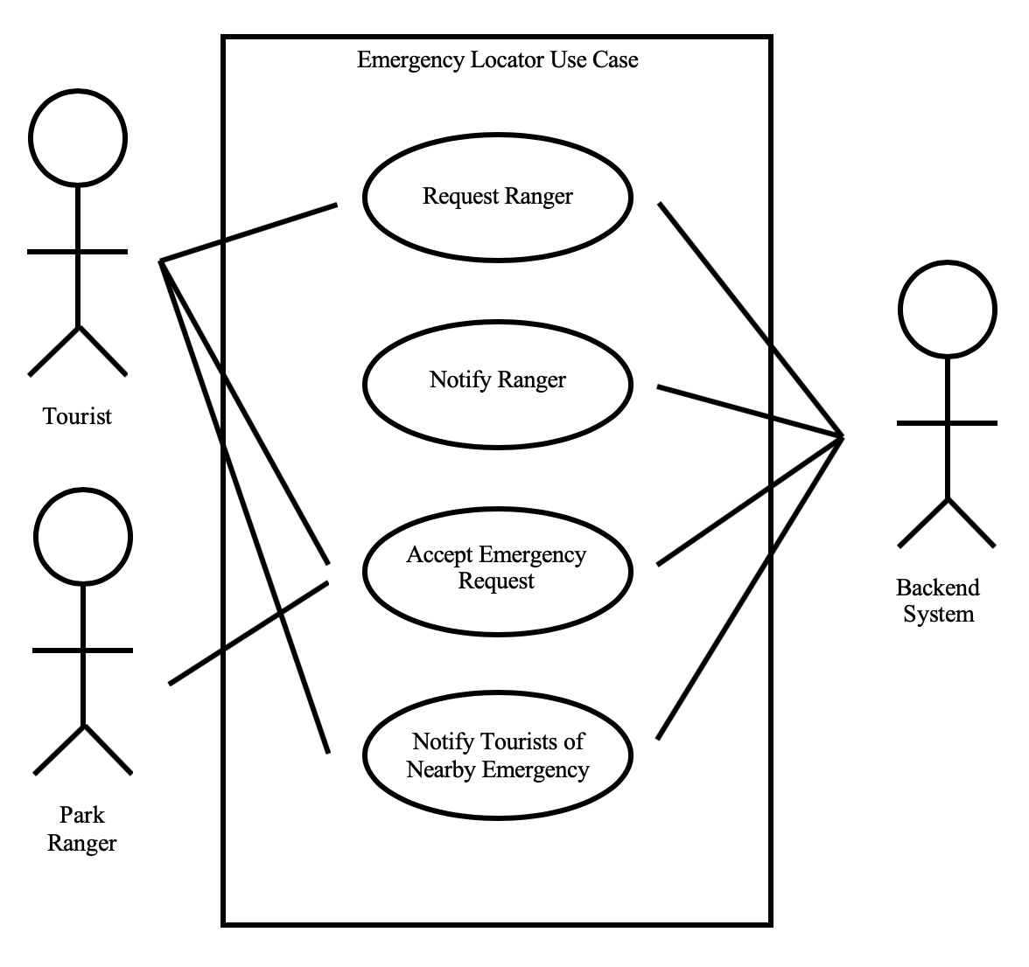

Emergency Locator
Implementing the Emergency contact database
A way to contact the park authorities from the application
Inform all other visitors of the emergency reported and the location of the emergency

Slide 7


Privacy
Users will have the option to use location services
All location information will remain on the users local machine
Valuable information that is stored will be encrypted

Slide 8
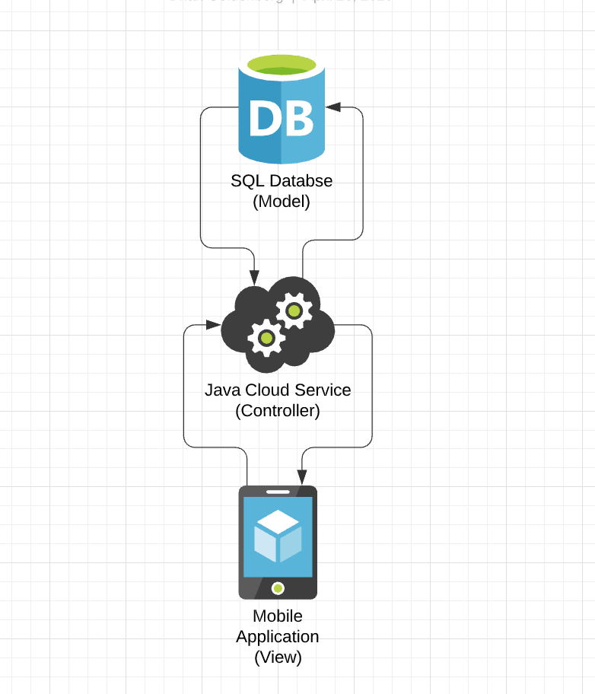
System Design
Model View Controller
Allows for code to be easily extensible and modular
Team work becomes easier as each member can work on individual components

Slide 9
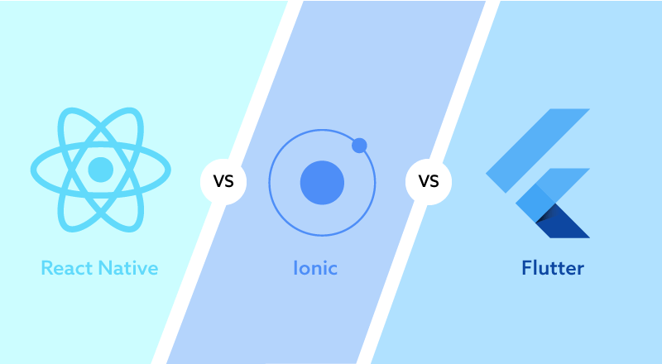
Frontend System Design and Implementation
Cross Platform Development
Some possible options are Flutter, Ionic and React
Match Client Design
On time completion

Slide 10
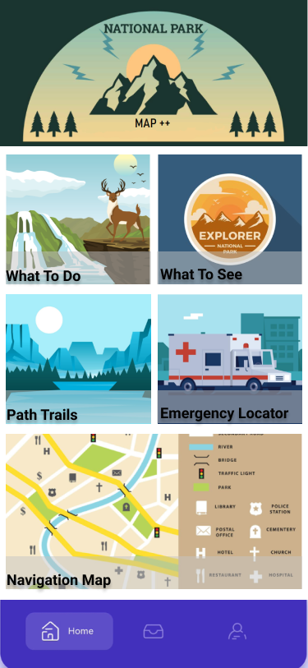
User Interface
The User Interface should be simple and easy to use
It should be responsive, attractive and consistent

Slide 11
Backend System Design and Implementation
Microsoft Azure hosting web servers and SQL servers
Functions are compiled from Java code and hosted on the cloud
Databases are hosted in multiple locations to provide 99.9% uptime in scenario of outages
Load balancer organizes traffic to mitigate latency
Inbound and Outbound connections transfer data between endpoints
See flowchart diagram on next slide

Slide 12
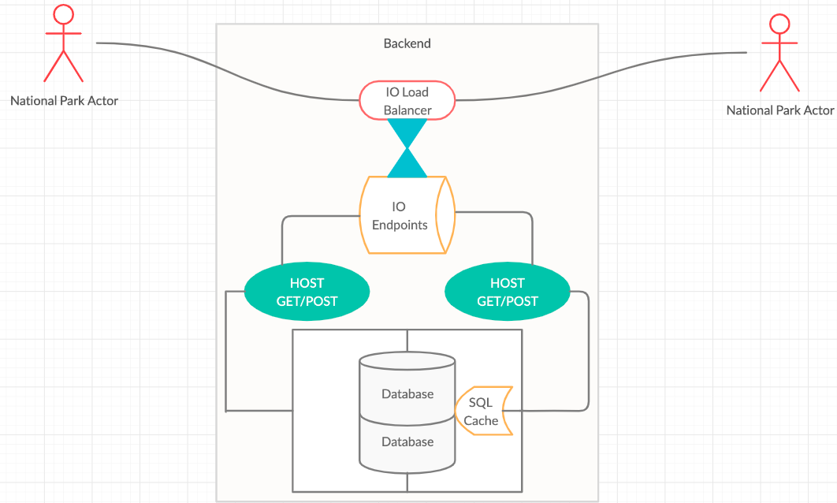
Backend System Design and Implementation

Slide 13
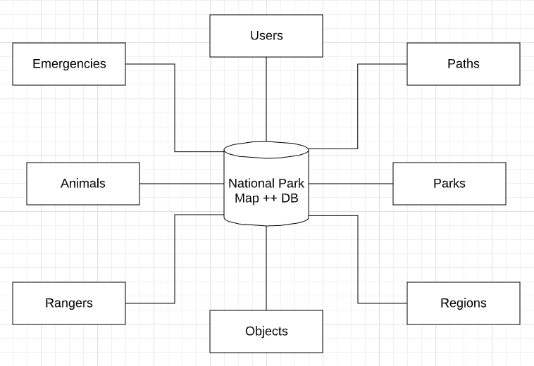
Database Design and Implementation
Central SQL database managed by the backend system
Multiple normalized data tables for the database
Indexing constantly accessed tables for faster queries

