Slide 1
National Park Map ++
Presentors: Omar Salas, Brian Goldenberg, Harsh Gupta, Emmanuel Utomi

Slide 2
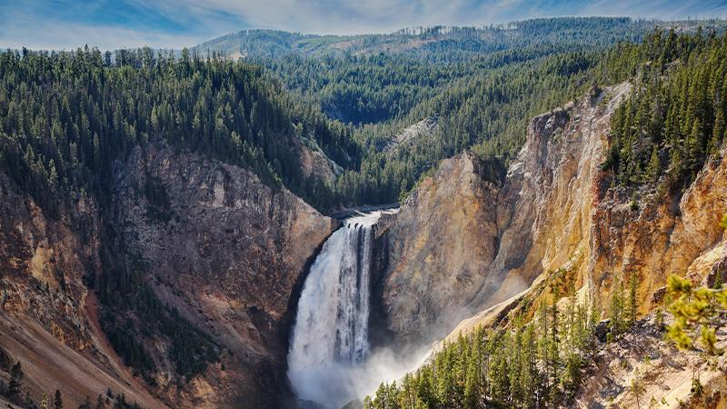
What is a National Park?
A national park is a designated plot of land that is protected by the government
Main objective is preservation of wildlife, which is conducted by environmental specialists

Slide 3


Application Overview
National Park exploration application
Obtain information about anything within the park with a single click
Path generator for tourists
Emergency Location finder
Park Data analysis

Slide 4
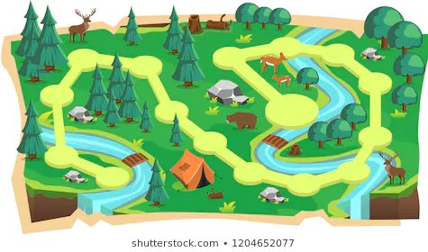



Exploration
Fun and interactive navigation
2D and 3D map for multiple options
AR view for a more immersive experience
Location tracking for those who want a real-time moving map

Slide 5


Data Collection
Initial data will be populated by the developers
Verification of data will be done by the users

Slide 6

Path Generator
Multiple paths are generated for each national park
Allow visitors to easily see entire park with an optimized trail
Allows curation of paths that focus on specific area(s) or that include certain sightings
Allow visitors to proactively avoid any unwanted locations, in case of dangerous animals/terrain

Slide 7


Emergency Locator
The Emergency locator is an important part of the application
Implementing the Emergency contact database
A way to contact the park authorities from the application

Slide 8

Application Integration
Medical ID - IOS
Compass
Health - IOS
Restaurants

Slide 9

Why do we need this?
Our application serves to provide national parks with cutting edge technology that expands their service capabilities
Improves safety, as well as overall tourist experience for the duration of their visit

