Slide 1
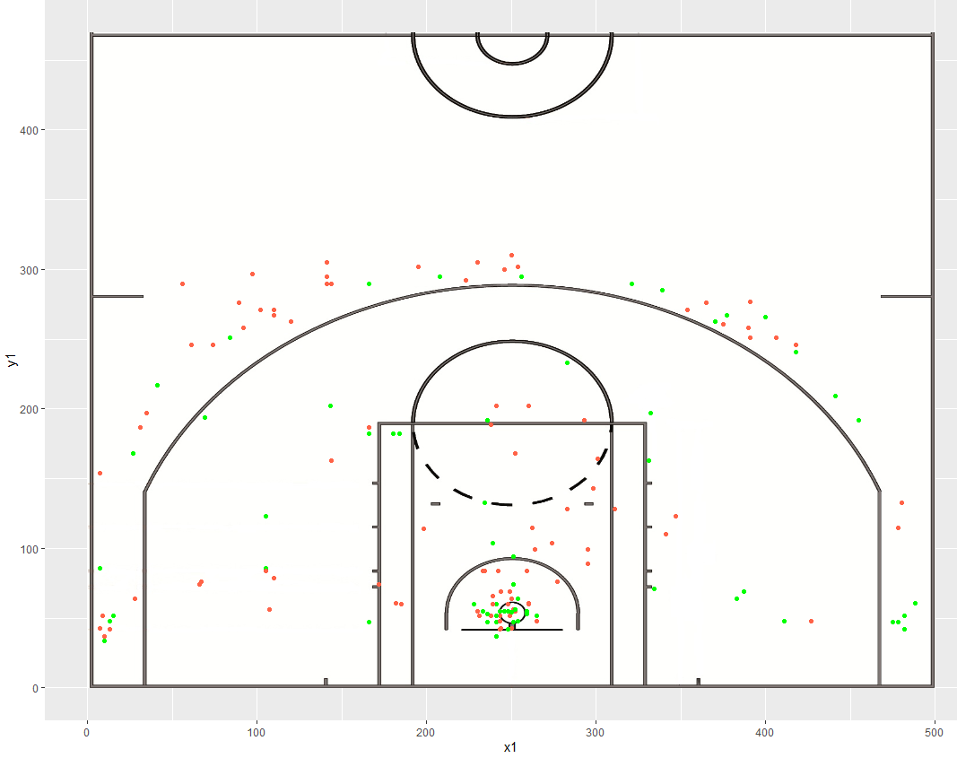
Data Mining Project
Analyzing basketball shots from 2013-2020
Sushil Vas

Slide 2
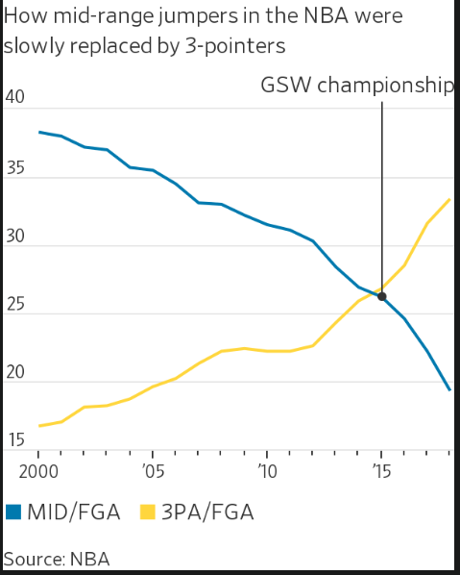
Introduction
Since 2016, basketball teams have emphasized shooting more 3 pointers (long range 22-30 ft) and layups (close range 2-4 ft)
Players are told not to shoot the midrange shot (6-22 ft), because it is inefficient.
Shot
Attempts
Goal: In this project, I will explore the mathematical reasons behind this trend.
Years
Data was obtained from www.bigdataball.com

Slide 3
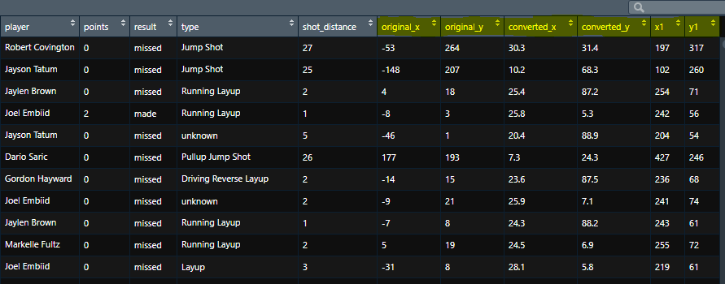
Data Snapshot
Highlighted: Shot locations (x and y coordinates)
Shot type: needs to be classified numerically.
Highlighted: Shot coordinates (x,y)

Slide 4
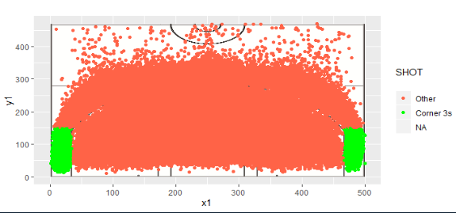
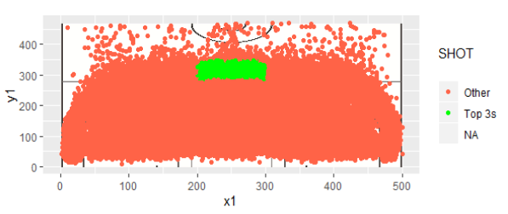
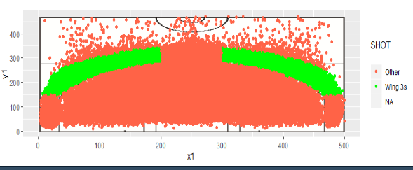
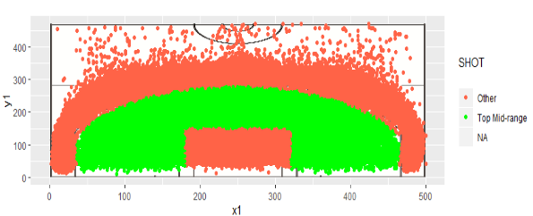
Classifying Shots By Location

Slide 5
Hypothesis: Does shot% from the corners affect winning on a game-to-game basis?
H₀: μ₁ = μ₂ = μ₃ = μ_{4,}
_{where} μx represents the mean shot percentage from the corner for a team x, over every game.
Each team has 82 rows, since there are 82 games in a season.
If we fail to reject the null hypothesis,
then we can conclude that the mean shot percentages are equal
_{and have no impact on winning.}
Note: Warriors and Raptors are great teams, and the Knicks and
Cavaliers are below average teams.
Team | Shot%
Warriors(game1) | 60.7
Warriors(game2) | 72.1
Raptors(game1) | 50.9
Raptors(game1) | 82.0
Knicks(game1) | 57.8
Knicks(game2) | 60.2
Cavaliers(game1) | 59.1

Slide 6
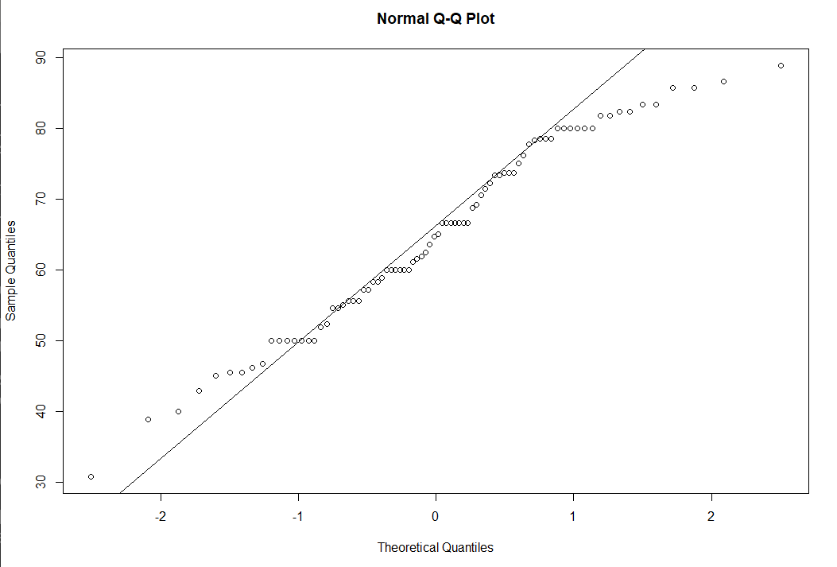
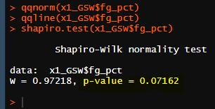
Assumptions to consider before testing
All rows are independent.
Dependent variable is continuous (shot%).
Each group has a normal distribution, with no major outliers.
Methods:
Visualization- qqnorm, qqline
Shapiro-Wilks Test for Normality
If p > 0.05, we can say that this is a normal distribution.

Slide 7
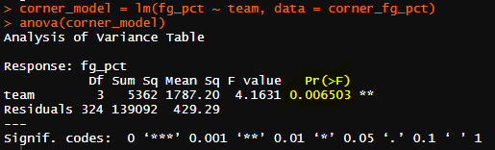
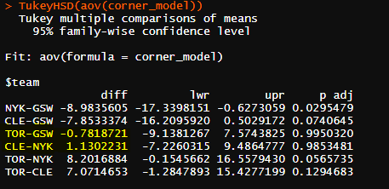
ANOVA Interpretation
Since the p-value < 0.05, we can conclude that not all population means are equal.
We can use Tukey’s Test to investigate how the means differ from each other.
The good teams (TOR-GSW) have similar means to each other.
The bad teams also have similar means to each other.
However, when a good team is compared to a bad team, the difference in means is large.

Slide 8
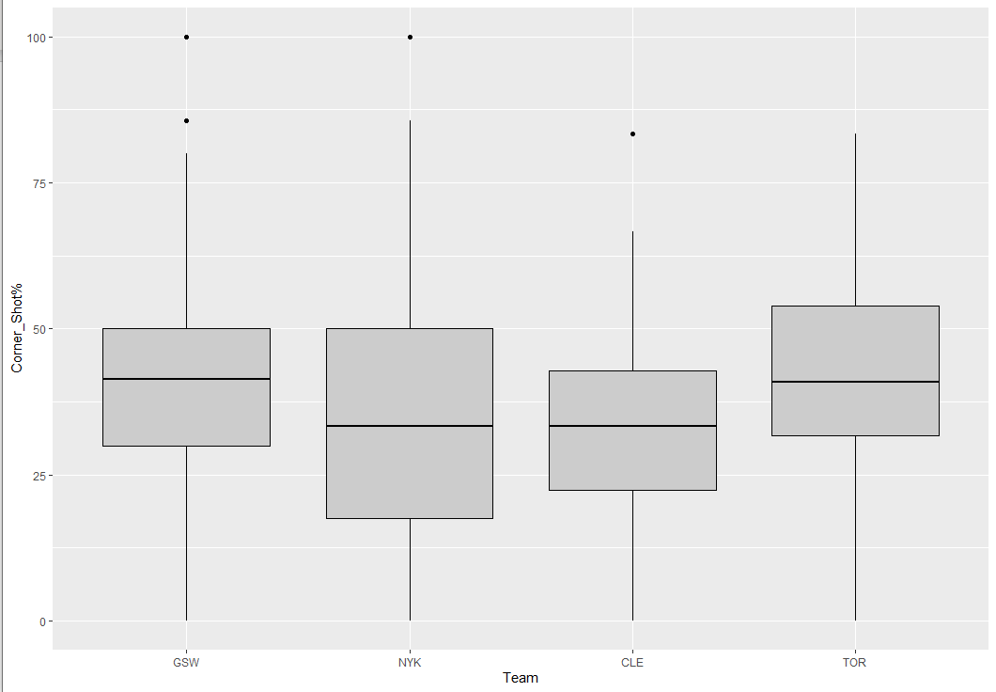
Boxplot
The good teams shoot the corner 3 at around 45%, while the bad teams shoot it at 35%.
The league average is 38%, indicated by the red line.
Every team has a few outlier games where they shoot extremely well, or very poorly.

Slide 9
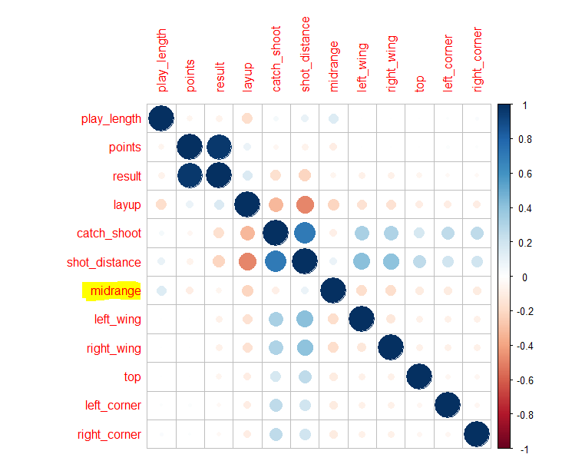
Correlation Plot
Goal: Predict points scored on each shot.
‘result’ was removed from the model.
Shot Types:
(midrange, left wing, right wing, top, left corner, right corner)
Observations:
The mid-range shot type has the most negative correlation with points.
Left wing, right wing, top, left and right corners are all 3 point shots. However, they are not good predictors.

Slide 10
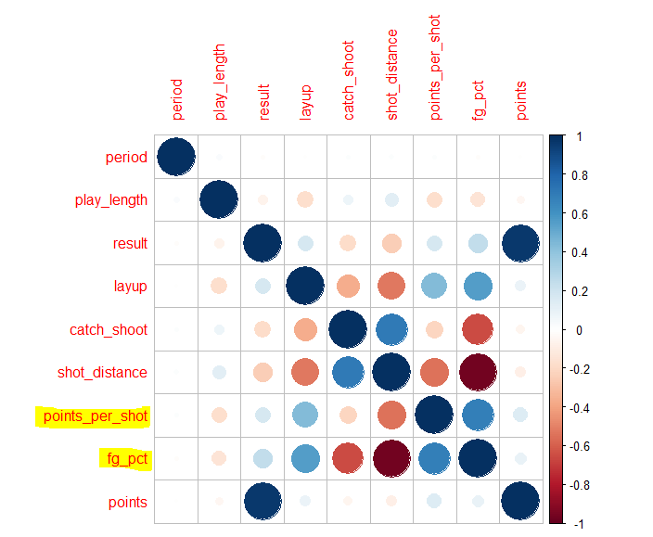
Correlation Plot (continued)
New variables: Points per shot, and Shot%.
Shot% is the probability of the shot going in, given the distance, location and shot type.
Points per shot will indicate the average expected points depending on shot location and shot type.
Points per shot is Shot% multiplied by 2, or 3,
Depending on the distance.

Slide 11
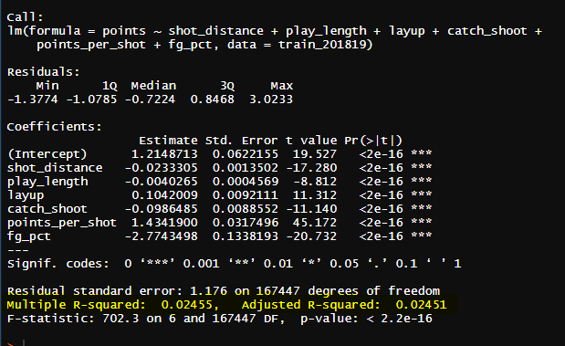

Linear Regression Model
Observations:
Very low R²
The independent variables are still not explaining much when it comes to the variance of ‘points’.
Very low prediction accuracy (~15%)
Suggestions for improvement:
Introduce player shot percentages, so that good shooters will have a higher number predicted for points.
Look at other sources to introduce new predictors.

Slide 12
Questions?

