Slide 1

7COM1079-2022 Student Group No: A099 Names of Student Attendees: Mukaila Salami, Rane Ebinne, Adeyemo Ayobami, Emmanuel Archibong
Group Id: A99 Name of Student Presenting: Daniel Williams
Data Analysis – Does the data show a correlation between the price (in dollars) of a house and its area (measured in square feet) in the USA?
Date: 04/11/24

Slide 2
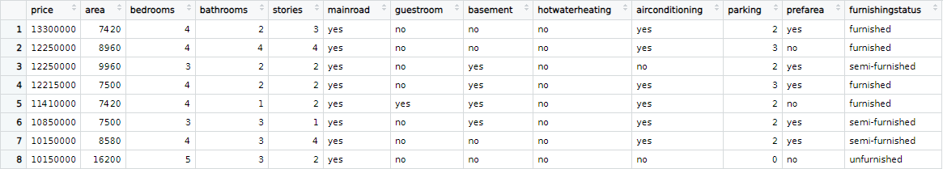
7COM1079-2022 Student Group ID: A99
We are using the dataset DS003 [Housing.csv] to answer our Research question “Is there a correlation between the price (in dollars) of a house and its area measured in square feet in the USA?“
2
The dataset has 545 rows
The dependent variable is price ($)
The independent variable is area (sq ft)
Notes:
2

Slide 3
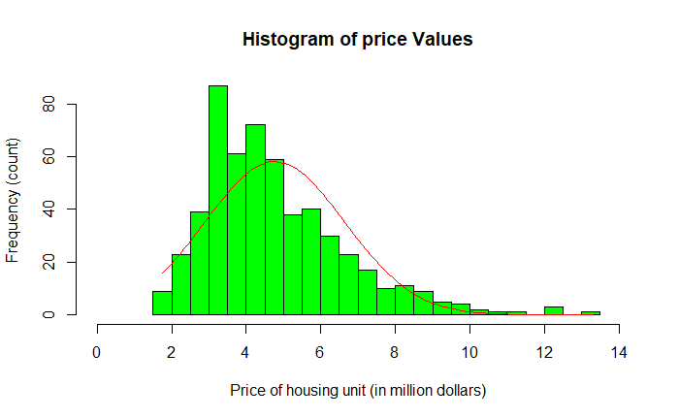
Here is a Histogram showing the frequencies of our dependent variable (price) to include the normal curve overlay.
Our RQ asks about Correlation
The normal curve overlay does not follow the shape of the underlying data, so for our analysis we use the non-parametric test for correlation that does not assume normality: Spearman’s Rho
3
Notes:
3

Slide 4
R Script and Results (For ALL types of test) – The Analysis
PRE 7COM1079-2022 Student Group No: ?????
4
RSCRIPT SNIPPET
#spearman correlation test
correlation_test <- cor.test(data$area, data$price, method = "spearman")
cat("\nCORRELATION ANALYSIS:\n")
cat("Spearman correlation coefficient:", correlation_test$estimate, "\n")
cat("P-value:", correlation_test$p.value, "\n")
RESULT: TEST STATISTIC
CORRELATION ANALYSIS:
Spearman correlation coefficient: 0.6028589
P-value: 3.128554e-55
P-VALUE
The p-value is <0.05
Notes:
4

Slide 5
R Script and Results (For ALL types of test) – The Analysis
PRE 7COM1079-2022 Student Group No: ?????
5
IS THE RESULT SIGNIFICANT?
Yes, the result is significant
DO YOU ACCEPT OR REJECT THE NULL HYPOTHESIS?
The null hypothesis is rejected
MEANING OF THE RESULT: WHAT WE LEARNT?
The test shows a moderate positive correlation (around 0.6) between housing area and price, with a very low p-value indicating a statistically significant relationship.
Notes:
5

Slide 6
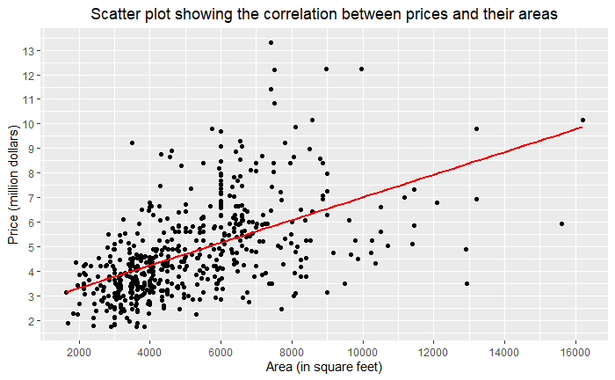
R Script and Results (For ALL types of test) – The Analysis
PRE 7COM1079-2022 Student Group No: ?????
6
Notes:
6

