Slide 1

AfriAvo Intelligence
AI-Powered Forecasting for Africa's Avocado Value Chain

Slide 2
Problem
Low forecasting capability, climate uncertainty, and volatile markets.

Slide 3
Solution
AI forecasting, ROI engine, and export intelligence.

Slide 4
Market Opportunity
Rwanda → East Africa → Africa-wide expansion.

Slide 5
Business Model
Subscriptions, premium reports, enterprise analytics.

Slide 6
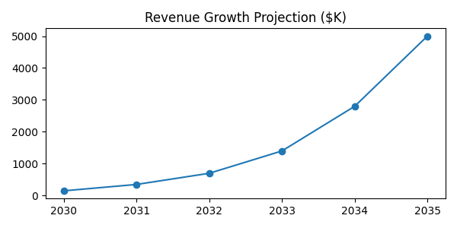
Financial Growth
Projected scaling through 2035.

Slide 7
Vision
Become Africa's leading agricultural intelligence platform.

Slide 8
Investment Ask
Strategic capital and partnerships for scale.

