Slide 1

CS589 PROJECT: Customer Support System: An email to the customer
Name: Makinde Emmanuel Student ID : 19729
Prof. Henry Chang
San Francisco Bay University

Slide 2
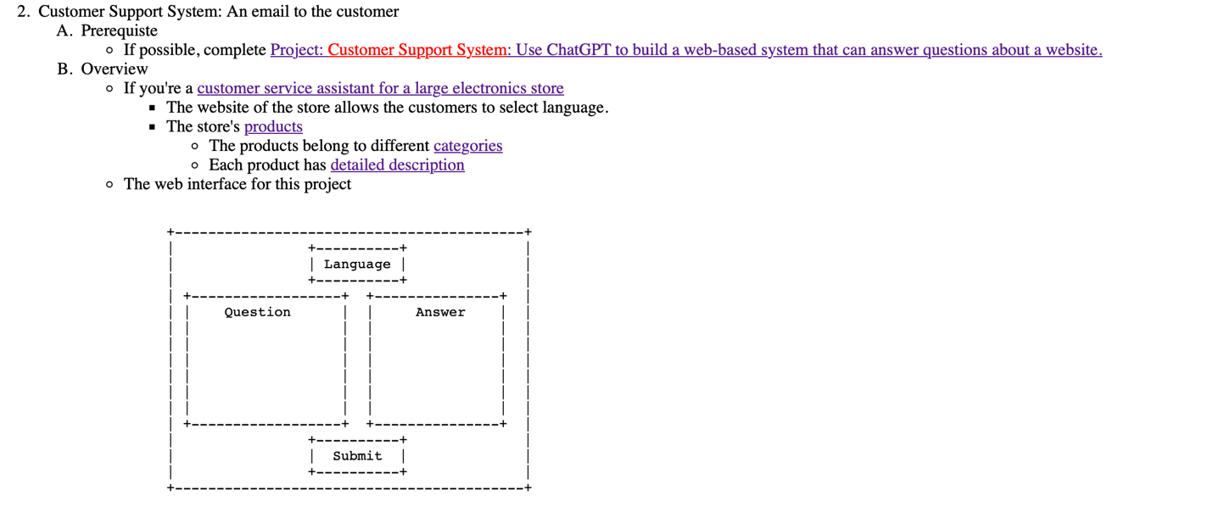
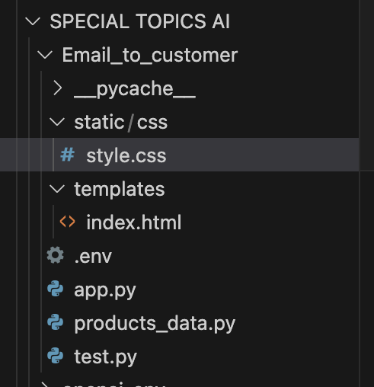

Slide 3


STEP 1

Slide 4

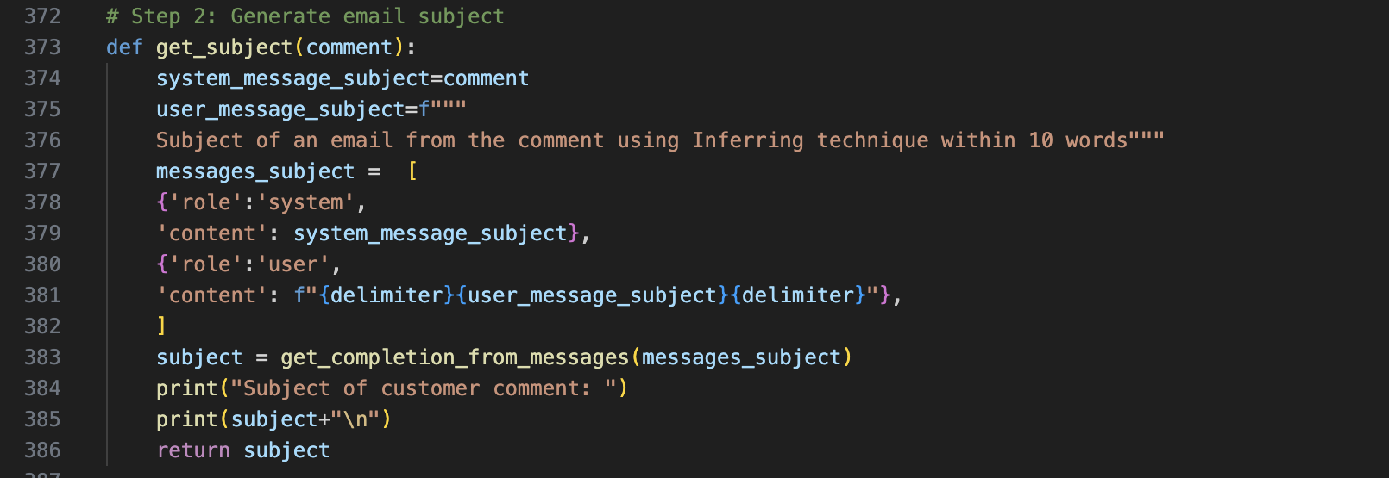
STEP 2

Slide 5


STEP. 3

Slide 6


STEP 4

Slide 7


STEP 5

Slide 8
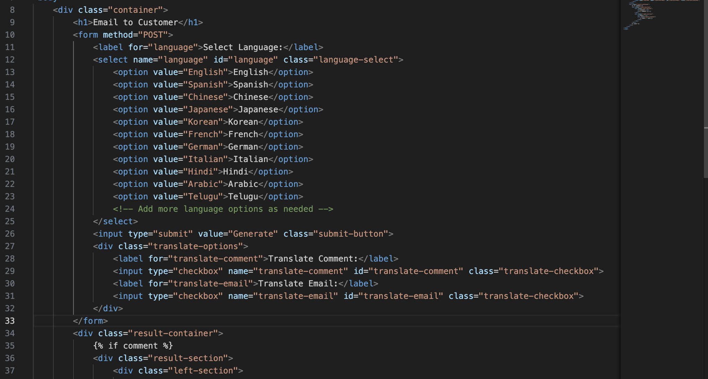
Html/css file

Slide 9
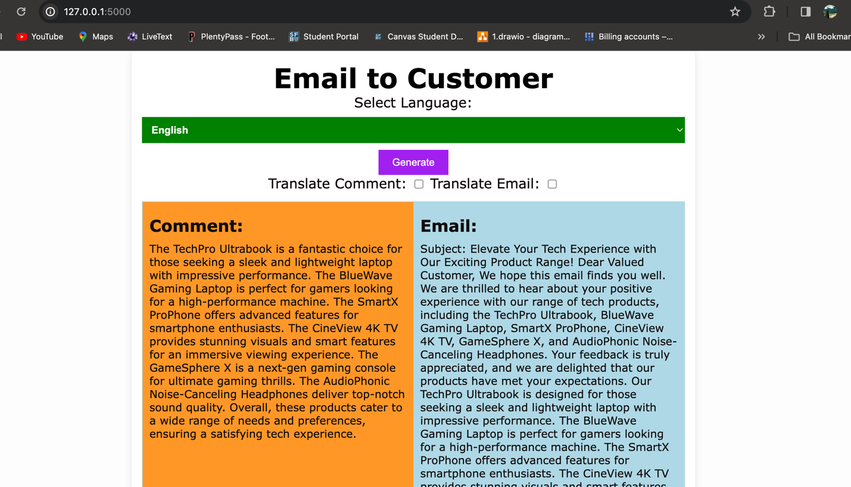
Run on localhost and port

