Slide 1
CHALKBOARD / THE PRODUCT
A live canvas for
shared thinking.
01 FIND THE SIGNAL
everyone can build on
Chalkboard is a real-time collaborative room where a team, a class, or a study group draws, explains, and sees one another's work as it happens — with one shared, persistent canvas to build on.
02 MAKE IT SHARED
then move together
BETA LIVE — CHALKBOARD.CLICK
EXTENSIBLE PLUGIN PLATFORM
CHALKBOARD — PITCH DECK
01 / 11
Notes:
Chalkboard: one shared, persistent canvas for thinking together. Beta is live at chalkboard.click.

Slide 2
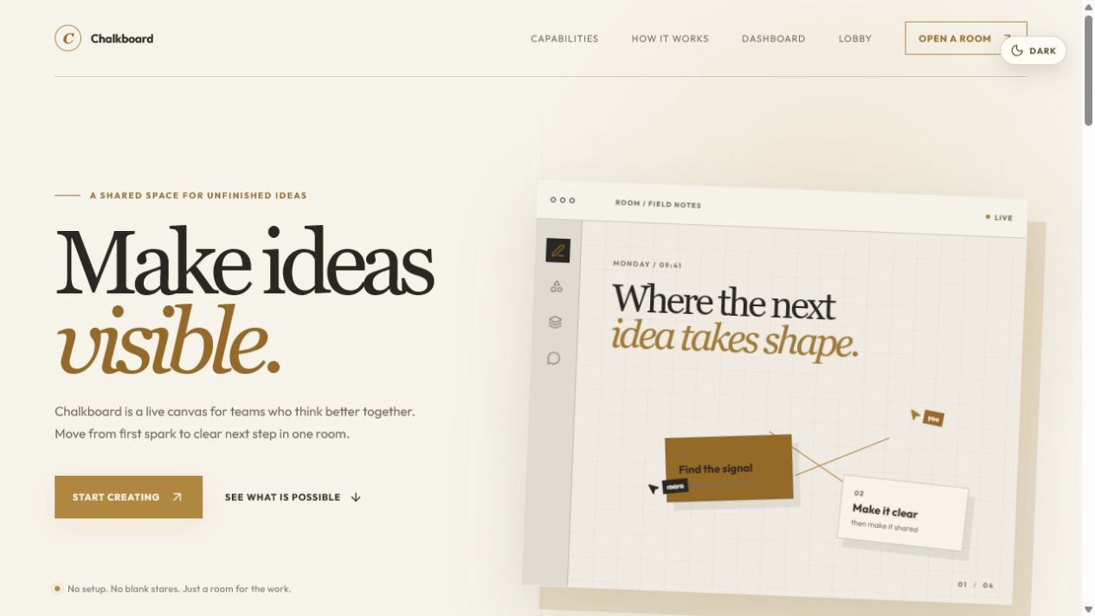
THE PROBLEM / 01
Good thinking gets scattered across disconnected tools.
Conversation happens in the video call, diagrams in a whiteboard app, notes in a document, links in chat.
THE USUAL ROOM / FOUR FRAGMENTS
01
Video call — the conversation
02
Whiteboard — the diagrams
03
Document — the notes
04
Chat — the links
DEMO SCENE 01 — WHERE THE IDEA STARTS
THE COST — everyone leaves with a different version of what was decided. 3–4 tools per session, zero shared homes for the idea afterward.
Where did we put that?
CHALKBOARD — PITCH DECK
02 / 11
Notes:
Ideas live across video, whiteboard, docs, and chat. Nothing keeps discussion, visual thinking, and next steps in one place.

Slide 3
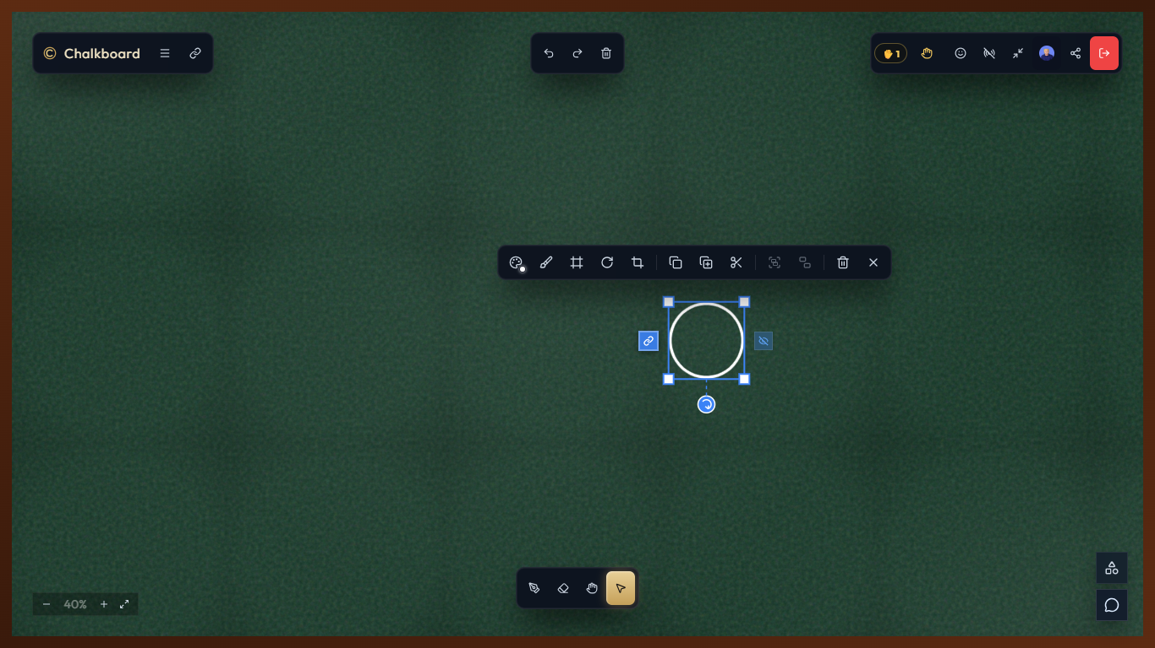
THE PRODUCT / 02
One room where the whole idea lives.
Chalkboard gives a team, classroom, workshop, or study group one shared, persistent canvas — drawn on together, live.
THE ROOM / WHAT IT GIVES YOU
Draw together — annotate the same canvas at the same time
See everyone — presence, live cursors, names, reactions
Reopen anytime — room history reloads for every participant
Control access — open, ask-to-join, or password rooms
Extend the board — built-in tools and reviewed community plugins
DEMO SCENE — SELECT, MOVE, RESIZE, GROUP, UNDO
A SIMPLE RHYTHM 01 open a room · 02 make it visible · 03 move together.
CHALKBOARD — PITCH DECK
03 / 11
Notes:
One shared, persistent room replaces the fragmented tool chain: draw, explain, react, and leave with the work intact.

Slide 4
THE CANVAS / 03
Tools that keep the thought moving.
Freehand chalk with color, size, intensity, and texture — and rigorous editing on top.
THE TOOLKIT
01
Freehand chalk — color, size, intensity, chalk-dust styling
02
Shapes & systems — lines, arrows, circles, polygons, stars, hearts
03
Notes & links — editable context, saved references to a spot
04
Select & transform — move, resize, rotate, group, duplicate, trim
LIVE DEMO — STROKES APPEAR FOR EVERYONE AS THEY ARE DRAWN
SYNCHRONIZED — every board mutation is shared with the room: undo, redo, clear, and collaborators keep one result, not isolated copies.
CHALKBOARD — PITCH DECK
04 / 11
Notes:
The canvas pairs loose chalk drawing with rigorous editing: selection, transforms, grouping, and synchronized undo/redo. The animated demo plays in slideshow mode.

Slide 5
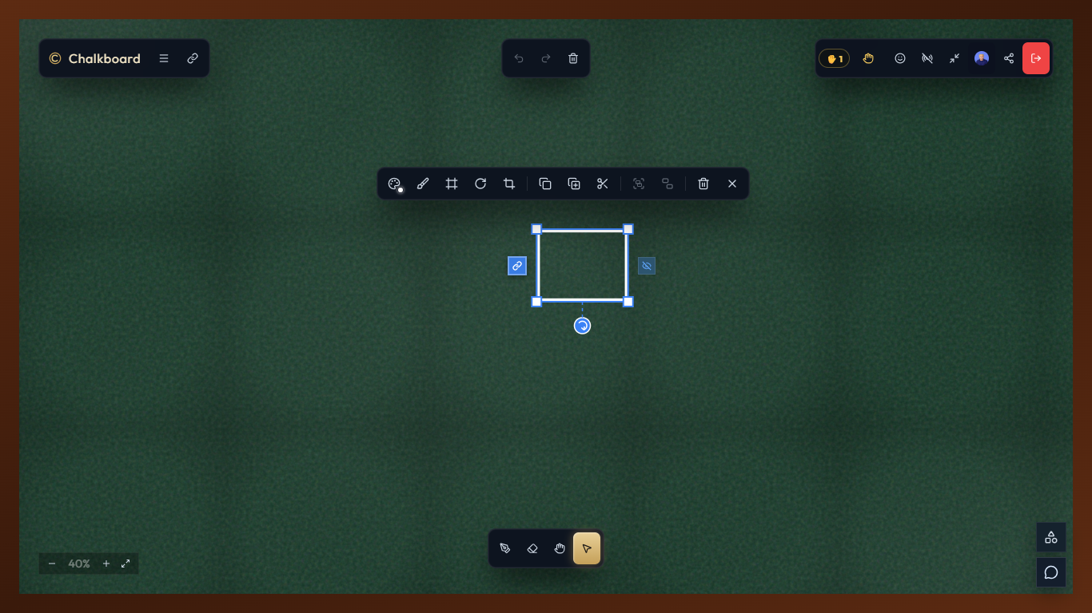
THE ROOM / 04
See everyone's thinking as it happens.
Presence, live cursors, reactions, and raised hands keep the room in sync even when the ideas are not.
INSIDE THE ROOM / LIVE
Live cursors — names and colors, moving in real time
Presence — who is here, where, and who is editing
Reactions & hands — lightweight feedback and raised hands
Voice rooms — scoped LiveKit audio when enabled
Roles — owners, instructors, and viewers
Reconnection — presence grace period — no flicker
THE ROOM — LIVE CURSORS, PRESENCE, REACTIONS, ROLES
ACCESS open rooms · ask-to-join · password-protected — six room themes: classroom, workshop, brainstorm, meeting, planning, studio.
CHALKBOARD — PITCH DECK
05 / 11
Notes:
Live cursors, presence, reactions, raised hands, voice, roles, and reconnection grace keep the room alive together.

Slide 6
ACCESS / 05
Private by default, safe by design.
Rooms start private. Authentication, roles, rate limits, and a guarded admin console do the housekeeping so the canvas stays open.
AUTHENTICATION & CONTROL
BY THE NUMBERS
Google sign-in — credential verified server-side, HTTP-only session cookie
24h
inactivity archive
stale rooms close with their state cleaned up
Room roles — owner, instructor, viewer — capabilities match the role
Platform roles — user, admin, super_admin for the wider system
2FA
admin protection
TOTP codes and recovery codes, separate session
Admin console — separate TOTP two-factor session
Guards — payload validation and rate limits on invites, reactions, hands
3
access modes
open, ask-to-join, password-protected
Lifecycle — inactive rooms archive after 24 hours by default
CHALKBOARD — PITCH DECK
06 / 11
Notes:
Private-by-default rooms, verified Google sign-in, role-based capabilities, TOTP-protected admin, rate limiting, and automatic archiving.

Slide 7
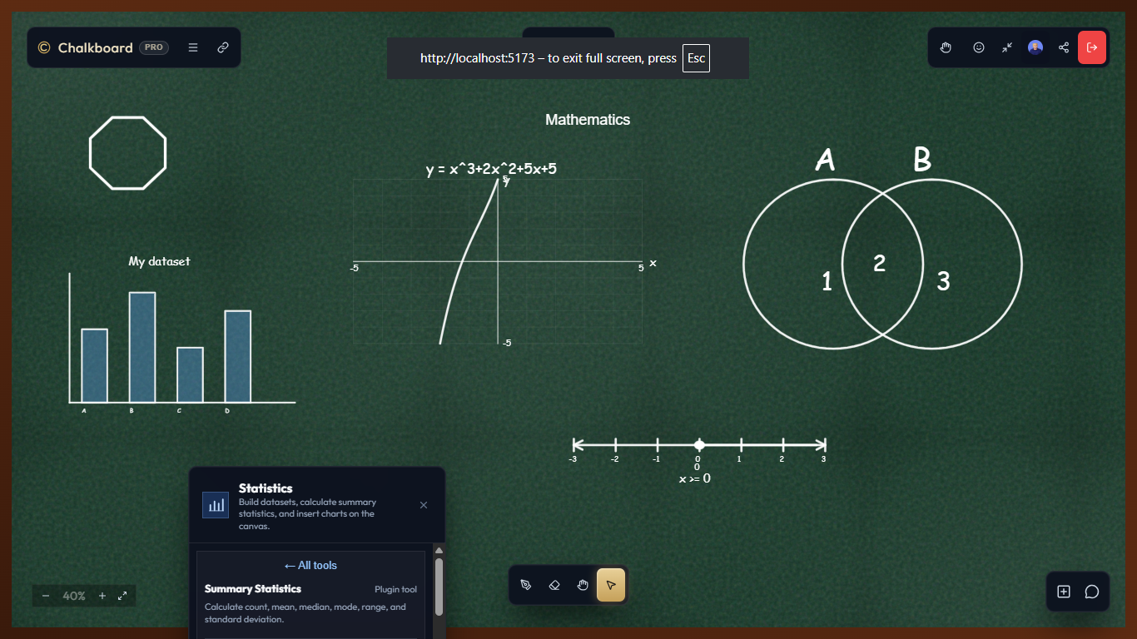
PLATFORM / 06
An extensible plugin platform inside the room.
Built-in tools cover the common cases; a reviewed community catalogue covers the rest — without ever leaving the canvas.
BUILT-IN TOOLKIT
01
Notes — editable text on the board
02
Tags — annotate selected content
03
Statistics — quick computations at the board
04
Mathematical Set — Venn diagrams, number lines, grids, set symbols
05
Example packages — Focus Dot, Inscribed Circles — MIT licensed
BUILT-IN PLUGINS — MATH SETS AS REAL, EDITABLE CANVAS STROKES
DEVELOPER WORKSPACE manifest + permissions · postMessage bridge · draft → review → publish · 15% of paid revenue funds plugin developers.
CHALKBOARD — PITCH DECK
07 / 11
Notes:
Built-in toolkit plus a developer workspace with a reviewed publish lifecycle and a 15% revenue share for plugin developers.

Slide 8
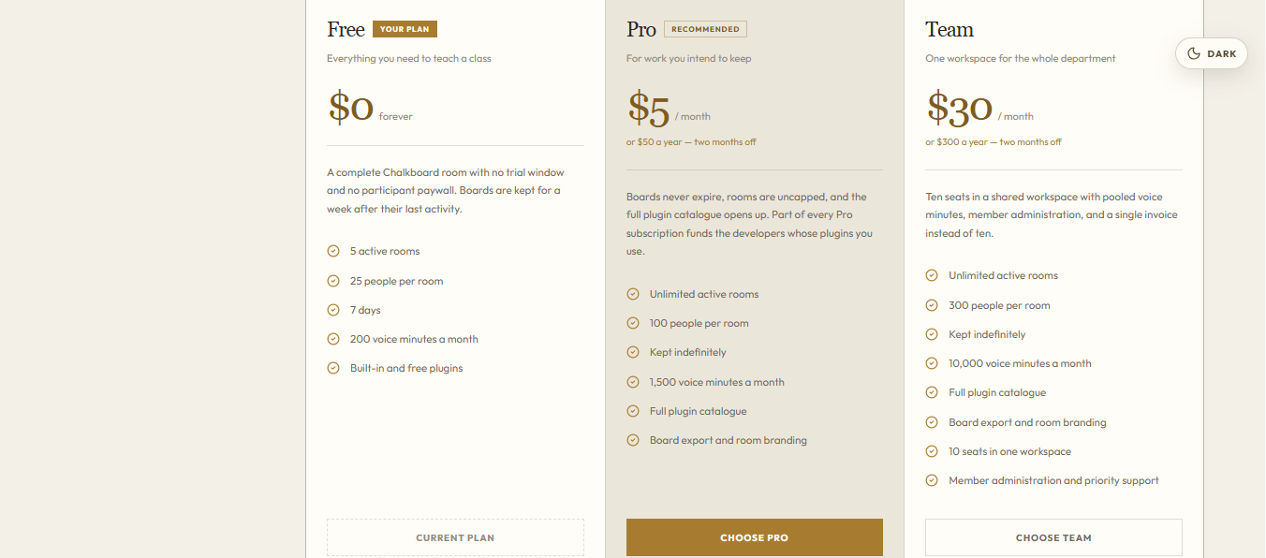
BUSINESS / 07
Free to teach. Subscribed to keep.
A defined Free tier, a Pro tier for work worth keeping, and a Team workspace for whole departments. No participant paywall, ever.
FREE
$0 forever
5 rooms · 25 participants · 7-day retention · 200 voice minutes
RECOMMENDED
PRO
$5 per month · $50 / year
Unlimited rooms · boards kept forever · full catalogue, export, publishing
TEAM
$30 per month · $300 / year
THE PLANS PAGE — SELF-SERVE CHECKOUT
10 seats · 300 participants · pooled voice · workspace admin, priority support
SELF-SERVE hosted checkout & customer portal (card, bank transfer, mobile money) · add-on seats for Team · 15% of paid revenue funds plugin developers.
CHALKBOARD — PITCH DECK
08 / 11
Notes:
Free / Pro / Team tiers from the pricing constants: retention, rooms, participants, voice minutes, seats, plugins, export, branding, workspace admin, priority support. Screenshot: the /plans page.

Slide 9
STACK / 08
Realtime by design, typed end to end.
A deliberately small stack: one Node.js process serves the API, realtime, and the compiled frontend.
React + TypeScript + Vite
Hono + Socket.IO
PostgreSQL + Drizzle
typed browser app, canvas renderers, Zustand state
HTTP API and authenticated realtime rooms, Redis adapter
users, rooms, members, plugins, billing, migrations
Redis + BullMQ
LiveKit + Google Identity
Cloudflare R2 + Zod
live canvas state, presence, rate limits, cleanup jobs
scoped voice tokens, verified server-side sign-in
plugin assets; validated payloads and structured logs
Development mirrors production: Vite proxies /api and /socket.io to the same backend — one process, one contract.
CHALKBOARD — PITCH DECK
09 / 11
Notes:
React/TS/Vite, Hono + Socket.IO with Redis adapter, PostgreSQL + Drizzle, Redis + BullMQ, LiveKit voice, Google Identity, R2 plugin storage.

Slide 10
STATUS / 09
Beta is live. The room is open.
chalkboard.click is running today with realtime rooms, a full plugin lifecycle, self-serve billing, and a guarded admin console.
SHIPPED / TODAY
NEXT / ON THE ROAD
Realtime rooms — history, reconnection, voice, roles, access modes
01
Onboarding — sharpen invites and first-room flow.
Canvas toolkit — chalk, shapes, notes, links, selection, sync
02
Catalogue — grow reviewed community plugins.
Plugin platform — workspace, review, approval, publishing
03
Scale — presence and voice across instances.
Self-serve billing — Free / Pro / Team with hosted checkout
Admin console — TOTP 2FA, plugin reviews, analytics
04
Tooling — export and workspace administration.
Try it: chalkboard.click
CHALKBOARD — PITCH DECK
10 / 11
Notes:
Beta is live at chalkboard.click. Shipped: rooms, canvas, plugins, billing, admin. Next: onboarding, catalogue, scale, tooling.

Slide 11
CHALKBOARD
Move together.
Give the next idea somewhere to go — a live room at chalkboard.click, or this repository to read the full plan.
OPEN A ROOM — CHALKBOARD.CLICK
CHALKBOARD — PITCH DECK
11 / 11
Notes:
Closing: Move together. CTA to chalkboard.click and the repository.

