Slide 1

LUNG CARE AI
Under the Guidance of:
Dr. Sarika S
Asso. Prof
Dept of CSE
Submitted By:
Allan T Jose
Emmanuvel Jose
Arun Jibi
Adarsh Jin

Slide 2
CONTENTS
1. Introduction
2. Objectives
3. Problem Statement
LITERATURE SURVEY
4. CXR-Net: A Multitask Deep Learning Network for Explainable and Accurate Diagnosis of COVID-19 Pneumonia From Chest X-Ray Images
5. Biomedical Image Analysis for Colon and Lung Cancer Detection Using Tuna Swarm Algorithm With Deep Learning Model

Slide 3
CONTENTS
6. Stochastic Learning-Based Artificial Neural Network Model for an Automatic Tuberculosis Detection System Using Chest X-Ray Images
7. Knowledge-based Collaborative Deep Learning for Benign-Malignant Lung Nodule Classification on Chest CT Network
8. CDC_Net: multiclassification convolutional Neural Network model for detection of COVID-19, pneumothorax, pneumonia, lung Cancer and tuberculosis using chest X-rays
9. Automated diagnosis of COVID-19 with limited posteroanterior chest X-ray images using fine-tuned deep neural networks

Slide 4
CONTENTS
PROPOSED MODEL
10. Architecture
11. Module Description
12. Implementation
13. Conclusion
14. References

Slide 5

INTRODUCTION
Importance of Early Detection
•Timely diagnosis for improved survival rates.
•The current diagnostic process is resource-intensive, time-consuming, and depends on expert interpretation.
Machine Learning as a Solution
•Deep learning, offers a promising solution for enhancing Lung cancer detection.
•The utilization of AI in lung cancer detection represents a significant advancement in the field.

Slide 6
PROBLEM DEFINITION
The existing challenge revolves around the complexities associated with tracking and diagnosing lung diseases.
The manual diagnostic process is often arduous and intricate.
The Lung Disease Detection System, powered by Convolutional Neural Networks (CNNs), offers a solution by streamlining and automating the diagnosis process

Slide 7

OBJECTIVES
To create an efficient and user-friendly mobile application to detect Lung Diseases, that harnesses the power of Convolutional Neural Networks (CNNs).
To accurately identify and classify different lung disease conditions from medical images.
To enhance healthcare outcomes by enabling timely disease detection and suggesting appropriate medical interventions and treatment plans based on the identified lung conditions.

Slide 8

LITERATURE
SURVEY

Slide 9
TITLE | TECHNIQUES / PROTOCOL | ADVANTAGES | DISADVANTAGES | AUTHOR
CXR-Net: A Multitask Deep Learning Network for Explainable and Accurate Diagnosis of COVID-19 Pneumonia From Chest X-Ray Images | CNN with encoder and decoder | Sharper and More Precise Visualizations | Computational Complexity with Large Kernel Sizes | Stephen White, Feb 2023
Biomedical Image Analysis for Colon and Lung Cancer Detection Using Tuna Swarm Algorithm With Deep Learning Model | GhostNet and Ecostatic network | High Accuracy | Higher Complexity | Marva Obayya, Aug 2023
Stochastic Learning-Based Artificial Neural Network Model for an Automatic Tuberculosis Detection System Using Chest X-Ray Images | Stochastic Gradient Descent | High Accuracy when compared to state-of-the-art methods. | Initialization Sensitivity Convergence and Local Minima | Shabana Urooj, 2022 Oct 5
Knowledge-based Collaborative Deep Learning for Benign-Malignant Lung Nodule Classification on Chest CT | MV-KBC approach | Multi-view learning, Collaborative Sub models | Nodule segmentation accuracy affect classification | Yutong Xie

Slide 10
TITLE | TECHNIQUES / PROTOCOL | ADVANTAGES | DISADVANTAGES | AUTHOR
CDC-Net: multi-classification convolutional Neural Network model for detection of COVID-19, pneumothorax, pneumonia, lung Cancer and tuberculosis using chest X-rays | Residual Network and Dilated convolution | Addresses resolution loss and texture pattern extraction challenges | Model Complexity and Dependency on High-Quality Data | Hassaan Malik 2022
Automated diagnosis of COVID-19 with limited posteroanterior chest X-ray images using fine-tuned deep neural networks | Weighted Class and Random oversampling approach Using CNN | Rapid Screening and Scalability | Limited Data and Generalization | Narinder Singh Punn 2020

Slide 11
PROPOSED MODEL

Slide 12
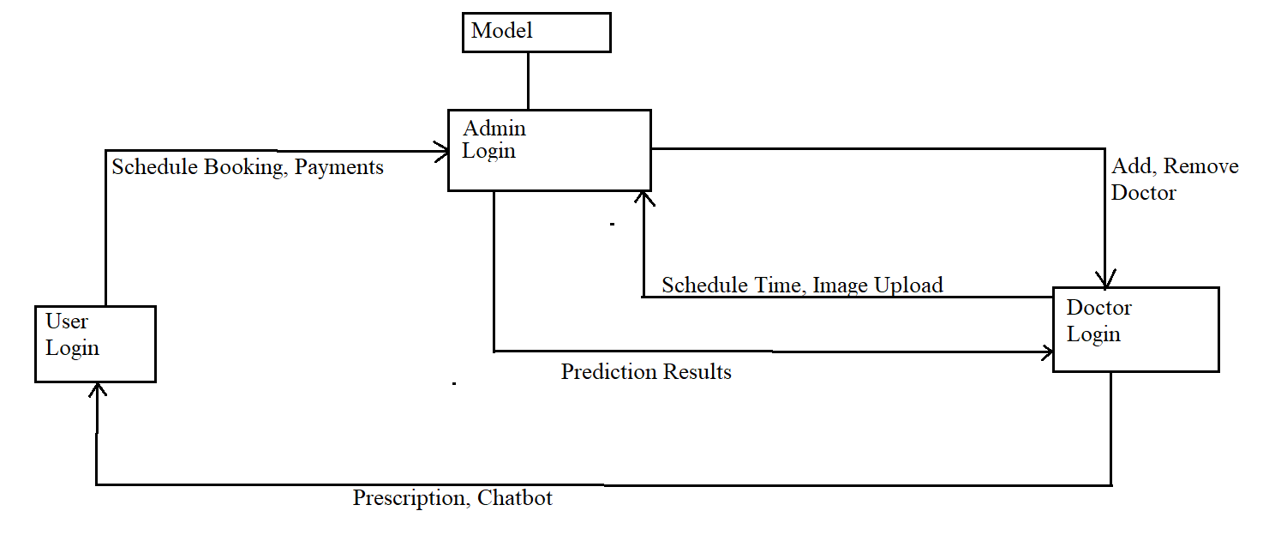
ARCHITECTURE
Doctor Login
User Login
Schedule
Medical Image
Booking and Consulting
Add Doctor
Pre-Processing
RESULT
Trained CNN Model
Admin

Slide 13
MODULE DESCRIPTION
User
Register/ Login
Choose and Consult
Doctor
Consultation Payment
View Prescription
Doctor
Login/Register
Schedule Consulting Time
View user details
Upload Medical Image
View Prediction result
Prescribe Medicines
Admin
Login/Register
Add Doctor
Client Support
Security
Obtain model result

Slide 14
User Module
User can see the prescription for the disease identified and confirmed by the doctor with Ai help and chat assistance is also made available.
Appointments and payments can be done to the Doctors.
Obtain useful tips for his/her health conditions.
Implemented as an Android Application.

Slide 15
Doctor Module
Doctors can login into the system, preview medical images, and prescribe medications to the patients.
Chat functionality to chat with the patients about their medical conditions.
Preview medical images and prescribe medications.
Implemented as a Web Application.

Slide 16
Admin Module
Management and fine tuning of the machine learning model to fit the varied needs of the clients.
Provide security for the clients’ data.
Add or remove Doctors as necessary.
Provide security and maintain the system from unauthorized access.
Admin passes the images received from Doctor to the Model, and returns the results to the Doctor.
Implemented as a Web Application.

Slide 17
IMPLEMENTATION
Bacterial Pneumonia
Sequential Model
Benign Tumor
CoViD-19
Image Dataset
Malignant Tumor
Normal Lungs
Tuberculosis
Flatten
Convo
Convo
Convo
Dropout
Dense
Max Pooling
Dense
Viral Pneumonia
Max Pooling
Max Pooling
Module Implementation
Python Flask : Web App
Java : Android App
WAMP : Database
Python TensorFlow :CNN Model
Test Accuracy: 95%
Loss Function: Categorical Cross Entropy
Optimizer Algorithm : Adam
Activation Functions: ReLu, Softmax
Preprocessing techniques: Rescaling, Rotation, Zoom, Flip, Shear

Slide 19
WORK ALLOCATION
Front End | Emmanuel Jose, Adarsh Jin
Module Building | Emmanuel Jose , Allan T Jose, Adarsh Jin, Arun Jibi
Model Building | Adarsh Jin, Arun Jibi
Model Training and Integration | Adarsh Jin, Allan T Jose
Model Testing | Arun Jibi , Emmanuel Jose
Database Management | Allan T Jose, Arun Jibi

Slide 20
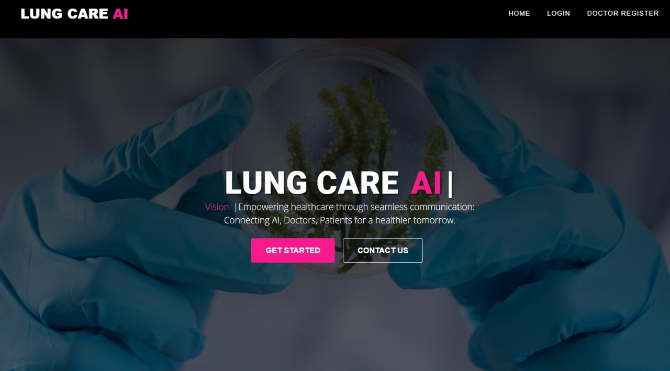
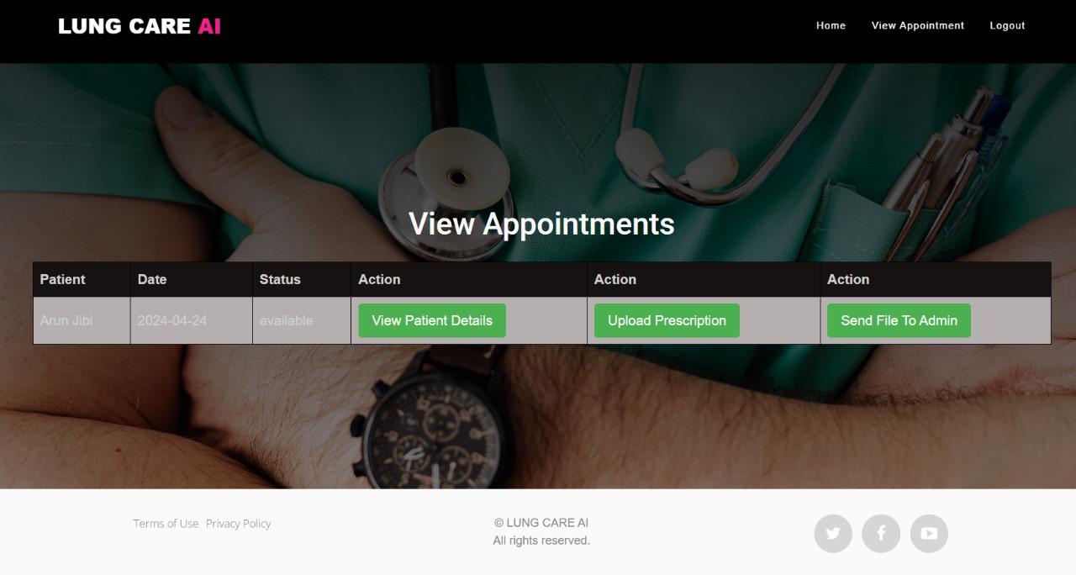
DEMO
Fig: Web Application Home Page
Fig: Appointment view in Web Application

Slide 21
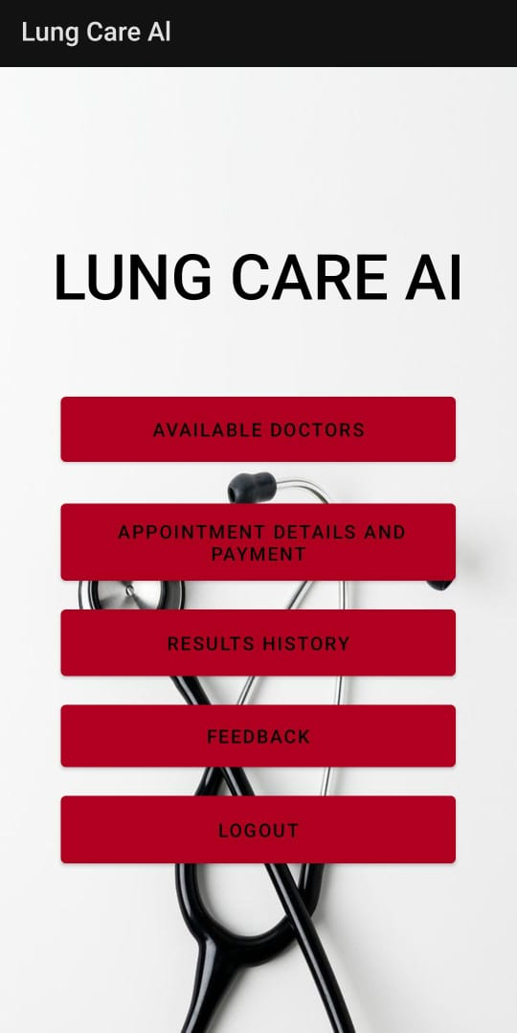
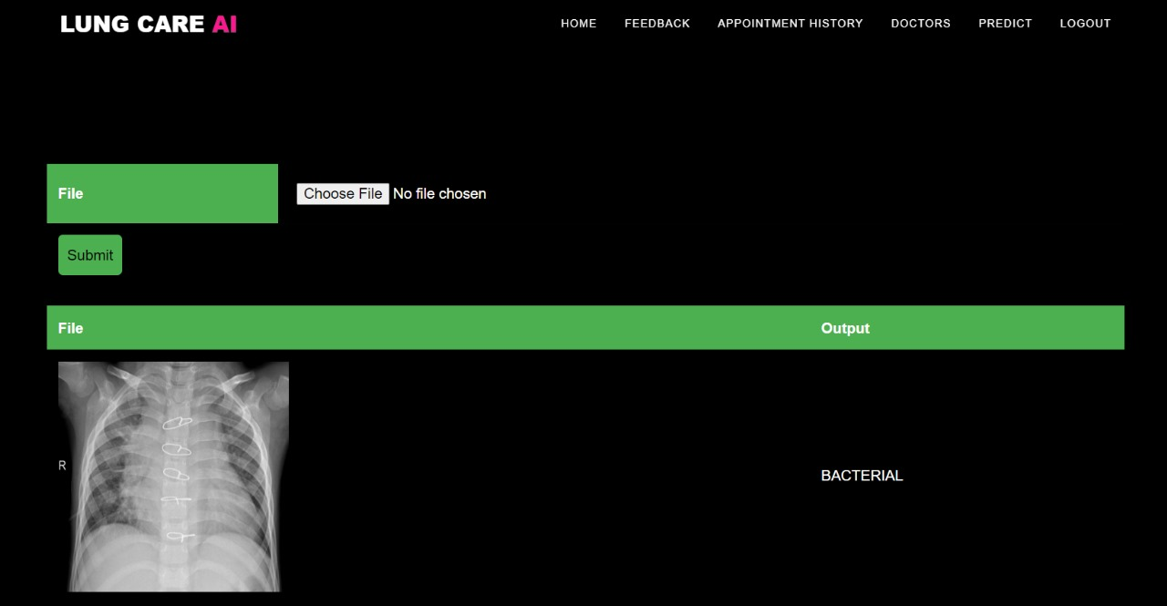
Fig: AI Model Interface
Fig: Android Application Home Page

Slide 22
CONCLUSION
•Meticulously incorporated advanced image preprocessing, feature extraction, and deep learning techniques to elevate the accuracy of lung disease predictions.
•The deployment of deep neural networks resulted in notably improved precision in identifying lung diseases and accurately forecasting disease conditions.
•This research underscores the transformative potential of AI in effectively distinguishing and classifying a relatively less common diseases.

Slide 23
REFERENCES
[1] YutongXie,, “Knowledge-based Collaborative Deep Learning for Benign Malignant Lung Nodule Classification on Chest CT” ,2018, IEEE .
[2] Vijayakumar, T. "Classification of Brain Cancer Type using Machine Learning." Journal of Artificial Intelligence 1, no. 02 (2019): 105-113.
[3] LilikAnifah, Haryanto, RinaHarimurti, “Cancer lung detection on CT Scan image using ANN backpropagation based gray level co occurrence matrix feature.” 978-1-5386-3172-0/17/ 2017 IEEE .
[4] Prof. Anuradha Deshpande, Dhanesh Lokhande, “Lung cancer detection with fusion of CT and MRI image using image processing.” (IJARCET) Volume 4 Issue 3, March 2015 .
[5] RachidSammouda, “Segmentation and analysis of CT chest images for early lung cancer detection.” Global Summit on Computer & Information Technology 978-1-5090-2659-3/17 2017 IEEE.
[6] Abbas Khosravi, Amin Khatami, “Lung cancer classification using deep learned features on low population dataset.” Canadian Conference on Electrical and Computer Engineering (CCECE) 978-1-5090-5538- 8/17 2017 IEEE .
[7] https://en.wikipedia.org.
[8] https:// www.icmr.nic.in

Slide 24


