Slide 1
Distributed Wireless Sensor Network
FIT3143 Applied #1 | EV Charging Navigation Simulator
Erwyna Soo | [student ID] | [Monash email]
Taabish [surname] | [student ID] | [Monash email]
Notes:
Hi, we're Erwyna and Taabish, and this is our design for the EV charging wireless sensor network simulator. I'll cover the topology choice and the structure of our MPI architecture, and Taabish will cover the message passing and the communication analysis.

Slide 2
CONTEXT
The system we simulate
Grid of EV charging nodes, each with charging ports
Over threshold → query adjacent neighbours
Neighbourhood saturated → alert base station
Base station: log, find closest free node, redirect
Notes:
The system we're simulating is a grid of EV charging nodes. Each node has charging ports; when a node passes its utilisation threshold it asks its neighbours, and if the whole neighbourhood is saturated it alerts a base station, which finds the closest free node and redirects incoming vehicles.

Slide 3
TASK 1
Comparing Week 5 topologies
Topology | Diameter | Fault tolerance | Scales?
Line | n − 1 | None: one cut splits it | No
Ring | ⌊n/2⌋ | Survives 1 cut | Poorly
Star | 2 | Hub = single point of failure | Hub bottleneck
Binary tree | ≈ 2 log₂ n | None: any cut splits it | No redundancy
Fully connected | 1 | Excellent | n(n−1)/2 links: unrealistic
2-D mesh | ≈ 2(√n − 1) | Redundant paths | Yes: degree capped at 4
Hypercube | log₂ n | Good | Needs n = 2^k
Notes:
For Task 1 we compared seven topologies from Week 5 on diameter, link count, fault tolerance and scalability. Line and tree fail immediately on fault tolerance: cut any link and the network splits. A ring survives one cut but its path length grows linearly, so it doesn't scale. Fully connected has perfect fault tolerance but needs n squared links, which no wireless deployment can provide. A star matches the base-station traffic but makes the hub a single point of failure for everything.

Slide 4
TASK 1
Our choice: 2-D mesh + star overlay
Spec = Cartesian grid, neighbours-only radio range
Mesh: redundant paths, degree capped at 4
Star overlay: every node reaches the base station
Realistic for a wireless sensor network
Notes:
So we chose a hybrid: a 2-D mesh between charging nodes, because the spec places nodes in a Cartesian grid talking only to adjacent neighbours, which is also what real radio range gives you, plus a star overlay to the base station for logging and redirection. The mesh gives redundant paths if a node dies, and its degree is capped at four, so it scales incrementally.

Slide 5
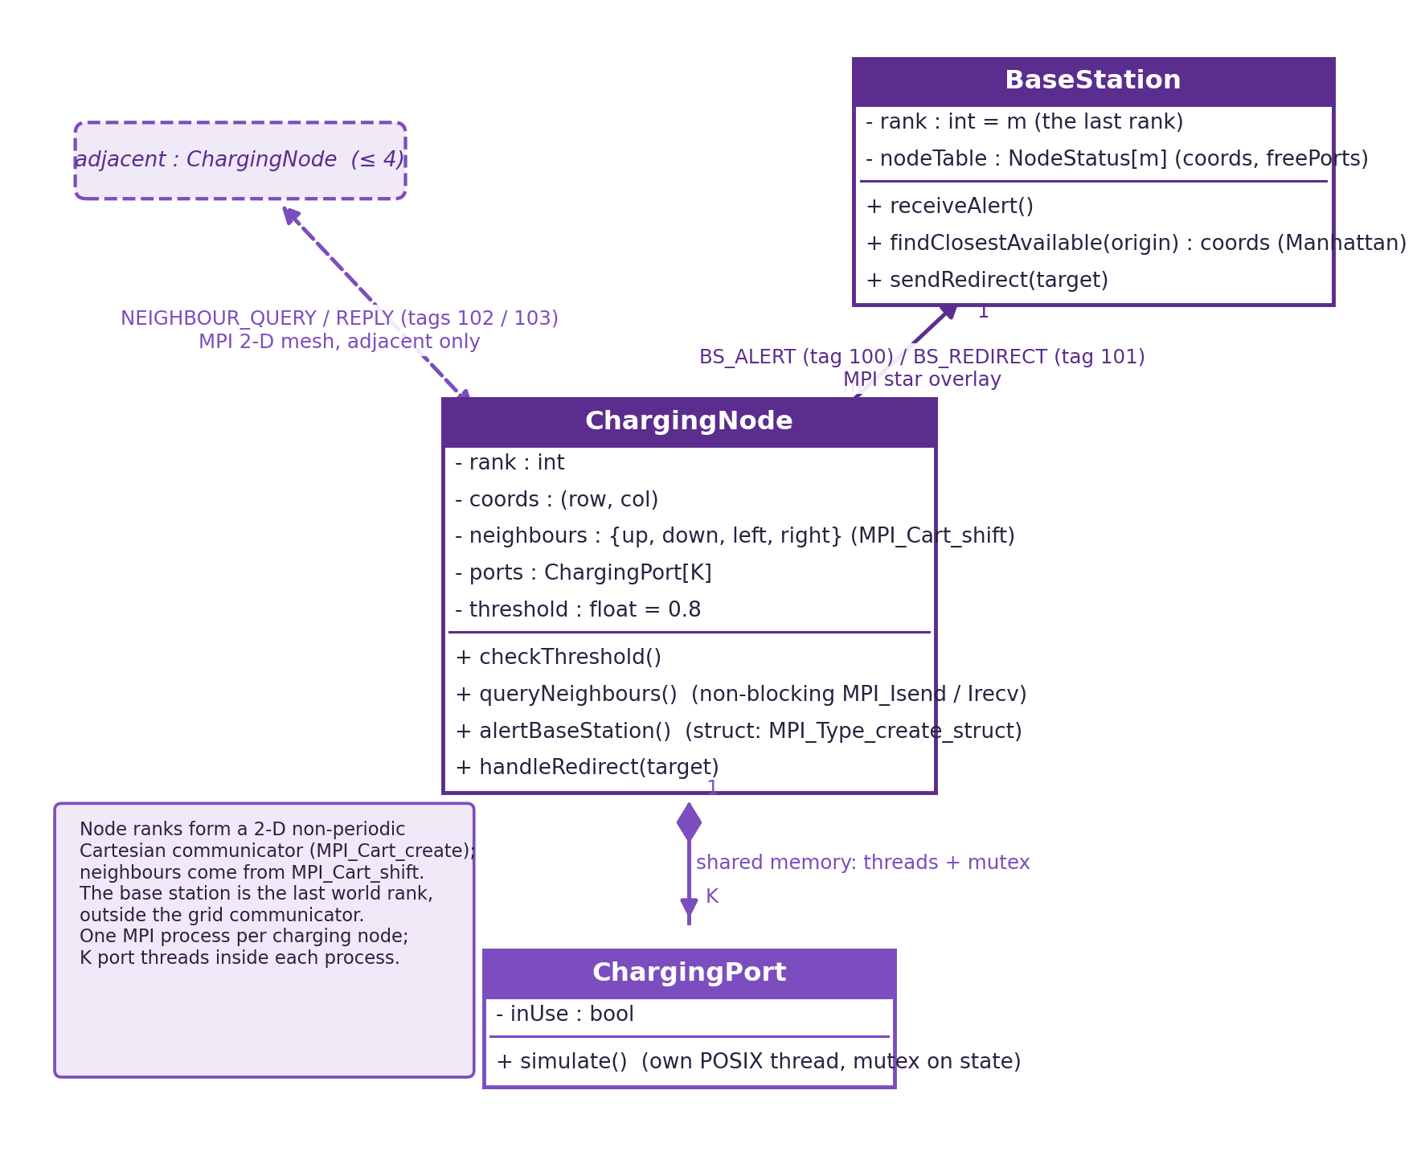
TASK 2
MPI architecture
1 charging node = 1 MPI process (MPI_Cart_create grid)
Neighbours via MPI_Cart_shift
Base station = dedicated rank, global table, Manhattan search
Ports = POSIX threads per node, mutex on shared state
Shared memory within machines + message passing between
Notes:
For Task 2, each charging node is one MPI process. The node ranks form a Cartesian communicator built with MPI_Cart_create, so every process finds its four neighbours with MPI_Cart_shift instead of us hard-coding a mapping. The base station is a dedicated rank holding the global availability table and doing a Manhattan-distance search for the closest free node. Inside each node process, every charging port is a POSIX thread updating shared port state under a mutex, so we combine shared-memory parallelism inside each multi-core machine with message passing between machines.

Slide 6
TASK 2
Deployment: machines, cores, bandwidth
3×3 grid + base station = 10 MPI processes
2 × 8-core machines, spare cores for port threads
Alert struct < 512 B → ~37 kbit/s worst case
1 Gbps Ethernet is ample
Notes:
A 3 by 3 grid needs ten processes; two 8-core machines cover that with cores to spare for the port threads. An alert struct is under 512 bytes, so worst-case base-station traffic is tens of kilobits per second, and 1 Gbps Ethernet is ample. Taabish will now take you through the messages themselves and how the delays scale.

Slide 7
Questions?
Appendix slides follow, clearly labelled
Notes:
Q and A period: about one minute each, answered individually, no AI tools. Erwyna covers topology and structure questions, Taabish covers message passing and delay analysis questions. Appendix slides after this one are labelled APPENDIX so markers do not confuse them with assessed sections.

Slide 8
APPENDIX
Extra material: full topology working, delay calculations, code skeleton
Notes:
Not presented: duplicate this divider's style for any extra slides (full delay arithmetic, extra graphs, code snippets) so markers can tell them apart from the assessed sections.

