Slide 1
Information Technology FIT3143 Parallel Computing Semester 2 2026
Applied Week 2

Slide 2
Overview
Introduction to C Programming [45 min]
Parallel computing on shared memory [1 hour]
Single address space: Any memory location can be accessible by any of the processors or cores within a processor.
The basic concept of threads
POSIX Threads: Thread creation, Thread synchronization using mutex

Slide 3
Introduction to C Programming

Slide 4
Instructions
Please download the C working exercises document
Download and prepare a C (or universal) program editor on your laptop
If infeasible, you can use an online editor/compiler for this class (e.g., https://www.programiz.com/c-programming/online-compiler/)
However, you will need one for your machine in later classes
Start working according to the instructions in the exercise document
Note: This is a set of scaffolding exercises for students without C background.
If you are an advanced/experienced C programmer, feel free to help your other classmates!

Slide 5
Parallel Computing on Shared Memory

Slide 6
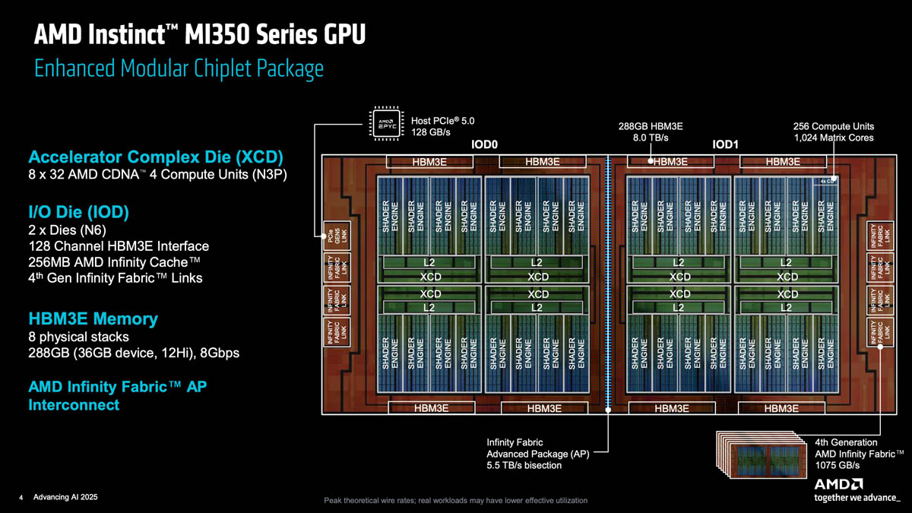
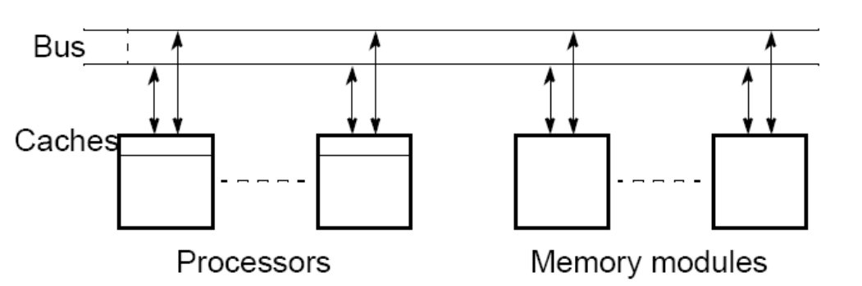
Shared Memory Architecture
Any memory location can be accessible by any of the processors or cores within a processor.
A single address space exists, meaning that each memory location is given a unique address within a single range of addresses.

Slide 7
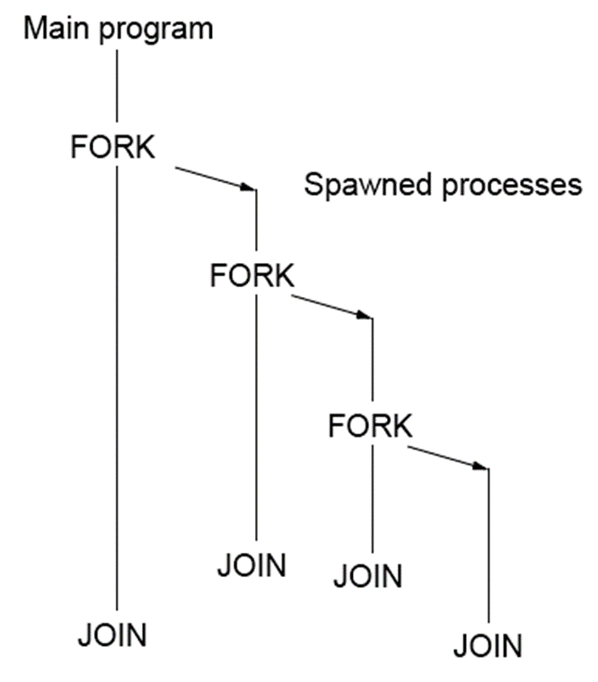

Creating concurrent processes
A process is an instance of a computer program that is being executed.
A process can execute another FORK to spawn further sub-processes, creating a cascade of concurrent tasks.
Each FORK branch eventually converges at a paired JOIN statement to terminate that branch safely.
The JOIN construct relies on a process counter, decrementing as each process finishes, to ensure sequential execution only resumes when the counter hits zero.

Slide 8
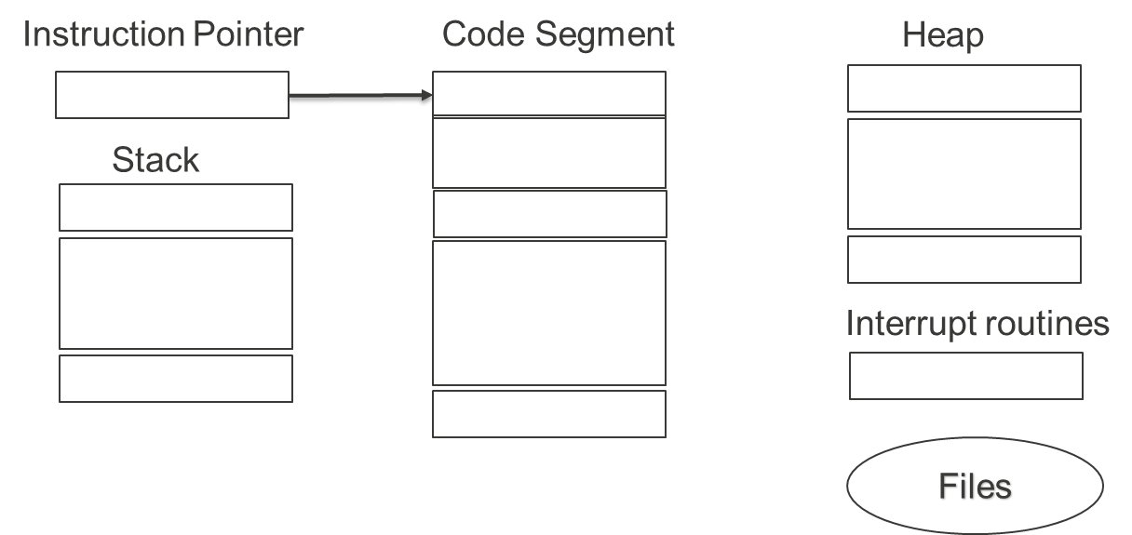
Constructs for specifying parallelism
An instruction pointer holds address of the next instruction to be executed. A stack is present for procedure calls, and a heap, system routines and files.

Slide 9
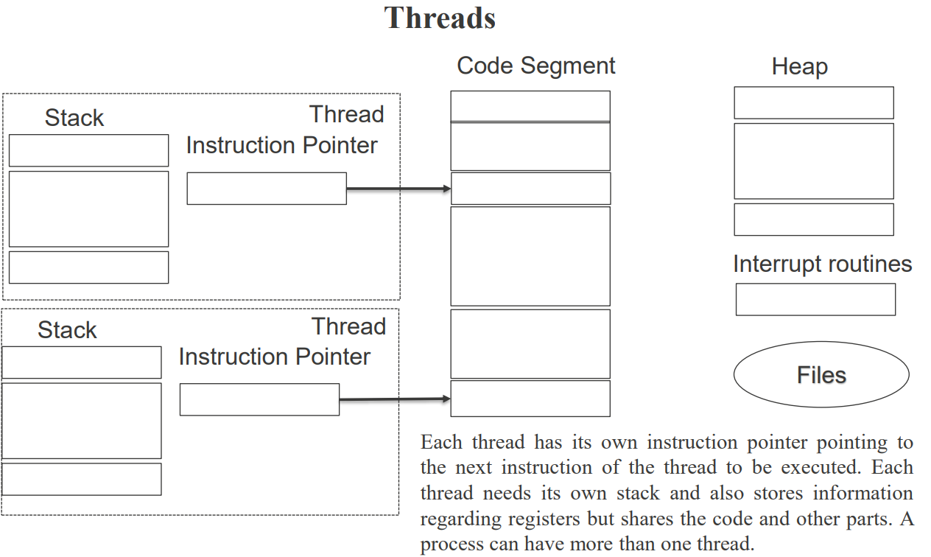
Constructs for specifying parallelism

Slide 10
Why Use Threads?
Creating threads is faster than spawning processes, and threads directly access shared global variables within the same process.
Thread synchronization incurs significantly lower overhead compared to inter-process synchronization.
When a thread blocks (e.g., waiting for I/O or message passing), the CPU can quickly switch to another thread to keep execution pipeline busy.
POSIX Threads (Pthreads, IEEE 1003.1c) is the widely adopted standard, supported across modern OS environments (e.g., Linux, macOS, and Windows via translation layers).

Slide 11
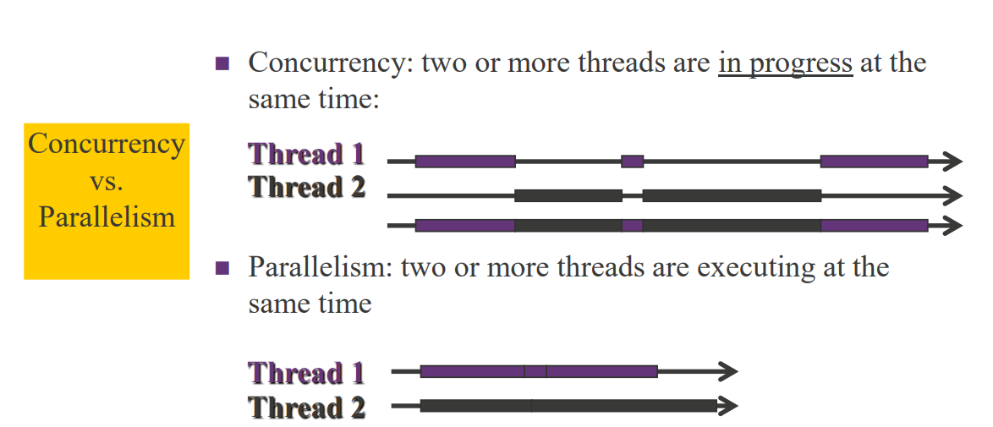
Threads
In shared-address architectures, processors communicate implicitly simply by reading and writing to the same shared memory space. Because communication is automatic, programming for these systems focuses on managing concurrency, synchronization (such as locks), and minimizing memory-access overheads.

Slide 12
Threads
Multiplying two n x n matrices requires n² dot-product operation
// Sequential Execution (Single Thread)
for(row = 0; row < n; row++)
for(column = 0; column < n; column++)
c[row][column] = dot_product(get_row(a,row), get_col(b,col));
Because all n² iterations are completely independent, each dot product can run as its own thread across multiple CPU/GPU cores simultaneously.
// Parallel Execution (n² Concurrent Threads)
for(row = 0; row < n; row++)
for(column = 0; column < n; column++)
c[row][column] = create_thread(dot_product(get_row(a,row), get_col(b,col)));

Slide 13
Thread Basics
On a single processor, multithreading generally occurs by time division multiplexing (as in multitasking): the processor switches between different threads.
This context switching generally happens frequently enough that the user perceives the threads or tasks as running at the same time.
On a multiprocessor or multi-core system, the threads or tasks will generally run at the same time, with each processor or core running a particular thread or task.

Slide 14
Advantages and Disadvantages of Threads
Software portability: Threaded applications can be developed on serial machines and on parallel machines without changes (migrating programs between diverse architectural platforms).
Latency hiding: One of the major overheads in programs is the access latency for memory access, I/O and communication. Multiple threads are executing on the same processor, thus hiding this latency. While one thread is waiting for a communication operation, other threads can utilize the CPU, thus masking associated overhead.

Slide 15
Advantages and Disadvantages of Threads
Scheduling and load balancing: A programmer must express concurrency in a way that minimizes overheads of remote interaction and idling. In many structured applications, the task of allocating equal work to processors is easily accomplished. In unstructured and dynamic applications (e.g. game playing and discrete optimization) this task is more difficult. Threaded APIs allow the programmer to specify a large number of concurrent tasks and support system-level dynamic mapping of tasks to processor with a view to minimizing idling overheads, thus there is no need for explicit scheduling and load balancing.
Ease of programming, widespread use: Threaded programs are easier to write than programs using message passing APIs. With widespread acceptance of POSIX thread API, development tools for POSIX are more widely available and stable.

Slide 16
POSIX* Thread or Pthread
Thread Creation & Synchronization

Slide 17
POSIX Threads
What are Pthreads?
POSIX.1c standard
C language interface
Threads exist within same process
All threads are peers
No explicit parent-child model
Exception: “main thread” holds process information

Slide 18

pthread_create
int pthread_create(tid, attr, function, arg);
pthread_t *tid
handle of created thread
const pthread_attr_t *attr
attributes of thread to be created
void *(*function)(void *)
function to be mapped to thread
void *arg
single argument to function
Spawn a thread running the function
Thread handle returned via pthread_t structure
Specify NULL to use default attributes
Single argument sent to function
If no arguments to function, specify NULL
Check error codes!

Slide 19
Thread Creation - Example I
#include <stdio.h>
#include <pthread.h>
void *hello (void * arg) {
printf(“Hello Thread\n”);
return NULL;
}
main() {
pthread_t tid;
pthread_create(&tid, NULL, hello, NULL);
}
Possible outcomes:
Message “Hello Thread” is printed on screen
Nothing printed on screen. Why?

Slide 20
Thread Creation - Example II
#include <stdio.h>
#include <pthread.h>
#define NUM_THREADS 4
void *hello (void *arg) {
printf(“Hello Thread\n”);
}
main() {
pthread_t tid[NUM_THREADS];
for (int i = 0; i < NUM_THREADS; i++)
pthread_create(&tid[i], NULL, hello, NULL);
for (int i = 0; i < NUM_THREADS; i++)
pthread_join(tid[i], NULL);
}
There must be one call for each thread needed to be “joined” after termination.
The joins are done in the order of the thread’s creation. Thus, if the last thread created is the first to finish, it will not be joined until the previous threads have finished.

Slide 21
Example III
void *threadFunc(void *pArg) {
int* p = (int*)pArg;
int myNum = *p;
printf( “Thread number %d\n”, myNum);
}
. . .
// from main():
for (int i = 0; i < numThreads; i++) {
pthread_create(&tid[i],
NULL, threadFunc, &i);
}
What’s wrong with the code?

Slide 22
Example III
void *threadFunc(void *pArg) {
int* p = (int*)pArg;
int myNum = *p;
printf( “Thread number %d\n”, myNum);
}
. . .
// from main():
for (int i = 0; i < numThreads; i++) {
pthread_create(&tid[i],
NULL, threadFunc, &i);
}
Problem is passing *address* of “i”; value of “i” is changing and will likely be different when thread is allowed to run than when pthread_create was called.
Time thread0 thread1 thread2 index
0: created 0
1: created 1
2: get *arg 2 // value of *arg is 2
Etc.

Slide 23
Example III - Solution
void *threadFunc(void *pArg)
{
int myNum = *((int*)pArg);
printf( “Thread number %d\n”, myNum);
}
. . .
// from main():
for (int i = 0; i < numThreads; i++) {
tNum[i] = i;
pthread_create(&tid[i], NULL, threadFunc, &tNum[i]);
}
Solve the problem of passing *address* of “i” by saving current value of “i” in location that will not change. Be sure each thread gets pointer to unique element of tNum array.

Slide 24
Pthreads Mutex Variables
Simple, flexible, and efficient
Enables correct programming structures for avoiding race conditions
New data types to declare objects
pthread_mutex_t
the mutex variable
pthread_mutexattr_t
mutex attributes
Mutex must first be initialized before it can be used.
Mutex can only be “held” by one thread at a time.
Mutexes can be shared between processes, but only if the Pthreads system supports the functionality.

Slide 25
pthread_mutex_init
int pthread_mutex_init( mutex, attr );
pthread_mutex_t *mutex
mutex to be initialized
const pthread_mutexattr_t *attr
attributes to be given to mutex
ENOMEM - insufficient memory for mutex
EAGAIN - insufficient resources (other than memory)
EPERM - no privilege to perform operation
Can also use the static, default initializer: PTHREAD_MUTEX_INITIALIZER
pthread_mutex_t mtx1 = PTHREAD_MUTEX_INITIALIZER;
which uses default attributes

Slide 26
pthread_mutex_lock
Attempts to lock mutex
If mutex is locked by another thread, calling thread is blocked
Mutex is held by calling thread until unlocked
Mutex lock/unlock must be paired or deadlock occurs
int pthread_mutex_lock( mutex );
pthread_mutex_t *mutex
mutex to attempt to lock
EINVAL - mutex is invalid
EDEADLK - calling thread already owns mutex

Slide 27
pthread_mutex_unlock
int pthread_mutex_unlock( mutex );
pthread_mutex_t *mutex
mutex to be unlocked
EINVAL - mutex is invalid
EPERM - calling thread does not own mutex

Slide 28
Example IV - Use of mutex
#define NUMTHREADS 4
// why does this have to be global?
pthread_mutex_t gMutex;
int g_sum = 0;
void *threadFunc(void *arg) {
int mySum = bigComputation();
pthread_mutex_lock( &gMutex );
// threads access one at a time
g_sum += mySum;
pthread_mutex_unlock( &gMutex );
}
Why not just put bigComputation() into critical region?
int main() {
pthread_t hThread[NUMTHREADS];
pthread_mutex_init( &gMutex, NULL );
for (int i = 0; i < NUMTHREADS; i++)
pthread_create(&hThread[i],NULL,threadFunc,NULL);
for (int i = 0; i < NUMTHREADS; i++)
pthread_join(hThread[i]);
printf (“Global sum = %f\n”, g_sum);
}

Slide 29
Task 1
Download and run the following files:
PThreadBasic.c
PThread_Cond.c (Preliminary exploration of condition variables)
Execute the code and review its implementation to understand the workflow.
Additional reading list:
POSIX Threads Programming
Linux manual pages for the POSIX thread APIs

