Slide 1
Monash FIT3143 Parallel Computing | Applied #2
GPU Image Rotation and the Ethics of Scaling HPC for AI
Erwyna Soo Wen Xin (36555789)
Taabish Farooq Bhat (35473932)
esoo0013@student.monash.edu | ttaa0006@student.monash.edu
Task 1: GPU design
Task 2: Ethics of HPC
Limits and Q&A
Notes:
ERWYNA (0:12)
Hi, I'm Erwyna and this is Taabish.
Taabish covers Task 1: rotating big images on a GPU with CUDA.
I cover Task 2: the ethics of scaling HPC for AI, then our limits.

Slide 2
Task 1: 33 million independent pixels
Presenter: Taabish
8K image: 33,177,600 pixels
Every pixel is independent
So the job is data parallel
One thread per output pixel
One writer per pixel, no holes
Output pixel (x, y)
Rotate back (R transpose)
Source pixel
Inverse mapping
Sources: 8K = 7680 x 4320.
Notes:
TAABISH (0:20)
An 8K image has about 33 million pixels.
Each output pixel depends only on the input, so this is data parallel.
We use inverse mapping: one thread per output pixel.
Each thread rotates back to find its source pixel. One writer per pixel, no holes.

Slide 3
1a. Host to device and back
Presenter: Taabish
CPU memory
(host)
GPU memory
(device)
PCIe: 12.3 GB/s
GDDR6: 320 GB/s
Pageable memory: extra staging copy, 4.6 GB/s
Pinned memory: direct DMA, 12.3 GB/s
The kernel only works inside GPU memory
Unified Memory and zero-copy move data on demand
Sources: NVIDIA (n.d.-d, 2026a, 2026b). Measured on Tesla T4.
Notes:
TAABISH (0:35)
cudaMalloc reserves both buffers in GPU memory.
For host to device, the GPU's DMA copy engine pulls the bytes over PCIe.
From pageable memory, the driver first copies into a pinned staging buffer.
cudaMallocHost gives pinned memory, so the DMA reads it directly.
The kernel works only in GPU memory, then device to host brings the result back.
PCIe is the narrow pipe: pinned ran at 12.3 GB per second, GPU memory is 320.

Slide 4
1b. CUDA model
Presenter: Taabish
Host (CPU): allocate, copy, launch, sync
Device (GPU): thousands of SIMT threads
Block: 16 x 16 = 256 threads = 8 warps
Grid: 480 x 270 = 129,600 blocks
Grid of blocks
Block: 16 x 16 threads
Sources: NVIDIA (2026b).
Notes:
TAABISH (0:25)
The host allocates, copies, picks the launch size, launches the kernel, then syncs and checks errors.
The device runs thousands of threads, SIMT style.
Our block is 16 by 16: 256 threads, or 8 warps of 32.
For 8K the grid is 480 by 270 blocks, one thread per pixel.

Slide 5
1b. Our kernel and launch
Presenter: Taabish
YOUR SCREENSHOT 1
Kernel rotate_nn_2d
rotate_cuda.cu lines 145 to 158
YOUR SCREENSHOT 2
Grid size and launch
rotate_cuda.cu lines 360 to 383
Thread finds its pixel from blockIdx, blockDim, threadIdx
Guard drops extra threads; grid is rounded up
Launch is async, so we check the error right after
Sources: rotate_cuda.cu in our submission zip.
Notes:
TAABISH (0:20)
This is the kernel from our submission.
Each thread finds its pixel from blockIdx times blockDim plus threadIdx.
The guard drops threads past the edge.
It rotates back to the source pixel, so every output pixel has one writer.
The launch rounds the grid up, and we check the error straight after, because launches are asynchronous.

Slide 6
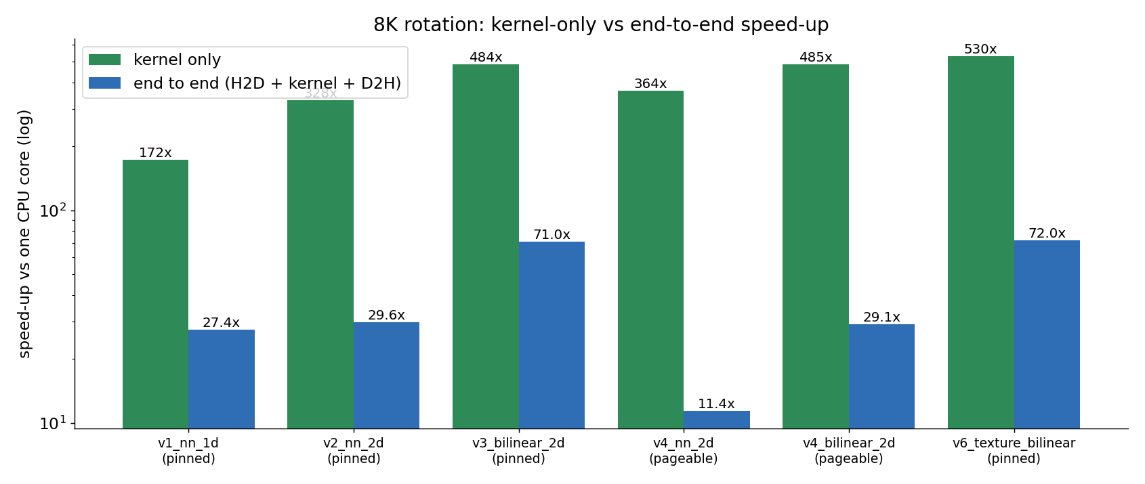
1b. Each feature, measured
Presenter: Taabish
328x
kernel only
29.6x
end to end
6 versions built, one per feature
2D grid beat 1D: 1.55 vs 2.96 ms
Amdahl cap: 32.6x
91%
time is copies
Sources: Tesla T4, 8K at 30 degrees, v2 nearest, mean of 10 runs. CPU baseline: one core.
Notes:
TAABISH (0:40)
We built one version per CUDA feature: 1D grid, 2D blocks, bilinear, pageable, streams, texture.
The 2D grid beat the 1D grid, 1.55 against 2.96 milliseconds.
Against one CPU core the kernel is 328 times faster.
But end to end it is only 29.6 times, because copies take 91 percent of the time.
Amdahl caps us at 32.6 times.
A 14-thread laptop beats the T4 end to end. So the kernel is memory bound.

Slide 7
1c. GPUDirect Storage
Presenter: Taabish
Helps
Does not help
Bulk raw frames
JPEGs decoded on the GPU (nvJPEG)
Disk I/O is the bottleneck
One photo
JPEGs decoded on the CPU
Images already in RAM
Not tested: Colab has no nvidia-fs module
Sources: Thompson & Newburn (2019); NVIDIA (n.d.-a).
Notes:
TAABISH (0:30)
GPUDirect Storage lets NVMe DMA straight into GPU memory.
The CPU only keeps the control path, so the host bounce buffer goes away.
For the company: yes, but only for the bulk pipeline, and only if frames are raw or decoded on the GPU with nvJPEG.
It does not help one photo, JPEGs decoded on the CPU, or images already in RAM.

Slide 8
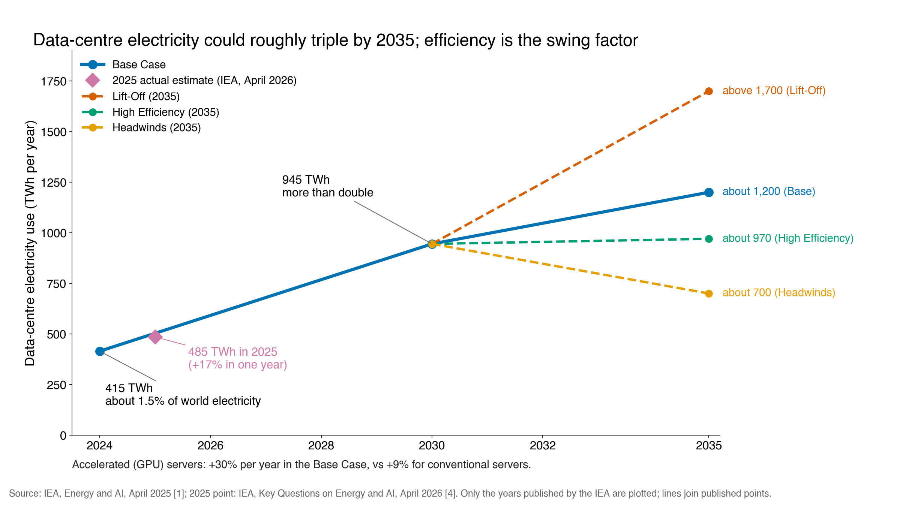
2a. Data centre demand keeps climbing
Presenter: Erwyna
415 TWh
in 2024
945 TWh
by 2030
1,200 TWh
by 2035 (about)
GPU servers drive the growth
Sources: International Energy Agency (IEA, 2025).
Notes:
ERWYNA (0:15)
The IEA says data centres used 415 terawatt hours in 2024.
That could reach about 1,200 by 2035, and GPU servers drive the growth.

Slide 9
2a. Same chip, different grid
Presenter: Erwyna
Frontier (USA)
LUMI (Finland)
55.0
53.4
GFLOPS per watt
GFLOPS per watt
100% hydropower
Waste heat warms a town
Carbon per FLOP depends on the grid, not only the chip
Sources: TOP500 (2026); LUMI consortium (2023).
Notes:
ERWYNA (0:20)
Frontier and LUMI use the same MI250X nodes, and their GFLOPS per watt are almost equal.
But LUMI runs on hydropower and heats part of a Finnish town.
So a FLOP's carbon cost depends on the grid, not only the chip.

Slide 10
2a. Malaysia lens and a myth check
Presenter: Erwyna
Johor, Malaysia
Kajaani, Finland
79% fossil grid
10 MW to 1.3 GW in 3 years
Up to 31% of Peninsular power by 2035
100% hydropower
Cold climate cooling
Waste heat warms the town
Myth: "AI out-emits aviation"
It is a 2030 projection. Today: about 180 Mt CO2
Sources: Ember (2026); Loo (2025); Bernama (2026); LUMI consortium (2023); Jamison et al. (2025); Giles (2025); IEA (2025).
Notes:
ERWYNA (0:22)
Johor went from 10 megawatts to over a gigawatt in about three years.
Data centres could use almost a third of Peninsular electricity by 2035, on a grid that is 79 percent fossil.
Kajaani in Finland is the opposite: hydropower, cold air, and waste heat for the town.
One myth check: AI does not emit more CO2 than aviation today. That is a 2030 projection.
(If asked: Johor also stopped approving new water-hungry Tier 1 and 2 sites.)

Slide 11
2b. Governance, security and fairness
Presenter: Erwyna
Governance
75% of AI supercomputer power is in the US
Gradients can leak data: keep it local
Security
Dual-use chips: hospital or military
US export limits; Malaysia needs permits
Fairness
Malay is 0.086% of web text
Tamil needs about 10 tokens per word
Sources: Pilz et al. (2025); Zhu et al. (2019); BIS (2022); MITI (2025); Common Crawl (2026); Ahuja et al. (2023).
Notes:
ERWYNA (0:35)
Where the GPUs are decides which country's law covers the data.
In data-parallel training, nodes swap gradients, and gradients can leak training data. So data residency becomes a scheduling rule.
Security is dual-use: the same chips train a hospital model or a military model. The US limits exports, and since July 2025 Malaysia needs a permit.
Fairness has a compute cost too: Malay is under 0.1 percent of web text.

Slide 12
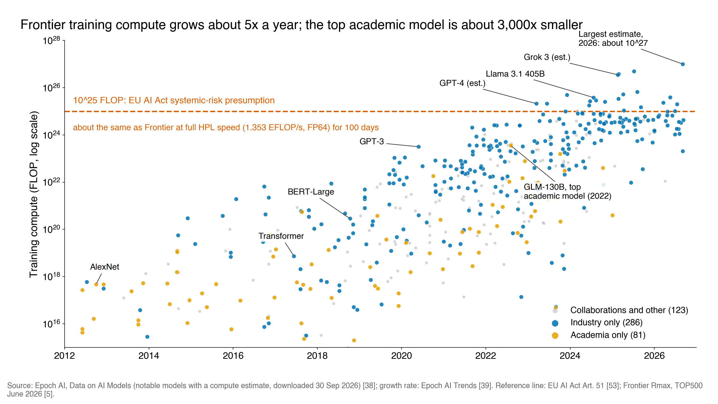
2c. The compute divide
Presenter: Erwyna
>90%
of models: industry
5x / year
frontier compute
1 to 8
academic GPUs
Only companies can audit
Sources: Stanford HAI (2026); Epoch AI (2026); Khandelwal et al. (2025); NCI (n.d.-a, n.d.-b).
Notes:
ERWYNA (0:25)
Over 90 percent of notable 2025 models came from industry.
Frontier training compute grows about five times a year, and the best academic model sits about three thousand times lower.
Most academics have one to eight GPUs. (If asked: NCI Gadi has 776 GPUs and demand near three times its allocation.)
If only companies can train frontier models, only companies can audit them.

Slide 13
2d. Our SCALE checklist
Presenter: Erwyna
S
Size right: stop when efficiency drops
C
Carbon-aware: run flexible jobs at low-carbon times
A
Account every joule: report energy per job
L
Lawful, local data: keep data in its country
E
Equitable access: fair-share queues
Principles give values. The EU gives numbers.
Sources: UNESCO (2021); OECD (2024); MOSTI (2024); European Parliament & Council (2024); Wiesner et al. (2021).
Notes:
ERWYNA (0:35)
UNESCO, the OECD and Malaysia's AIGE give values, but no number to report.
The EU is closer: the AI Act flags models above 10 to the 25 FLOP, and big sites must report PUE.
So we propose SCALE. Each step is a Slurm setting and a reported number.
Size right. Carbon-aware: jobs that can wait cut CO2 by up to 19 percent. Account every joule. Lawful, local data. Equitable access.

Slide 14
Limitations, future work and takeaways
Presenter: Erwyna
Task 1
Task 2
Limit: Colab has 2 vCPUs, no GDS test
Next: nvJPEG + GDS + streams
Takeaway: memory bound, PCIe sets the ceiling
Limit: model energy figures are estimates
Ours: 0.71 J per 8K image on the T4
Takeaway: a FLOP's cost depends on where and for whom
Sources: Epoch AI (2026); Radovanovic et al. (2023).
Notes:
ERWYNA (0:28)
Task 1 limits: a one-core CPU baseline on a shared Colab VM, so our speed-ups belong to that setup, and we could not test GDS.
Next: nvJPEG, GDS and streams on a GDS server.
Task 2 limits: most model energy figures are estimates, so we measured ours: about 0.7 joules per 8K image on the T4.
Google's fleet only saved 1 to 2 percent at peak-carbon hours.
Takeaways: rotation is memory bound, so PCIe sets the ceiling. And the cost of a FLOP depends on where and for whom it runs.

Slide 15
Questions?
Erwyna Soo Wen Xin and Taabish Farooq Bhat
Notes:
ERWYNA (0:03)
Thank you. Any questions?
Q&A RULE: verdict first, then the mechanism, then our number. Use parallel terms, no analogies. Name the problem before the fix.

Slide 16
A1. Where the time goes (8K, 30 degrees)
APPENDIX: extra material for Q&A, not part of the 7-minute talk
H2D 8.06 ms
D2H 7.58 ms
Kernel is only 1.55 ms (9%)
Total on GPU: 17.19 ms
CPU, one core: 509.3 ms
Mismatch vs CPU: 0 pixels
Sources: v2 nearest, pinned, Tesla T4, mean of 10 runs.
Notes:
APPENDIX (Taabish). Only for Q&A. H2D 8.06 ms, kernel 1.55 ms, D2H 7.58 ms, total 17.19 ms. CPU one core 509.3 ms. Mismatch 0 pixels.

Slide 17
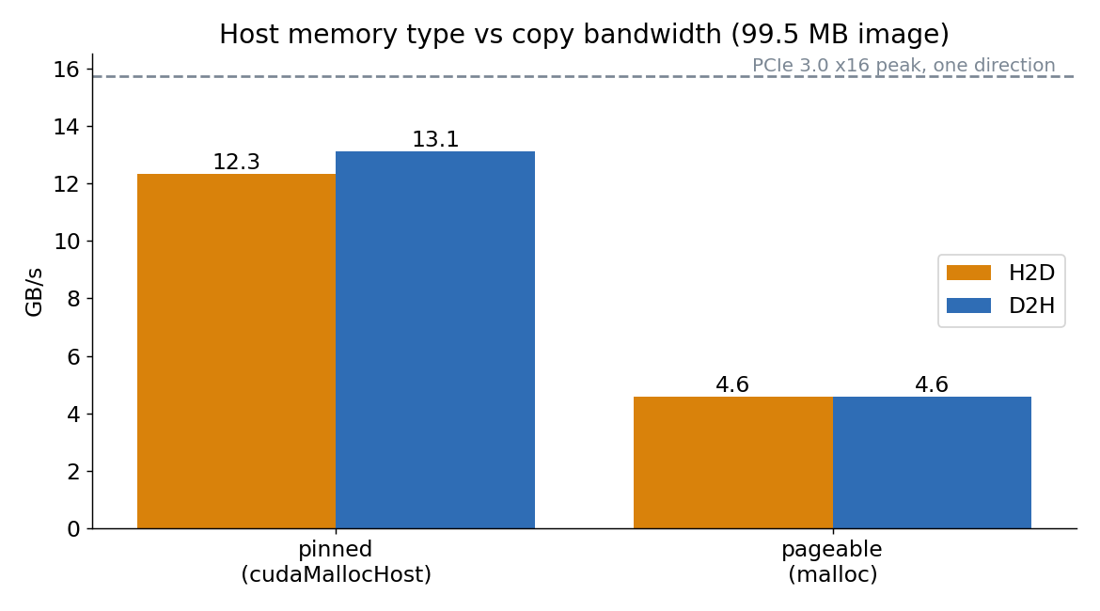
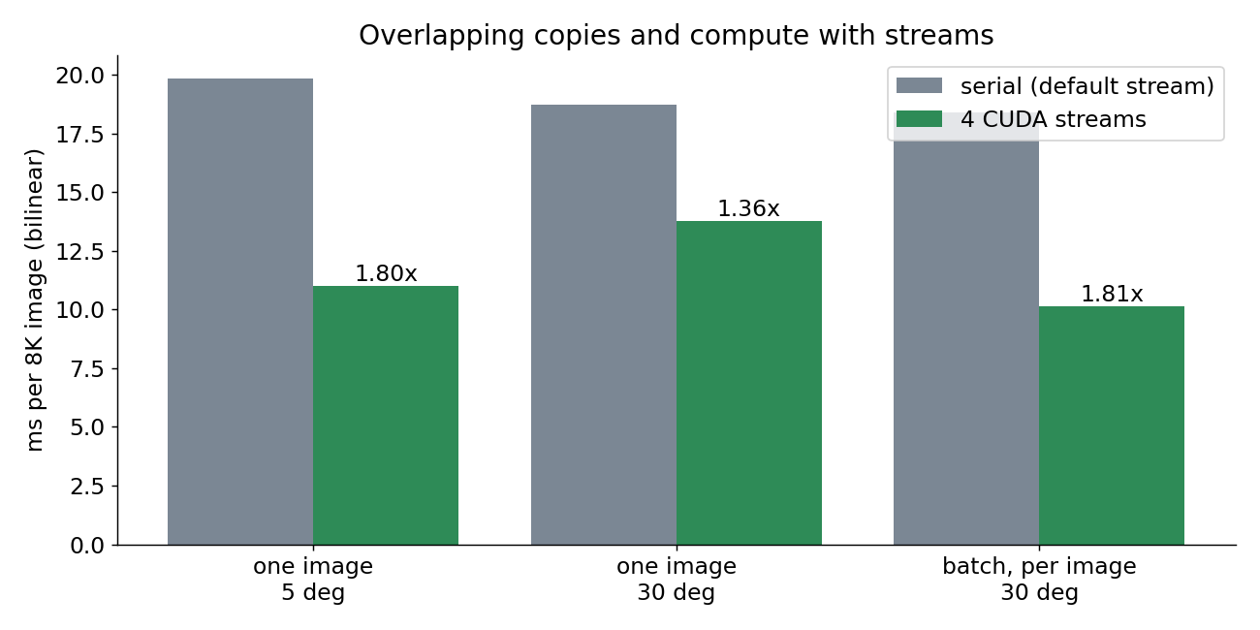
A2. Pinned vs pageable, and streams
APPENDIX: extra material for Q&A, not part of the 7-minute talk
Pageable 4.6 GB/s vs pinned 12.3 GB/s
Streams: 1.8x on 8 images, 1.36x on one image
Notes:
APPENDIX (Taabish). Only for Q&A. Pageable 4.6 GB/s vs pinned 12.3 GB/s. Streams: 1.8x on a batch of 8 images, 1.36x on one image.

Slide 18
A2. Streams code (from our code)
APPENDIX: extra material for Q&A, not part of the 7-minute talk
YOUR SCREENSHOT 3
Round-robin streams loop with cudaMemcpyAsync
rotate_cuda.cu lines 803 to 815
Image i goes to stream i % 4
Async copies need pinned memory
Sources: rotate_cuda.cu in our submission zip.
Notes:
APPENDIX (Taabish). Only for Q&A. Image i goes to stream i % 4. Async copies need pinned RAM. Same stream runs in order; different streams overlap.

Slide 19
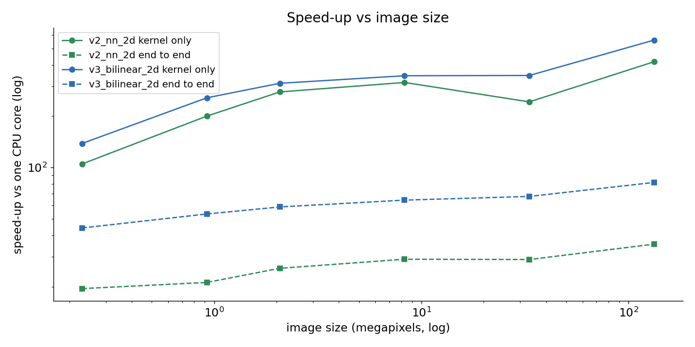
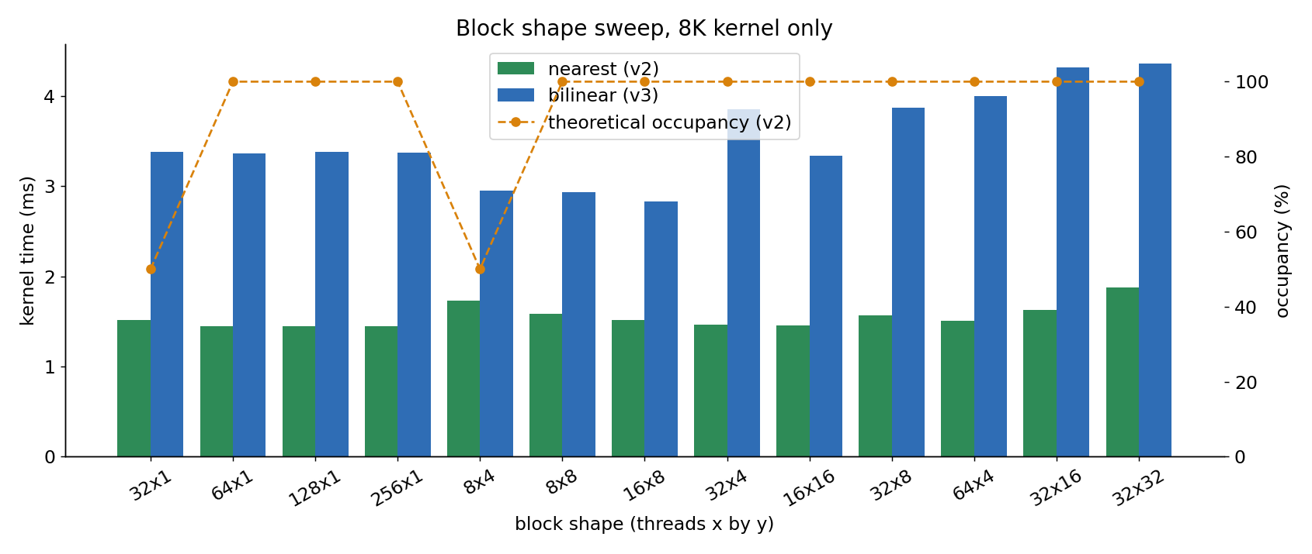
A3. Block sweep and image size sweep
APPENDIX: extra material for Q&A, not part of the 7-minute talk
Nearest: block shape barely matters
Bilinear: 16 x 8 is fastest (2.83 ms)
Bigger images: bigger speed-up
Notes:
APPENDIX (Taabish). Only for Q&A. Nearest: flat from 64 to 256 threads per block (about 1.44 to 1.45 ms); 32x32 slower (1.88 ms) from register and cache pressure. Bilinear: 16x8 fastest (2.83 ms). End-to-end speed-up grows from 19x at 640x360 to 35x at 16K for nearest. Run to run the v2 kernel varied 1.45 to 2.11 ms; copies stayed 8.06 ms.

Slide 20
A4. How we timed it (from our code)
APPENDIX: extra material for Q&A, not part of the 7-minute talk
YOUR SCREENSHOT 4
CUDA events around H2D, kernel, D2H
rotate_cuda.cu lines 440 to 450
Events use the GPU clock
Warm-up run discarded
Mean of 10 runs
--fmad=false: v1 to v5 match the CPU exactly
Sources: rotate_cuda.cu in our submission zip.
Notes:
APPENDIX (Taabish). Only for Q&A. Each stage is timed on the GPU clock with a pair of events. Warm-up run discarded, then mean of 10. Built with --fmad=false so v1 to v5 match the CPU byte for byte. v6 texture differs in 257,964 bytes (0.26%), each by at most 1, from the texture unit's low-precision filter weights.

Slide 21
A5. Why PCIe is the narrow pipe
APPENDIX: extra material for Q&A, not part of the 7-minute talk
T4 GDDR6
320 GB/s
PCIe 3.0 x16
15.75 GB/s
Pinned copy
12.3 GB/s
PCIe is about 20x narrower than GDDR6
T4 needs about 25 FLOP per byte; rotation does a few: memory bound
Sources: PCI-SIG (2019); NVIDIA (n.d.-d).
Notes:
APPENDIX (Taabish). Only for Q&A. T4 balance is about 25 FLOP per byte. Rotation does a few FLOPs per byte moved, so the kernel is memory bound. PCIe is about 20x narrower than GDDR6, so copies are 91 percent of the time for one image.

Slide 22
A6. GDS in practice
APPENDIX: extra material for Q&A, not part of the 7-minute talk
cuFileDriverOpen
cuFileHandleRegister
cuFileBufRegister
cuFileRead
Data goes NVMe to GPU, no host bounce buffer
Needs nvidia-fs, O_DIRECT, aligned buffers
Without them: falls back to a bounce buffer (Colab)
Sources: NVIDIA (n.d.-a, n.d.-b, n.d.-c).
Notes:
APPENDIX (Taabish). Only for Q&A. cuFileDriverOpen, cuFileHandleRegister (file opened with O_DIRECT), cuFileBufRegister (GPU buffer), then cuFileRead into GPU memory. The CPU issues the calls; data DMAs from NVMe to GPU with no host bounce buffer. Without nvidia-fs and the rest, cuFile falls back to a host bounce buffer, which is what Colab would do.

Slide 23
A7. SIMD vs SIMT vs NPU
APPENDIX: extra material for Q&A, not part of the 7-minute talk
SIMD (CPU)
One instruction, wide register, lanes in lockstep
SIMT (GPU)
Warps of 32 threads, each with its own index
NPU
Fixed matrix units: fast, but rotation is a poor fit
Sources: Lindholm et al. (2008); Jouppi et al. (2017).
Notes:
APPENDIX (Taabish). Only for Q&A. SIMD: one instruction on a wide register, lanes in lockstep, divergence is masked and wastes lanes. SIMT: warps of 32 threads run one instruction, each with its own index; divergent branches serialise inside the warp. NPU: fixed matrix-multiply units (systolic array) for low-precision inference, high TOPS per watt, little flexibility. Rotation is a gather, so it maps poorly.

Slide 24
A8. References, Task 1 (APA 7)
APPENDIX: extra material for Q&A, not part of the 7-minute talk
Jouppi, N. P., Young, C., Patil, N., Patterson, D., Agrawal, G., Bajwa, R., Bates, S., Bhatia, S., Boden, N., Borchers, A., Boyle, R., Cantin, P.-l., Chao, C., Clark, C., Coriell, J., Daley, M., Dau, M., Dean, J., Gelb, B., . . . Yoon, D. H. (2017). In-datacenter performance analysis of a tensor processing unit. In Proceedings of the 44th Annual International Symposium on Computer Architecture (pp. 1-12). ACM. https://doi.org/10.1145/3079856.3080246
Lindholm, E., Nickolls, J., Oberman, S., & Montrym, J. (2008). NVIDIA Tesla: A unified graphics and computing architecture. IEEE Micro, 28(2), 39-55. https://doi.org/10.1109/MM.2008.31
NVIDIA. (n.d.-a). cuFile API reference guide. https://docs.nvidia.com/gpudirect-storage/api-reference-guide/index.html
NVIDIA. (n.d.-b). NVIDIA GPUDirect Storage overview guide. https://docs.nvidia.com/gpudirect-storage/overview-guide/index.html
NVIDIA. (n.d.-c). NVIDIA GPUDirect Storage release notes. https://docs.nvidia.com/gpudirect-storage/release-notes/index.html
NVIDIA. (n.d.-d). NVIDIA T4 Tensor Core GPU. https://www.nvidia.com/en-us/data-center/tesla-t4/
NVIDIA. (2026a). CUDA C++ best practices guide (Version 13.4). https://docs.nvidia.com/cuda/cuda-c-best-practices-guide/
NVIDIA. (2026b). CUDA programming guide (Version 13.4). https://docs.nvidia.com/cuda/cuda-programming-guide/
PCI-SIG. (2019). PCI Express base specification (Revision 5.0). https://pcisig.com/specifications
Thompson, A., & Newburn, C. J. (2019, August 6). GPUDirect Storage: A direct path between storage and GPU memory. NVIDIA Technical Blog. https://developer.nvidia.com/blog/gpudirect-storage/
Notes:
APPENDIX. Full references. Small type is deliberate: this is a reference list, not a slide to read aloud.

Slide 25
A9. References, Task 2 (APA 7), part 1
APPENDIX: extra material for Q&A, not part of the 7-minute talk
Ahuja, K., Diddee, H., Hada, R., Ochieng, M., Ramesh, K., Jain, P., Nambi, A., Ganu, T., Segal, S., Ahmed, M., Bali, K., & Sitaram, S. (2023). MEGA: Multilingual evaluation of generative AI. In Proceedings of the 2023 Conference on Empirical Methods in Natural Language Processing (pp. 4232-4267). Association for Computational Linguistics. https://doi.org/10.18653/v1/2023.emnlp-main.258
Bernama. (2026, July 1). Electricity consumption of data centres expected to surge to 31 pct by 2035. BernamaBiz. https://www.bernamabiz.com/news.php?id=2575423
Bureau of Industry and Security. (2022, October 13). Implementation of additional export controls: Certain advanced computing and semiconductor manufacturing items; supercomputer and semiconductor end use; entity list modification. Federal Register, 87, 62186. https://www.federalregister.gov/d/2022-21658
Common Crawl. (2026). Distribution of languages (CC-MAIN-2026-39) [Data set]. https://commoncrawl.github.io/cc-crawl-statistics/plots/languages
Ember. (2026, April 22). Malaysia: Electricity data. https://ember-energy.org/countries-and-regions/malaysia/
Epoch AI. (2026). Data on AI models [Data set]. https://epoch.ai/data/notable-ai-models
European Commission. (n.d.). Energy performance of data centres. https://energy.ec.europa.eu/topics/energy-efficiency/energy-efficiency-targets-directive-and-rules/energy-efficiency-directive/energy-performance-data-centres_en
European Parliament & Council of the European Union. (2024). Regulation (EU) 2024/1689 laying down harmonised rules on artificial intelligence (Artificial Intelligence Act). Official Journal of the European Union. https://eur-lex.europa.eu/eli/reg/2024/1689/oj
Giles, M. (2025, June 27). By 2030, AI data centers could take a bigger share of CO2 emissions than aviation. Sherwood News. https://sherwood.news/world/by-2030-ai-data-centers-could-take-a-bigger-share-of-co-emissions-than/
International Energy Agency. (2025). Energy and AI. https://www.iea.org/reports/energy-and-ai
Jamison, S., Podder, S., Burden, A., Ghosh, B., Ramani, S., Singh, S. K., & Robinson, M. (2025). Powering sustainable AI: Balancing growth with environmental responsibility. Accenture. https://www.accenture.com/content/dam/accenture/final/corporate/corporate-initiatives/sustainability/document/Powering-Sustainable-AI.pdf
Khandelwal, A., Yun, T., Nayak, N. V., Merullo, J., Bach, S. H., Sun, C., & Pavlick, E. (2025). $100K or 100 days: Trade-offs when pre-training with academic resources. In Conference on Language Modeling. https://arxiv.org/abs/2410.23261
Loo, S. (2025, June 12). Data centres, energy demand and sustainability: Can Malaysia strike the right balance? (ISEAS Perspective No. 2025/43). ISEAS-Yusof Ishak Institute. https://www.iseas.edu.sg/articles-commentaries/iseas-perspective/2025-43-data-centres-energy-demand-and-sustainability-can-malaysia-strike-the-right-balance-by-sara-loo
LUMI consortium. (2023, March 9). LUMI data center receives the Green Data Centre of the Year award. https://lumi-supercomputer.eu/lumi-data-center-receives-the-green-data-centre-of-the-year-award/
Notes:
APPENDIX. Full references. Small type is deliberate: this is a reference list, not a slide to read aloud.

Slide 26
A9. References, Task 2 (APA 7), part 2
APPENDIX: extra material for Q&A, not part of the 7-minute talk
Ministry of Investment, Trade and Industry Malaysia. (2025, July 14). Malaysia regulates trade of US AI chips [Press statement]. https://www.miti.gov.my/miti/resources/Media%20Release/%5BFINAL%5D_MITI_Press_Stmt_Malaysia_Regulates_Trade_of_US_AI_Chips_2025-07-14.pdf
Ministry of Science, Technology and Innovation. (2024). The national guidelines on AI governance and ethics. https://mastic.mosti.gov.my/storage/2024/09/THE-NATIONAL-GUIDELINES-ON-AI-GOVERNANCE-ETHICS.pdf
National Computational Infrastructure. (n.d.-a). HPC systems: Gadi. https://nci.org.au/infrastructure/hpc-systems
National Computational Infrastructure. (n.d.-b). Record demand highlights Australia's growing need for supercomputing power. https://nci.org.au/news-events/news/record-demand-highlights-australias-growing-need-supercomputing-power
OECD. (2024). OECD AI principles. https://oecd.ai/en/ai-principles
Pilz, K. F., Sanders, J., Rahman, R., & Heim, L. (2025). Trends in AI supercomputers. arXiv. https://arxiv.org/abs/2504.16026
Radovanovic, A., Koningstein, R., Schneider, I., Chen, B., Duarte, A., Roy, B., Xiao, D., Haridasan, M., Hung, P., Care, N., Talukdar, S., Mullen, E., Smith, K., Cottman, M., & Cirne, W. (2023). Carbon-aware computing for datacenters. IEEE Transactions on Power Systems, 38(2), 1270-1280. https://doi.org/10.1109/TPWRS.2022.3173250
Shadiqe, J. (2025, November 27). Johor shuts door on water-guzzling data centres, tightens approval rules. New Straits Times. https://www.nst.com.my/news/nation/2025/11/1324188/johor-shuts-door-water-guzzling-data-centres-tightens-approval-rules
Stanford Institute for Human-Centered AI. (2026). The AI index 2026 annual report. https://hai.stanford.edu/ai-index/2026-ai-index-report
TOP500. (2026). Green500 list, June 2026. https://www.top500.org/lists/green500/list/2026/06/
UNESCO. (2021). Recommendation on the ethics of artificial intelligence. https://www.unesco.org/en/artificial-intelligence/recommendation-ethics
Wiesner, P., Behnke, I., Scheinert, D., Gontarska, K., & Thamsen, L. (2021). Let's wait awhile: How temporal workload shifting can reduce carbon emissions in the cloud. In Proceedings of the 22nd International Middleware Conference (pp. 260-272). Association for Computing Machinery. https://doi.org/10.1145/3464298.3493399
Zhu, L., Liu, Z., & Han, S. (2019). Deep leakage from gradients. Advances in Neural Information Processing Systems, 32. https://arxiv.org/abs/1906.08935
Notes:
APPENDIX. Full references. Small type is deliberate: this is a reference list, not a slide to read aloud.

