Slide 1



Autoencoder-based identification of key micro-organisms within climate zones
Durieux Emmely, 22/06/2023

Slide 2
1.Introduction
2.Methods
3.Reflection
2

Slide 3
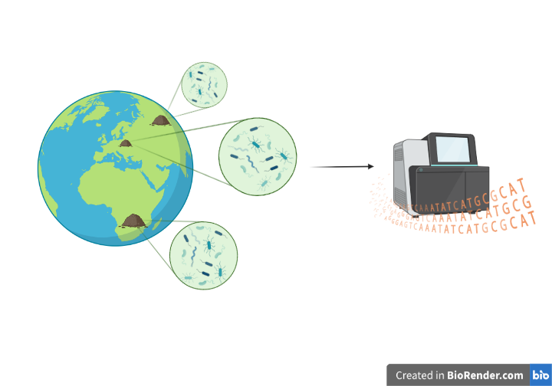
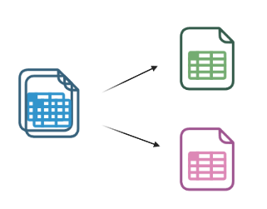
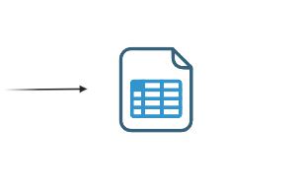
Project: Meta-analysis microbial ecology
1.Introduction
Goal: Identify informative microorganism in climate zones
Data: public data Earth Microbiome Project (EMP)
Biom table
Sample mapping file
Crowd sourced sample collection
V4 16S rRNA sequencing
Data curation
3
Notes:
The EMP is a large-scale collaborative initiative focused on comprehensively studying microbial life on Earth, employing amplicon sequencing by targeting the V4 region of 16S rRNA in crowd-sourced samples. Sequence data undergo error-filtering and trimming, utilizing the Deblur software to ensure consistency across samples. De novo OTU picking (Deblur) is applied to obtain biological observations matrixes (biom-tables) that provide abundance counts for each exact sequence variant (ESV) in each sample

Slide 4
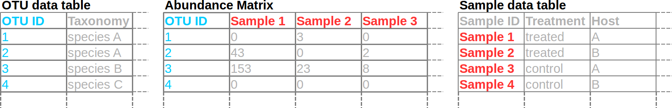
Input data
1.Introduction
Biom-table: Biological Observation Matrix
Sample mapping file:
Metadata : location, ontology …
Abundance matrix is sparse and has a high dimensionality !
4
Notes:
Biom : abbreviation : JSON-based file format

Slide 5
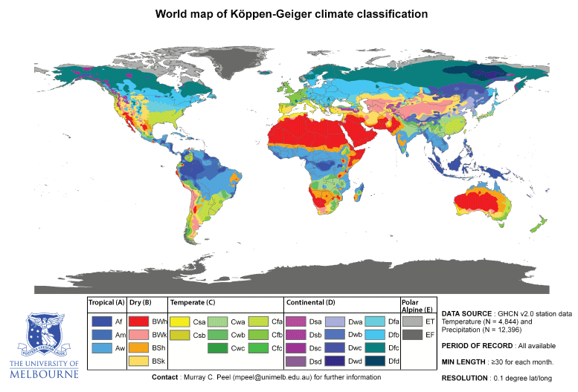
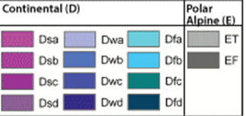
Köppen-Geiger classification (Kgc)
1.Introduction
monthly air temperature and precipitation
Source :
5

Slide 6
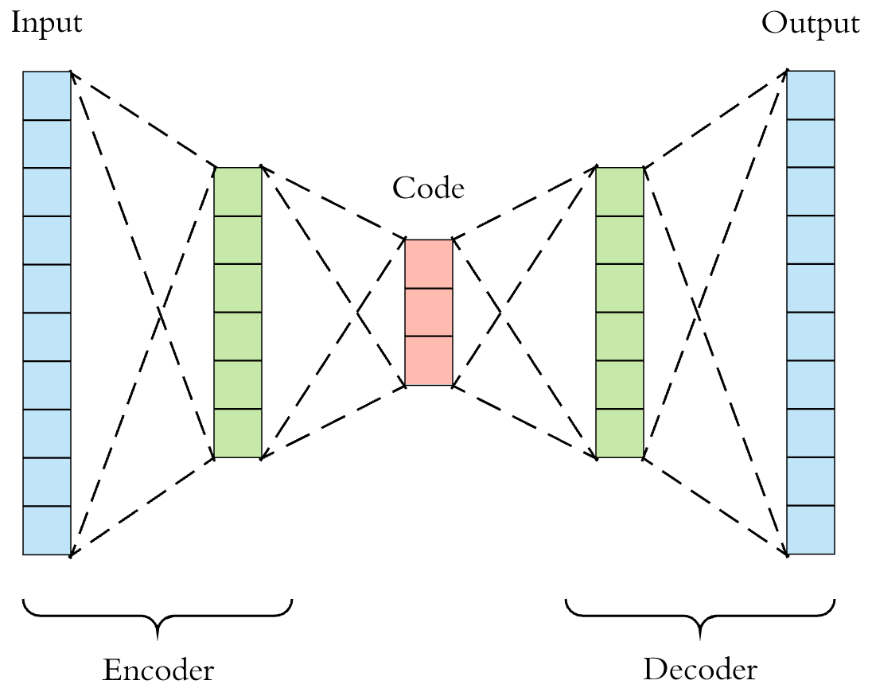
Autoencoder model
1.Introduction
Neural network:
encoder:
compresses input
decoder:
reconstructs input
Self – supervised
Dimensionality reduction
Latent space
6

Slide 7

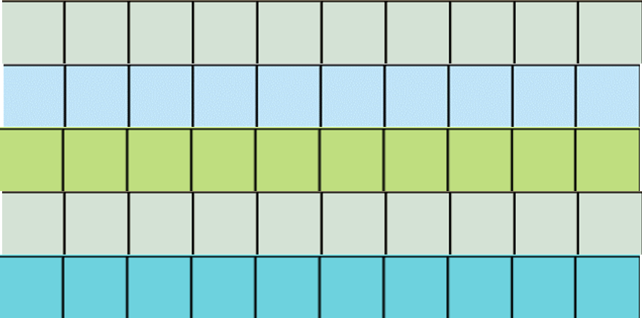
General approach
2.Methods
Every script is coded in R (4.3.0)
Data preprocessing
Training autoencoder model
Latent space representation
Latent space
Latent space
Taxa
7

Slide 8


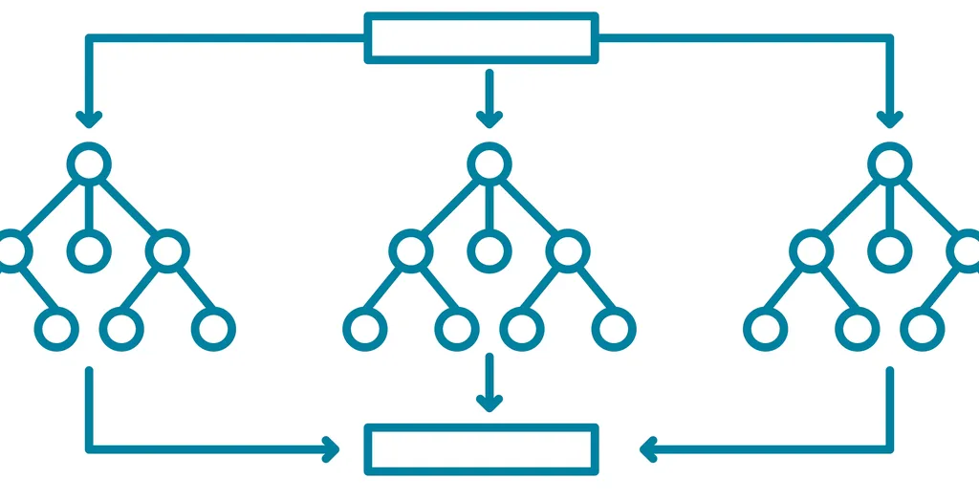

General approach
2.Methods
Random forest classification
Identify informative latent variables
Extract key features based on weight
Latent space
Latent space
8

Slide 9
Data preprocessing
2.Methods
BIOM-table
Soil (non-saline)
Relative abundance >= 0,01%
Prevalence >= 10%
Sample metadata
Soil (non-saline)
Kgc package: climate zone classification
Climate zone representation
>= 3 samples / climate zone
Table 1: dataset dimensions after filtering
Subset | Samples | Taxa
2k | 125 | 1648
5k | 359 | 1462
10k | 955 | 1498
9

Slide 10
Autoencoder model
2.Methods
R packages : Tensorflow and Keras
Input data: relative abundances
2 Keras sequential models : encoder + decoder
3 dense layers each:
input layer, hidden layer & latent layer
“Relu” activation function
loss: binary crossentropy
hidden
Latent space
10
Notes:
ReLu: rectified linear activation function is a piecewise linear function that will output the input directly if it is positive, otherwise, it will output zero.9 j
Binary cross entropy (or log loss) is a model metric that tracks incorrect labeling of the data class by a model, penalizing the model if deviations in probability occur into classifying the labels. Low log loss values equate to high accuracy values.

Slide 11
Hyperparameter tuning
2.Methods
R package: tfruns
Following parameter were determined by tuning grid
Number of units in each layer (256, 64 and 32 latent)
Number of epochs (100)
Learning rate (0,005)
11
Notes:
epochs : controls the number of complete passes through the training dataset.
learning rate: how much to change the model in response to the estimated error each time the model weights are updated.
too small → long training process tht could get stuck,
too large → learning a sub-optimal set of weights too fast or an unstable training process.
The batch size: the number of training samples to work through before the model’s internal parameters are updated.

Slide 12
Random forest classifier
2.Methods
R package: randomForest
Input data:
latent space representation + climate zone
Separate random forest classifier for each climate zone
Extract informative variables
Based on highest mean decrease in gini impurity
2 key variables for each climate zone
Latent space
V1
…
V32
Sample 1
Sample 2
.
.
.
12
Notes:
Gini impurity measures how often a randomly chosen element of a set would be incorrectly labeled if it was labeled randomly and independently according to the distribution of labels in the set. It reaches its minimum (zero) when all cases in the node fall into a single target category.

Slide 13
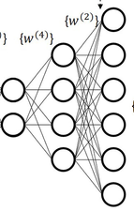
Feature extraction in autoencoder
2.Methods
Tracing back informative taxa for each latent variable
Based on highest weight in the decoder
Top 5 most weighted variables/ latent variable
Combine top 5 taxa with top 2 latent variable/climate zone
Top 10 informative taxa per climate zone
Informative taxa ≠ present taxa
Latent
space
Decoder
13
Notes:
weights : the strength of the connections between neurons in the network. Each connection between two neurons has a weight associated with it, indicating the importance or influence of the input neuron on the output neuron.

Slide 14
Reflection
Current progress:
Accuracy autoencoder : ~75% (on 10k subset)
Accuracy random forest : ~87% (on 10k subset)
Separate scripts
Room for improvement
Informative taxa ≠ present taxa
14

Slide 15
References
Thompson, L., Sanders, J., McDonald, D. et al. A communal catalogue reveals Earth’s multiscale microbial diversity. Nature 551, 457–463 (2017). https://doi.org/10.1038/nature24621
Beck, H., Zimmermann, N., McVicar, T. et al. Present and future Köppen-Geiger climate classification maps at 1-km resolution. Sci Data 5, 180214 (2018). https://doi.org/10.1038/sdata.2018.214
Oh, M., Zhang, L. DeepGeni: deep generalized interpretable autoencoder elucidates gut microbiota for better cancer immunotherapy. Sci Rep 13, 4599 (2023). https://doi.org/10.1038/s41598-023-31210-w
Figures:
Biorender.com, Kgc: , autoencoder

Slide 16
Questions

Slide 17
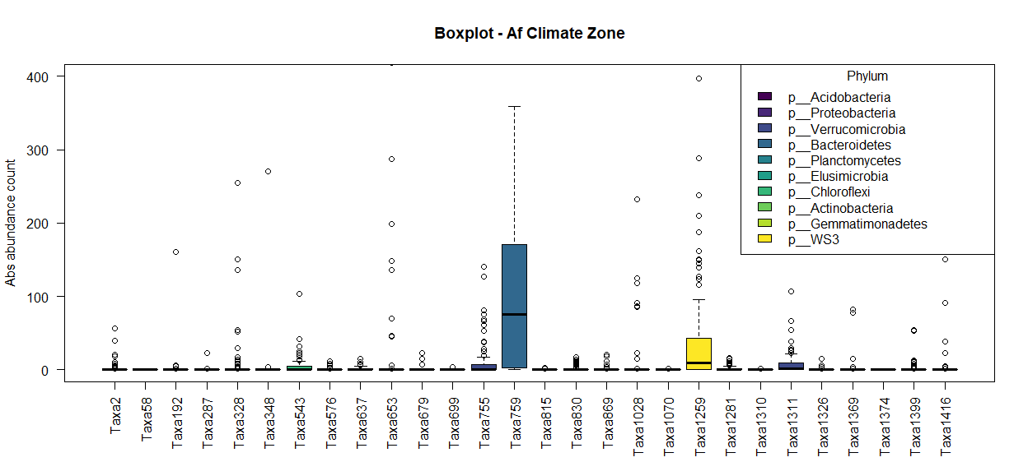
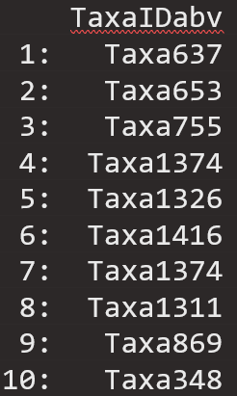
Visualization : informative ≠ present
extra
Example: climate zone “Af”
Top 10

Slide 18
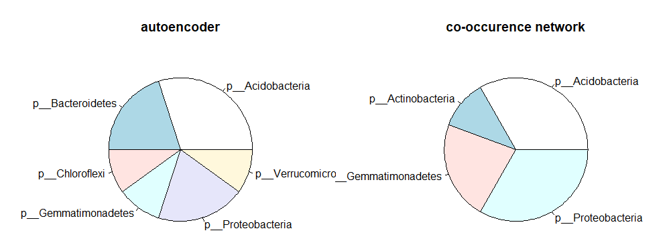
Comparison alternative approach
extra
Example: comparison for climate zone “Af”
Percentage of frequency informative phylum

Slide 19
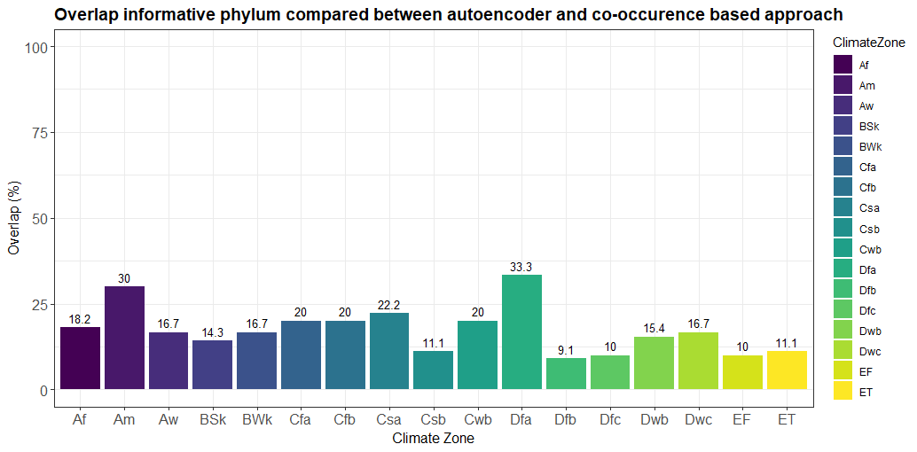
Comparison alternative approach
extra

Slide 20
Difference Autoencoder - PCA
PCA
Autoencoder
linear relationships
Unsupervised
no aim to reconstruct input data
non – linear relationships
Self-supervised
reconstructs input data
computationally more intensive
Notes:
PCA: PCA assumes a linear relationship between the input variables and the principal components. It looks for linear projections of the data that capture the most variance.
Autoencoder: Autoencoders have the ability to capture non-linear relationships in the data because they use non-linear activation functions and can have multiple layers. This allows them to potentially capture more complex structures and dependencies in the data.

