Slide 1

COMP47350: Data Analytics (Conv) 2017/18
Cambridge Analytica: Bikeshare Demand Forecasting
Emmet Tracey Conor Lawlor
Eoin LeMasney Daniel O’Byrne

Slide 2
The Problem
The success of a bike sharing system is reliant on stations being properly resourced
Bikes need to be added/removed as needed
The Problem:
No bikes at a station so a user cannot get one
Station is full of bikes so a user cannot return one
Difficult to calculate how many bikes need to be added/removed
We focus on the bike sharing system in Washington, D.C. - Capital Bikeshare

Slide 3

The Data
The dataset was provided by Capital Bikeshare
Consisted of hourly user activity over a 2 year period
Some of the features included:
Datetime
Temperature
Humidity
Weather description
Count (Casual + Registered users)
Our target feature was Count – Number of bikes in use

Slide 4
The Analysis
We split datetime to extract the hour, day and month
We dropped atemp feature – values similar to temp
Dropped casual and registered feature – data leakage
Normalised season and weather
This preparation allowed us to explore the data further

Slide 5
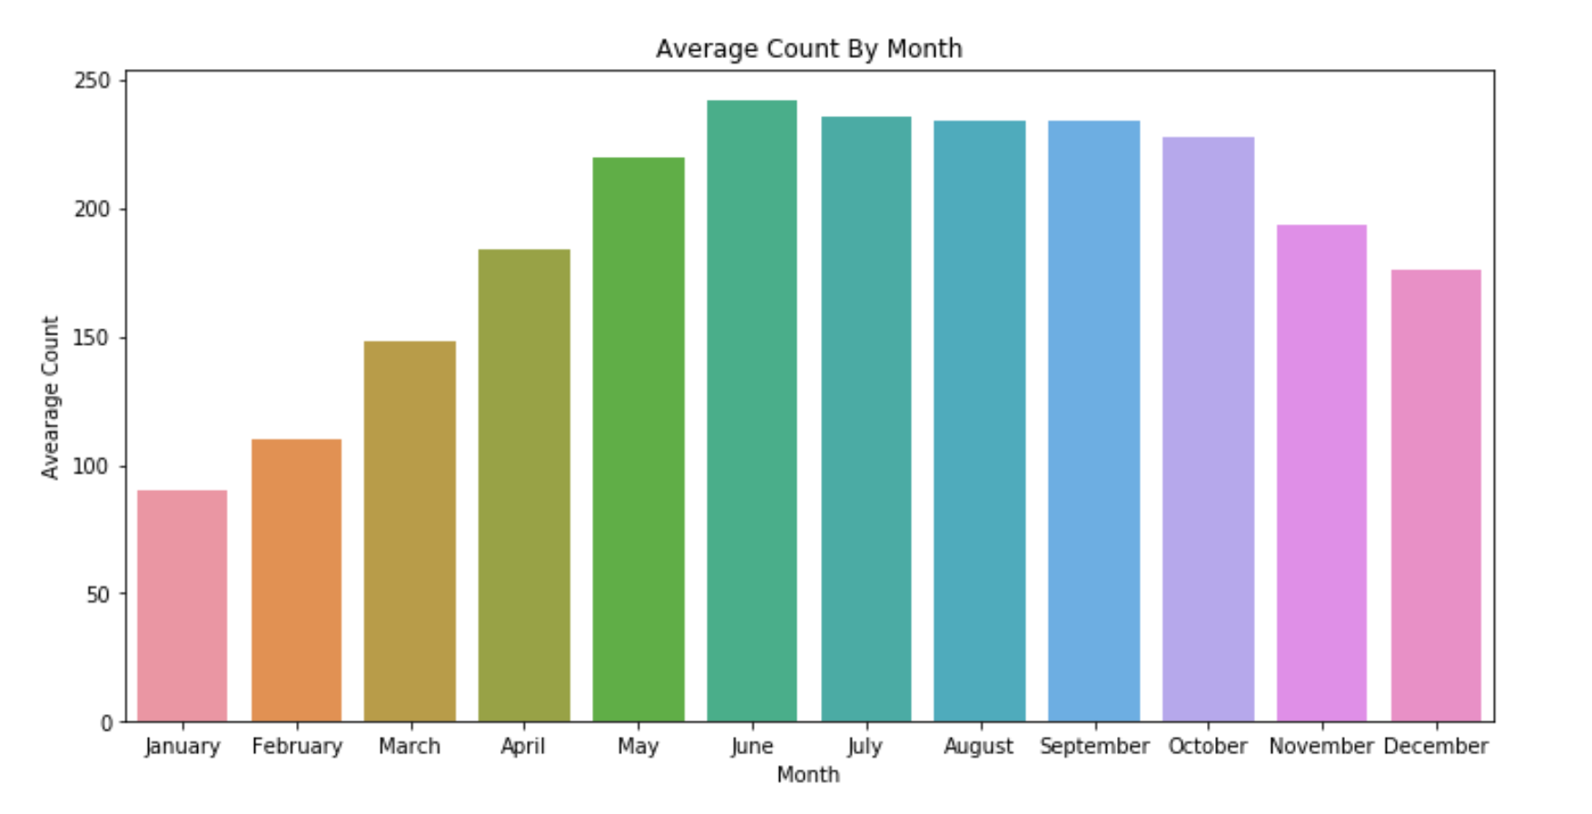
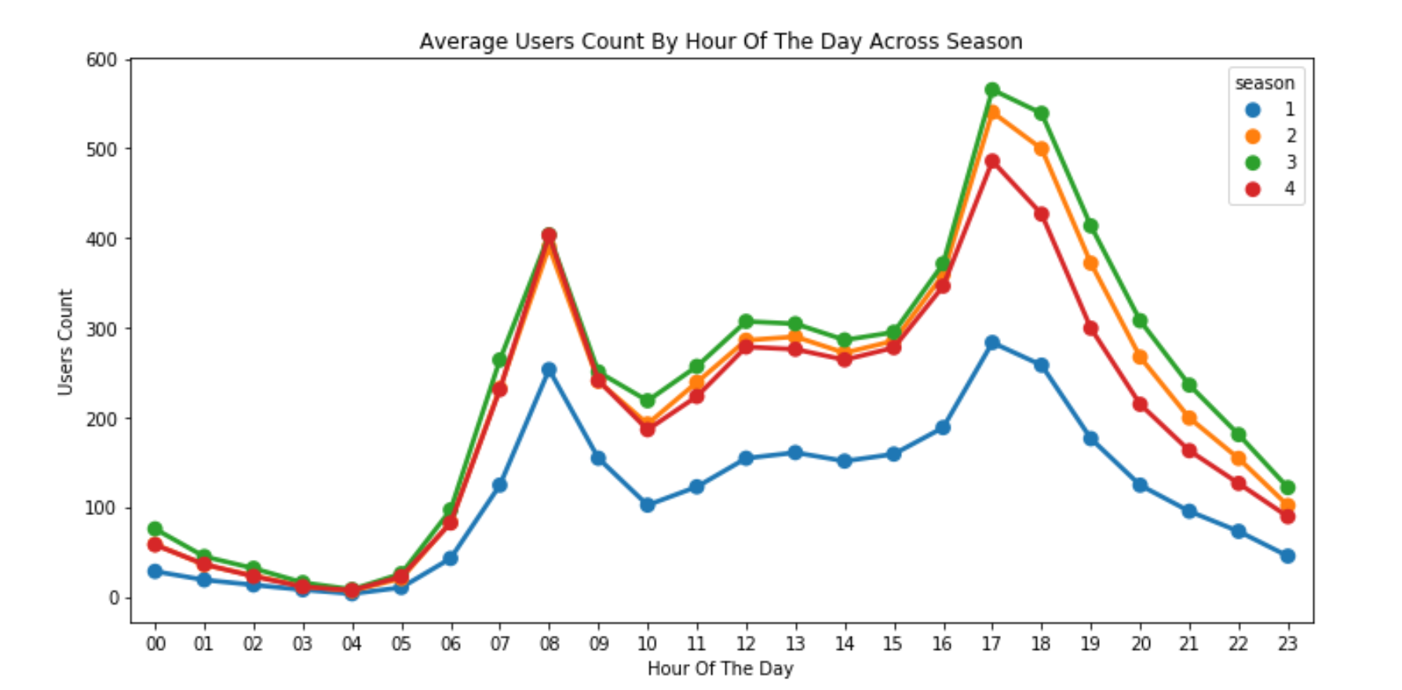
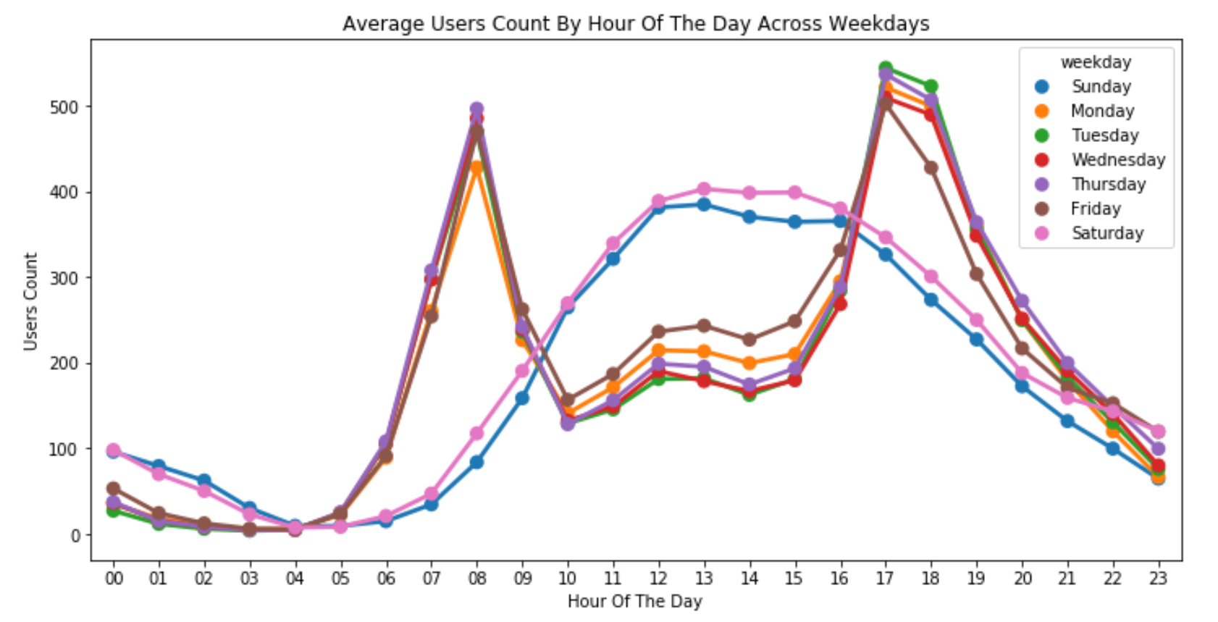

Slide 6
Modeling/ Prediction
Descriptive and visual exploration of the data
Chose a subset of features that looked promising:
W1, W3
Spring, Autumn
Month
Hour
Used these to train three regression models:
Linear
Logistic
Random Forest

Slide 7
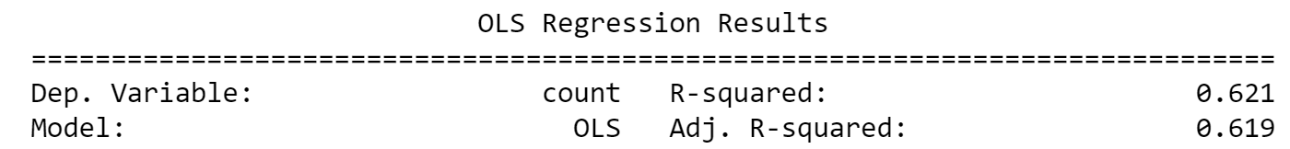
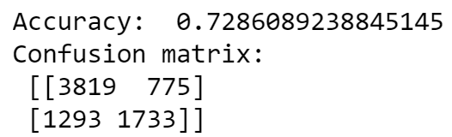
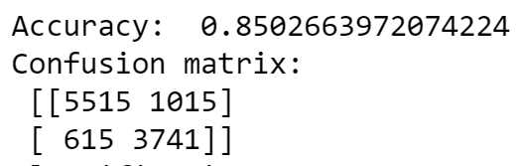
Initial Results
Linear Regression Model:
Logistic Regression Model:
Random Forest Model:

Slide 8
Refine Linear
Linear model most suited to our problem
Try and improve the model
Made following changes to dataset:
Normalised month, day, hour
Dropped season feature
Clamped outliers in count at upper threshold (Upper quartile + 1.5*IQR = 647)

Slide 9
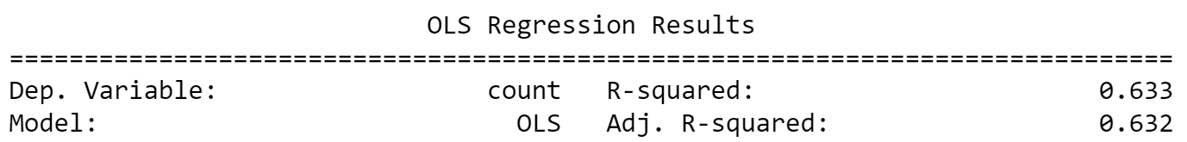

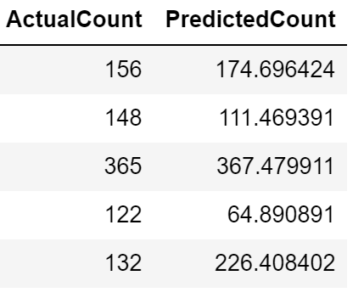
The Results
What new model tells us:
Possible downfalls of the model:
We had hoped for a higher R-squared value
Macro solution for a micro problem
To be useful does a station just take an average of our count prediction?

