Slide 1
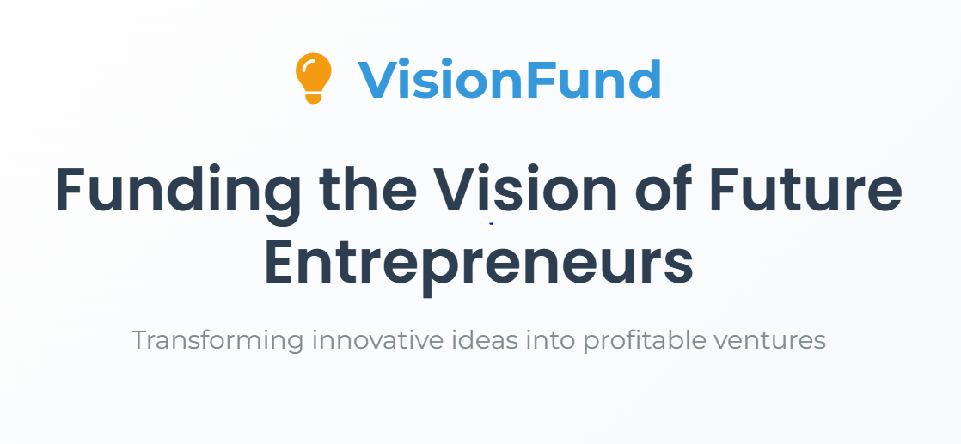

Slide 2

The Big Idea
1
Bridging the Gap
2
Strategic Location
Connects entrepreneurs with investors.
Based in Casablanca, Sidi- Maârouf.
3
Slogan
Funding the Vision of Future Entrepreneurs.

Slide 3

Business Model & Budget
Initial Investment
Platform Development & security
Marketing & Branding
500,000 – 1,000,000 MAD.
Essential for a successful launch.
Covers security and development.
Office space & operational costs
A highly skilled team
Legal fees
to ensure investor protection

Slide 4


Our Team
👨‍💻
Project Managers
Developers
Oversee operations and partnerships.
Maintain & improve the platform.
📢
📞
Marketing Team
Customer Support
Handle advertising and social media.
Assist entrepreneurs and investors

Slide 5



Our Services
For Entrepreneurs
For Investors
Submit ideas for funding.
Mentorship
Invest in promising startups.
Revenue
Receive guidance from investors.
Earn a percentage of sales or shares.

Slide 6
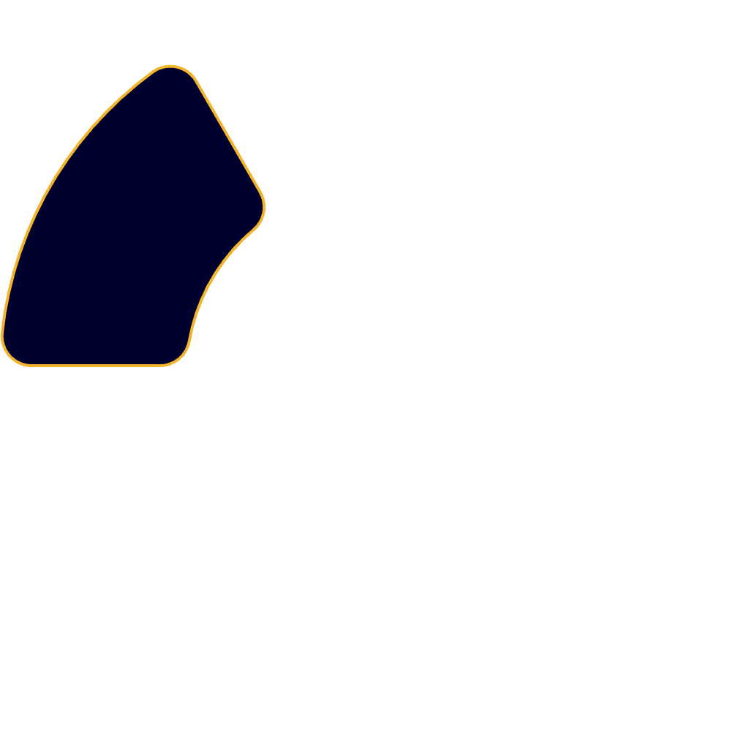
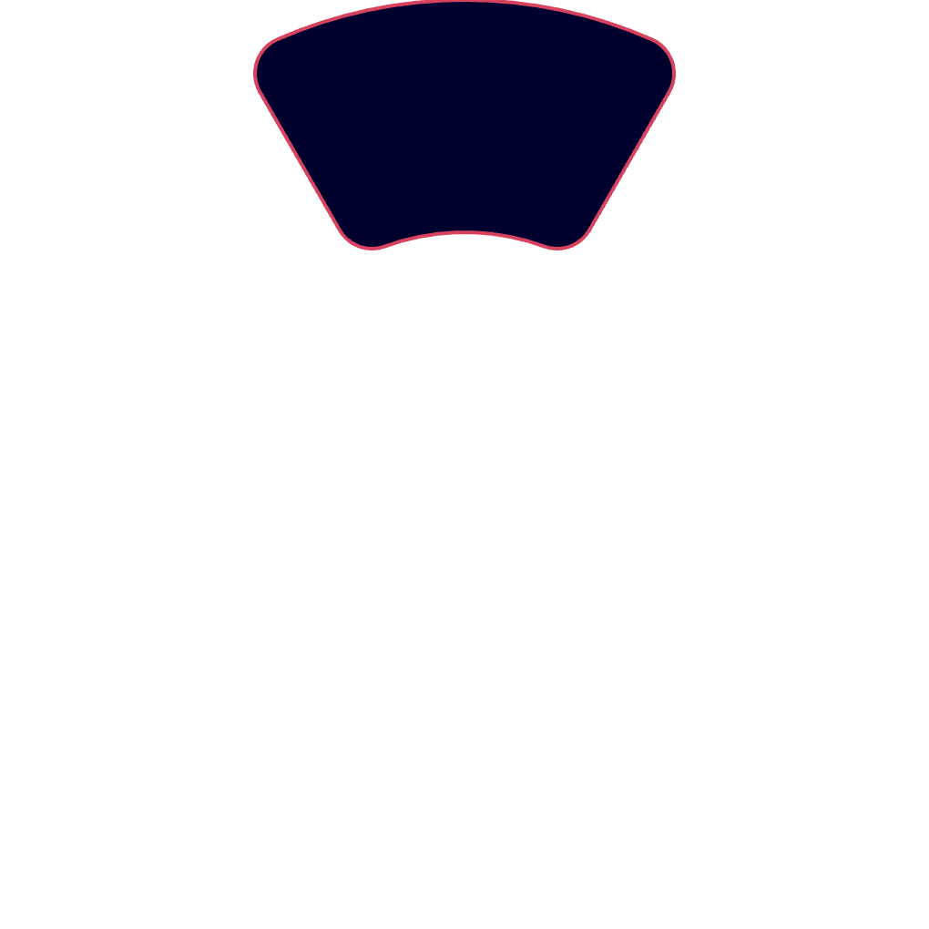
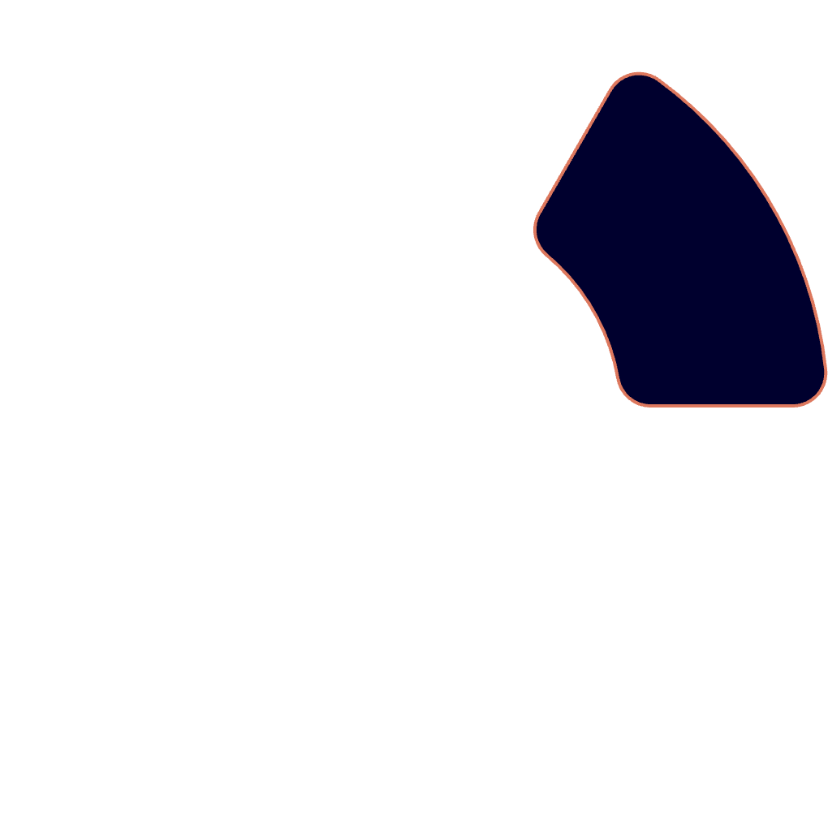
🎯Target Audience
Gender
Open to all.
Age
2
Social Class
18 years and older.
Middle to high-income.
1
3

Slide 7
SWOT Analysis
Strengths
Weaknesses
Opportunities
Threats
Unique platform in Morocco.
Requires strong marketing.
Expansion into Africa.
International competition.
Partnerships with banks & financial institutions.
High growth potential.
High initial investment.
Economic instability.
Supports innovation.

Slide 8

Advertising & Marketing
1
Social Media
Ads on Facebook, LinkedIn, Instagram, TikTok, YouTube
2
Networking Events
Business forums & startup competitions.
3
Partnerships
With banks and startup incubators.
4
Endorsements
From influencers.

Slide 9

Future Expectations
Investors’ Club
AI System
Create an Exclusive club for high-net-worth individuals.
African Markets
Launch investment recommendations.
Expand into multiple markets.

Slide 10
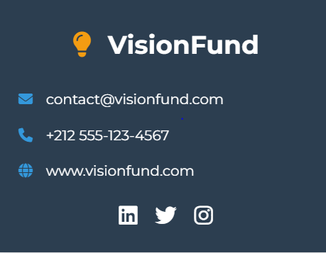
Join Us & Build the Future
🌍 Together, we are shaping the future.
💡 VisionFund is where great ideas come to life.

