Slide 1
Champion Solution in the MIND News Recommendation Challenge
Huige Cheng

Slide 2
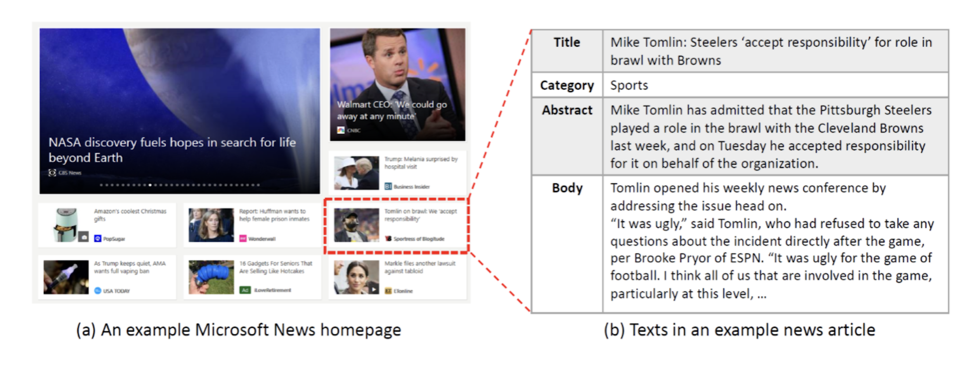
About MIND

Slide 3
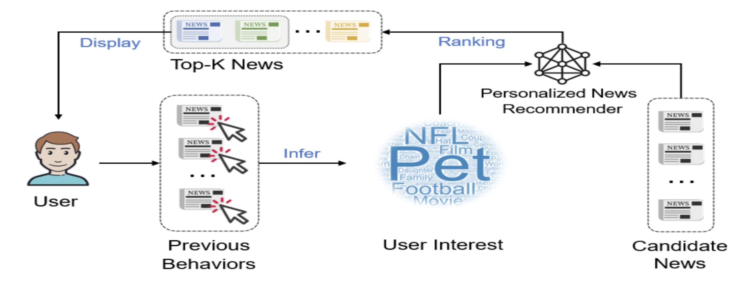
News Recommendation

Slide 4
Overview
Use 4 weeks to predict the 5th week(test dataset) click behaviours.
With 87.5% new docs in the testset we can view this puzzle as a content based recommendation problem.
Better representation of news and clicked news sequence using nlp features is the key for this problem.

Slide 5
How to evaluate?
MIN There are huge difference between dev set(only 1 day) and testset(1 week)
Randomly masked 92% docids of dev set as UNK in the dev set for evaluation.
 | dev | test
New user | 15.3% | 22.1%
New doc | 32.3% | 87.5%
Notes:
New doc ratio is much higher in the test set then dev , that means algos highly depend on docid which got good results on dev set will not perform well on test set.
But we found docid still helpful for the dev performance and we still use doc id as an input feature.
In order to make dev and test results consistent we randomly masked 92% docids as UNK in the dev set which do not exist in the train set for evaluation and we found using this strategy we got similar results on both dev and test.
However if we add context features like titles of the same impression we can still increase the dev result a lot but get worse results on the test set.
Anyway just using id and nlp features of news we can get consistent results on both dev and test.
We have found global auc of new docs is a very important evaluation metric also. Higher new doc auc means better generalization on new docs.
We found evaluation of 100w instances is enough(not much difference with using all dev instances), so we just use the first 100w dev instances for evaluation. We also use async validation so we can get evaluation results in parallel with the training process.
The dev result I will mention below will always be using the first 100w dev instances and randomly mask 92% docids.

Slide 6
Strategy
 | Max history used | Max elems per news
docid | 200 | 1
cat | 200 | 1
entity | 200 | First 2 entities
title | 50 | First 30 words
abstract | 50 | First 50 words
body | 50 | First 100 words
Pointwise training
Use Downsampling of negative instances.
About ⅕ instances to achieve similar result
Multiple datasets helps ensemble.
Use all available infos including ID feature.
Body > Title > Abstract > Cat > Entity > Docid > Userid
Remember we still have 12.5% old doc, 67% old user.
Ensemble
Use all 5 datasets to make 5 models for ensemble
Notes:
With only about 4% positive ratio. We found just using ⅕ negative instances can get nearly the same result while greatly reducing training time.
We just randomly shuffle each impression to get ⅕ negative instances per impression. By doing this we got 5 datasets(all positive instances + ⅕ negative instances dataset 0, dataset 1… dataset 4).
We did not do much experiments here, this might not be the best down sampling method ,for example we might leave all negative instances for impressions with less instances(<5). Also the split method we use will make dataset 1 with less negative instances then dataset 0.
We just use dataset 0 for most of our experiments, dataset 1-4 will be used for ensemble only if needed.
Downsampling to make 5 datasets each with different ⅕ negative instances.
Use dataset 0 for all experiments and use dataset 1-4 only for ensemble.

Slide 7
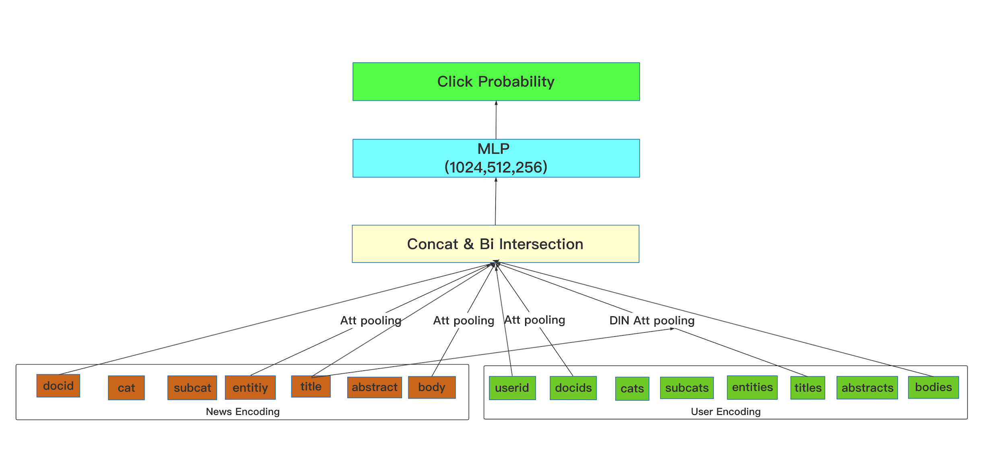
Model Structure
Notes:
We model each field like uid,docid,class, title, abstract,body separately and use concat + dot pooling(inner product for each field pair like DLRM) before feeding to mlp.
For candidate news we use attention pooling for words of title, abstract and body.
For history clicked news we use attention pooling for docids, cats,subcats and use DIN attention pooling for entities, titles, abstracts and bodies.
Features:
['uid', 'docid', 'history_docids',
'cat', 'sub_cat', 'history_cats','history_sub_cats',
'title_entities', 'abstract_entities',
'history_title_merge_entities', 'history_abstract_merge_entities',
'title', 'history_titles',
'abstract', 'history_abstracts’,
'body', 'history_bodies‘]

Slide 8
Milestones
 | Dev AUC | Test AUC (10%)
uid,docid,his_ids | 0.61 (without dev masked docids) 0.514 (with dev masked docids) | 0.5272
+cat, entity | 0.6829 | 0.6763
+title, abstract | 0.6987 | 0.6979
Adjust parameters | 0.7004 | 0.7036
+body(body model) | 0.7042 | 0.707 (best single)
+dev data | NA | 0.7104 (best single with dev)
Ensemble (4 body models with datasets 0,1,2,4 average) | NA | 0.7133

Slide 9
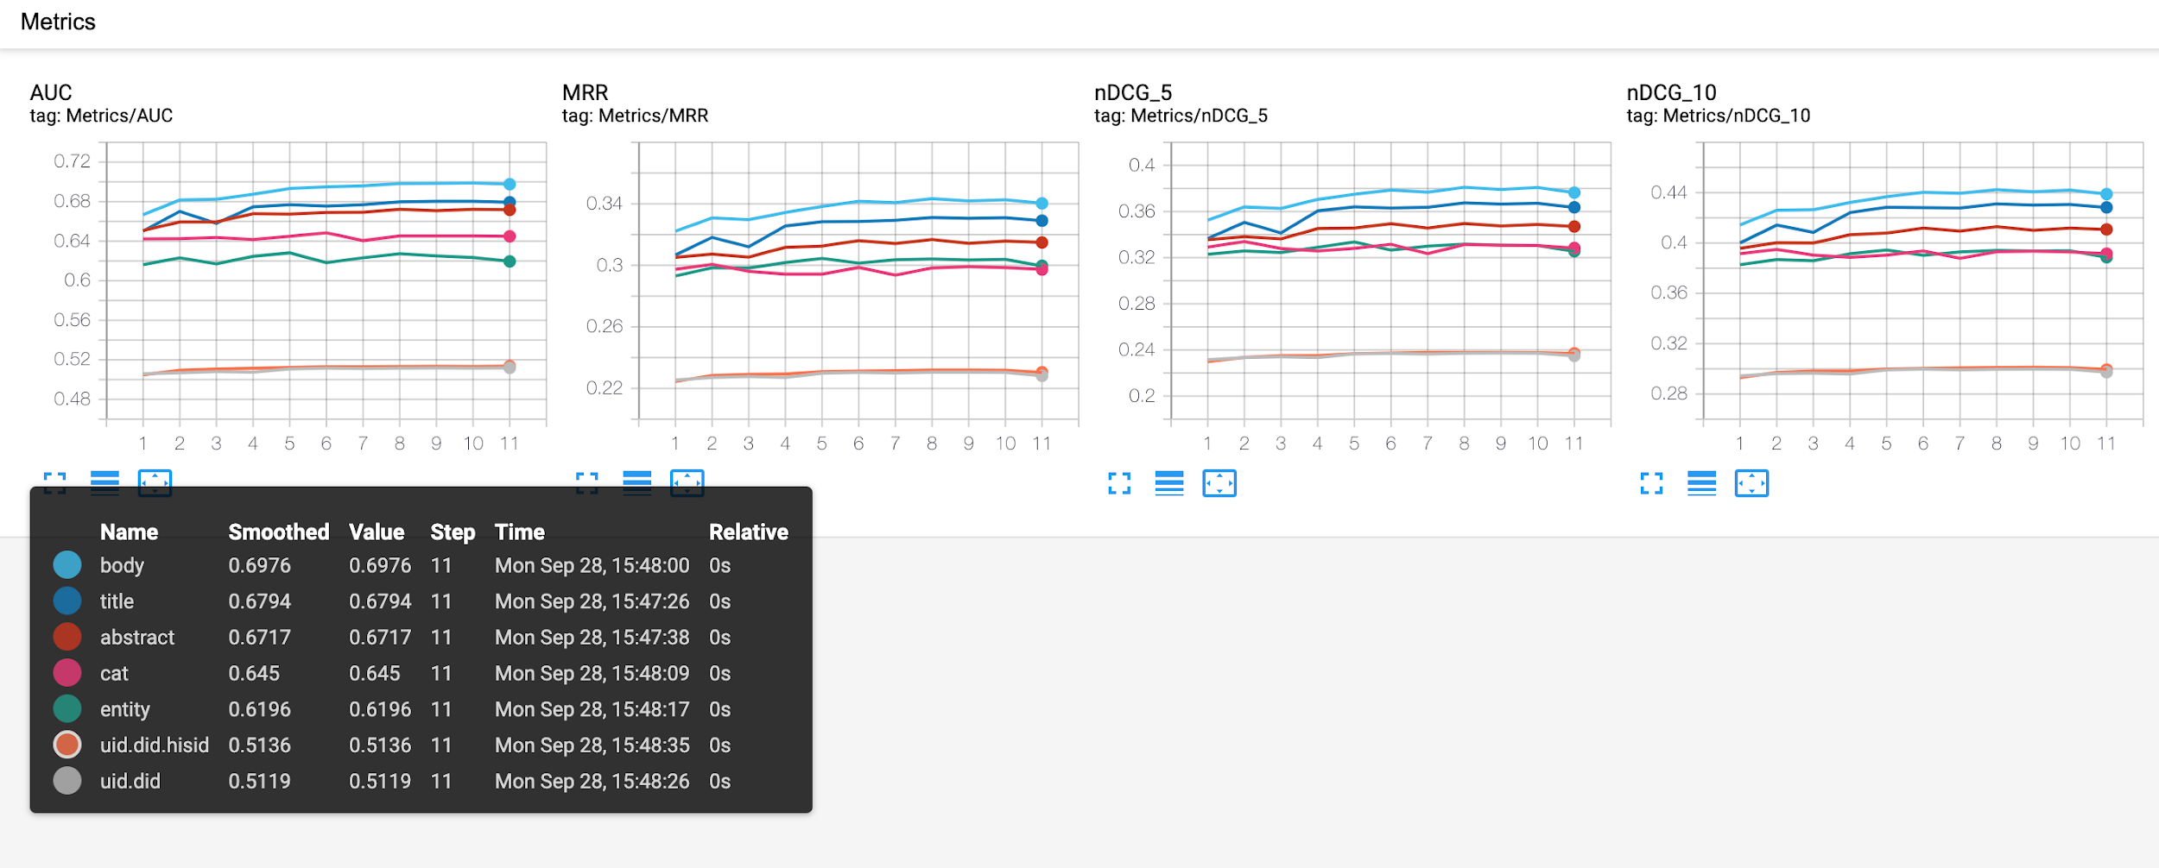
Solo feature importance
Notes:
All using tpu v2 8G * 8 CORE

Slide 10
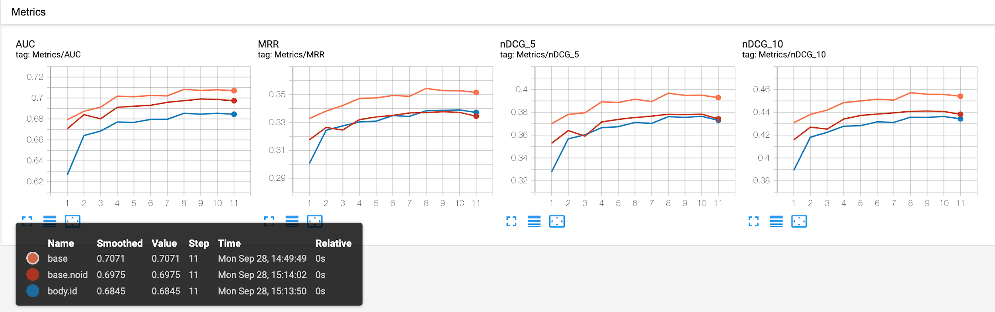
ID feature helps
Dev (with did mask) | AUC | TestAUC | MRR | nDCG@5 | nDCG@10
entity,cat,abstract,title,body (base.noid) | 0.6975 | 0.704 | 0.3344 | 0.3742 | 0.4383
+uid,did,hisid (base) | 0.7071 | 0.7123 | 0.3515 | 0.3929 | 0.4541
base evaluated all docid unk | 0.7016 |  | 0.3397 | 0.3794 | 0.443
Notes:
All using tpu v2 8G * 8 CORE

Slide 11
Use bert-tiny
Better news encoding with bert.
Using bert-tiny (2heads, 2 layers, output 128)
Continue pretrain on clicked title sequence, entity sequence
Predict masked words
Predict next clicked title, next clicked entity
Notes:
All using tpu v2 8G * 8 CORE

Slide 12
Bert-tiny helps ensemble
Test | AUC | MRR | nDCG@5 | nDCG@10
base | 0.7145 | 0.3625 | 0.3967 | 0.4537
bert-tiny | 0.7145 | 0.3622 | 0.3973 | 0.4533
Base + bert-tiny | 0.7158 | 0.3630 | 0.3983 | 0.4544
Avg of above 3 | 0.7187 | 0.3659 | 0.4018 | 0.4576
Notes:
All using tpu v2 8G * 8 CORE

Slide 13
TODO
Better encoding of LM part, like using unilm.
Better feature interaction.

Slide 14
Thanks！

