Slide 1
Twitter Sentiment Analysis of the 2020 Presidential Election
Ethan Xia¹, Han Yue² and Hongfu Liu²
¹Wellesley High School
²Brandeis University
Email: ethanyxia@gmail.com

Slide 2

Outline
Problem
Challenge Analysis
Philosophy and Design
Method
Data
Results
Conclusion

Slide 3
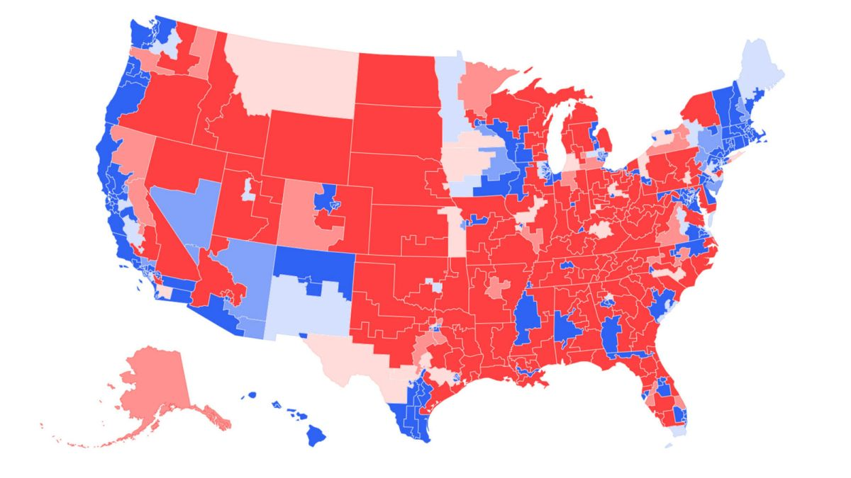

Problem
How can we predict an election involving tens of millions of voters ahead of time?
Can we use social media opinions to properly reflect public opinion on presidential candidates?
Can a model based on social media data be a cheap and reliable way to judge sentiment?

Slide 4
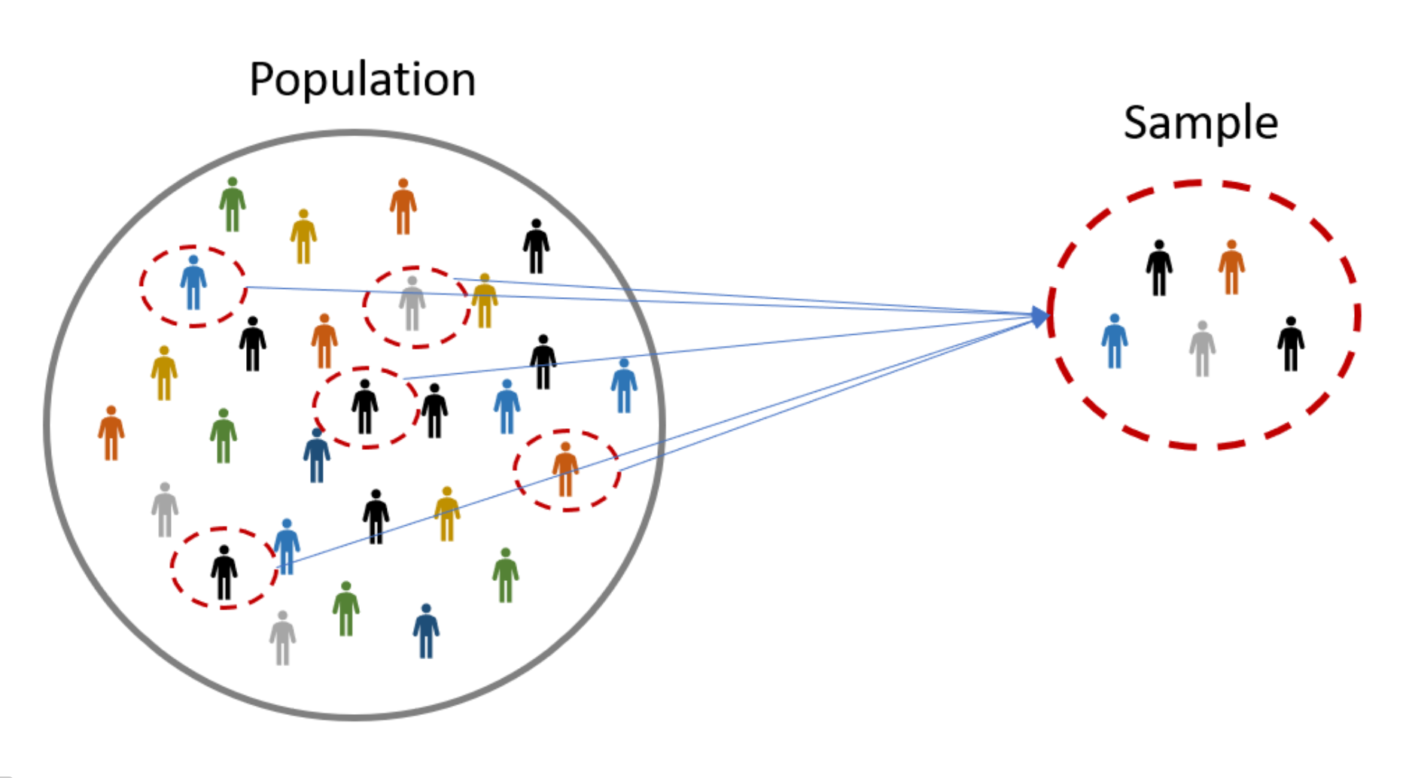
Challenge Analysis
Surveys often suffer from insufficient sample size
Properly representing the entire nation through the sample is challenging, as the sample is often biased
Individual models suffer from issues such as mixed parts of speech, sarcasm, and negation words.

Slide 5

Philosophy
Online data from social media is more easily accessible and people are more vocal and transparent about their opinions
We seek to use a larger and more representative dataset than traditional polls.
We also look to simplify the sentiment analysis process and reduce run time by removing complex tools like lexicons and giving single labels instead of a spectrum.
Using our data we try to understand patterns in sentiment analysis over time.

Slide 6


Design
We sampled tweets through the Twitter API, filtering with keywords
For our training data, we used the labeled Sanders Twitter dataset to train our model on general tweets.
We performed preprocessing and model selection before testing the data, applying either a positive, negative, or neutral rating to tweets.
Finally, we recorded our total results and percentages as well as graphing hourly trends.

Slide 7
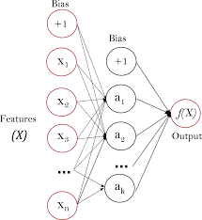
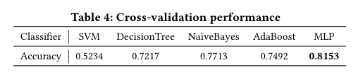
Method
We performed preprocessing to remove special characters like URLs, hashtags, and repeating characters to reduce feature size.
We tested the SVM, Decision Tree, Naive Bayes, AdaBoost, and MLP classifiers to determine the best model.
MLP performed the best during cross validation due to its strength in handling non-linear data.

Slide 8


Data
We collected a total of 260,498 tweets on Biden and Trump through the Twitter API with keywords such as “Biden,” “Trump,” “president,” and “election.”
We spread the collection period over 2 weeks starting from 10/19/2020 and ending on 11/02/2020
The author, date, text, and status were all recorded for each tweet

Slide 9
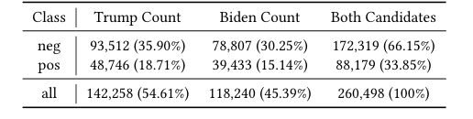
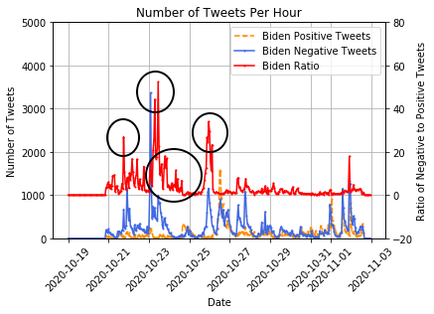
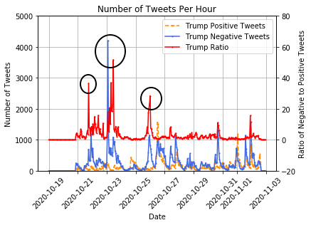
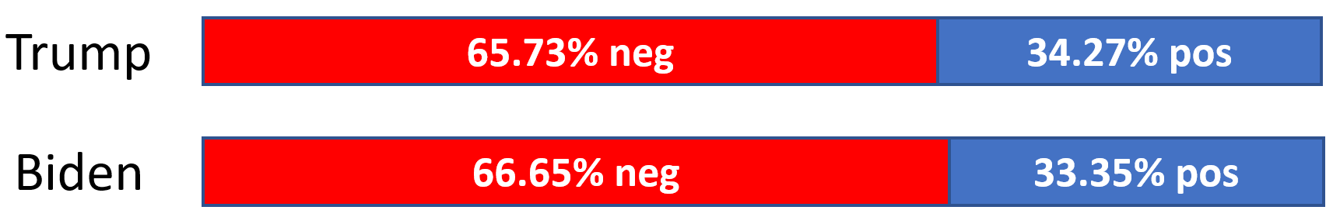
Results and Analysis
Biden had a 33.35% positive sentiment rate out of his total tweets and Trump had a 34.27% positive rate
Less than 1% difference in sentiment rating, and overwhelmingly negative sentiment towards both
We were able to observe trends in the hourly results and draw conclusions on the effects of major events

Slide 10
Conclusion
We were successful in making an accurate prediction that the election would be close and come down to slim percentages in battleground states.
We determined that the election was suspect to change and that critical political events like the debate led to change in sentiment.
With further refinement of the model and dataset, social media data can be reliable for sentiment analysis in the political landscape.
Challenges/Improvements: Adapted model for the electoral college voting system and factor twitter bias

Slide 11

Questions?

