Slide 1
Collocating News Articles with Structured Web Tables
The 1st International Workshop on News Recommendation and Intelligence
Co-located with The Web Conference 2021
2021-04-14
Alyssa Lees, Flip Korn, You Wu, Cong Yu
Google, New York, USA
Luciano Barbosa, Levy de Souza Silva
CIn - UFPE, Recife, Brazil

Slide 2
Motivation
People are interested in exploring knowledge while consuming news
Relational tables on the Web (a.k.a., Web Tables [1]) contain rich knowledge
Goal: associate news with relevant Web Tables for knowledge exploration
[1] WebTables: Exploring the Power of Tables on the Web. M. Cafarella et al.

Slide 3
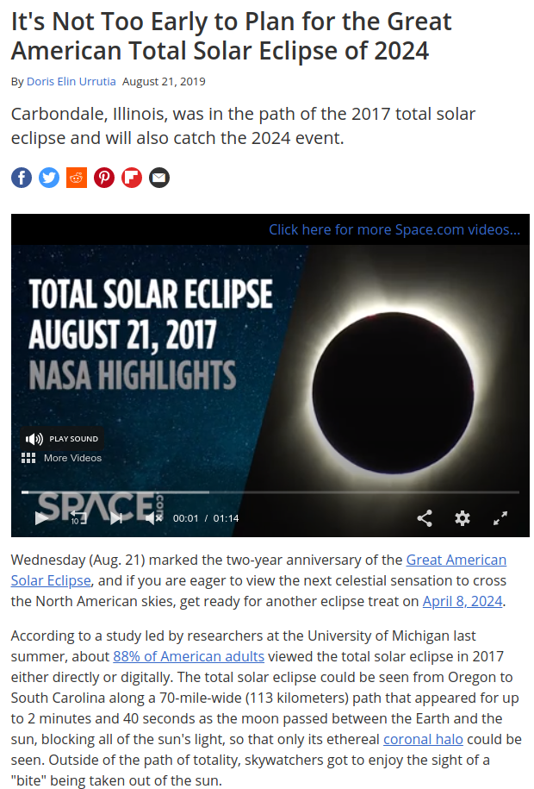
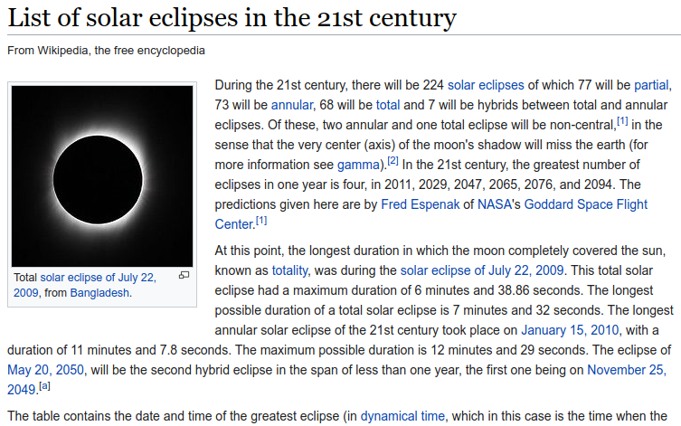
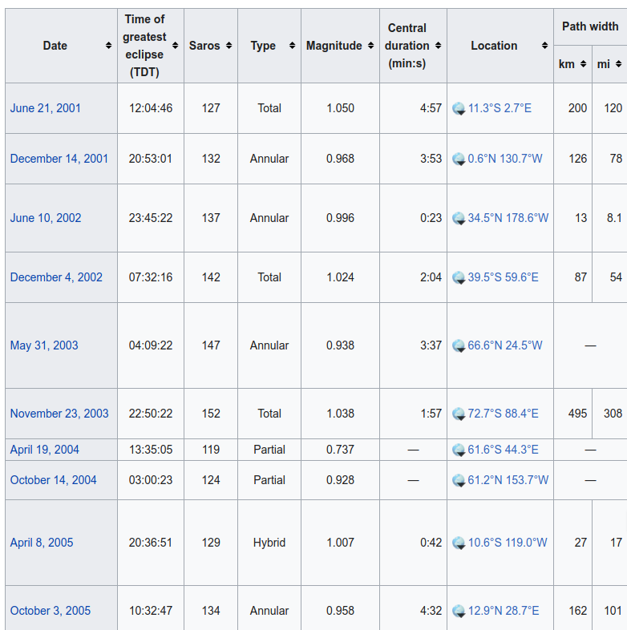
News Article and Relevant Web Table

Slide 4
Problem Definition
Title token sequence →
Inputs
News article A
Candidate table set T
Knowledge Base with IsA hypernym relations (side input)
Output
Ranked list of tables in T by topical relevance to A
Content token sequence →

Slide 5
Problem Definition
Title token sequence →
Content token sequence →
Inputs
News article A
Candidate table set T
Knowledge Base with IsA hypernym relations (side input)
Output
Ranked list of tables in T by topical relevance to A
Table header →
Table content →

Slide 6
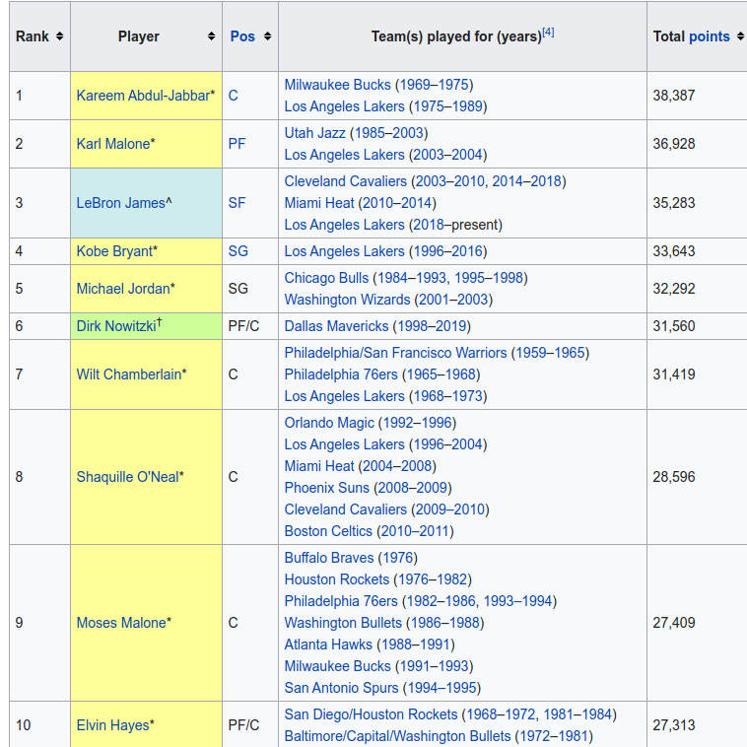
Problem Definition
Instances of
“basketball player/athlete” →
Inputs
News article A
Candidate table set T
Knowledge Base with IsA hypernym relations (side input)
Output
Ranked list of tables in T by topical relevance to A
Notes:
Subject column name is often very general, such as “Name”. Aggregated hypernym of subject column entities significant enhances table understanding.

Slide 7
Problem Definition
Inputs
News article A
Candidate table set T
Knowledge Base with IsA hypernym relations (side input)
Output
Ranked list of tables in T by topical relevance to A

Slide 8
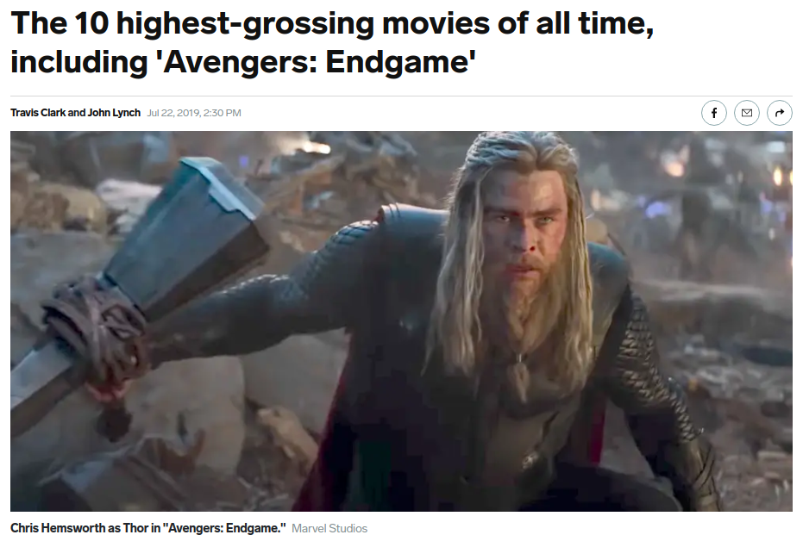
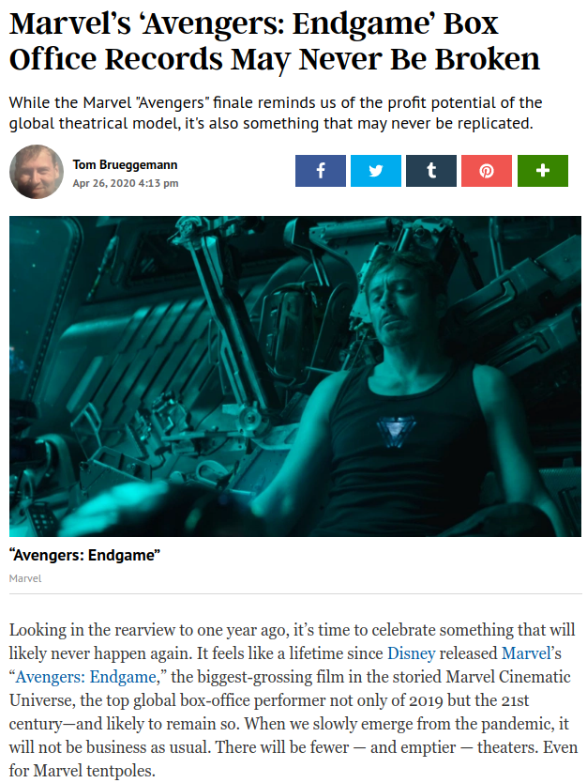
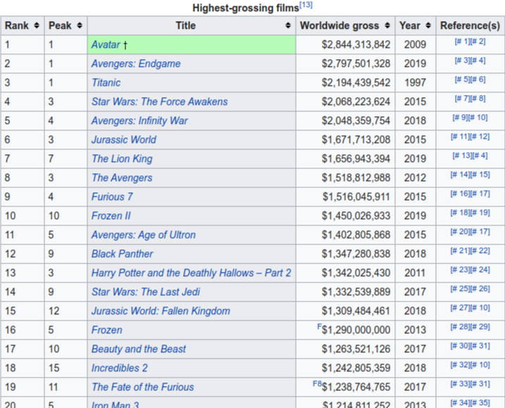

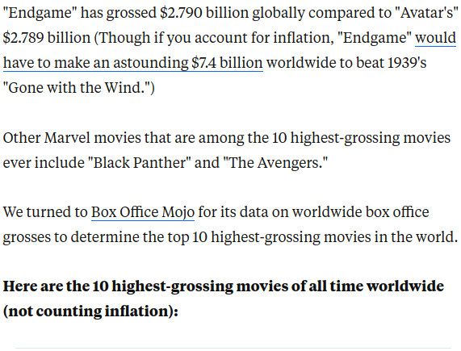
Common Types of Exploration
“sideway”
“downward”
[2] Knowledge exploration using tables on the Web. F. Chirigati et al.
Notes:
Example: a table can be relevant to different news articles in different ways. Showing two common types using terms coined in an earlier paper.
Highlights differences:
[1] studied entity-driven exploration; used traditional IR techniques such as TF-IDF, co-occurrence.
We study article-driven exploration: topical entities may be too narrow or too broad; use language model to capture article topic & intricate relationships among the same set of entities

Slide 9
We let (aggregated) user activities drive our definition of relevance.
“sideway”
“downward”
[2] Knowledge exploration using tables on the Web. F. Chirigati et al.
Notes:
Example: a table can be relevant to different news articles in different ways. Showing two common types using terms coined in an earlier paper.
Highlights differences:
[1] studied entity-driven exploration; used traditional IR techniques such as TF-IDF, co-occurrence.
We study article-driven exploration: topical entities may be too narrow or too broad; use language model to capture article topic & intricate relationships among the same set of entities

Slide 10
Model

Slide 11
Data Collection
Training
50M (English) news articles for pre-training
53K Wikipedia pages with 1+ large enough (>=5 rows) “horizontal” table
Wikipedia articles & tables of better quality than general WebTables
Wikipedia pages <-> Freebase entity mapping help with hypernym extraction
120K triples of <A, T⁺, T⁻> for fine-tuning
T⁺: at least z% (0.3%) of visits to A are followed shortly by a visit to T⁺
T⁻: randomly sampled between 100th and 300th most similar according to pre-trained model
Evaluation Set
300 pairs of <A, T⁺> verified by human labelers (then removed from training set)
[3] Generating Representative Headlines for News Stories. X. Gu et al.

Slide 12
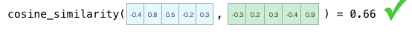
BERT-style Pre-training for News
“Person Killed in Rollover Crash on Hwy 101”
“What are the most common reasons for road accidents”
Loosely relevant story
Same story / near duplicate
“1 woman killed in early morning crash on Highway 101 in Redwood City”
Other irrelevant stories:
Sports, politics, entertainment, …
Similar / relevant story
“Fatal Crash on Hwy 90 This Morning and One Person Died”
[3] Generating Representative Headlines for News Stories. X. Gu et al.

Slide 13
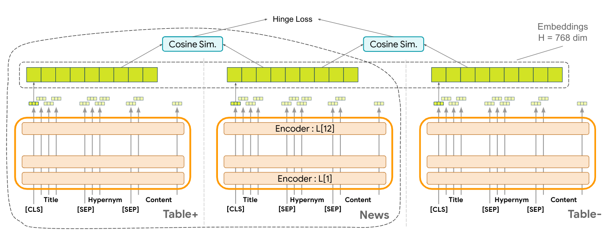
Fine-tuning on Article-table Triples
<A, T⁺, T⁻> : users are more likely to visit table T⁺ than table T⁻ after visiting news article A.
Notes:
Mentions sequence representation, referring to the diagram

Slide 14
Experiments
Metric: accuracy@k (k = 1, 5, 10, 100)
Baselines:
BM25
TF-IDF
Universal Sentence Encoder
Doc2Vec
BERTpublic
NewsBERT (BERT model pre-trained on news corpus)

Slide 15
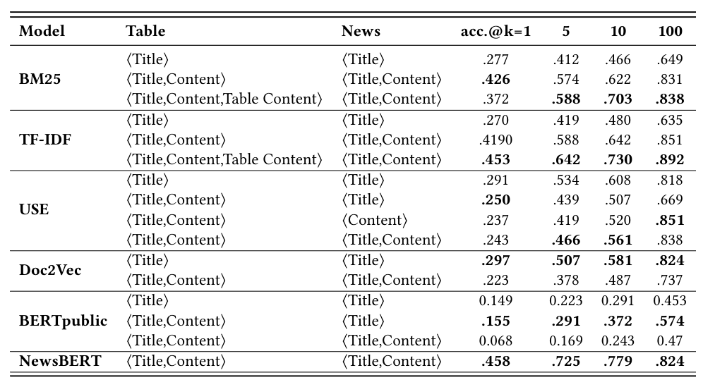
Baseline Results

Slide 16
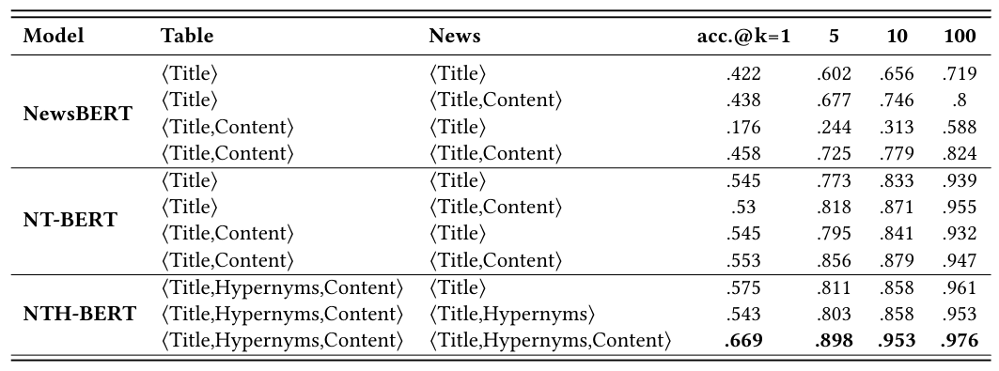
Experimental Results

Slide 17
Thank you!
Questions? Comments?

