Slide 1
MemeSonic
Multimodal Meme Understanding for Emotion-Aware Audio Generation
Image-Text Fusion · Incongruity Modeling · FusionMoE
MAS.60 Final Project · Spring 2026

Slide 2
Project Overview
Goal: Detect meme sentiment & intention → generate emotion-matched audio
Meme Input (image + text)
Multimodal Fusion
Sentiment & Intention
Audio Generation
→
→
→
Sentiment
Intention
Sarcasm
Humor
7-class emotion (happiness, sorrow, …)
4-class purpose (expressive, entertaining, …)
Binary + 3-class across datasets
3-class (not funny → hilarious)
3 Datasets: MET-Meme (3,389) · Memotion-7k (6,992) · MMSD 2.0

Slide 3
01 Datasets
Meme Datasets: What We're Working With
MET-Meme
Memotion-7k
MMSD 2.0
• 3,389 samples
• 6,992 samples
• 2,409 test samples
• 7-class sentiment
• Humor · Sarcasm
• Binary sarcasm detection
• 5-class intention
• Offensive · Motivational
• Cleaner labels
• Hate · Metaphor tasks
• Strong class imbalance
• Benchmark dataset
⚠ Class imbalance: positive sentiment 59.5% · funny 67% · motivational 65% not-motivational → use Macro-F1 as primary metric

Slide 4
02 LLM Baseline
LLM Baseline: GPT-4o & Gemini-2.5-Flash
Task
GPT-4o
Gemini-2.5
Key Takeaways
MET-Meme Intention
52%
48%
Hate / binary tasks
MET-Meme Sentiment
28%
34%
relatively easy (74–86%)
MET-Meme Hate
76%
74%
Sentiment & Intention
MET-Meme Metaphor
58%
72%
very hard (26–52%)
Memotion Humor
68%
68%
Interactive intention
0% recall across ALL models
Memotion Sarcasm
52%
50%
Memotion Sentiment
30%
26%
Label subjectivity
limits ceiling performance
MMSD Sarcasm
80%
86%
→ LLMs alone are insufficient for fine-grained meme understanding

Slide 5
03 Incongruity Fusion
The Key Insight: Meme Humor Lives in Incongruity
A meme's meaning often emerges from the gap between image and text — not from either alone.
Redundancy
Incongruity
Synergy
Image & text say the same thing
Image & text contradict each other
Meaning only emerges from both together
→ simple concat works
→ capture the tension
→ joint reasoning
Incongruity-Aware Fusion Architecture
① Image → ResNet-50 → projection
④ Cross-modal disagreement = incongruity score
② Text → BERT [CLS] → projection
⑤ Fused representation for classification
③ Both → sentiment distribution space
Trainable params: only 200,336 (frozen BERT + ResNet backbones)

Slide 6
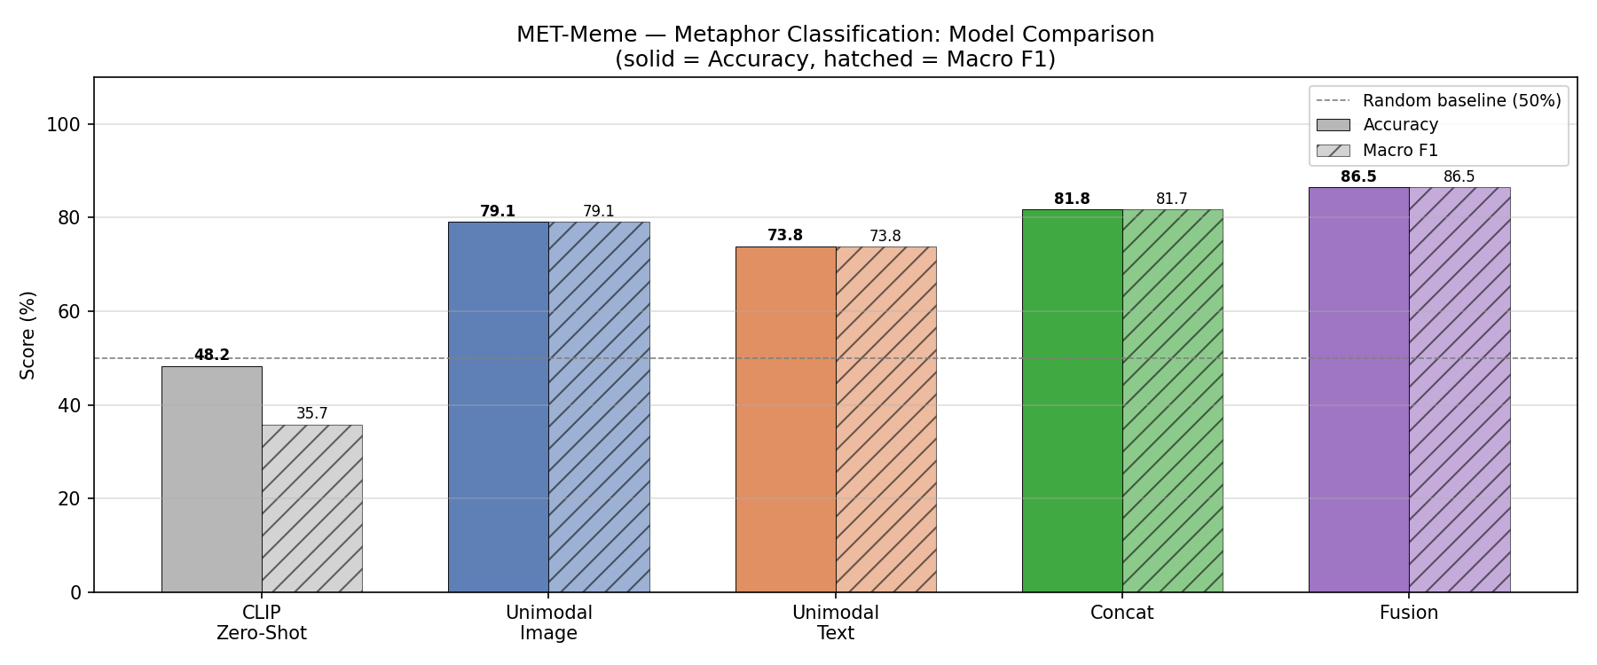
03 Incongruity Fusion
Incongruity Fusion Results: Wins & Limits
Concat baseline → Incongruity Fusion
Metaphor
+6.5 pp
81% → 87.7%
MMSD Sarcasm
+1.4 pp
82.7% → 84.1%
Hate
+3.6 pp
83.5% → 87.1%
Sentiment
+4.1 pp
43.8% → 47.9%
Intention
+1.1 pp
42.4% → 43.5%
✓ Strong on incongruity-heavy tasks (metaphor, sarcasm) ✗ Limited gains on fine-grained sentiment & intention

Slide 7
04 FusionMoE
The Problem: One Fusion Strategy Doesn't Fit All Tasks
Different tasks require different fusion strategies — a single architecture can't optimise for all of them.
Metaphor
Sentiment
Sarcasm (MMSD)
Intention
High incongruity between image & text
Both modalities carry unique signals
Balanced contribution from both modalities
Complex & imbalanced class distribution
Incongruity fusion works best
Late fusion works better
No clear winner fusion
All fusion strategies struggle
Solution: Let the model learn WHICH fusion strategy to apply, conditioned on the incongruity signal → FusionMoE

Slide 8
04 FusionMoE
FusionMoE Architecture
Three experts, each capturing a different fusion mode. An incongruity-aware router assigns weights.
Expert R (Redundancy)
Expert U (Uniqueness)
Expert S (Synergy)
Router
Incongruity score → softmax gate weights (learned temp τ)
Concat Fusion Shared info from both
Late Fusion Each modality's unique contribution
Incongruity Fusion Captures cross-modal tension
↓ weighted sum → classifier
Backbone: Pre-cached CLIP embeddings (512-dim, L2-normalized) · Trained end-to-end on each task
Gate weight examples (mean across test set):
Metaphor
Sentiment
Sarcasm
Hate
Concat 0.87 · LateFusion 0.13
Concat 0.44 · LateFusion 0.56
Concat 0.50 · LateFusion 0.50
Concat 0.49 · LateFusion 0.51

Slide 9
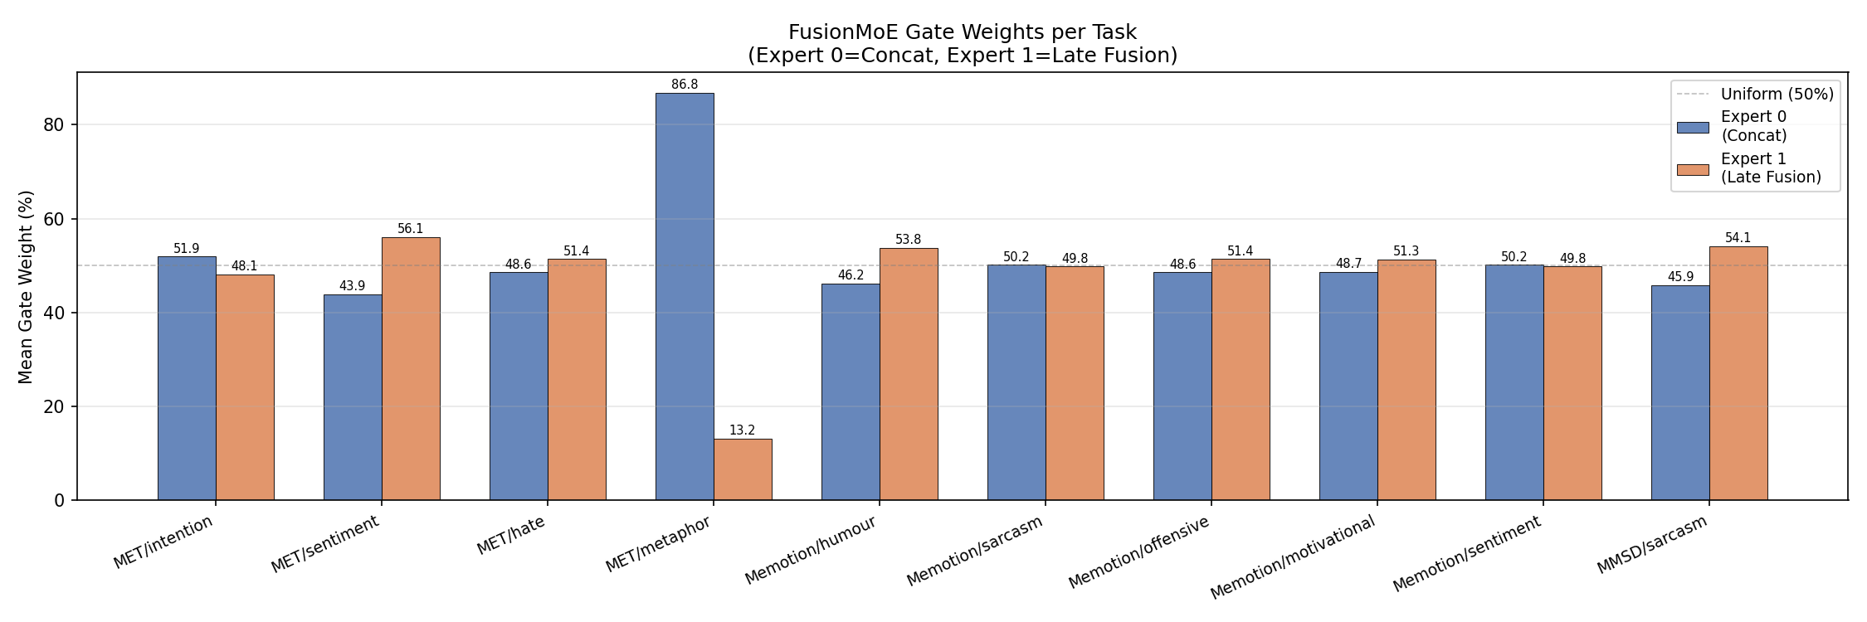
04 FusionMoE
FusionMoE Results
Key results (Accuracy · Macro-F1)
Task
Acc
F1
MET-Meme Metaphor
87.65%
87.65%
MET-Meme Hate
87.06%
38.26%
MET-Meme Sentiment
48.24%
26.81%
MMSD Sarcasm
84.10%
83.97%
Memotion Humor
65.86%
28.28%
MET-Meme Intention
40.00%
27.31%
← Gate weights show the router learns task-specific fusion strategies

Slide 10
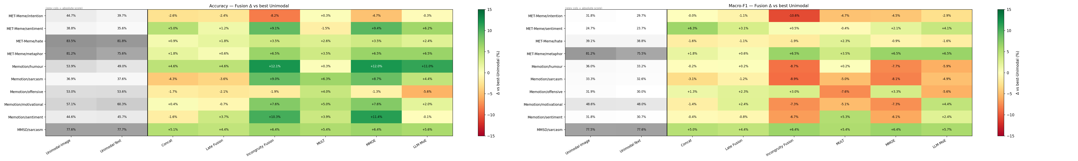
04 FusionMoE
Model Comparison: All Tasks × All Methods
Darker = higher accuracy. FusionMoE / MMOE consistently competitive; incongruity fusion strong on metaphor & sarcasm.

Slide 11
05 Analysis
Error Analysis & Limitations
Interactive intention: 0% recall across ALL models
Rarest class, semantically ambiguous — models default to majority classes
Macro-F1 << Accuracy on imbalanced tasks
Sentiment positive=60%, funny=67% → high accuracy from majority class voting
Incongruity fusion hurts intention
42.4% (concat) → 36.5% (incongruity) — cross-modal disagreement is noisy for this task
FusionMoE gate learns task signal
Metaphor → concat-heavy | Sentiment → late-fusion-heavy (without any supervision)
LLaVA probing (supplementary)
Cross-modal attention differs between sarcastic / non-sarcastic at specific layers & heads

Slide 12
Summary & Next Steps
Contributions
Best Results
✓ LLM baseline → fine-grained meme tasks are hard (26–52% on sentiment/intention)
Metaphor
87.65%
Acc
✓ Incongruity-Aware Fusion → captures cross-modal tension, strong on metaphor (+6.5 pp) & sarcasm
MMSD Sarcasm
✓ FusionMoE → task-adaptive routing; router learns fusion preference without supervision
84.10%
Acc
✓ Systematic analysis across 10 tasks, 3 datasets, 8+ model architectures
Hate
87.06%
Acc
Next Steps
Humor
→ Connect FusionMoE output to audio generation (tone / mood conditioning)
65.86%
Acc
→ Address Interactive class: data augmentation or few-shot prompting
Motivational
52.9%
F1 (LLM-MoE)
→ Scale to larger CLIP / LLM backbone for richer embeddings

