Slide 1



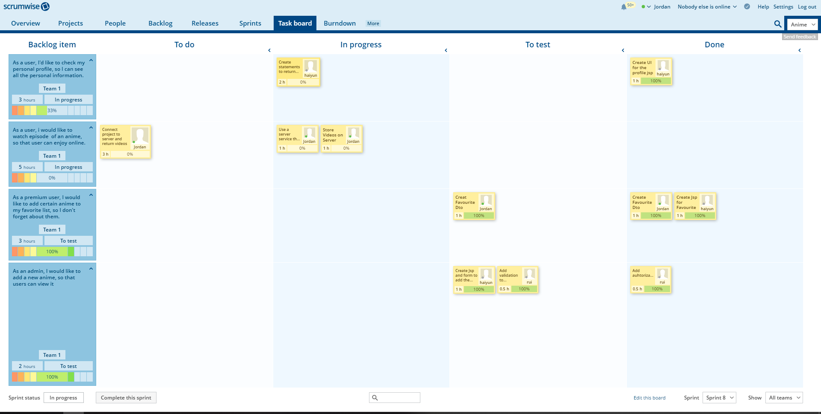
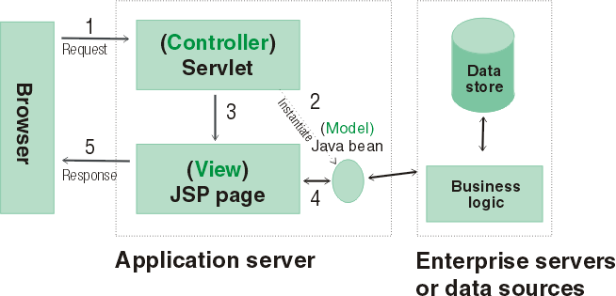
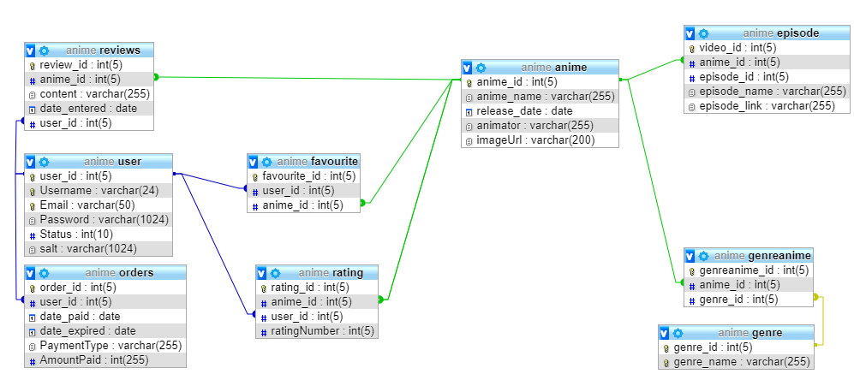
Emmine Anime
Anime Subscription Service
Rui Hu, Haiyunn Yu, Jordan Donnelly
Bachelor of Science in Computing
Introduction
Product Functionality
Process and Teamwork
This project involved the development of a web application that allows users to view anime, get more information on them and upgrade to premium.
The system facilitates three types of user: Free Registered Users, Premium Registered User and Administrator. Free Registered users can view all the anime and learn more information about them, they also have the option of upgrading to premium for the low price of €5. Premium Registered Users can add ratings to anime, add anime to their favorites and also watch anime. Users can register for an account.
Administrators can add, edit and delete any anime they please. The site has been developed to work with mobile devices and is internationalized to Mandarin as well as English.
An Agile approach was used in the development of this project using the Scrumwise tool was used to support the process. Every week we made a new sprint in Scrumwise which kept us on track with our goals.
Database Design
Architecture
Tools & Technologies
Apache, Tomcat, Java Servlets, JSP, HTML5, CSS, JavaScript, MySQL, Bitbucket, Scrumwise, Junit, Selenium, Katalon, Java Commands.
The following design patterns were implemented Data Access Object (DAO), Factory, DTO, Front Controller …

