Slide 1
Online Class Simulation Using Chatting-Based Features
Web-based Online Class

Slide 2
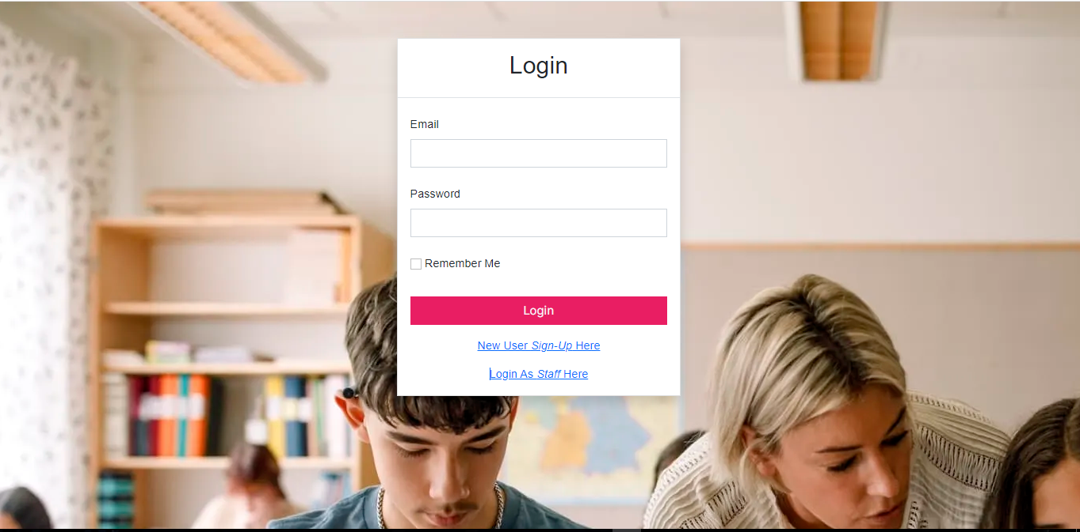
Student Login Page

Slide 3
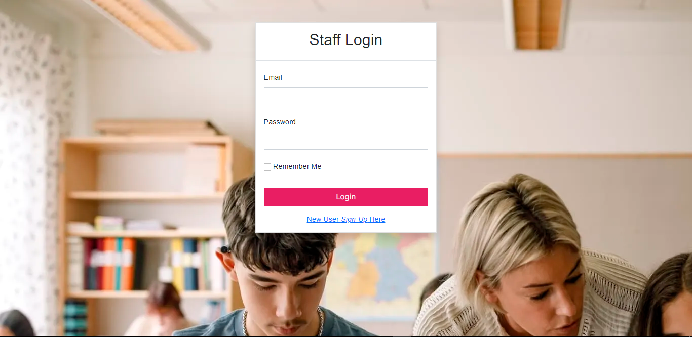
Staff Login Page

Slide 4
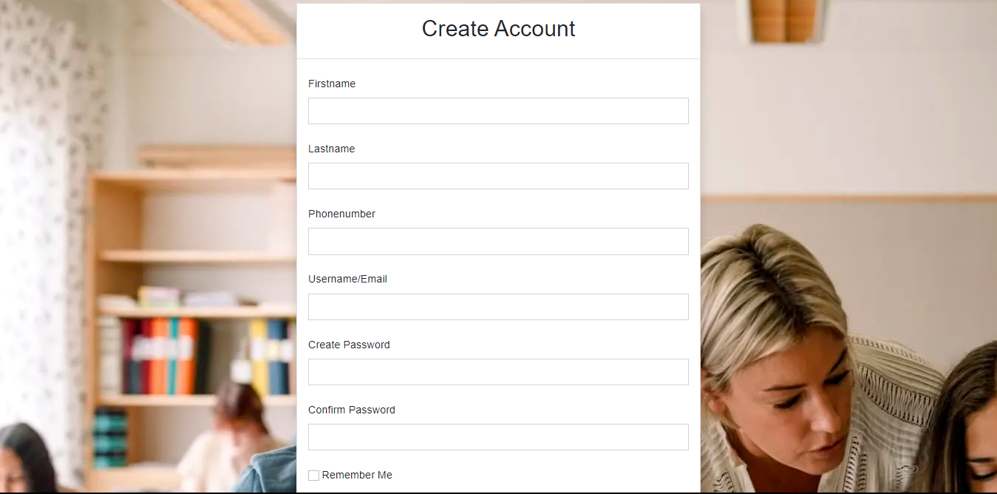

Student Registration Page

Slide 5
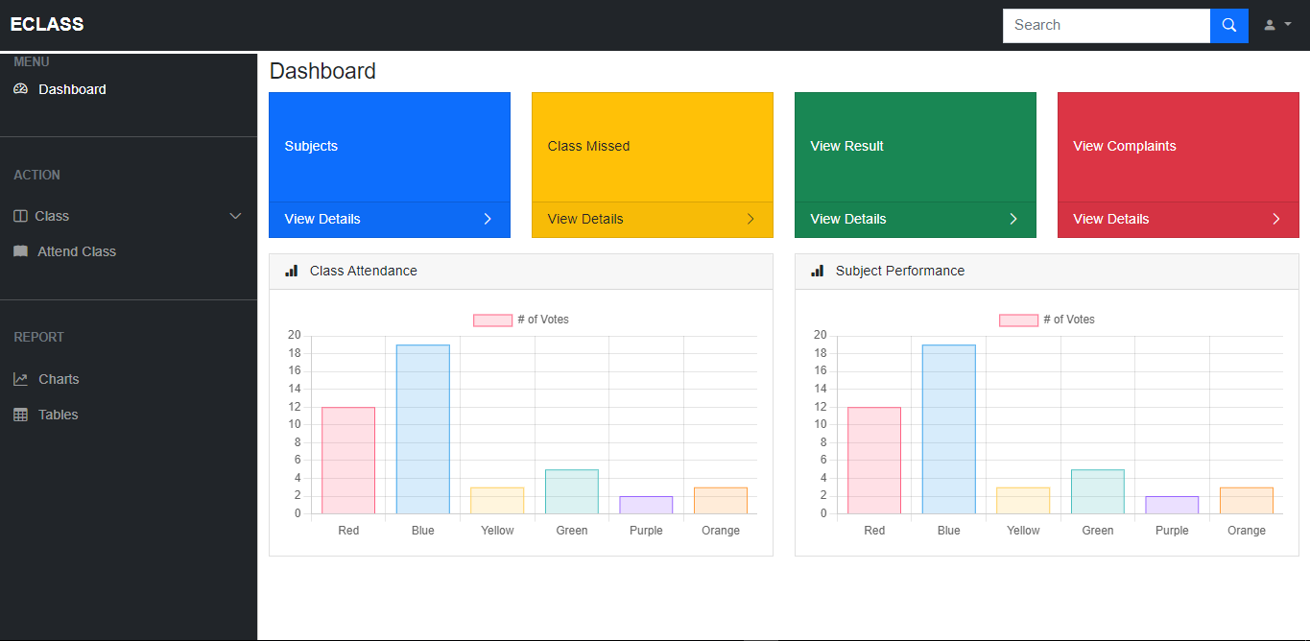
Dashboard

Slide 6
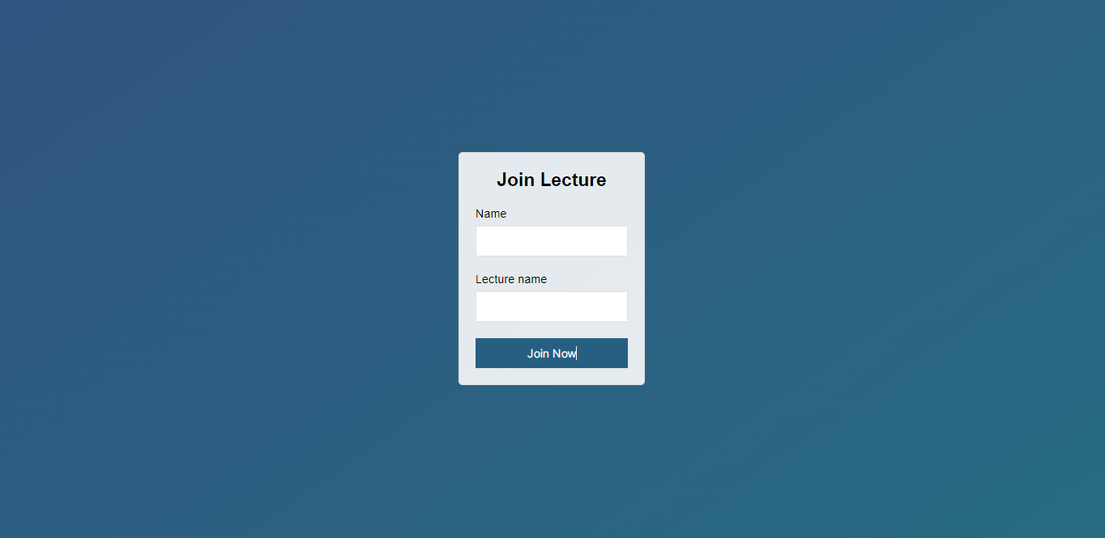
Join Lecture Page

Slide 7
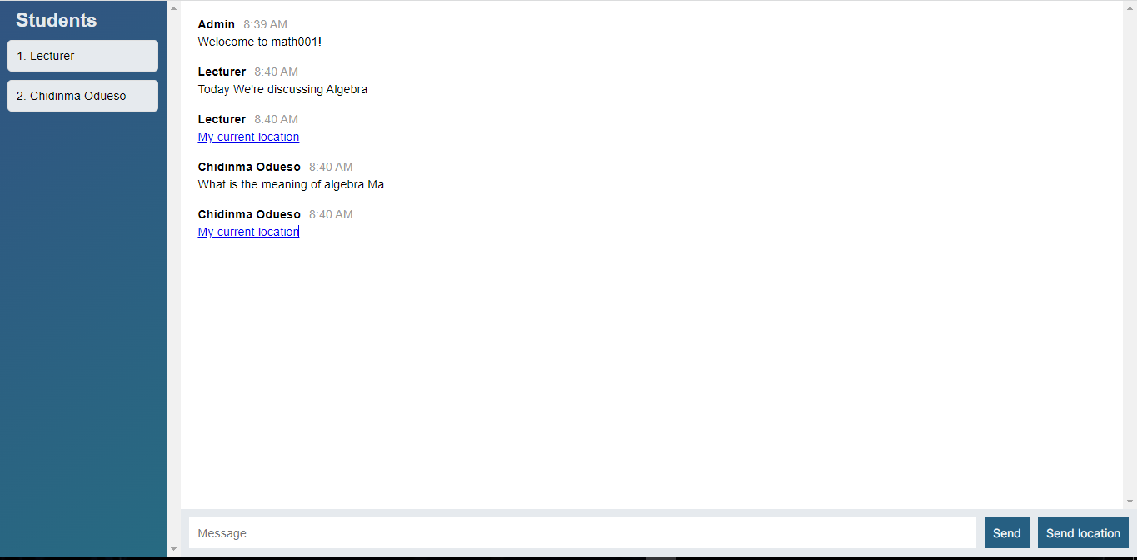
Lecture Page – Student Interface

Slide 8
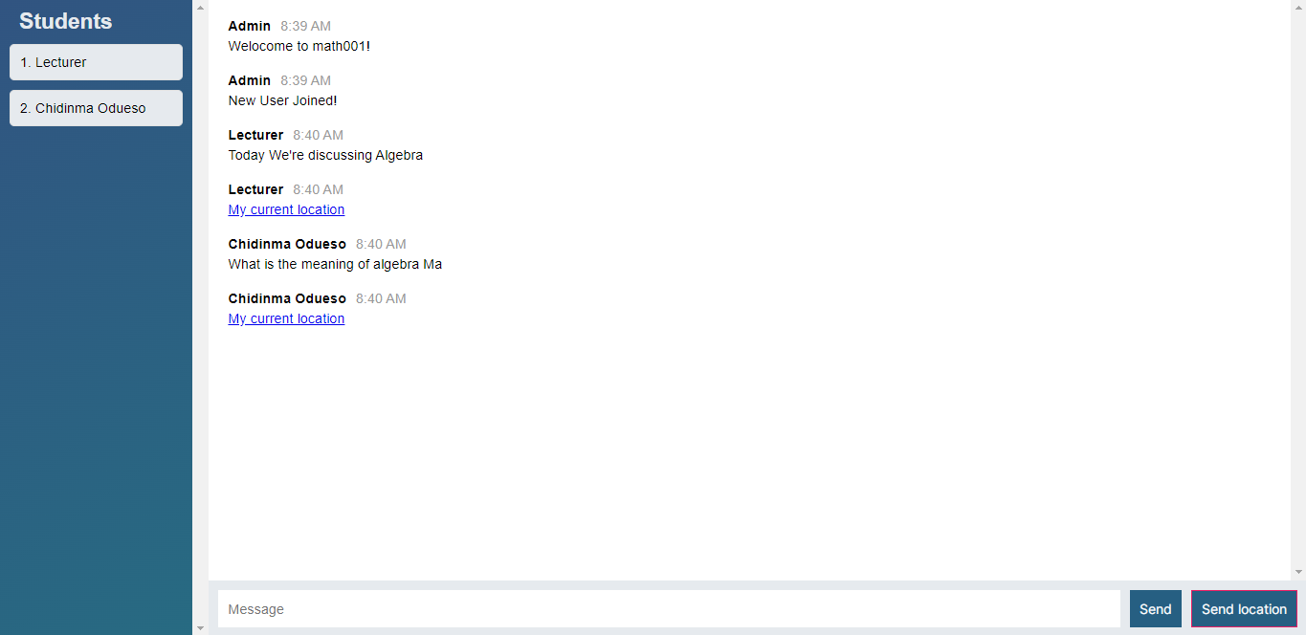
Lecture Page – Staff Interface

