Slide 1
Covid’s News Anxiety classification
Presented by :
Eya ben Khater & Emna Guermazi

Slide 2
Plan
Introduction
Project
Conclusion

Slide 3

Introduction

Slide 4
Introduction to NLP (Natural Language Processing )
NLP can be summorized in:
Understanding
Manipulating
the generation of natural language by the machine.
It is the intermediary between computer science and linguistics.
It concerns the machine's ability to interact directly with humans.
Notes:
Le NLP pour Natural Language Processing (ou TNL pour Traitement Numérique du Langage)

Slide 5
Importance of NLP
Many of the applications we use every day rely on NLP:
Sentiment analysis
Chatbots
Text classification

Slide 6

Project

Slide 7
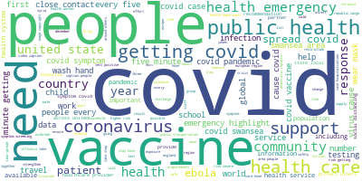
Objective
Classify weither a given news is a source of anxiety or not if it’s related to CORONA.

Slide 8
Steps
Data Scrapping
Data Cleaning
Labeling with kmeans
Embedding
Machine Learning
Preparing the Flask interface

Slide 9
Steps
Data
Scrapping
Data Cleaning
Embedding
WHO
TopicModeling
Clustering 2 classes
News Anxiety classification
Machine learning
CDC
No_corona
Corona
Defence.gov/rumor_control
Model
TopicModeling
Clustering 2 classes
Annotation of data
BBC
Anxious news
Not Anxious news

Slide 10
Data Scrapping
ToolBox :
Newspaper3K : to scrap data
Pandas : IO files

Slide 11
Data Scrapping
It is an automated technique of gathering data from the web using a scraper.
The scraper is set to extract specific data from targeted websites.
The scrapper that we used is newspaper3k .

Slide 12
Data Scrapping
Chosen sites :
Who : World health organization
CDC : Center for desease control and Prevention
Defence.gov/rumor_control : it’s a site that distinguishes between rumors and truths
BBC : news channel

Slide 13
Data Cleaning
ToolBox:
Nltk :Natural Language Processing
Re: Regular expression
Pandas : read files

Slide 14
Data Cleaning
Data cleaning is one of the most crucial tasks that we face in the realistation of any machine learning related project .
That’s why it is very important to pay extra attention to it.

Slide 15
Data Cleaning
Corpus
Tokenization
Special character removal
Stop words removal
Lemmatization
Translation

Slide 16
Clustering 2 classes
Scrapped Data
Corona News
Other News
Notes:
Goal :
Obtaining 2 classes :
News that are related to corona
News that have nothing to do with corona
In this step we parsed the articles gathered and discarded the articles if it doesn’t have one of corona ‘s key words

Slide 17
Clustering 2 classes
We’ll apply Sklearn's TFIDF vectorizer and MiniBatchKmeans to perform articles clustering.
After which , we’ll plot the clusters using PCA and TSNE, then show the keywords in each cluster.

Slide 18
Clustering 2 classes
Sklearn's TFIDF vectorizer :
This is very common algorithm to transform text into a meaningful representation of numbers.
It is used to fit machine algorithm for prediction.
Notes:
TF-IDF is an abbreviation for Term Frequency Inverse Document Frequency.

Slide 19
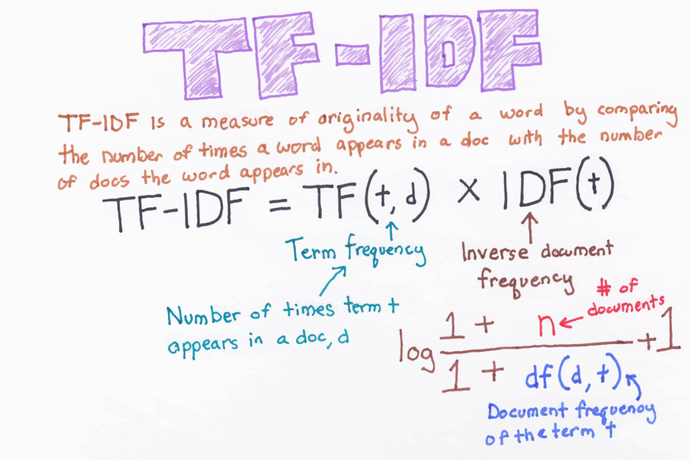
Clustering 2 classes
Sklearn's TFIDF vectorizer :
Notes:
TF-IDF is an abbreviation for Term Frequency Inverse Document Frequency.

Slide 20
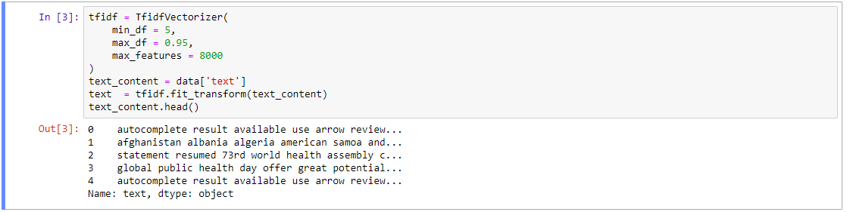
Clustering 2 classes
Sklearn's TFIDF vectorizer

Slide 21
Clustering 2 classes
Sklearn's TFIDF vectorizer :
min_df : When building the vocabulary ignore terms that have a frequency strictly lower than the given threshold.
max_df : When building the vocabulary ignore terms that have a frequency strictly higher than the given threshold
fit_transform(df[, y]) : Learn vocabulary and returns a matrix with terms.

Slide 22
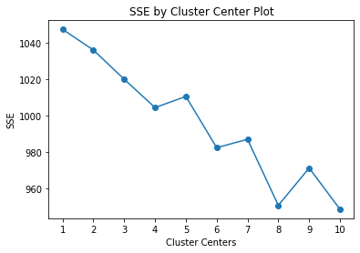
Clustering 2 classes
Clustering is an unsupervised operation, and KMeans requires that we specify the number of clusters.
One simple approach is to plot the SSE for a range of cluster sizes.
We look for the "elbow" where the SSE begins to level off.
Number of clusters = 4

Slide 23
Clustering 2 classes
MiniBatchKmeans :
Unfortunately the regular Kmeans implementation is too slow.
Here we chose 4 clusters.
n_clusters : The number of clusters to form as well as the number of centroids to generate.

Slide 24
Clustering 2 classes
MiniBatchKmeans :
batch_size : Size of the mini batches
init_size : Number of samples to randomly sample for speeding up the initialization
random_state : Determines random number generation for centroid initialization and random reassignment.
fit_predict(X[, y]) : Compute cluster centers and predict cluster index for each sample.

Slide 25
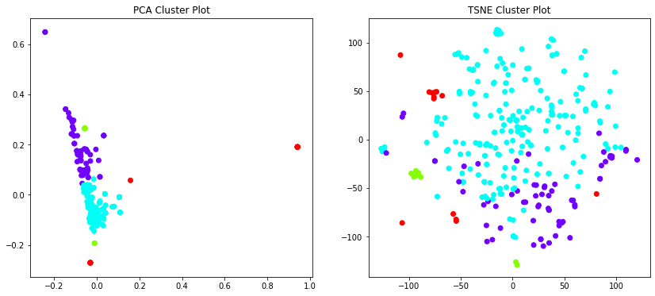
Clustering 2 classes

Slide 26
Clustering 2 classes
Cluster 0 : four, control, disease, seven, protecting, center, prevention, saving, twenty, cdc
Cluster 1 : caption, covid, people, two, area, getting, every, five, minute, swansea
Cluster 2 : day, uk, one, people, year, say, said, health, ha, wa
Cluster 3 : death, cdc, state, case, symptom, vaccine, health, spread, covid, 19
Notes:
We can notice that we don’t really need cluster 0, since it doesn’t actually contain one of the keywords we need
So in the next step, we’ll remove it and consider the ones belonging to cluster 1, 2 and 3 as our Covid-related-data

Slide 27
Annotating Data with kmeans
Corona News
Anxious
Not Anxious
Notes:
After optaining our relevant data , the next step would be labeling our data , for that we are going to divide our data to 2 classes according to their Anxiety

Slide 28
Annotating Data with KMeans
Our input is a data with Covid-related-articles according to the previous algorithm.
We’ll apply the same algorithm to have 2 clusters, and a labeled csv file as an output.

Slide 29
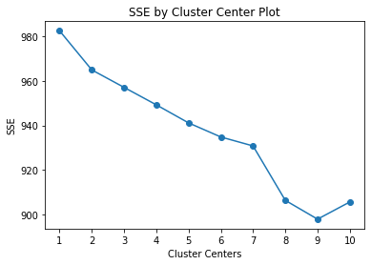
Annotating Data with KMeans
.
Number of clusters = 2

Slide 30
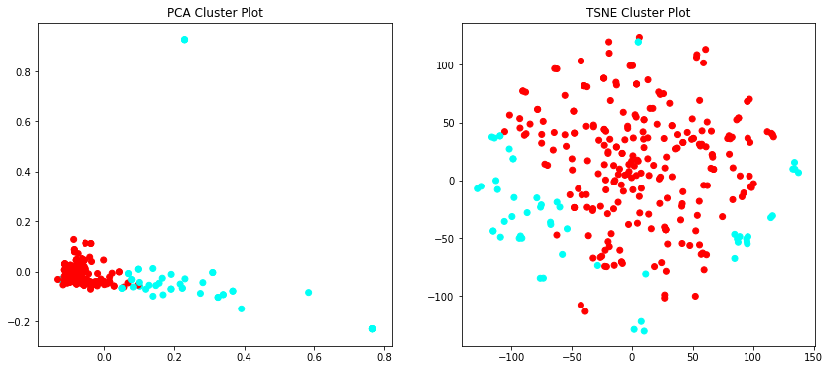
Annotating Data with KMeans

Slide 31
Annotating Data with KMeans
Cluster 0 : one, uk, say, year, said, vaccine, people, health, ha, wa
Cluster 1 : symptom, case, cdc, minute, spread, people, swansea , getting, 19, covid

Slide 32
Machine Learning
Our dataset has 1015 rows and 2 columns :
text: processed articles about covid
label: For the normal texts, it will be 0 and for the anxious Covid-related-texts, it will be 1.

Slide 33
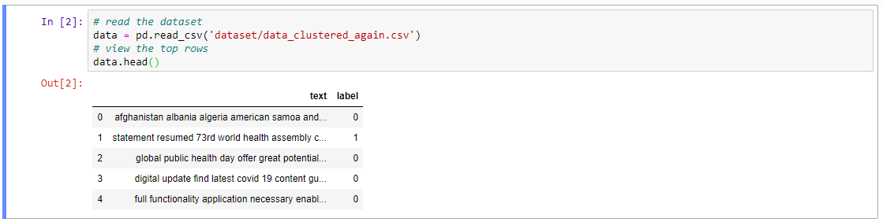
Machine Learning
Notes:
This is a glimpse of the data we have

Slide 34
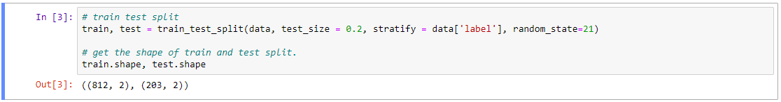
Machine Learning
We will divide the data into train and test using the scikit-learn train_test_split function.
We will take only 20 percent of the data for testing purposes.

Slide 35
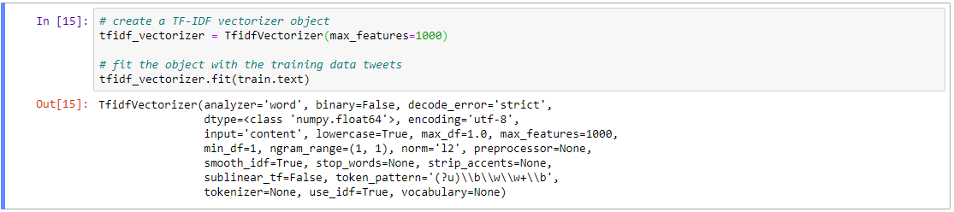
Machine Learning
We create the object of the TFidfVectorizer.
We build our model.
We fit the model with the training data.

Slide 36
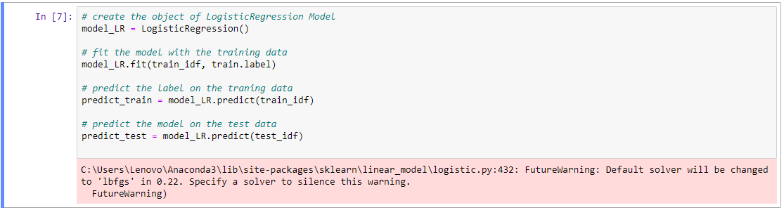
Machine Learning
We will create an object of the Logistic Regression model.

Slide 37
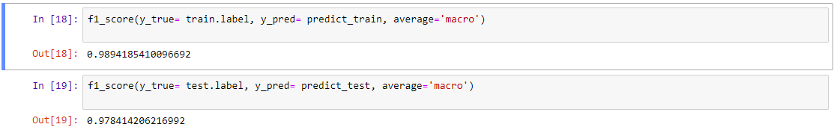
Machine Learning
Here’s the score on train and test data :

Slide 38
Machine Learning
The steps of the pipeline:
Step 1: Create a TF-IDF vector of the text.
Step 2: Use a logistic regression model to predict the target labels

Slide 39
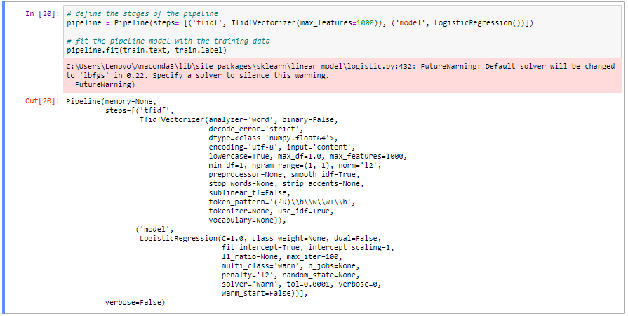
Machine Learning
Notes:
The fit() function with the pipeline object, executes both steps.

Slide 40
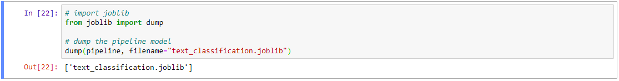
Machine Learning
The machine learning pipeline is successfully built
We will save this pipeline object using the dump function in the joblib library for future use.

Slide 41
Preparing the Flask interface
Submit button
Anxious
Load model
Clean the text
Embedding
Categorize
the given text
Not Anxious

Slide 42
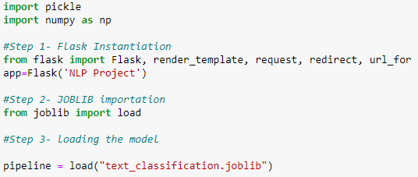
Preparing the Flask interface
We will connect the webpage with the model.
The first step would be to load the saved pipeline model.

Slide 43
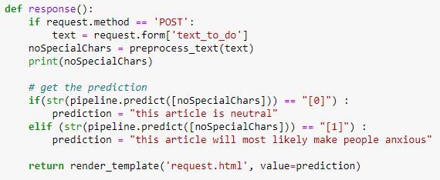
Preparing the Flask interface
The response function :
Takes the input text
Apply the cleaning algorithms on it
Predicts and returns the class it belongs to

Slide 44
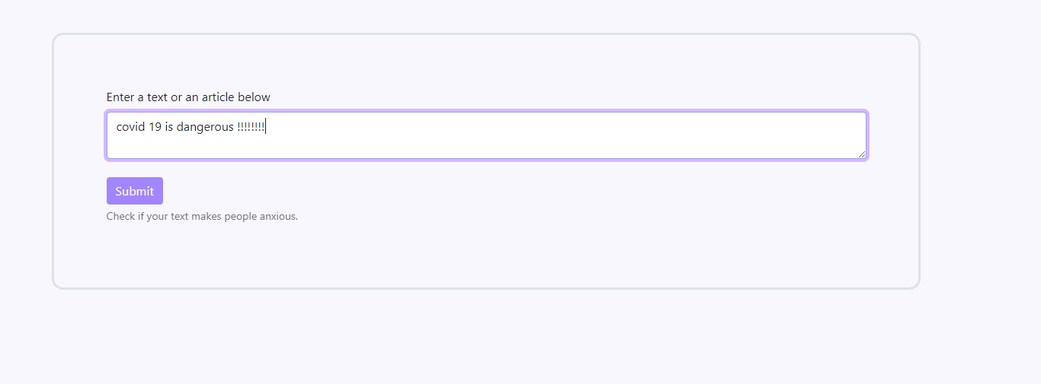
Preparing the Flask interface

Slide 45
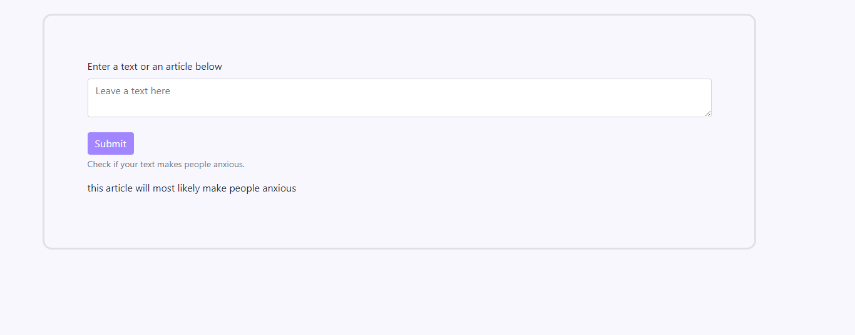
Preparing the Flask interface

Slide 46

Conclusion

Slide 47
OverAll experience
Now we managed to change our status from simple users to experienced developers .
This project made us master :
Data scrapping
Data cleaning
Clustering data and annotating them
Embedding and applying a machine learning algorithm
Manipulate flask well

Slide 48
Thank you for your attention

