Slide 1

Presented By :
Emna Zayani
Timothy Ajayi
Viktor Yudin
Kickstarter
Project Analysis
A Data-Driven Study of 300,000+ Crowdfunding Campaigns

Slide 2

INTRODUCTION
Kickstarter is a popular crowdfunding platform that has helped thousands of entrepreneurs and creators bring their innovative ideas to life. However, not all Kickstarter projects are successful, and understanding the factors that contribute to success or failure can be valuable for both creators and investors alike.
Today, I’ll walk you through the key factors that drive success on Kickstarter, using insights from thousands of real projects.

Slide 3


Objective:
Understanding which factors lead a Kickstarter project to success
Identify patterns behind failures
Build simple guidelines which creators can use to improve chances of success

Slide 4



About the Dataset
Data for 375,000+ Kickstarter projects from 2009-2017, including project name, category, launch date, deadline, goal, amount pledged, number of backers, state, and country.

Slide 5
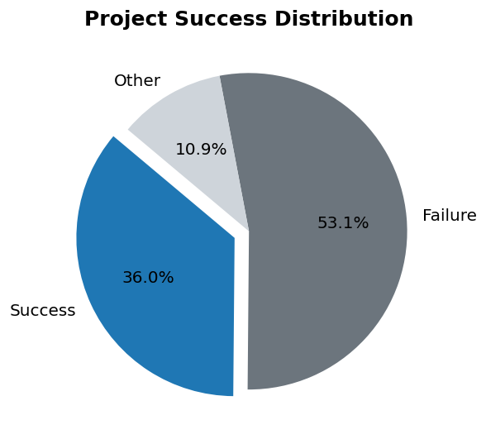
Percentage of Successful Campaigns
Most Kickstarter projects unfortunately fail. Only a smaller portion reaches their funding goal. Understanding why is the main focus of this analysis.”

Slide 6
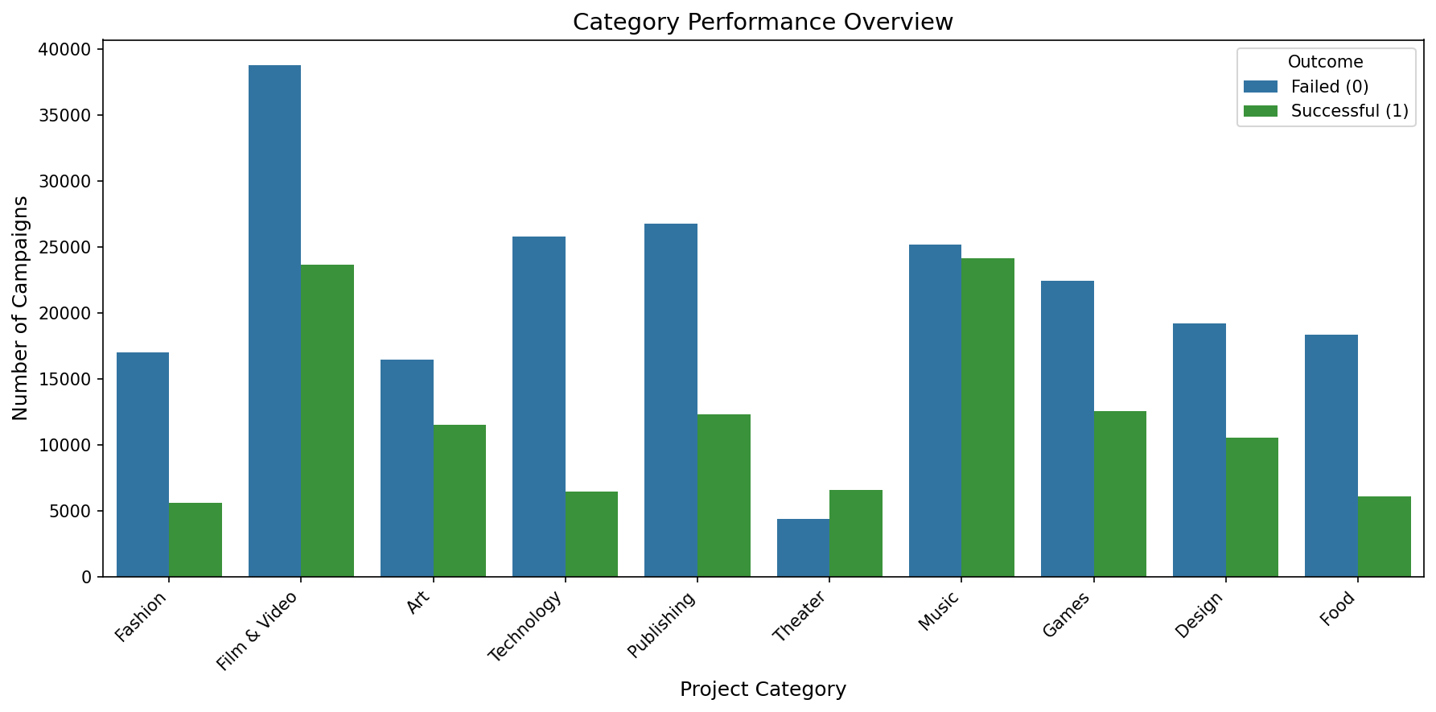
Certain categories are more likely to fail, highlighting the importance of choosing the right project topic.
Notes:
Projects that needs less funding have high chances of success
Music seems to do well? I was have said food because I like food.

Slide 7
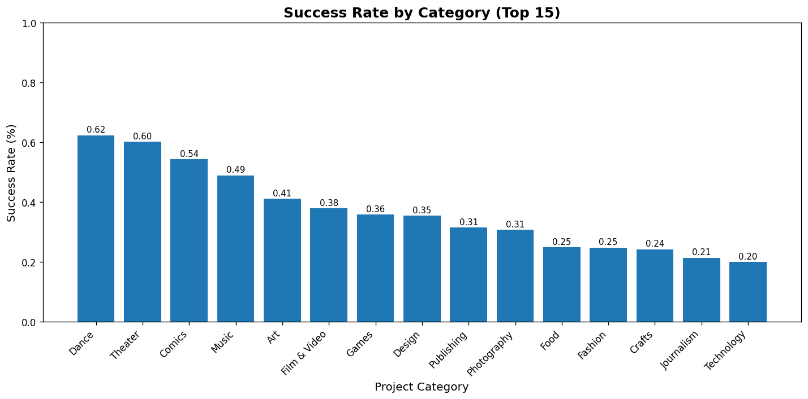
Projects in 'dance' or 'theater' categories have best chances to success,; journalism and technology are mostly doomed to fail.
Notes:
These communities are passionate, tightly connected, and extremely supportive.

Slide 8
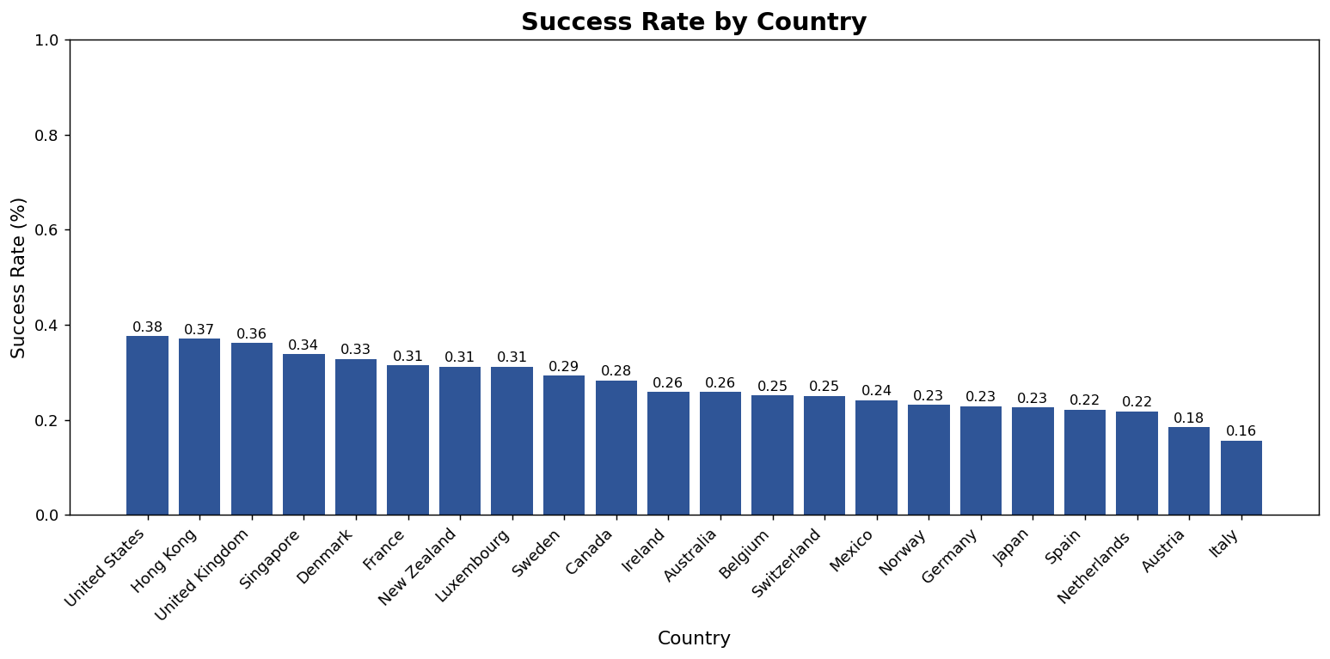
Projects that start in the “United States” have more chances to succeed than those in countries like “Italy”.
Notes:
General view: Projects launched in the U.S. and the U.K. are almost twice as likely to succeed as projects launched in Italy.
If the project category are some like, dance, theater, something the community are passionate, connected with and can support

Slide 9
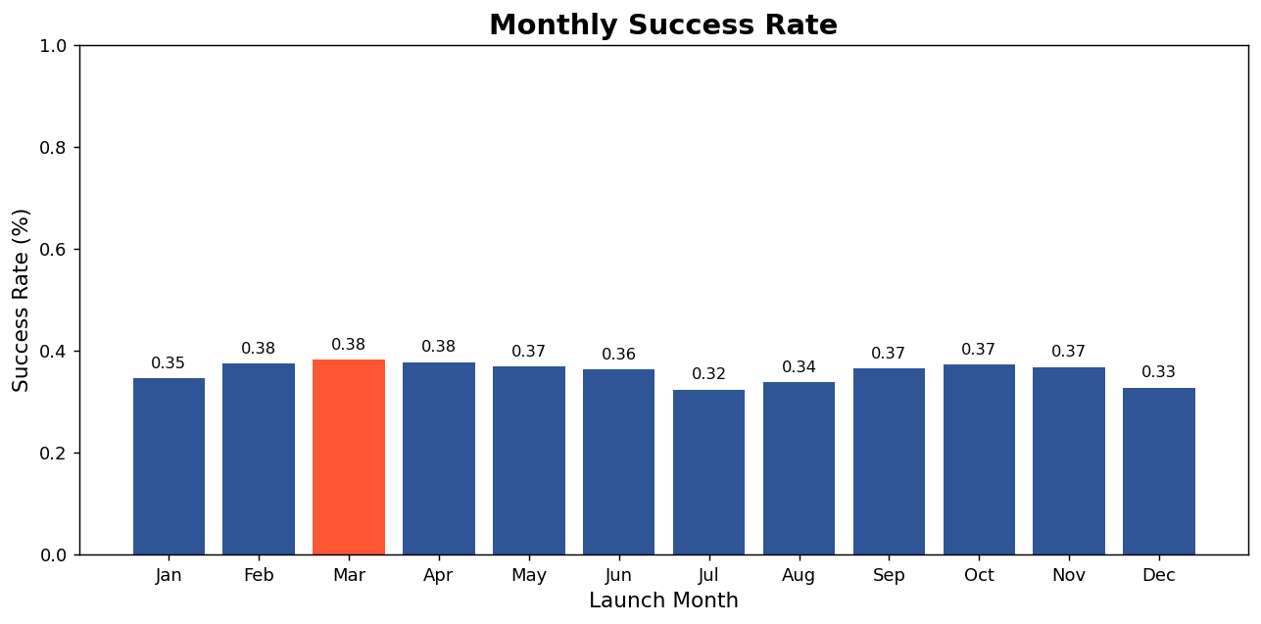
Projects launched in July and December have low success chances, due to Christmas and summer vacation.

Slide 10
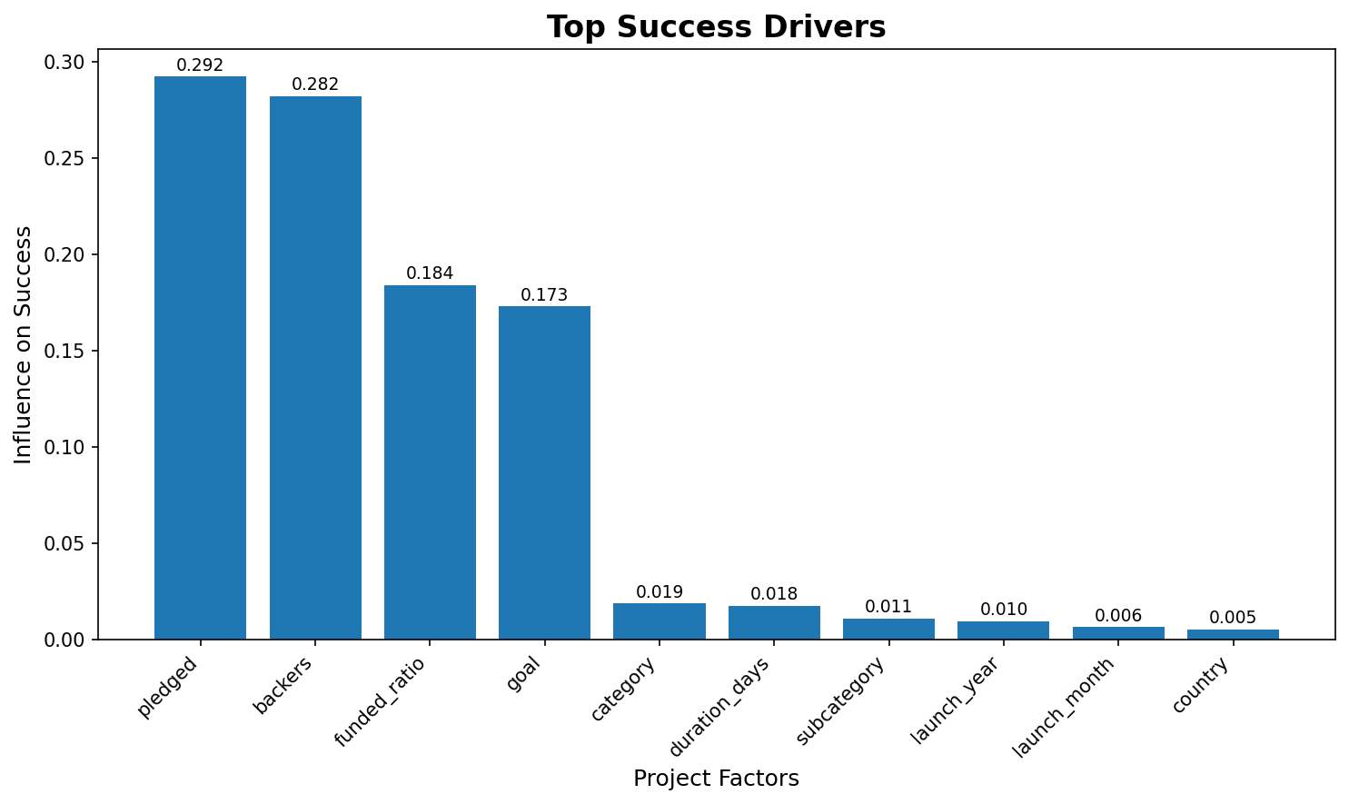
These are the key factors that have the strongest influence on project chances to succeeds.
The taller the bar, the more that factor contributes to success.
Notes:
The more you have high numbers of people that pledge (money) the higher chance the project happens, if the goal of the project is reached only then is money
Backers, the number of supporters aka backers are people give towards the project, more like friends and family and people who genuinely believe the project
Funded_ratio": "Funding Achieved (%), which goal / pledge
goal: Amount Requested if you request for a fund that its attainable

Slide 11

Key Findings
Bullet points:
Smaller funding goals significantly improve success rates.
Dance and Theater are the highest-performing categories.
Projects launched in the United States and United Kingdom have nearly twice the success rate of those in Italy.
July and December show the lowest success rates — poor months to launch.
Funding Achieved (%) is the strongest predictor of whether a campaign succeeds.

Slide 12
Recommendations
To improve chances of success:
Set a realistic and achievable funding goal
Select high-performance categories when possible
Engage your community early to build momentum before launch.
Launch campaigns during high-activity months to maximize visibility.

Slide 13

CONCLUSION
In summary, Kickstarter success depends heavily on category, timing, and setting a reasonable goal.
These insights help creators launch more strategic projects and increase their chances of success.”

Slide 14
Presented By :
Emna Zayani
Timothy Ajayi
Viktor Yudin
THANK
YOU

