Slide 1


ERP-BANK
Integrated Development Project 2015-2016

Slide 2
Plan
1
1
Introduction
.
2
Global analysis
3
Global design
4
Marketing strategy
5
Conclusion and perspective

Slide 3

Introduction
2
Problematic
How to manage an entire bank
Choose an appropriated bank
Want to work for a bank

Slide 4
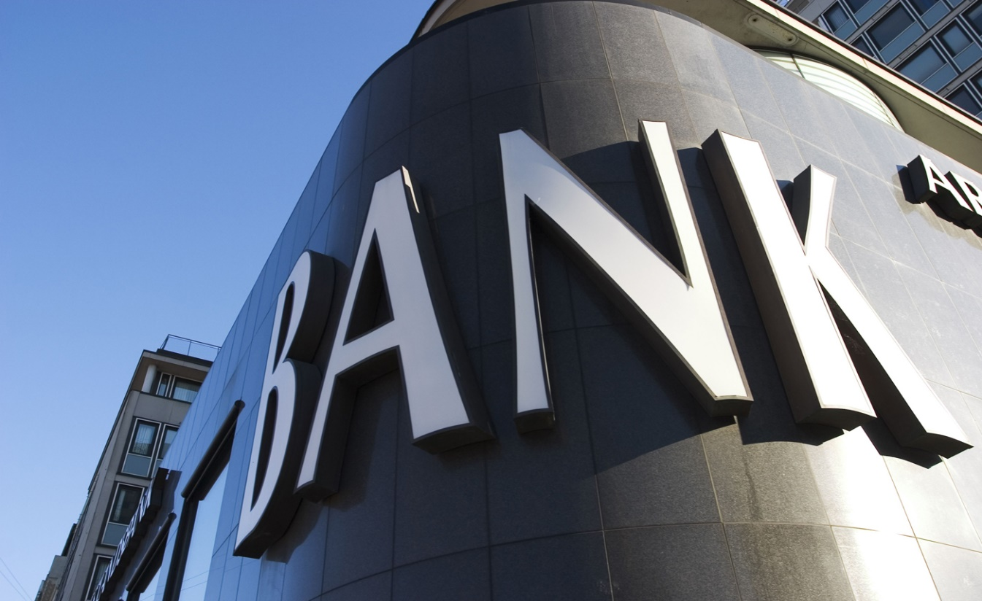
Introduction
3
Solution

Slide 5
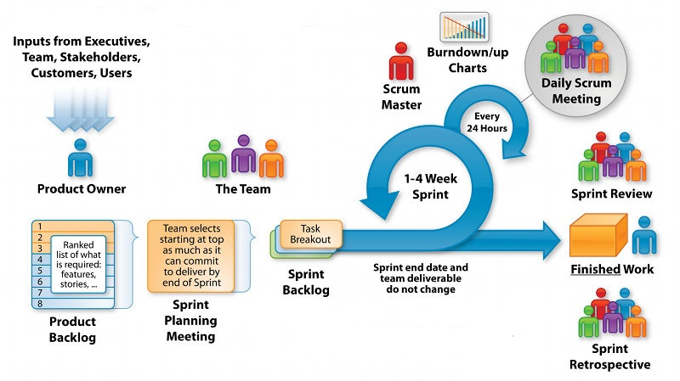
Introduction
4
Scrum methodology

Slide 6




Introduction
5
05
04
03
Sprint 4
02
Sprint 3
01
Sprint 2
Sprint 1
Java Server Faces
JSF
SharePoint
Sprint 0
Java Enterprise Edition
JEE
Asp.net
Analysis of the project

Slide 7
Plan
6
1
Introduction
2
Global analysis
3
Global design
4
Marketing strategy
5
Conclusion and perspective

Slide 8

Global analyses
7
Functional needs
Not functional needs

Slide 9
Plan
8
1
Introduction
2
Global analysis
3
Global design
4
Marketing strategy
5
Conclusion and perspective

Slide 10
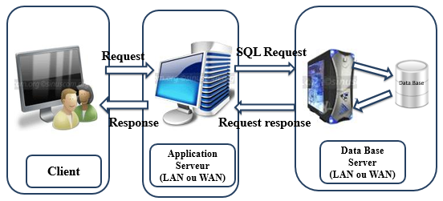
Global Design
9
Architecture JEE sprint

Slide 11
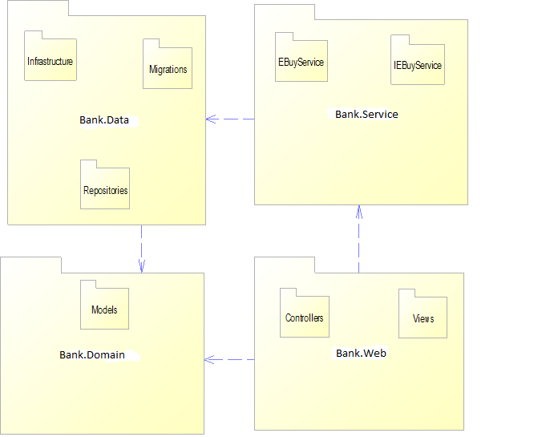
Global Design
10
Architecture
Asp.net sprint

Slide 12
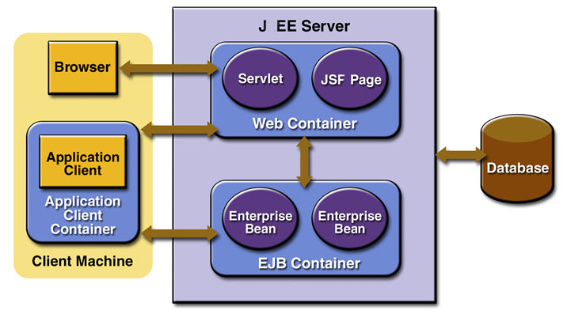
Global Design
11
Architecture JSF
sprint
12

Slide 13
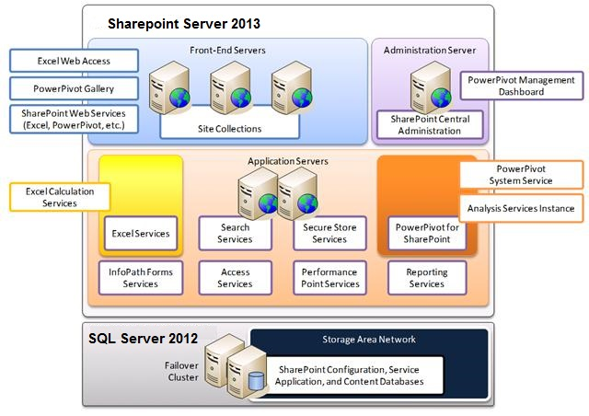
Global Design
12
Architecture
SharePoint sprint

Slide 14
Plan
13
1
Introduction
2
Global analysis
3
Global design
4
Marketing strategy
5
Conclusion and perspective

Slide 15
Marketing strategy : Product
14
Name
Logo
ERP-BANK
Slogan
Helping you to manage daily banking...
2004

Slide 16

Marketing strategy : Promotion
15
Newspaper
Email phone
Offline
Advertising media
Advertising media
TV ads
Trade
fairs
Radio

Slide 17
Marketing strategy : Price
16
Penetration strategy
Price : 9000
Additional service :
maintenance
integration
hosting
training
Low prices
Max sales

Slide 18
Conclusion and perspective
17
Great Human and Professional experience
Master the modeling language UML and the programming
language JEE,JSF ,.net and sharepoint
Integrate the PayPal web service
New functionality

Slide 19
Success story
18
The quality of the applications offered by DEVSTERS enterprise justifies the
charge and mass of the work done through the project.
Agile Scrum method has been adopted through the project, which is to
divide the work into sprints and each sprint lasts a month.
The quality of the coaching provided by ESPRIT teachers contribute to
increasing the quality of our products.

Slide 20

Our values
19
Professionalism
Commitment
Attendance
Innovation
Integrity

Slide 21
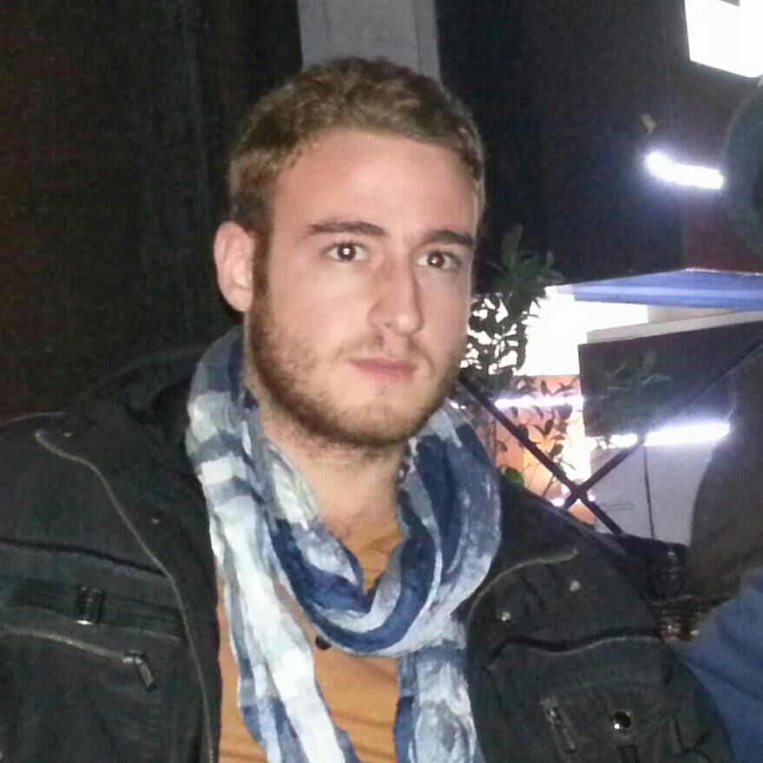
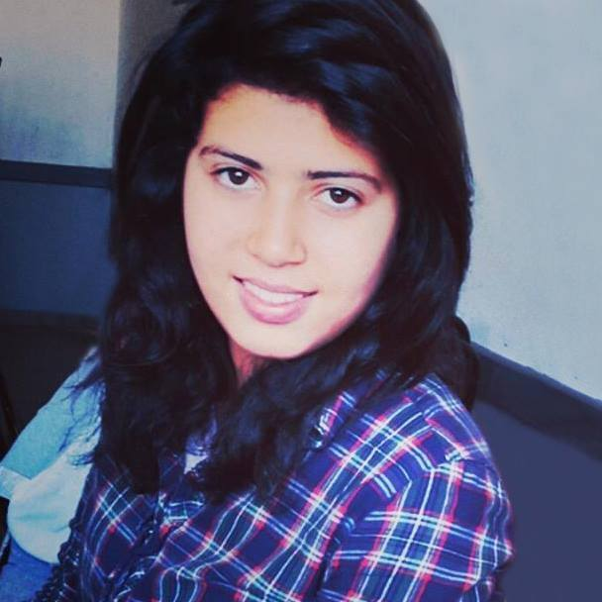
Who we are ?
20
we are a team of 5 engineering students at ESPRIT
Business intelligence
Team Devsters is composed of :
ABEN MED YOSRI
AMOR EMNA

Slide 22
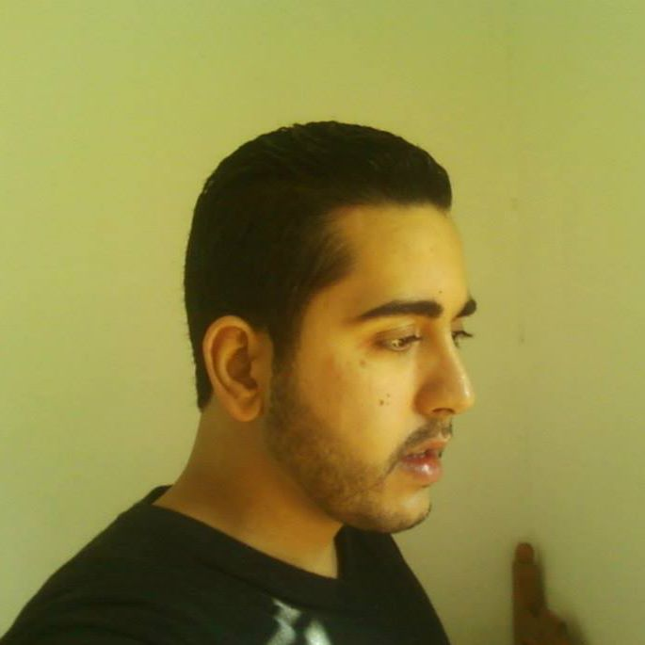
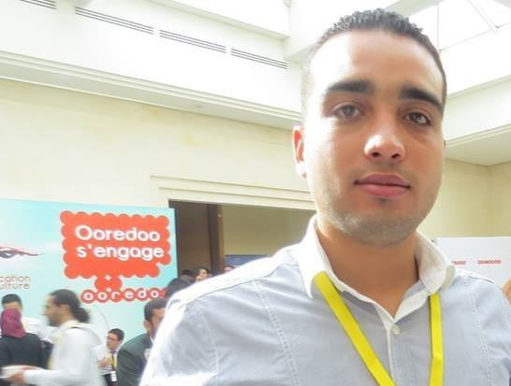
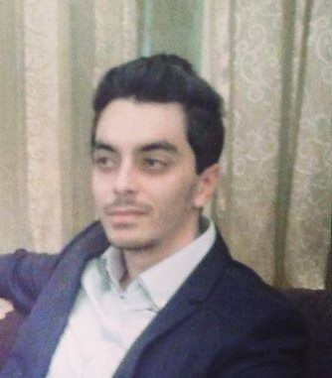
Who we are ?
21
SGHAIER OUSSAMA
BEN MANSOUR NIEZE
CHRAKI MED KAIS

Slide 23
Thank You!

