Slide 1
Leveraging Location Data to Model Hotspots for Possible COVID-19 outbreaks in Suburban Neighbourhoods
Shaik Abdillah

Slide 2
Problem Introduction
The COVID-19 pandemic precipitated in the end of 2019, w
The pandemic has caused widespread nation-wide lockdowns beginning in early 2020 and its effects are still in play some 2 years later
Much research has been conducted in an attempt to slow the spread of the virus;

Slide 3
Measures to Slow the Spread of COVID
Wearing Face masks
Social Distancing
Working from Home
It is thus of interest for public health officials to model possible hotspots based on venues that require unmasking and close physical contact.

Slide 4
Data Collection
The neighbourhood in question is ultimately arbitrary; but the location data used will be from the FourSquare API. Businessess will be ranked based on:
If the service(s) provided requires unmasking
The duration of which customers are present for
The possiblity of social distancing

Slide 5
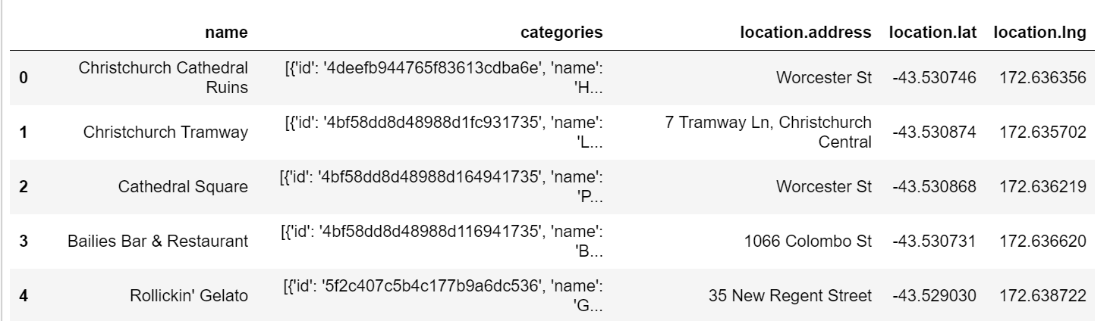
Data Collection
The dataset for businesses in Christchurch NZ
Obtained from The FourSquare API

Slide 6
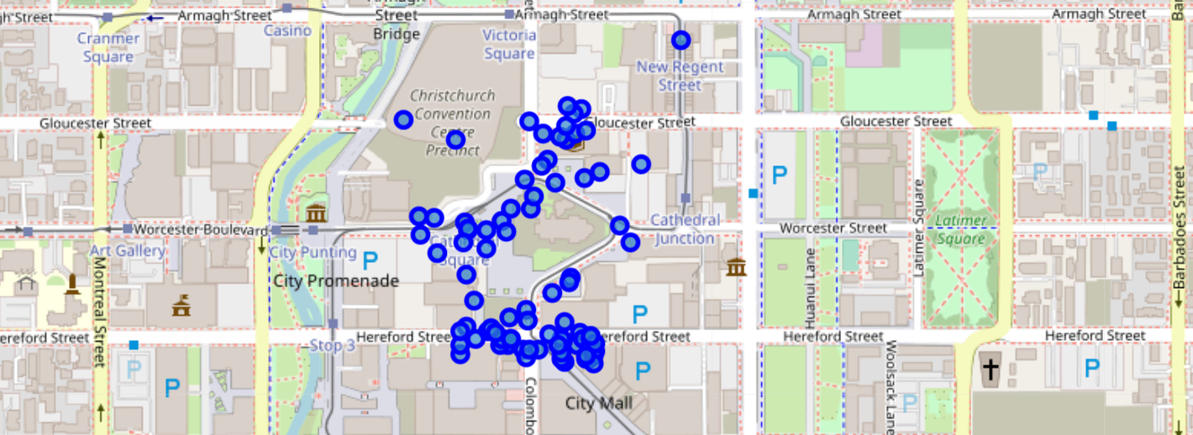
Data Visualisation

Slide 7
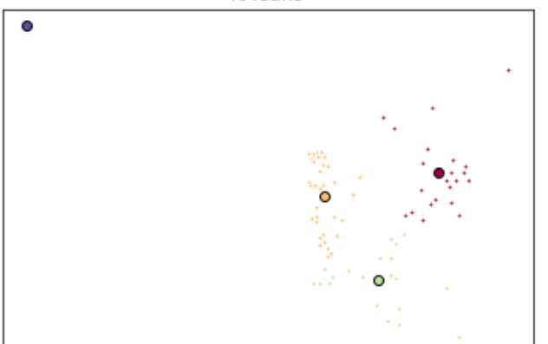
K-Means Clustering
K = 4
Seems too much

Slide 8
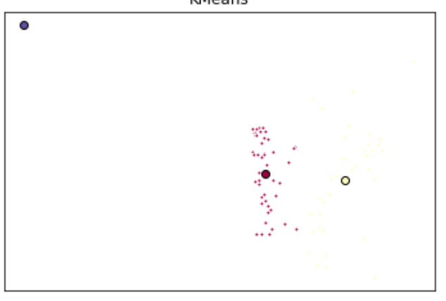
K Means Clustering
K =3

Slide 9
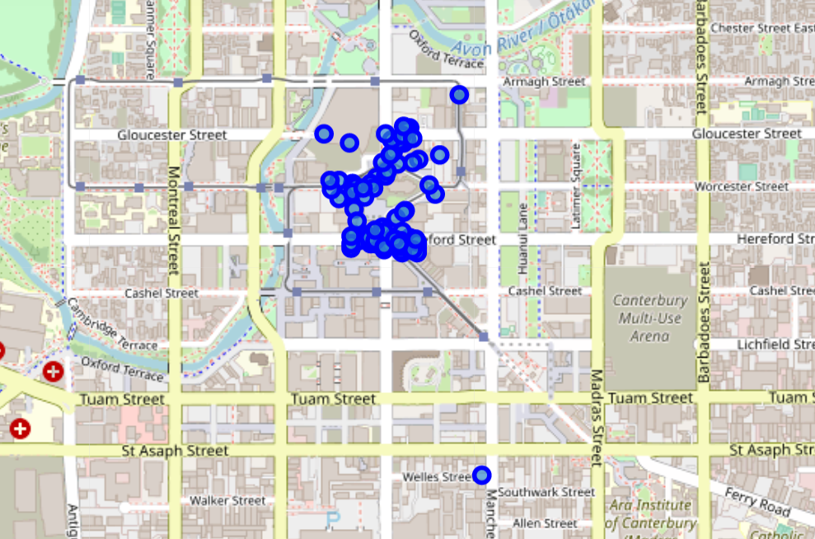
Thus we can Visualise the Hotspots

Slide 10
Thank You

