Slide 1
Blitzkrieg Enigma
Emon karmoker

Slide 2
Goal
The purpose of this project was to find marker genes that are specific to each cluster of cells. Marker genes are genes that are highly expressed in one group (cluster) of cells compared to others, and they help us:
Identify what each cluster represents biologically.
Understand how cells in different clusters are unique.

Slide 3
The Data
Expression Data: A table showing how much each gene is expressed in every cell.
Rows: Genes (like Gja1, S1pr1).
Columns: Cells.
Values: Expression levels (how active a gene is).
Metadata: A table with information about the cells.
It includes which cluster each cell belongs to (e.g., Astro-adult, Immature-Pyr).

Slide 4
Process
We broke the task into four main steps:
1. Cleaning the Data
Removed duplicates in the metadata to ensure accuracy.
Matched the metadata with the expression data so every cell had the correct cluster assigned.
2. Preprocessing the Data
Normalized the expression values to ensure fair comparisons between cells.
Log-transformed the values to make the data easier to analyze.
3. Identifying Marker Genes
Used a tool called COSG to find the top 50 marker genes for each cluster.
COSG calculated:
COSG Score: How specific a gene is to its cluster.
Log Fold Change: How much more active the gene is in one cluster compared to others.
4. Saving the Results
Organized the results into a table and visualized the findings

Slide 5
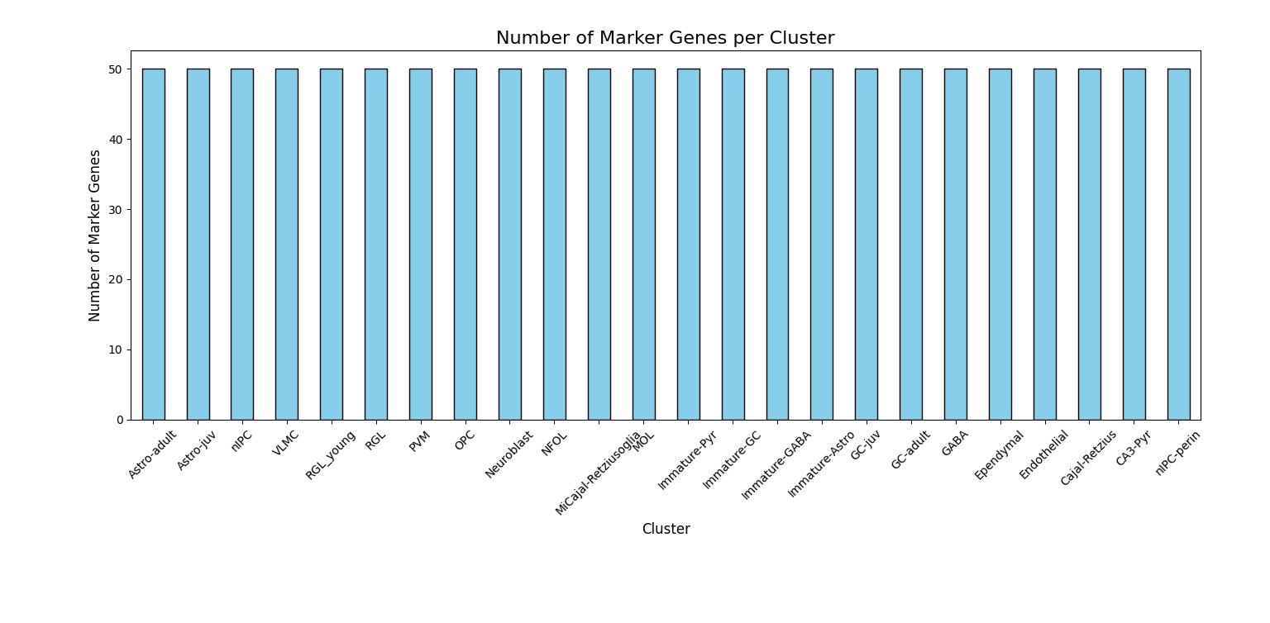
Bar Chart

Slide 6
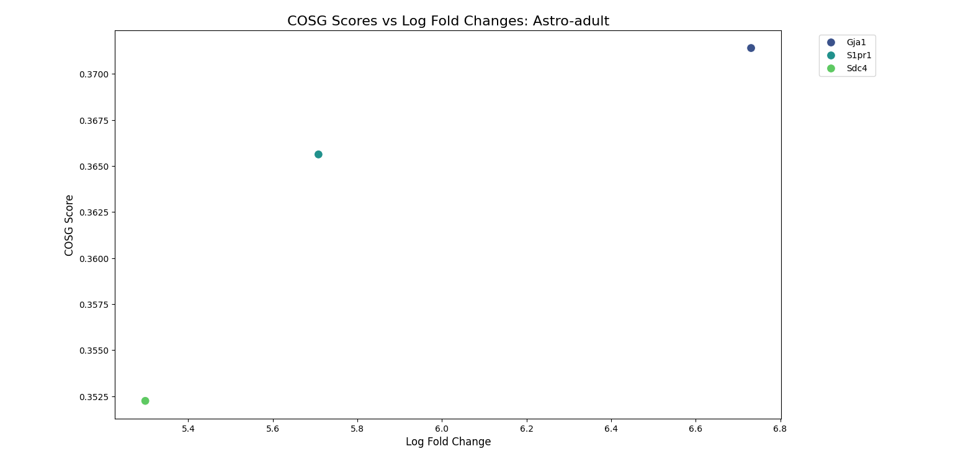
Cosg scores vs log fold changes: Astro-adult

Slide 7
Cluster | Gene Name | COSG Score | Log Fold Change
Astro-adult | Gja1 | 0.371 | 6.731
Astro-adult | S1pr1 | 0.366 | 5.708
Astro-adult | Sdc4 | 0.352 | 5.298
"Here is a table showing the top 3 marker genes for the Astro-adult cluster. These genes help us identify what makes this cluster unique biologically."

Slide 8
Axes:
X-axis (Log Fold Change): Measures how much more a gene is expressed in the Astro-adult cluster compared to all other clusters. Higher values mean the gene is very active in Astro-adult and much less active in other clusters.
Y-axis (COSG Score): Represents how specific the gene is to the Astro-adult cluster. Higher scores mean the gene is a very strong identifier for this cluster.
Dots:
Each dot represents one marker gene.
Top-right corner genes:
High COSG Score: The gene is very specific to Astro-adult.
High Log Fold Change: The gene's expression in Astro-adult is much higher than in other clusters.
Key Insights from the Scatter Plot
Highly Specific Marker Genes:
Genes like Gja1, S1pr1, and Sdc4 are located higher on the Y-axis (high COSG Scores). This means these genes are very good at distinguishing Astro-adult from other clusters.
Strongly Expressed Genes:
These genes also have high values on the X-axis (high Log Fold Changes). For example:
Gja1:
COSG Score: 0.371 (very specific to Astro-adult).
Log Fold Change: 6.73 (much more active in Astro-adult compared to other clusters).
Genes with Lower Specificity:
Genes lower on the Y-axis (lower COSG Scores) are not as specific to Astro-adult. They may still be useful but are less reliable as markers.
This plot helps us:
Identify the Best Marker Genes:
Genes in the top-right corner (like Gja1) are the best at identifying Astro-adult cells.
Understand Gene Behavior:
We can see which genes are both highly specific and strongly expressed, helping us focus on biologically relevant markers.

Slide 9
Astro-adult:What it is: A cluster or group of cells from the dataset.
Biological meaning: Likely represents a population of astrocyte cells in their adult stage, which are star-shaped cells in the central nervous system (brain and spinal cord). These cells play key roles in supporting neurons, maintaining the blood-brain barrier, and repairing tissue after injury.
Log Fold Change:What it is: A measure of how much more active (expressed) a gene is in one cluster (e.g., Astro-adult) compared to all other clusters.
How it's calculated: Log Fold Change=log⁡2(Expression in Astro-adultExpression in other clusters)\text{Log Fold Change} = \log_2\left(\frac{\text{Expression in Astro-adult}}{\text{Expression in other clusters}}\right)Log Fold Change=log2​(Expression in other clustersExpression in Astro-adult​)
Meaning:
A higher value means the gene is much more active in Astro-adult compared to other clusters.
Example: If Gja1 has a Log Fold Change of 6.73, it means this gene is 2^6.73 ≈ 107 times more active in Astro-adult compared to other clusters.
COSG Score:What it is: A score calculated by the COSG algorithm to measure how specifically a gene belongs to a single cluster (like Astro-adult) compared to all other clusters.
How it works:
A higher COSG Score means the gene is very specific to one cluster and not active in other clusters.
Meaning:
A COSG Score of 0.371 (e.g., for Gja1) means the gene is a strong identifier of the Astro-adult cluster.

Slide 10
How Clusters Are Unique:
Each cluster of cells (e.g., Astro-adult, Immature-Pyr) has distinctive genes that make it biologically unique.
These marker genes help us identify what type of cells are in each cluster.
Top Marker Genes:
For every cluster, we have a ranked list of genes based on:
COSG Score: Measures how specific the gene is to the cluster (higher is better).
Log Fold Change: Measures how much more active the gene is in the cluster compared to other clusters (higher is better).
Uniformity Across Clusters:
Every cluster has exactly 50 marker genes, ensuring equal representation in the analysis.
Top genes are:
Gja1:
COSG Score = 0.37 (high specificity).
Log Fold Change = 6.73 (very active in Astro-adult).
S1pr1:
COSG Score = 0.36.
Log Fold Change = 5.71.
Sdc4:
COSG Score = 0.35.
Log Fold Change = 5.30.
Interpretation: These genes are most active in the Astro-adult cluster and help identify it.

Slide 11
1. Start with the Data
We have two types of input files:
Expression Data: Tells us how active each gene is in every cell.
Metadata: Provides cluster assignments for each cell.
2. Data Preprocessing
This step prepares the data for analysis:
Remove Duplicates:
Duplicates in metadata were removed to ensure accuracy.
Align Metadata with Expression Data:
Matched each cell in the expression data to its cluster in the metadata.
Normalize Expression Data:
Scaled the expression levels so they can be compared across cells.
Log-Transform the Data:
Applied a logarithmic function to smooth out large variations in expression levels.
3. COSG Analysis
We used the COSG tool to identify marker genes. Here's what happened:
Cluster-Specific Analysis:
COSG analyzed the data for each cluster to find genes that are:
Highly active in the cluster.
Unique to the cluster compared to others.
Output:
For each cluster, COSG generated:
A list of the top 50 marker genes.
COSG Scores and Log Fold Changes for each gene.
Cleaned and Prepared Data:
Ensured the input data was ready for analysis.
Cluster-Specific Marker Genes:
Identified the best marker genes for each cluster.
Actionable Insights:
Provided a way to interpret how genes define each cluster’s unique biology.

Slide 12
"We aimed to identify marker genes to understand what makes each cluster of cells unique."
Log Fold Change:What it is: A measure of how much more active (expressed) a gene is in one cluster (e.g., Astro-adult) compared to all other clusters.
How it's calculated: Log Fold Change=log⁡2(Expression in Astro-adultExpression in other clusters)\text{Log Fold Change} = \log_2\left(\frac{\text{Expression in Astro-adult}}{\text{Expression in other clusters}}\right)Log Fold Change=log2​(Expression in other clustersExpression in Astro-adult​)
Meaning:
A higher value means the gene is much more active in Astro-adult compared to other clusters.
Example: If Gja1 has a Log Fold Change of 6.73, it means this gene is 2^6.73 ≈ 107 times more active in Astro-adult compared to other clusters.
"We cleaned the data, prepared it for analysis, and ran COSG to find the top 50 marker genes for each cluster. We then visualized the results to interpret them better."
The scatter plot to highlight how specific genes (like Gja1) are to a particular cluster.
Astro-adult:What it is: A cluster or group of cells from the dataset.
Biological meaning: Likely represents a population of astrocyte cells in their adult stage, which are star-shaped cells in the central nervous system (brain and spinal cord). These cells play key roles in supporting neurons, maintaining the blood-brain barrier, and repairing tissue after injury.
Log Fold Change:What it is: A measure of how much more active (expressed) a gene is in one cluster (e.g., Astro-adult) compared to all other clusters.
How it's calculated: Log Fold Change=log⁡2(Expression in Astro-adultExpression in other clusters)\text{Log Fold Change} = \log_2\left(\frac{\text{Expression in Astro-adult}}{\text{Expression in other clusters}}\right)Log Fold Change=log2​(Expression in other clustersExpression in Astro-adult​)
Meaning:
A higher value means the gene is much more active in Astro-adult compared to other clusters.
Example: If Gja1 has a Log Fold Change of 6.73, it means this gene is 2^6.73 ≈ 107 times more active in Astro-adult compared to other clusters.

