Slide 1


May 08, 2026
LitReviewRAG: Automated Literature Review Synthesis
Md Rokonuzzaman Reza
CSC 7644: Applied LLM Development
Code: https://github.com/EmonRezaBD/LitReviewRAG

Slide 2
The Problem & Motivation
Literature reviews take 15–20 hours of manual extraction
Existing tools fall short in different aspects
Zotero → citations only
NotebookLM → conversational Q&A, no structured table
Elicit → no field-level extraction, no contradiction detection, no Excel export
LitReviewRag addressed all these gaps
Notes:
Quick orientation before I go into the details. CommitFuzz has three layers. There’s the change-specific risk engine. It takes a commit from our dataset, reads the before and after versions of the changed function, and computes three metrics that combine into a single risk score. That score feeds directly into Layers 2 and 3 — the visualizations and the dashboard.
Everything I'm about to show you is implemented and running on our qBittorrent dataset.

Slide 3
Project Objectives
Extract 8 structured fields per paper automatically
Detect factual contradictions across papers
Export results to a styled Excel deliverable
Achieve verifiable, grounded extraction (no hallucinations)
Reduce 15–20 hours of manual work → ~10 minutes of compute time
Notes:
The first metric is Cyclomatic Complexity Delta. This is grounded in McCabe's 1976 paper and the NIST Structured Testing report — both shown here.
The formula is V(G) equals E minus N plus 2P — edges, nodes, connected components. In practice, tools like SonarQube simplify this to just counting decision points plus one, where a decision point is any node with two or more outgoing branches — if, for, while, case, &&, double-pipe.
We compute this for the before and after versions of the function and take the delta. That change in complexity is our first risk signal.

Slide 4

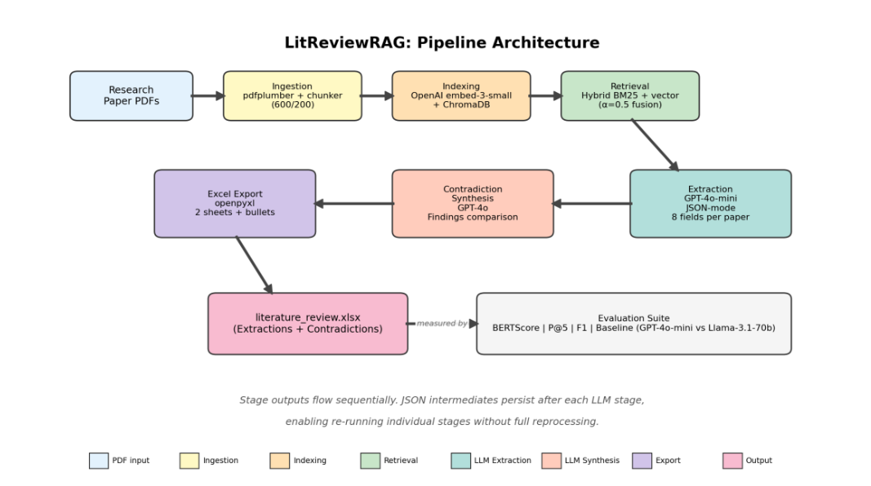
High-Level Technical Approach
Fig1: End-to-end pipeline architecture, from PDF ingestion through Excel export
Notes:
The second metric is Control Flow Alteration Score, from Nagappan and Ball 2005.
We used the simplified version — the algorithm counts how many decision points were added or removed between the before and after code. The key idea here is that any touch to control flow equals risk, regardless of direction. CC Delta tells us the direction of complexity change. Flow Score tells us the magnitude of control flow disruption. Together they give a fuller picture

Slide 5
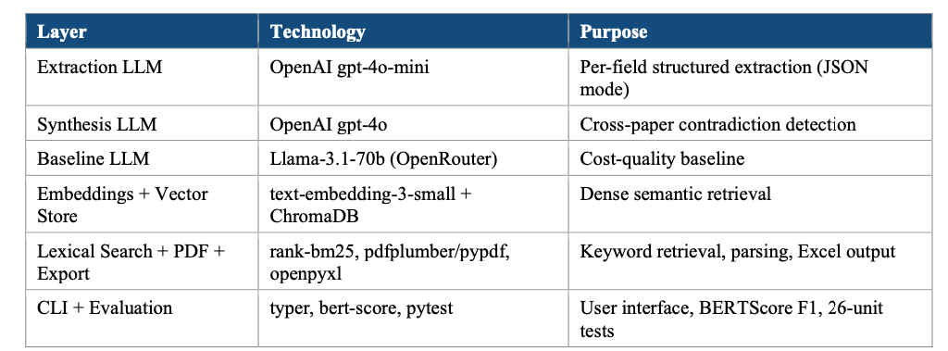
High-Level Technical Approach
Table 1: Technology stacks across the pipeline
Notes:
The second metric is Control Flow Alteration Score, from Nagappan and Ball 2005.
We used the simplified version — the algorithm counts how many decision points were added or removed between the before and after code. The key idea here is that any touch to control flow equals risk, regardless of direction. CC Delta tells us the direction of complexity change. Flow Score tells us the magnitude of control flow disruption. Together they give a fuller picture

Slide 6
Live Demo — Step-by-Step
Live demonstration on 5 papers (Generative Agents in Usable Security & Privacy)
Notes:
First, point-in-time static analysis tools, such as Clang-Tidy, examine code at a single moment and detect general issues like code smells or style violations. These tools are useful, but they do not understand the specific context of a code change. Because of that, they can sometimes mark mature and safe code as risky, which leads to false positives.
Second, there are fuzzing visualization tools, such as VisFuzz and Cvfuzz. VisFuzz helps developers observe fuzzing activity in real time through visual representations like call graphs and control-flow graphs. Cvfuzz focuses on detecting complexity-related vulnerabilities in OpenCL kernels using pathological inputs. VisFuzz and Cvfuzz are useful, but they mainly help during dynamic fuzzing. They do not focus on early, change-aware risk prediction before expensive testing starts.
In contrast, our approach, CommitFuzz, works earlier. We use Differential CFGs and Complexity Heatmaps to analyze the risk of a code commit before expensive dynamic testing begins. So our contribution is not just visualization or general static checking — it is an early risk prediction method that is change-aware.”

Slide 7
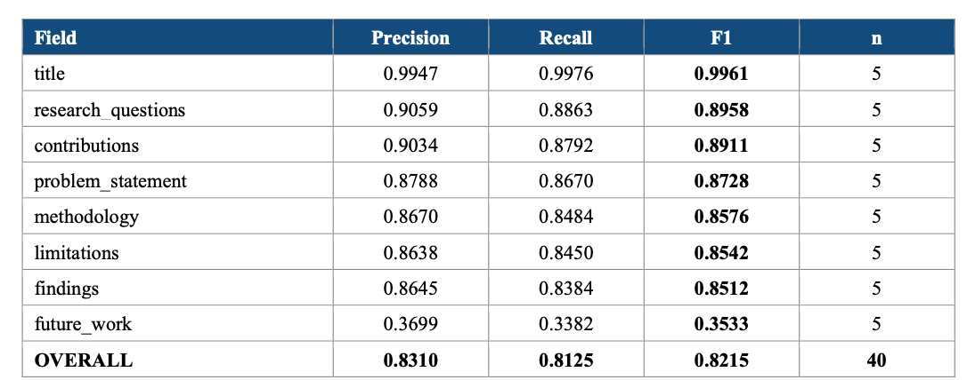
Key Results — Extraction Quality
Table 2: BERTScore Precision, Recall, and F1 per extraction field
Notes:
First, point-in-time static analysis tools, such as Clang-Tidy, examine code at a single moment and detect general issues like code smells or style violations. These tools are useful, but they do not understand the specific context of a code change. Because of that, they can sometimes mark mature and safe code as risky, which leads to false positives.
Second, there are fuzzing visualization tools, such as VisFuzz and Cvfuzz. VisFuzz helps developers observe fuzzing activity in real time through visual representations like call graphs and control-flow graphs. Cvfuzz focuses on detecting complexity-related vulnerabilities in OpenCL kernels using pathological inputs. VisFuzz and Cvfuzz are useful, but they mainly help during dynamic fuzzing. They do not focus on early, change-aware risk prediction before expensive testing starts.
In contrast, our approach, CommitFuzz, works earlier. We use Differential CFGs and Complexity Heatmaps to analyze the risk of a code commit before expensive dynamic testing begins. So our contribution is not just visualization or general static checking — it is an early risk prediction method that is change-aware.”

Slide 8
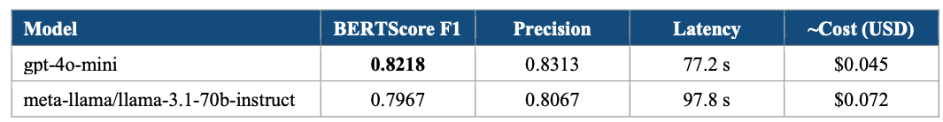
Contradiction Detection & Cost Comparison
Perfect precision on contradictions + 38% lower cost
Contradiction results: Precision = 1.00 (no false positives), Recall = 0.67, F1 = 0.80
Table 3: Cost-quality comparison on the same five-paper evaluation set
Notes:
“This slide explains how our system uses a Control Flow Graph, or CFG, to represent program execution. A CFG shows how execution can move from one code block to another.
First, the source code is divided into basic blocks, usually at control-flow boundaries like if, for, while, return, break, and case.
Second, each block is identified by its type, such as conditional, loop, return, or normal sequential block.
Third, we connect these blocks in a directed graph. It is directed because execution moves in a specific order from one block to the next.
Then, the edges are labeled based on the type of control flow. For example, an if statement may create true and false branches, loops may have loop_body and loop_exit, and normal execution uses a sequential edge.
Finally, when we compare CFGs before and after changes, we can detect which blocks remain unchanged and which are modified, deleted, or newly added. This helps visualize how the program structure evolves.”

Slide 9
Conclusion & Next Steps
What worked well-
✅ Hybrid BM25+vector retrieval (BM25 catches exact terms, embeddings catch paraphrase)
✅ JSON-mode with null handling → zero hallucinations
✅ Title special case (positional retrieval) → F1 from 0.69 → 0.996
Limitations & next steps: (i) Expand to 20–30 papers (ii) Layout-aware PDF parser for two-column papers (iii) Manual annotation for retrieval evaluation (vs LLM-as-judge) (iv) Tune fusion weight α per field
Notes:
“This slide explains how our system uses a Control Flow Graph, or CFG, to represent program execution. A CFG shows how execution can move from one code block to another.
First, the source code is divided into basic blocks, usually at control-flow boundaries like if, for, while, return, break, and case.
Second, each block is identified by its type, such as conditional, loop, return, or normal sequential block.
Third, we connect these blocks in a directed graph. It is directed because execution moves in a specific order from one block to the next.
Then, the edges are labeled based on the type of control flow. For example, an if statement may create true and false branches, loops may have loop_body and loop_exit, and normal execution uses a sequential edge.
Finally, when we compare CFGs before and after changes, we can detect which blocks remain unchanged and which are modified, deleted, or newly added. This helps visualize how the program structure evolves.”

Slide 10
References
Lewis et al., “Retrieval-augmented generation for knowledge-intensive NLP tasks,” NeurIPS 2020
Zhang et al., “BERTScore: Evaluating text generation with BERT,” arXiv 2019 Robertson & Zaragoza, BM25 and Beyond, 2009
OpenAI Structured Outputs, ChromaDB, rank-bm25
Notes:
“This slide explains how our system uses a Control Flow Graph, or CFG, to represent program execution. A CFG shows how execution can move from one code block to another.
First, the source code is divided into basic blocks, usually at control-flow boundaries like if, for, while, return, break, and case.
Second, each block is identified by its type, such as conditional, loop, return, or normal sequential block.
Third, we connect these blocks in a directed graph. It is directed because execution moves in a specific order from one block to the next.
Then, the edges are labeled based on the type of control flow. For example, an if statement may create true and false branches, loops may have loop_body and loop_exit, and normal execution uses a sequential edge.
Finally, when we compare CFGs before and after changes, we can detect which blocks remain unchanged and which are modified, deleted, or newly added. This helps visualize how the program structure evolves.”

Slide 11
Questions?
Thank you for your attention.

