Slide 1
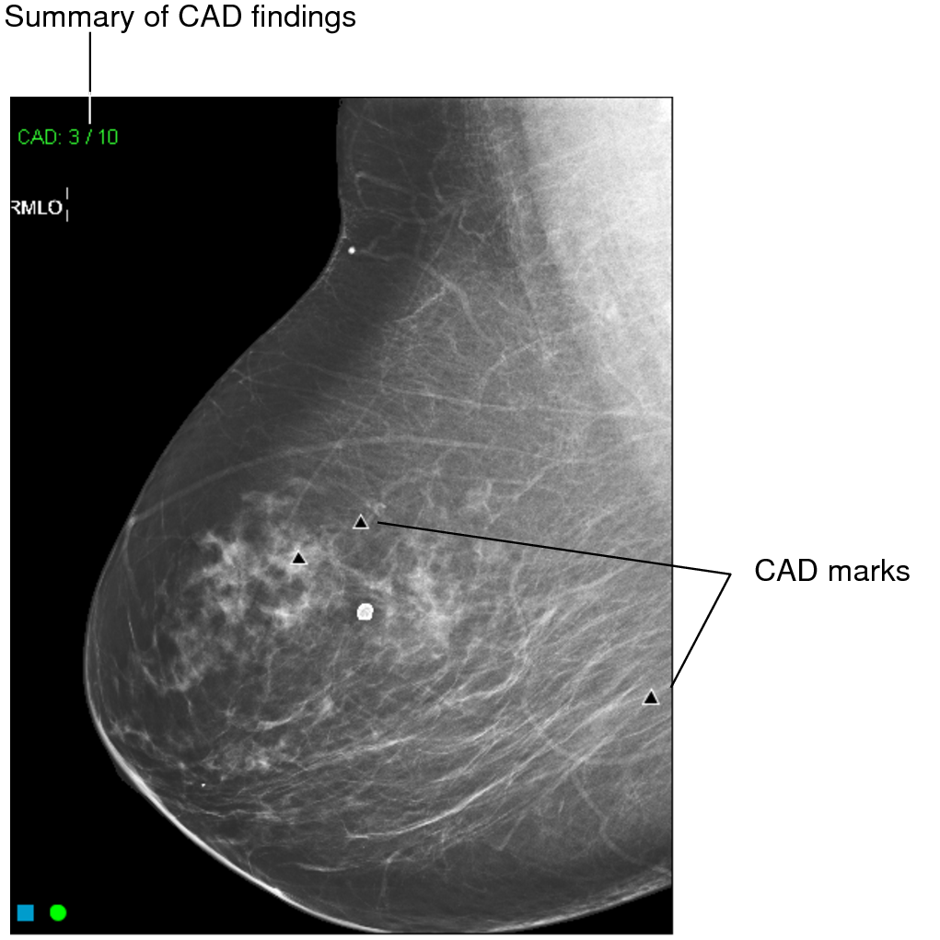
ERA I · 1998 · LESION → IMAGE → PATIENT
The year is 1998.
Computer-aided detection has just arrived — software that puts a mark on every mammogram to flag a possible cancer. A second set of eyes, automatically. It feels like the future.

Slide 2
ERA I
Within a decade, CAD was used on most US mammograms.
1998
2002
2008
2016
2015
FDA clears first CAD
(R2 ImageChecker)
CMS reimburses CAD
— drives adoption
~74% of US screening
mammograms use CAD
~92% — near-universal
The verdict lands:
no benefit
A 2002 reimbursement code drove adoption — not evidence of benefit. The definitive study landed in 2015, after CAD already ran on ~9 in 10 mammograms.

Slide 3
ERA I
Conventional CAD put a false-positive mark on most normal exams.
Non-dense
Dense
3
2.6
70–85%
2.0
2
1.8
1.5
of normal mammograms had ≥1 false positive
1
0.5–1.5
0.6
0.3
false positives per image — about 2–4 per 4-view case
0
All marks
Masses
Calcifications
Mean false-positive marks per case · ImageChecker v7.2 — Mahoney & Meganathan, J Digit Imaging 2011 (Table 4)
Kim 2009 · Mahoney 2011 · Watanabe 2019 · Leon 2009

Slide 4
ERA I
$400M /yr
−47% odds
U.S. spend ≈ $1 of every $10,000 in health care
odds of detecting a malignant lesion — CAD on vs off, same readers (OR 0.53)
When the definitive study finally ran, CAD added cost and, for the same readers, lowered the odds of catching a cancer.
Lehman et al., JAMA Internal Medicine 2015 · 323,973 women · 271 radiologists

Slide 5
ERA I
“Computer-aided detection does not improve diagnostic accuracy of mammography. These results suggest that insurers pay more for CAD with no established benefit to women.”
85.3% vs 87.3%
sensitivity — with vs without CAD
4.1 = 4.1 /1,000
cancer detection — identical
0.871 vs 0.919
AUC — with vs without (Fenton, NEJM 2007)
— Lehman et al., JAMA Internal Medicine 2015

Slide 6
ERA I
⚑ HIDDEN IN FINAL
Same readers, same detection rate — with CAD or without.
Measure | CAD | No CAD | aOR | P
Cancers detected /1000 | 4.1 | 4.1 | 0.99 | .86
Sensitivity, % | 85.3 | 87.3 | 0.81 | .18
Specificity, % | 91.6 | 91.4 | 1.02 | .58
Recall rate /100 | 8.7 | 9.1 | 0.96 | .35
Pooled ROC across 271 radiologists: pAUC 0.88 without CAD vs 0.84 with. No adjusted OR favors CAD. Lehman 2015, Table 2.

Slide 7
ERA I
What went wrong.
01 It targeted the cancers we already find well.
Hand-tuned rules aimed at cancers radiologists already catch — so it added marks, not new information.
02 Readers learned to ignore it.
70–85% of normal mammograms carried a false mark. After enough false alarms, you stop trusting the marks.
03 It could lower a good reader's sensitivity.
As an imperfect second reader it pulled attention toward its marks — the over-dependence Lehman described (OR 0.53).

Slide 8
ERA I
The lesson, and the turn.
TRADITIONAL CAD
Programmed
We wrote the rules for what cancer looks like. It pointed at spots for a human to check.
MODERN DEEP LEARNING
Trained
The model learns the patterns from the images. It can read the image — as a second reader, or on its own.
The lesson from Era I: CAD was reimbursed before it was proven, and never shown to help. For two decades we taught machines to point at mammograms; the change was teaching them to read the image — and validating that before billing for it. The next section picks up sixteen years later.

