Slide 1
International Workshop on Breast Imaging · 2026
Thirty Years,
Three Eras.
AI in Breast Imaging — from CAD to Clinical Intelligence
Hari Trivedi, MD · Emory University
Notes:
[Title card] Thirty Years, Three Eras: AI in Breast Imaging, from CAD to Clinical Intelligence. — Hari Trivedi, Emory University.

Slide 2
R MLO · screening
AI —
A normal screening mammogram — read as normal.
[ de-identified Emory screening case ]
Notes:
As you all know, this is a screening mammogram. In fact, a normal one — and it was read as normal. This is a real, de-identified exam from Emory. This is what we do today.

Slide 3
What are we not seeing?
Notes:
Two radiologists read this and were right — there is no cancer to see today. So the question I want to pose is: what are we not seeing?

Slide 4
R MLO · screening
AI reads this same mammogram — and her eventual biopsy slide — for information not visible to us.
AI ✓✓✓
01 Image-based risk — high probability of cancer within ~5 years
which she developed
02 Cardiovascular disease — breast arterial calcification
an independent risk marker, with a dose-response relationship
03 Recurrence prediction — a genomic recurrence score from the biopsy slide
None of these is hypothetical. Each is published and externally validated — and one is already in this year's screening guidelines.
[ de-identified Emory screening case ]
Notes:
What I want to describe by the end of this talk is how AI models — past, present, and future — read this same mammogram, and her eventual biopsy slide, and extract information that is not visible to us. The first estimates a high probability of breast cancer within about five years — which she did develop. The second quantifies calcification in her breast arteries — an independent cardiovascular risk marker, with a measurable dose-response. The third, applied to the slide from her eventual biopsy, estimates a recurrence score we currently send to a genomics lab for about four thousand dollars. None of these is hypothetical. Each is published and externally validated, and one is already in this year's screening guidelines.

Slide 5
We built tools to find the lesion — to mark the spot. That was CAD.
~30 YRS
What's changing is the scope of the question we ask.
NOW
Notes:
For about thirty years, we built tools to help us find the lesion — to mark the spot. That was CAD. What's changing now is the scope of the question we ask.

Slide 6
From lesions to patients.
01
PAST
Lesion
find & characterize
02
PRESENT
Image
risk & opportunistic signal
03
FUTURE
Patient
pathology + integration
Notes:
So over the next thirty minutes or so, I want to take you on a short journey of how we got here and where we can expect to go: from the lesion, to the image, to the patient. And I'll start with a cautionary tale, because this field has overpromised before.

Slide 7
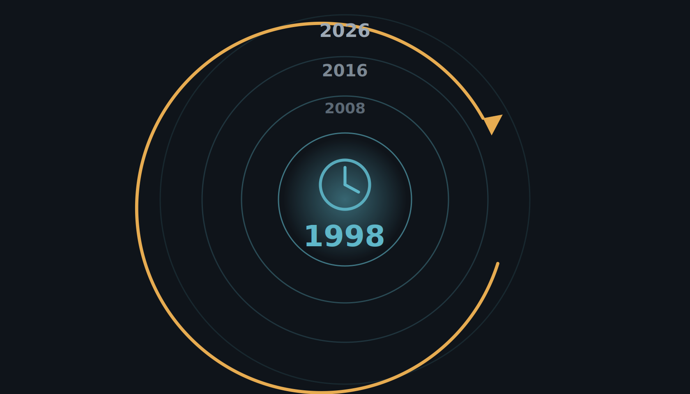
Let's step into a time machine.
This field has overpromised before. Let's start there — in 1998.
Notes:
To understand where this is going, we have to start with where it has been — because this field has overpromised before. So let's step into a time machine and go back to the beginning, to 1998.

