Slide 1
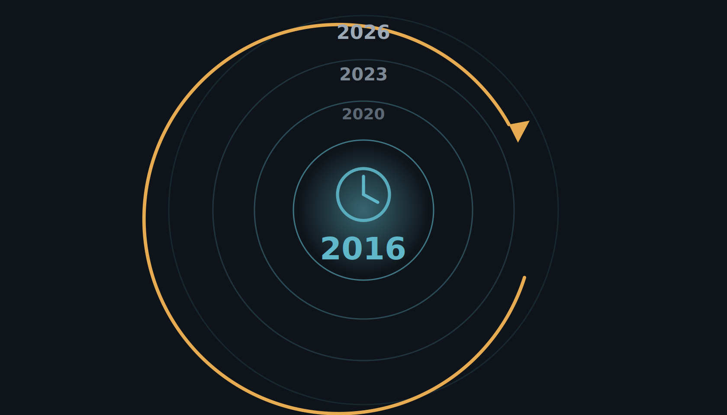
ERA II
The year is 2016.
You're beginning to hear about AI — and still feeling the burn from CAD.
Notes:
The year is 2016. You're a radiologist, you're just beginning to hear about AI for breast imaging — and the reading room is still feeling the burn from CAD. So what does mammography AI actually look like, and what is the evidence?

Slide 2
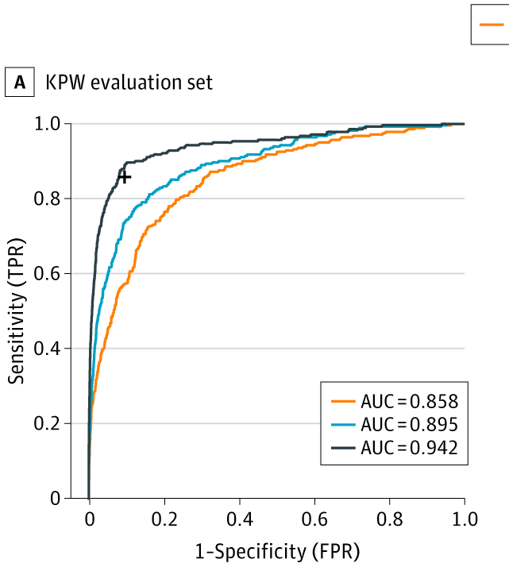
ERA II
2016: the first large-scale push — and a surge of optimism.
The Digital Mammography DREAM Challenge was the first large-scale effort to build breast-cancer AI — and we took part. The hope: a crowdsourced competition would simply solve it.
1,000+ participants · 126 teams · 44 countries
~640,000 mammograms
Best model AUC 0.858 → ensemble 0.895 → + a radiologist 0.942. Winner Therapixel spun out MammoScreen — still in use.
Schaffter et al., JAMA Network Open 2020;3(3):e200265.
Notes:
The optimism wasn't new in 2020. Back in 2016 came the first large-scale effort to build breast-cancer AI: the Digital Mammography DREAM Challenge. Over a thousand participants, 126 teams from 44 countries, on roughly 640,000 mammograms; we took part. There was an incredible surge of optimism that this would simply solve breast AI. On the held-out evaluation set, the best single model reached an AUC of 0.858; the ensemble of the eight best models reached 0.895; and the ensemble plus a single radiologist reached 0.942. The winner, Therapixel, spun out a company whose product, MammoScreen, is still in clinical use today.

Slide 3
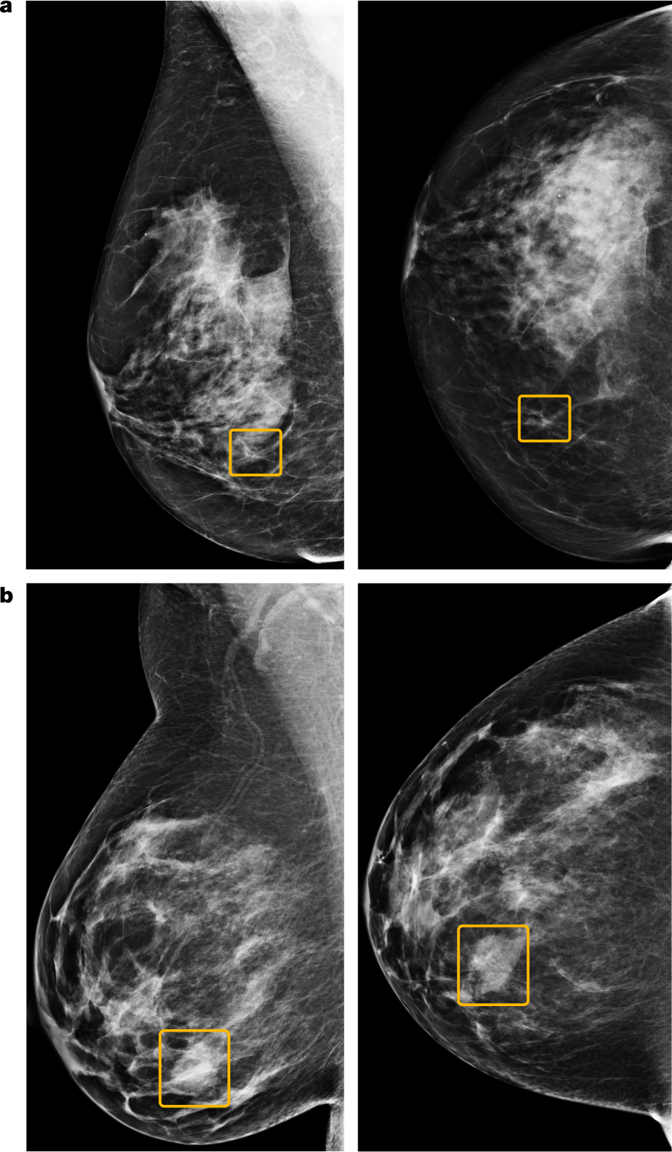
ERA II
2020: Google publishes its breast-cancer AI model.
−5.7% / −1.2%
false positives (US / UK)
−9.4% / −2.7%
false negatives (US / UK)
+11.5%
AUC over the average radiologist
−88%
simulated second-reader workload
McKinney et al., Nature 2020;577:89–94 — promising, but only on clean, curated data.
Notes:
So what was the early evidence? In 2020, McKinney and colleagues at Google Health, in Nature, reported an AI that on US data cut false positives by 5.7% and false negatives by 9.4%, exceeded the average radiologist's AUC by over 11 points, and could cut a second reader's workload by 88%. The figure shows example cases the model localized. On paper, superhuman — but only on clean, curated data.

Slide 4
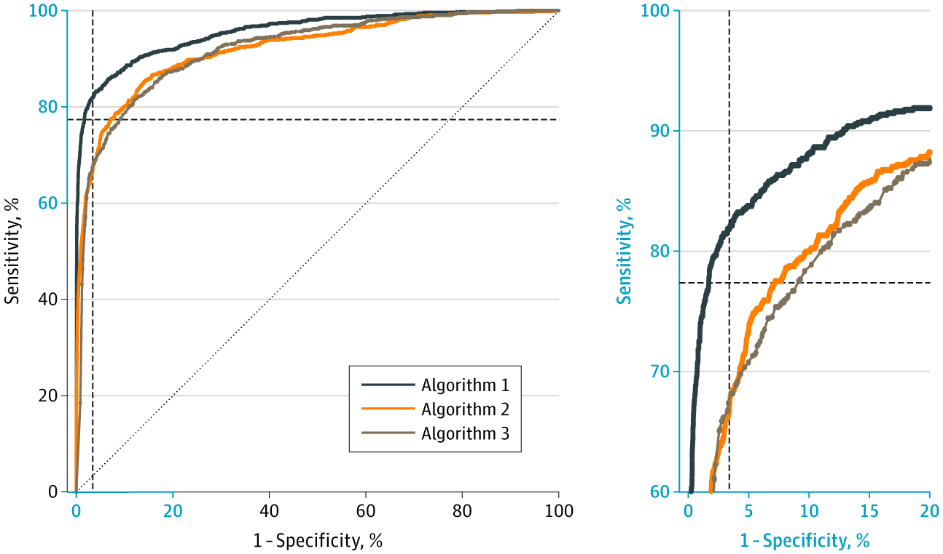
ERA II
2020: three commercial models, independently validated on 8,800 women.
Best algorithm AUC 0.956. AI + first reader reached 88.6% sensitivity at 93.0% specificity — exceeding two human readers.
Salim et al., JAMA Oncology 2020 (Stockholm, 8,805 women).
Notes:
And it held up independently. Salim and colleagues, in JAMA Oncology, took three commercial AI algorithms and tested them on an external Stockholm cohort of about 8,800 women. The best — Algorithm 1 here — reached an AUC of 0.956, and combined with a first reader it reached 88.6% sensitivity at 93% specificity, exceeding two human readers. Three different vendors, external data — the evidence is looking good.

Slide 5
ERA II
2023: MASAI publishes its safety analysis.
A randomized trial, ~80,000 women (≈40,000 per arm) — AI-supported reading vs standard double reading.
6.1 vs 5.1 CDR per 1,000 · ratio 1.2 (95% CI 1.0–1.5)
Measure | AI | Control
Recall rate | 2.2% | 2.0%
False-positive rate | 1.5% | 1.5%
PPV of recall | 28.3% | 24.8%
Invasive cancers | 75% | 81%
Lång et al., Lancet Oncology 2023 — above the lowest acceptable detection limit for safety.
Notes:
In 2023, MASAI published its clinical safety analysis — a randomized trial of about eighty thousand women, roughly forty thousand per arm. Cancer detection was 6.1 per thousand with AI versus 5.1 in controls, a ratio of 1.2, above the lowest acceptable safety limit. Recall was essentially identical, 2.2 versus 2.0 percent; the false-positive rate was 1.5 percent in both; and the positive predictive value of recall was higher with AI, 28 versus 25 percent. Three-quarters of detected cancers were invasive. So: safe, and detecting more — the green light to continue.

Slide 6
ERA II
Data isn't enough to drive adoption.
Enriched cases, lab conditions, no real workflow — CAD had good numbers too. The bar is prospective deployment, and real-world uptake has been slow.
48%
13.7%
~2%
of European radiologists use AI (2024)
of them, for breast imaging
of US practices, by one estimate
ESR EuroAIM/EuSoMII survey, Insights Imaging 2024 (n=572) · US estimate: industry report.
Notes:
But here is the discipline this talk runs on. Reader studies have well-known limits: enriched case sets, lab conditions, no real workflow. CAD had good numbers too. That kind of data is not enough to drive adoption. And it shows: a 2024 European survey found about 48% of radiologists use AI, but of those only 13.7% use it for breast imaging, about one in eight. In the US, by one estimate, only around 2% of practices use it at all.

